Slide 1

J. P. Dawer Institute Of Information Science And Technology
BSc(I.T)
Semester-6
Dhvani Gondaliya (23)
Megha Mistry (57)

Slide 2
Index
Introduction
Scope
Objective
Advantages
Interface Design

Slide 3
Introduction
BookSeize is a web-based PHP CI application with MYSQL database.
BookSeize provides platform of one can buy or sell different categories books may be new & old books.
Our site is maintaining users’ wallets for maintaining purchasing.
User can provide rating and review of appropriate book.

Slide 4
Scope
Admin :
Admin can login.
Admin can manage User.
Admin can manage Category & Sub Category Books.
Admin can View the information of registered books and Users.
Admin can view & reply the inquires provided by various users.
Admin can manage the banners.

Slide 5
Scope
User :
User can register and login in the website.
User can manage their own Profile and their Wallet.
User can manage address.
User can search books and buy books.
User can manage cart.

Slide 6
Scope
User can check the status of their order.
User can also make inquiry.
User can manage password.
User give the feedback and rating on the site.
User (Seller) can manage status of order delivery.
User can also add book to sell.

Slide 7
Scope
Visitor :
Visitor can view the books for different category.
Visitor can view/search required books.
Visitor can manage cart but visitor has to register himself to sale or purchase books.
Visitor can view banner also visitor can make inquiry.
Visitor can give review of books.

Slide 8
Objectives
User can search any books.
User can buy old and new books.
User can also sell books.
User can find rarely available books easily.

Slide 9
Advantages
Online buying, selling and exchange of used books itself is a big advantage and a unique feature of our project.
Helps in saving trees and user’s investment.
Transaction using credit points makes it simple and safe.
User friendly and hence satisfies customers.
Used books on a website helps to fulfill the need of rare and unavailable books.
Users contribute in saving natural resources without any extra effort.

Slide 10
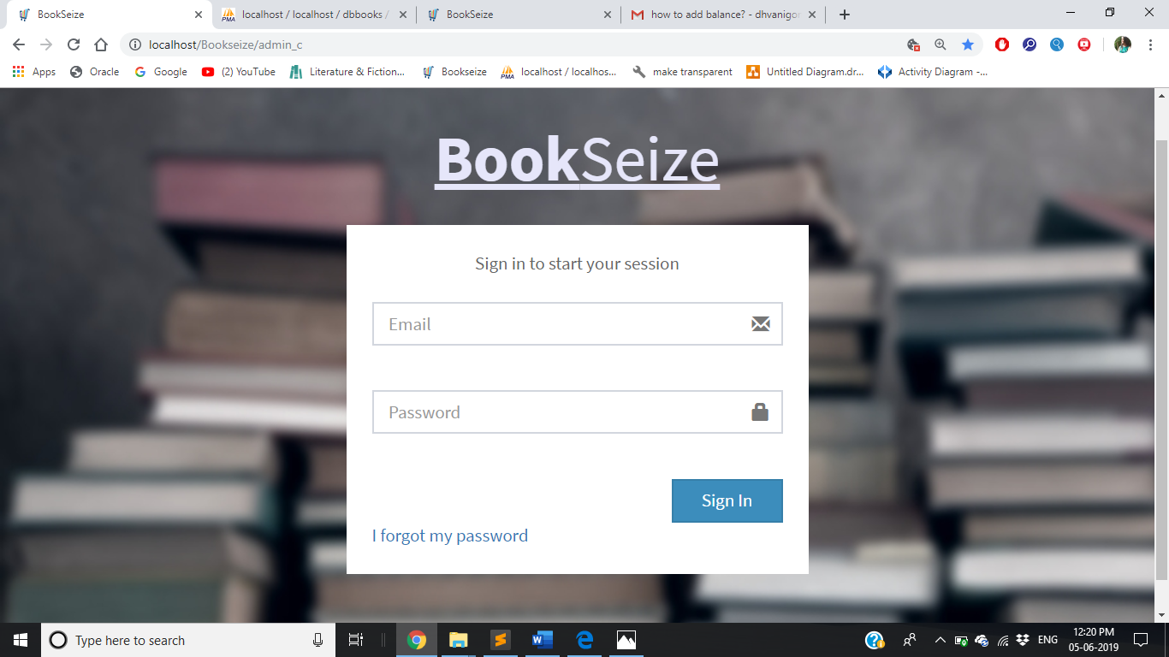
Interface Design
Admin Side
Admin Login

Slide 11
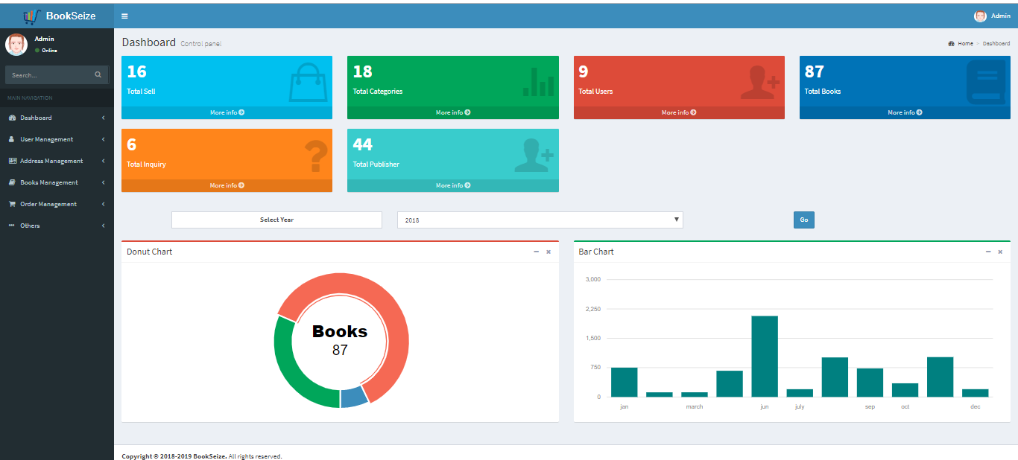
Interface Design
Admin Home Page

Slide 12
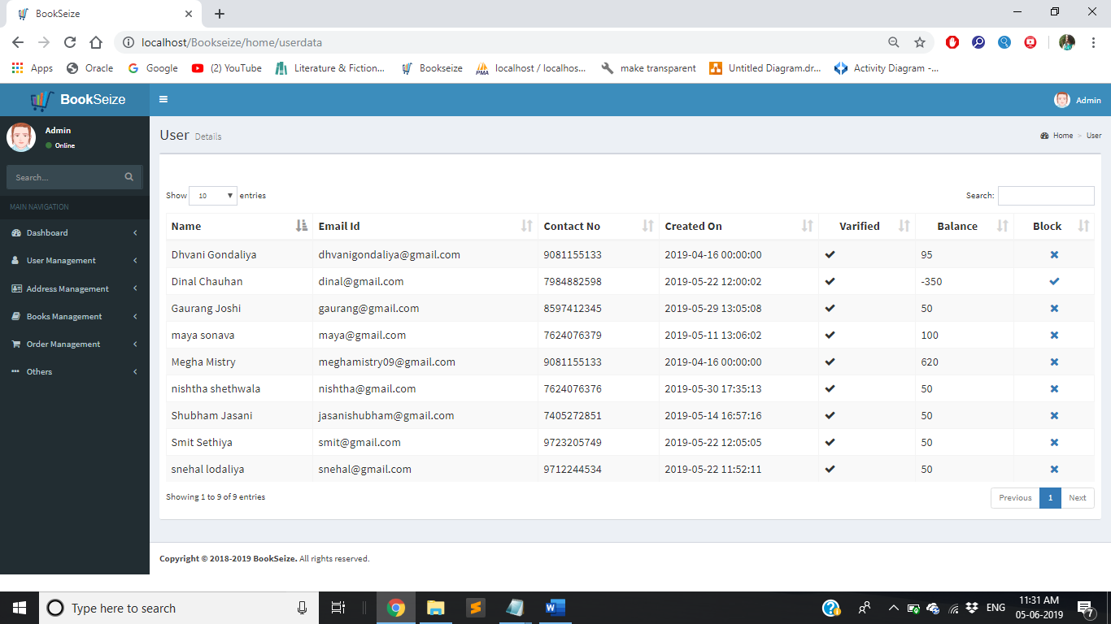
Interface Design
Admin View User Page

Slide 13
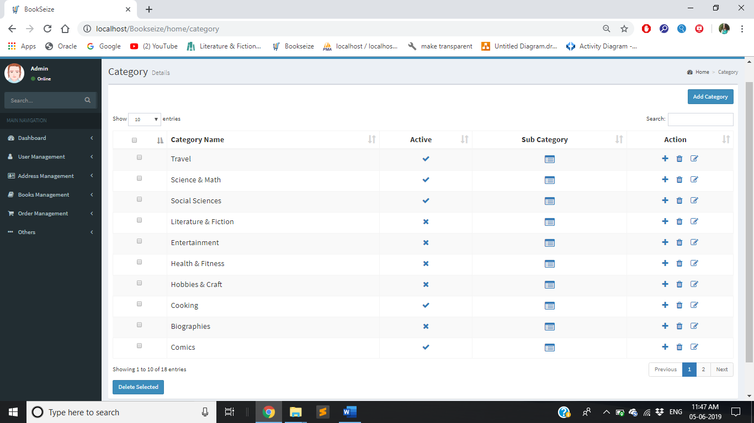
Interface Design
Admin Manage Category Page

Slide 14
Interface Design
Admin View Books Page

Slide 15
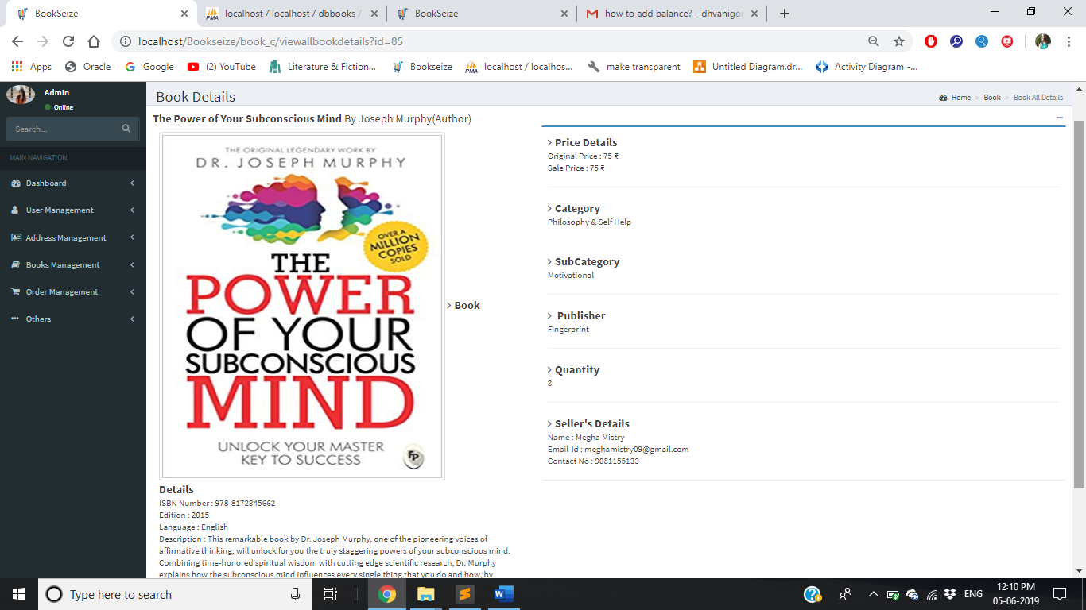
Interface Design
Admin View Book Details Page

Slide 16
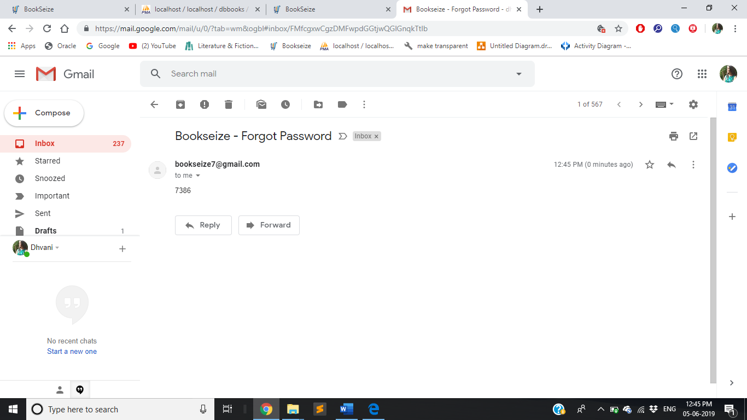
Interface Design
OTP to change password in mail

Slide 17
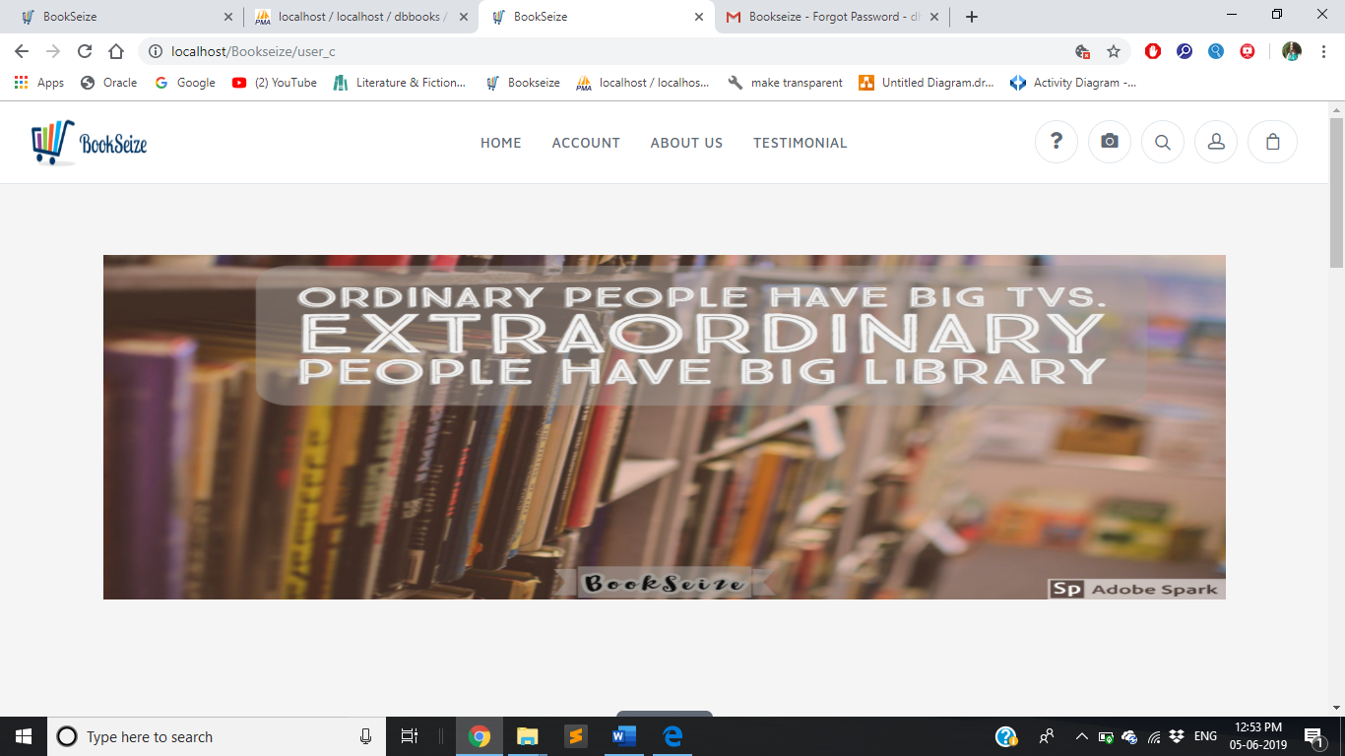
Interface Design
User Side
User Home Page

Slide 18
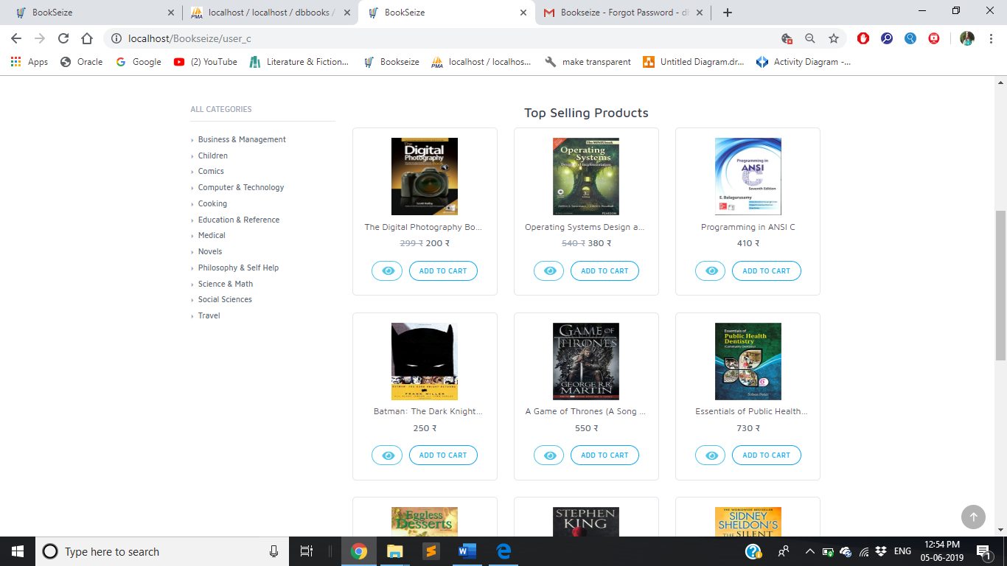
Interface Design
User Home Page Top Selling Products

Slide 19
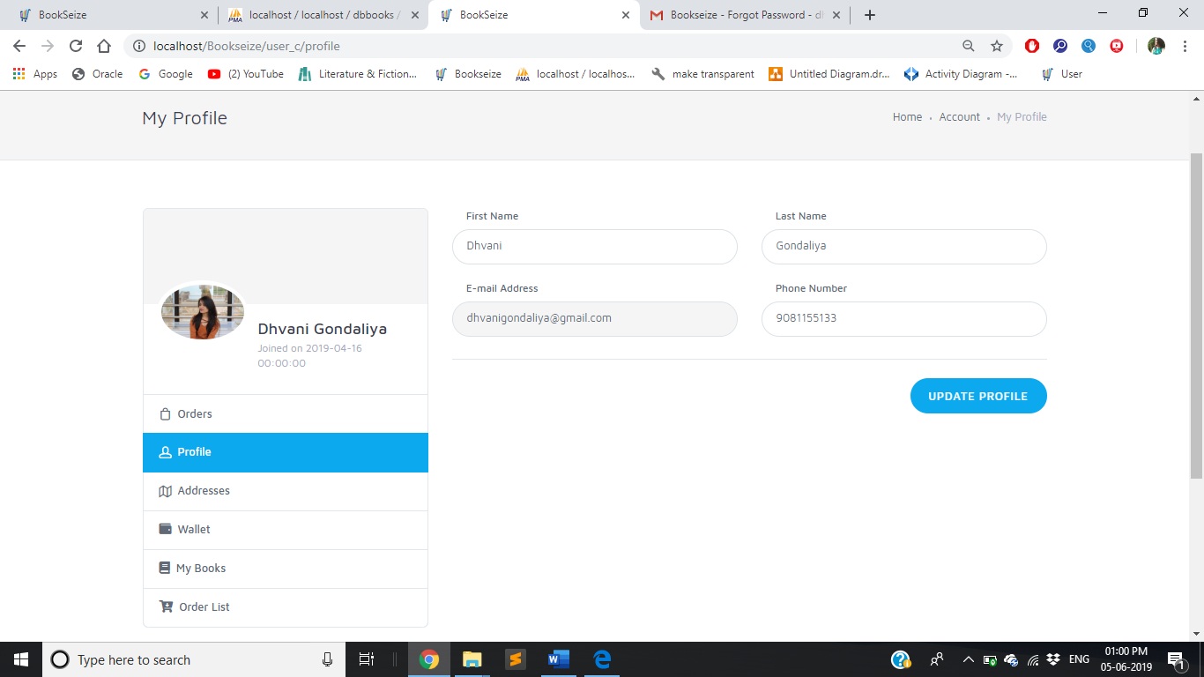
Interface Design
User Manage Profile Page

Slide 20
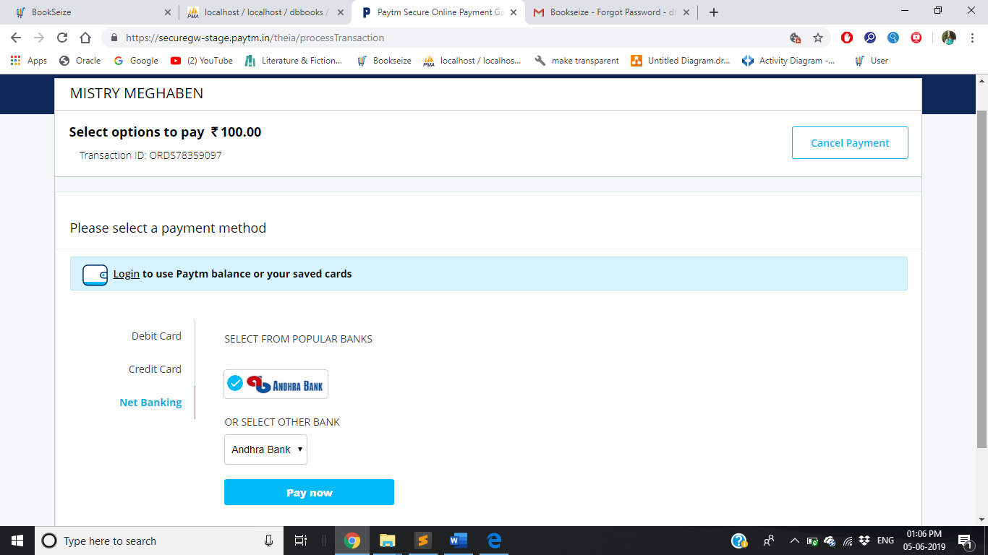
Interface Design
User adding balance to BookSeize wallet via Paytm

Slide 21
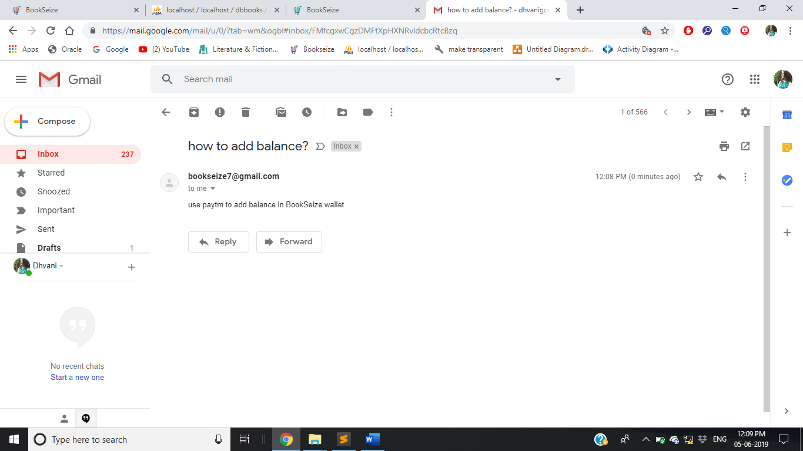
Interface Design
User Inquiry Reply in mail

Slide 22
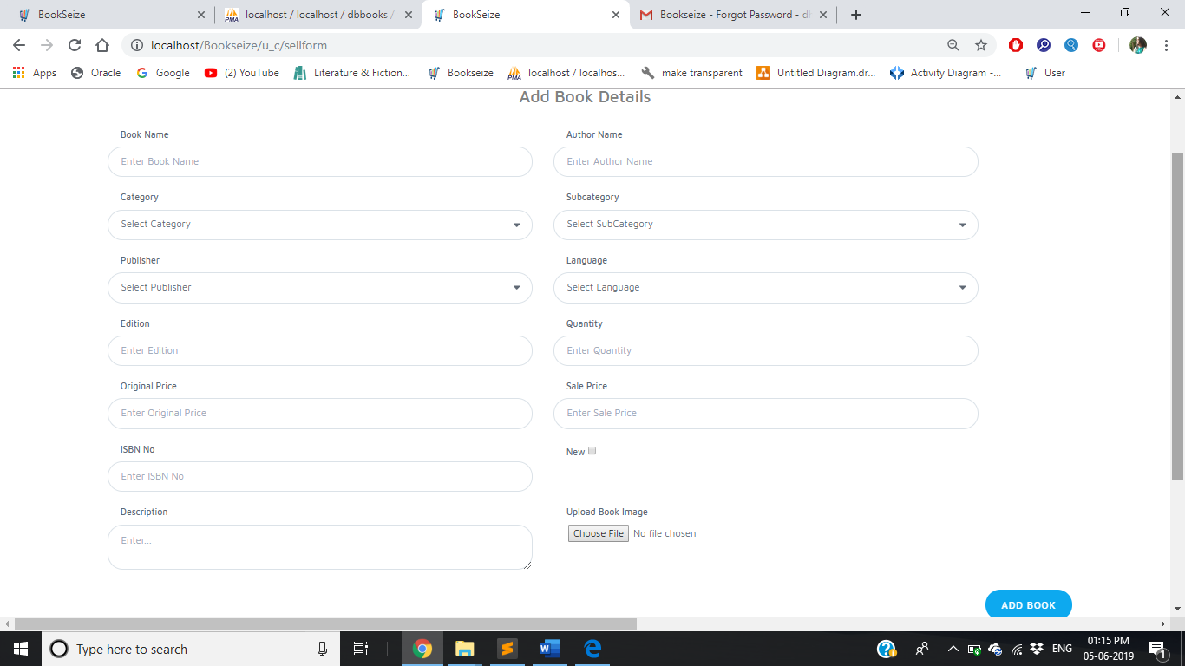
Interface Design
User Sell Book form

Slide 23
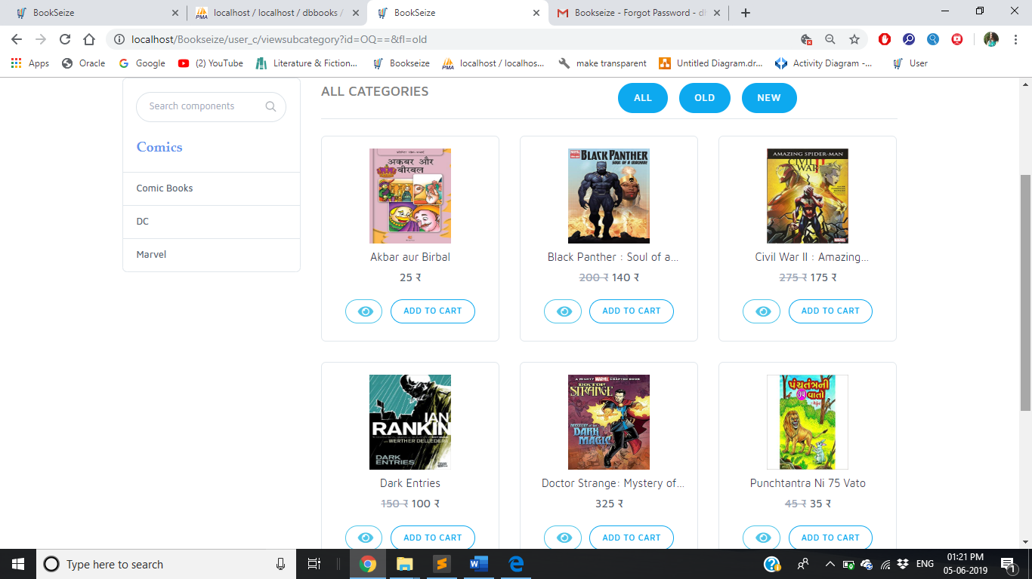
Interface Design
Subcategory and Condition wise sorting

Slide 24
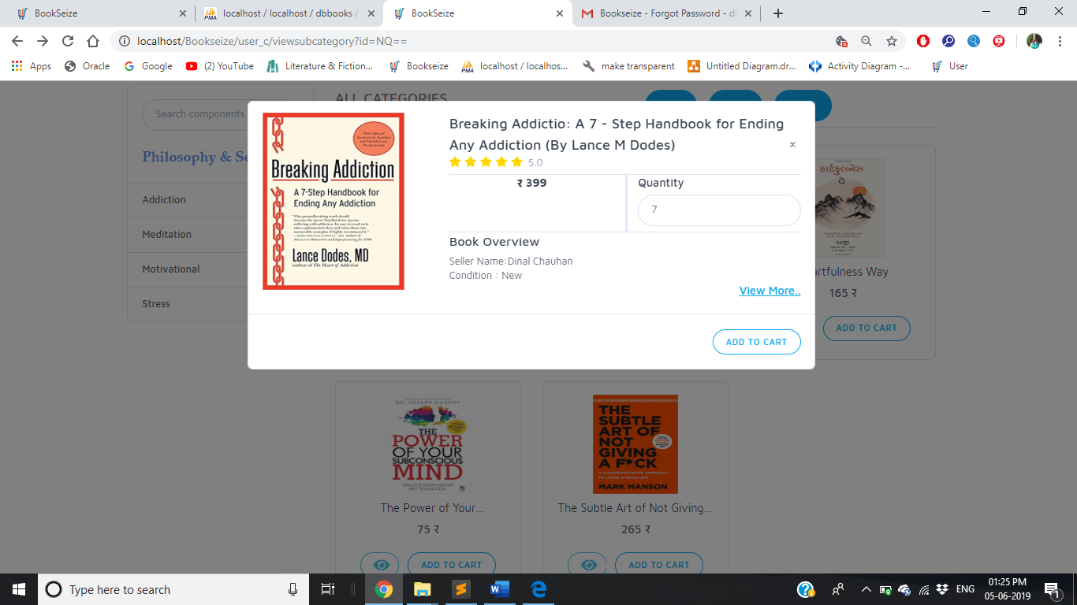
Interface Design
Quick View

Slide 25
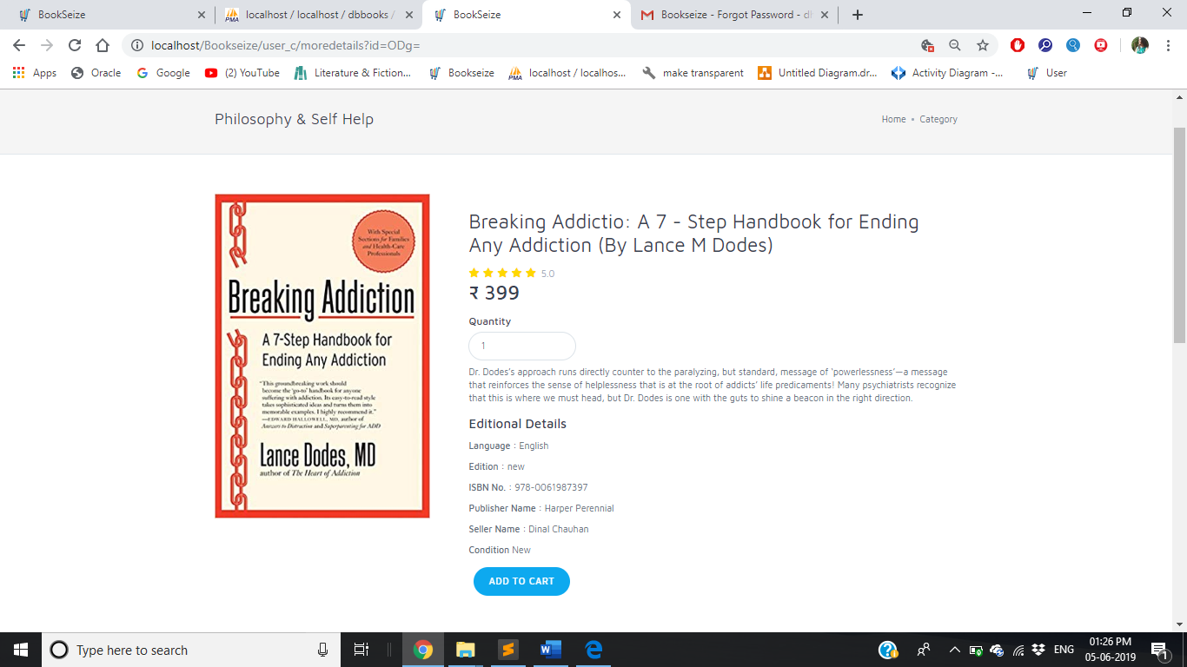
Interface Design
User More Details Page

Slide 26
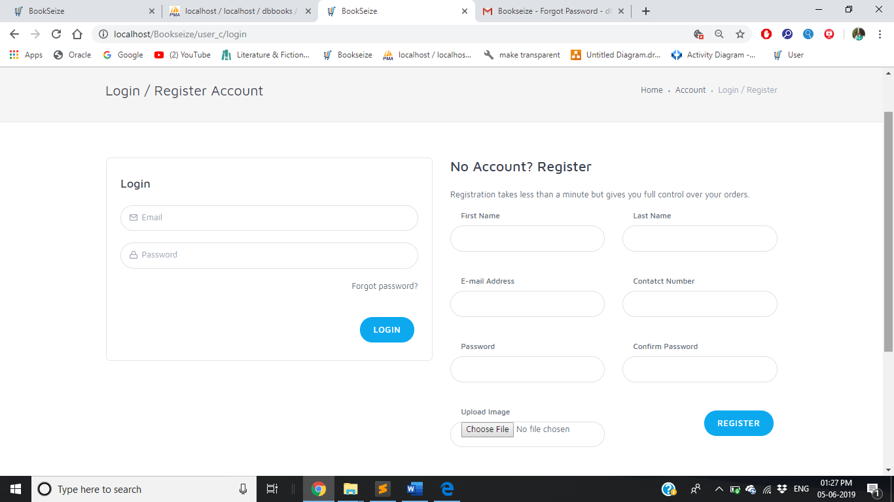
Interface Design
Login and Register Page

Slide 27
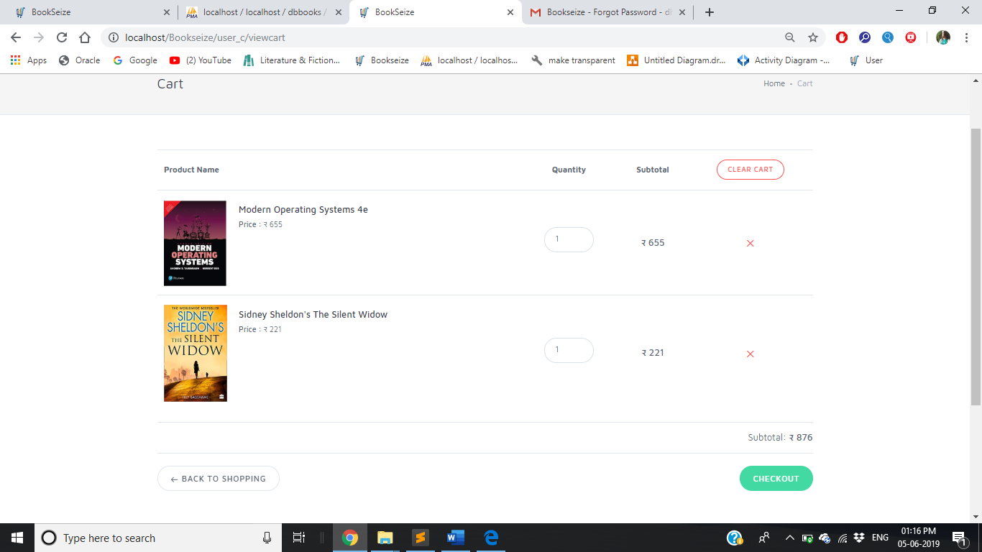
Interface Design
User Cart Page

Slide 28
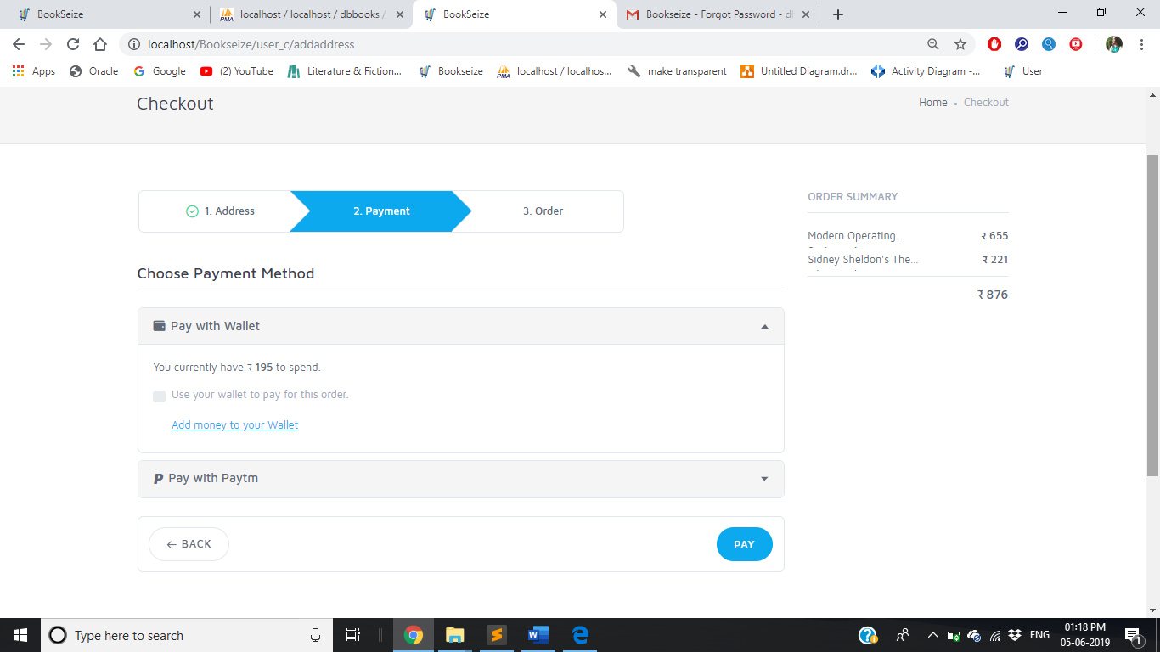
Interface Design
User Payment Page

Slide 29
Thank You

