Slide 1
A Winnow Based Approach to Context Sensitive Spelling Correction

Slide 2
Motivation
Spellcheckers are widely used to fix non-words errors but the predominant type of spelling errors are the ones that results in real but unintended words
For example, typing there when their was intended
requires completely diff. technology than conventional spell checkers
account anywhere from 25% to over 50 % of the observed spelling errors
Large scale real world task

Slide 3
Task?
Context sensitive spelling correction requires analyzing the context to infer when some other word is more likely to have been intended.
Task includes fixing errors like:
Homophone errors: “peace” and “piece”
Typographic errors: “form” and “from”
Grammatical errors: “among” and “between”
Errors crossing word boundaries: “may be” and “maybe”

Slide 4
Challenges
Richness of linguistic structures to be represented results in high-dimensional feature space for the problems.
Target concept depends on a small subset of features leaving others as irrelevant for it.
This paper proposed an approach called WinSpell, combining variants of Winnow (Littlestone, 1988) and Weighted Majority (Littlestone and Warmuth, 1994)

Slide 5
Related work
Word trigrams (Mays et al., 1991)
Bayesian classifiers (Gale et al., 1993)
Decision list (Yarowsky, 1994)
Bayesian hybrids: (Golding, 1995)
Combination of part-of-speech trigrams and Bayesian hybrids (Golding, 1995)
Transformation based learning (Mangu and Brill, 1997)
Latent semantic analysis (Jones and Martin, 1997)
Differential grammars (Powers, 1997)
BaySpell (Golding, 1995) a statistics based method represents the state of the art for this task

Slide 6
Problem Formulation
The ambiguous words are modelled by confusion sets, C = {W₁,W₂.....W_{n})
Target problem here consists of : Sentence and the target word in that sentence to correct.
Problem is represented as an active feature F which indicate the presence of a particular linguistic pattern in the context of the target word.
Two types of features: Context words, collocations
Context words test for the presence of a particular word within +- k words of the target word.
Collocations test for a pattern of up to l contiguous words/ part-of-speech tags around the target word.

Slide 7
Example of features for confusion set C = {weather, whether} include:
1. cloudy within +- 10 words
2. _ to VERB
Context features refer to the lexical atmosphere around the target word whereas collocations refer to the local syntax around the target word.

Slide 8
Existing approach: BaySpell
Given a sentence with a target word to correct, BaySpell starts by invoking a feature extractor (pruning enabled) that converts the sentence into active features.
Suppose BaySpell acts a naive Bayesian classifier. It would then calculate the probability that each word W_{i} is the correct identity of the target word, given the features F have been observed using Bayes' rule with conditional probability assumption.

Slide 9
posterior = (prior * likelihood) / evidence
P(W_{i}|F) = Π_{f∈F} P(f|W_{i}) * P(W_{i} ) / P(F)
where each probability at right hand side is calculated by maximum likelihood estimation (MLE)
Word with highest P(W_{i}|F) would be picked up as answer.
BaySpell differs in two aspects: 1. Dependency Resolution: does not assume conditional independence among features rather detect strong dependencies, and resolve them by deleting features until left with a set F' of independent features which are then used in place of F.

Slide 10
2. Smoothing technique : BaySpell does not use MLE as it tends to give likelihoods of 0.0 for rare features which are abundant in this task. Instead it performs smoothing by interpolating between MLE of P(f|W_{i}) and the MLE of uni-gram probability P(f).
P_{interp}(f|W_{i}) = (1-λ)*P_{ML}(f|W_{i}) + (λ *P(f))
where λ is set as the probability that the presence of the feature f is independent of the word W_{i}. It is the chi-square probability that the observed association between f and W_{i} is due to chance.

Slide 11
WinSpell
It learns the contextual characteristics of each word W_{i} individually. This learning can then be used to distinguish W_{i} from any other word in the set as well as to perform natural learning tasks.
The approach developed is influenced from Neuroidal system by Valiant (1994).

Slide 12
General approach
The system consists of high level concepts, for which humans have words and low level predicates (they encode the current state of world & are input to the architecture from outside) from which high level ones are composed.
Each high-level concept is learned by a cloud or ensemble of classifiers.
All classifiers within the cloud learn the cloud's high-level concept autonomously as a function of the same lower-level predicates but with different learning parameter values.

Slide 13
Within each classifier a variant of Winnow algorithm is used. Training occurs when the architecture interacts with the world.
ex. by reading a sentence; the architecture receives new values for its lower-level predicates which in turn train the high level ensemble of classifiers.
It is an on-line learning process that is done on a continuous basis.

Slide 14
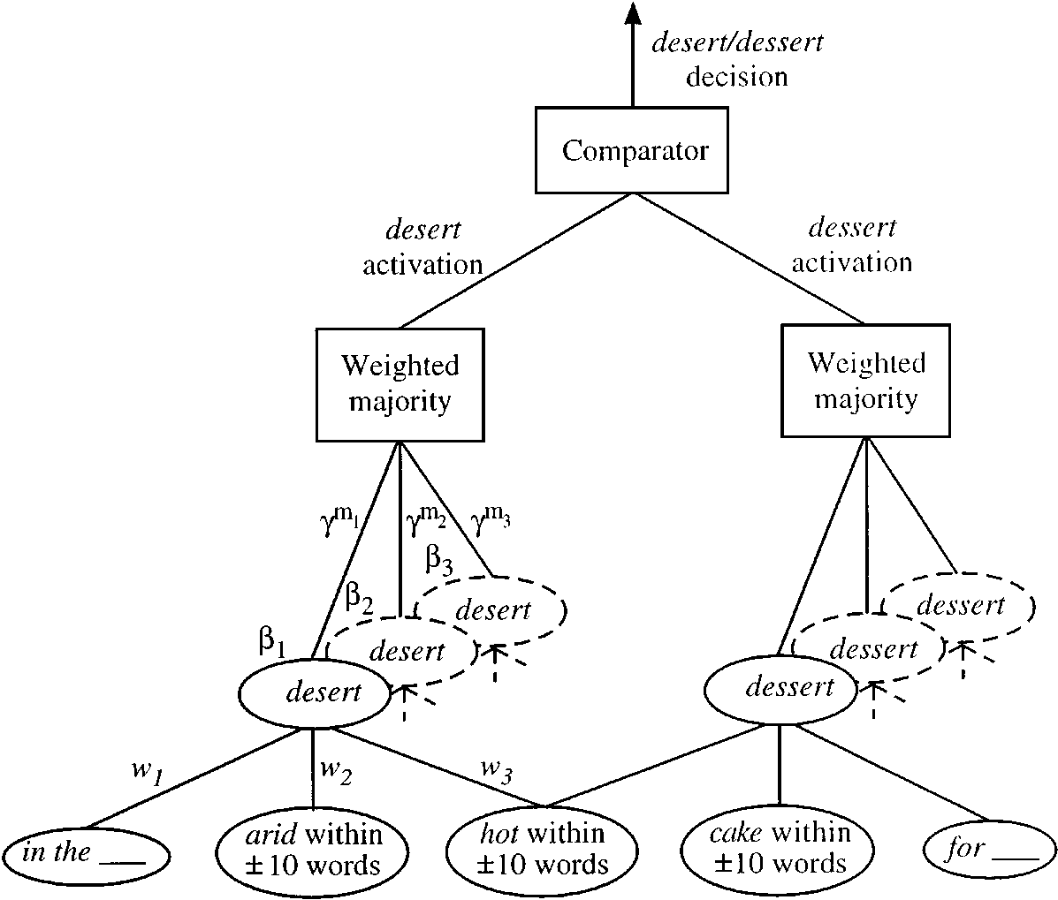

Slide 15
Winnow
Each classifier takes as input a representation of a target sentence as a set of active features and return a binary decision as to whether its word W_{i} belongs in the sentence.
It returns a classification of 1(+ve) iff:
∑_{f∈F}W_{f} > q
where W_{f} is the weight on the arc connecting f to the classifier at hand and q is the threshold parameter.

Slide 16
Initially the classifier has no connection to any feature in the network. Through training, it establishes appropriate connections and learns weight for these connections.
TRAINING:
1. For training the classifier on the example, appropriate connections between classifier and the active features F are established. If there is no connection present and the sentence is a positive example for the classifier, then we add a connection between the feature f and the classifier with a default weight of 0.1
No connection is made if the sentence is a negative example.

Slide 17
2. Next step is to update the weights on the connections using Winnow multiplicative weight update rule(mistake driven)
If classifier predicts 0 for a positive (1) example, then the weights are promoted:
∀ f∈F, W_{f} α.W_{f} where α > 1
Otherwise demoted:
∀ f∈F, W_{f} β.W_{f} where β = (0,1)
The update time of the algo. Depends on the number of active features and not on the total no. Of features in the domain.

Slide 18
Weighted Majority
WinSpell combines the evidence from multiple classifiers to evaluate the evidence of a given word.
Each classifier makes different prediction, depending on the accuracy of its prediction a weight is derived.
For example, here a cloud is composed of 5 classifiers, differing in the value of β (.5,.6,.7,.8,.9).
The weighting scheme assigns to the jth classifier a weight γ^{m}_{j} where m_{j} is the total no. of mistakes made by the classifier and γ is a constant.
The final activation level output by the cloud is the sum of the predictions of its member classifiers weighted on the above mentioned weights.
The weight of the classifier that makes many mistakes decreases with time.

Slide 19
Performance
When run on an unpruned set, WinSpell achieved higher accuracy than BaySpell could achieve on either pruned or unpruned set.
WinSpell exhibits highest performance when compared to other systems.
The major factor that contributes to it superiority is that it learns a better linear separator than BaySpell could learn.
When using a test set from a diff. Corpus than training set, WinSpell was better able to learn using sup/unsup approach that is to use supervised learning on training set and unsupervised on test set.

