Slide 1
🚗 MetroPark
Metropolitan City Parking Management System
CSE (AI&ML) | SR University
G. Megha Akanksha - 2303A52058
Find & Book Parking in Hyderabad | 2026

Slide 2
Introduction
What is MetroPark?
🚗
Smart Parking System
MetroPark is a web-based application for real-time parking management in Hyderabad.
📍
GPS-Based Discovery
Users can find the nearest available parking areas using location detection.
📋
Instant Slot Booking
Reserve a parking slot in seconds with just your name and vehicle number.
🔄
Slot Release Flow
When done parking, users release their slot, freeing it for others instantly.
🛠
Admin Control Panel
Admins monitor occupancy, manage slots, and export CSV reports in real time.

Slide 3
Objectives
Goals of the MetroPark System
Reduce Traffic Congestion
Real-Time Slot Visibility
Minimize time spent searching for parking by showing real-time availability.
Provide live slot status so drivers know instantly what is free or taken.
Seamless Booking Experience
Admin Monitoring
Allow users to reserve a slot in under 30 seconds from any device.
Give administrators a clear dashboard to view, manage, and release slots.
Data Export & Reporting
Scalable City-Wide Deployment
Enable CSV export of booking history for record-keeping and analysis.
Design the system to support multiple zones and areas across Hyderabad.

Slide 4
Stakeholders
Who uses MetroPark?
🚗
🛠
Users / Drivers
Admin
Search parking areas, book slots, navigate to them, and release when done.
Monitor real-time occupancy, release slots, view all bookings, download reports.
🏙
💻
City Authorities
Developers
Benefit from reduced congestion through data-driven parking management.
Maintain and extend the Flask backend, JSON data, and frontend UI.

Slide 5
Technologies Used
Stack powering MetroPark
Languages
Framework
• Python
• HTML5
• CSS3
• JavaScript
• Flask (Python)
• Jinja2 Templates
• Werkzeug
• Flask Routes
Database
Tools & AI
• JSON File Storage
• parking_data.json
• Bookings log
• In-memory state
• VS Code
• GitHub
• GitHub Copilot
• ChatGPT / Copilot

Slide 6
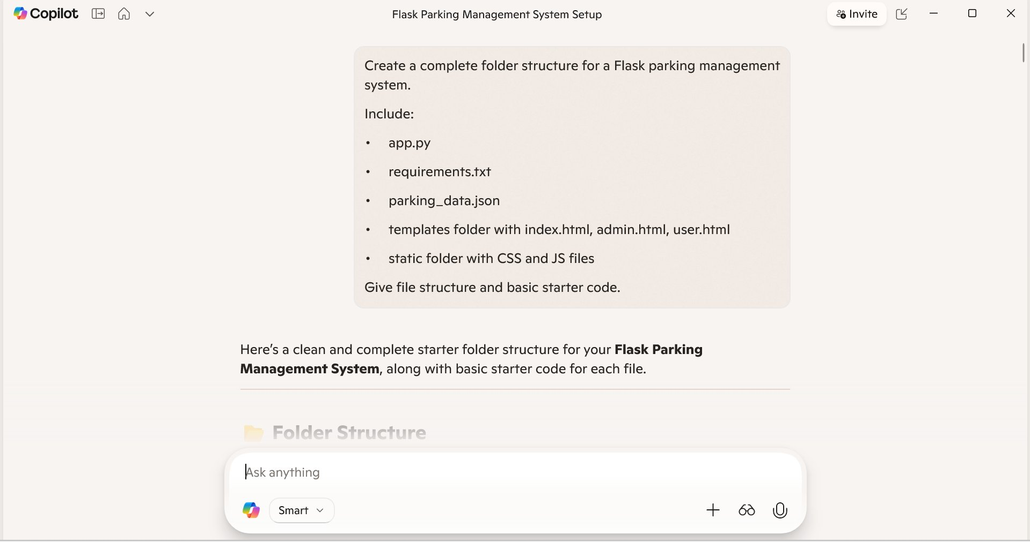
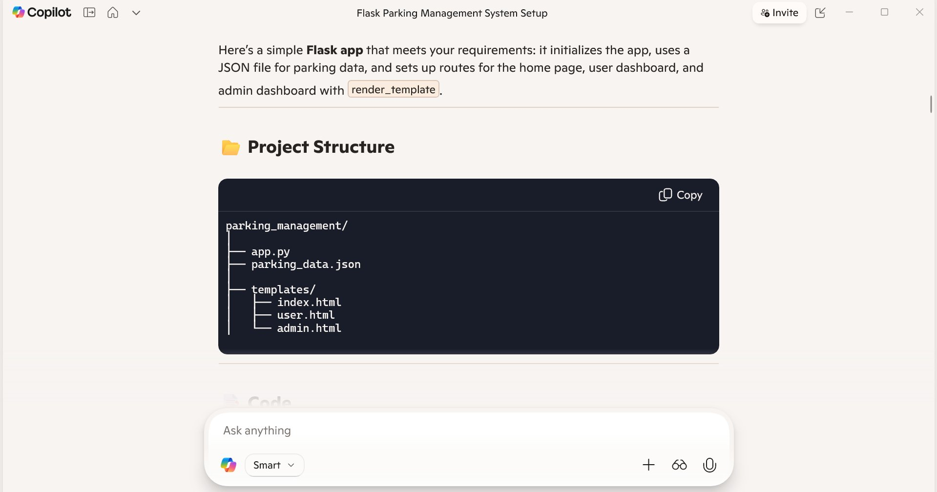
AI Prompts Used — Project Setup
GitHub Copilot prompts to scaffold the system
Prompt: Flask Folder Structure
Prompt: Project Directory Structure
AI tools like GitHub Copilot were used to generate boilerplate code, data models, and full feature implementations.

Slide 7
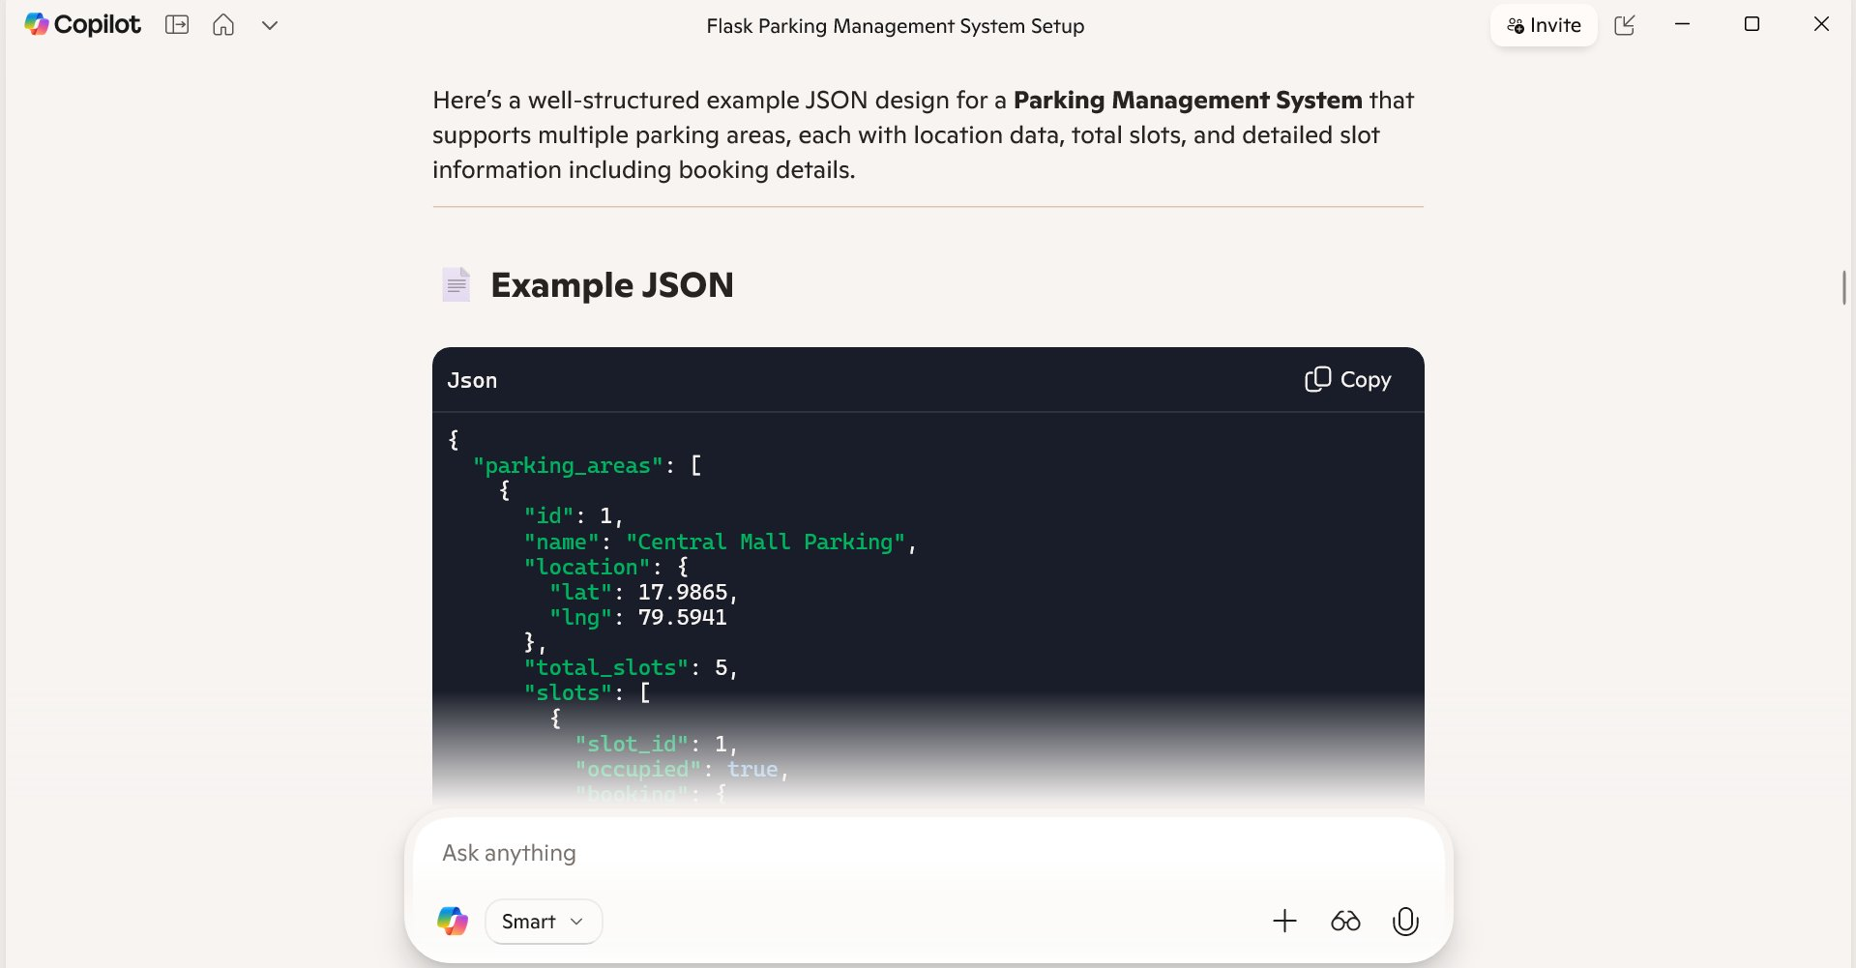
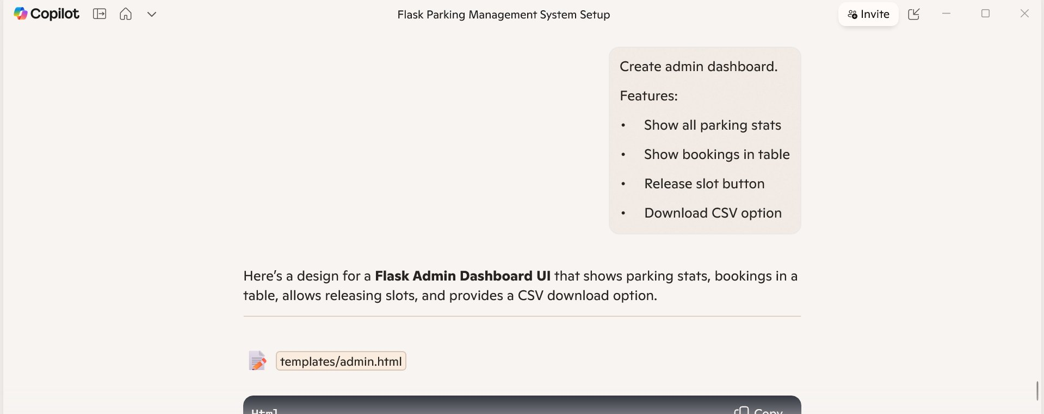
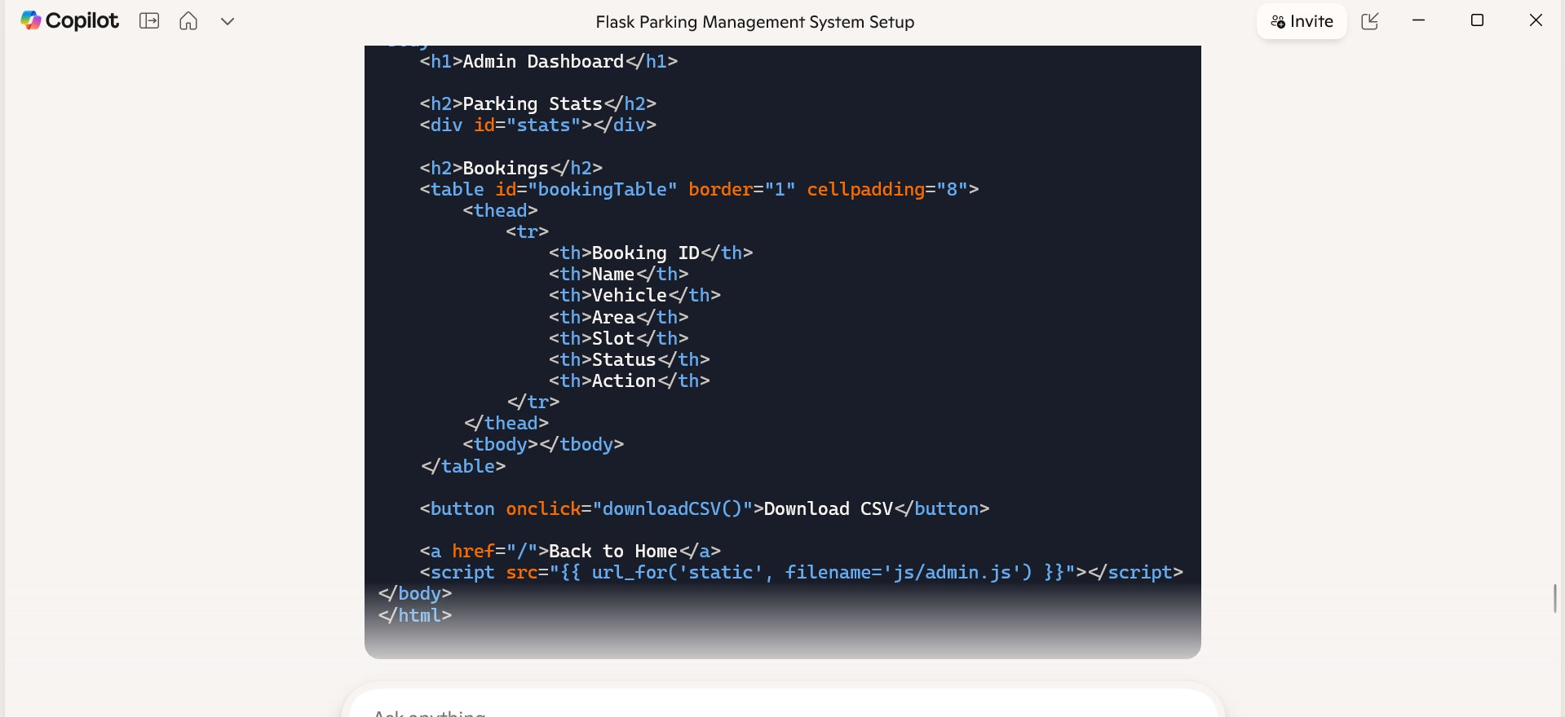
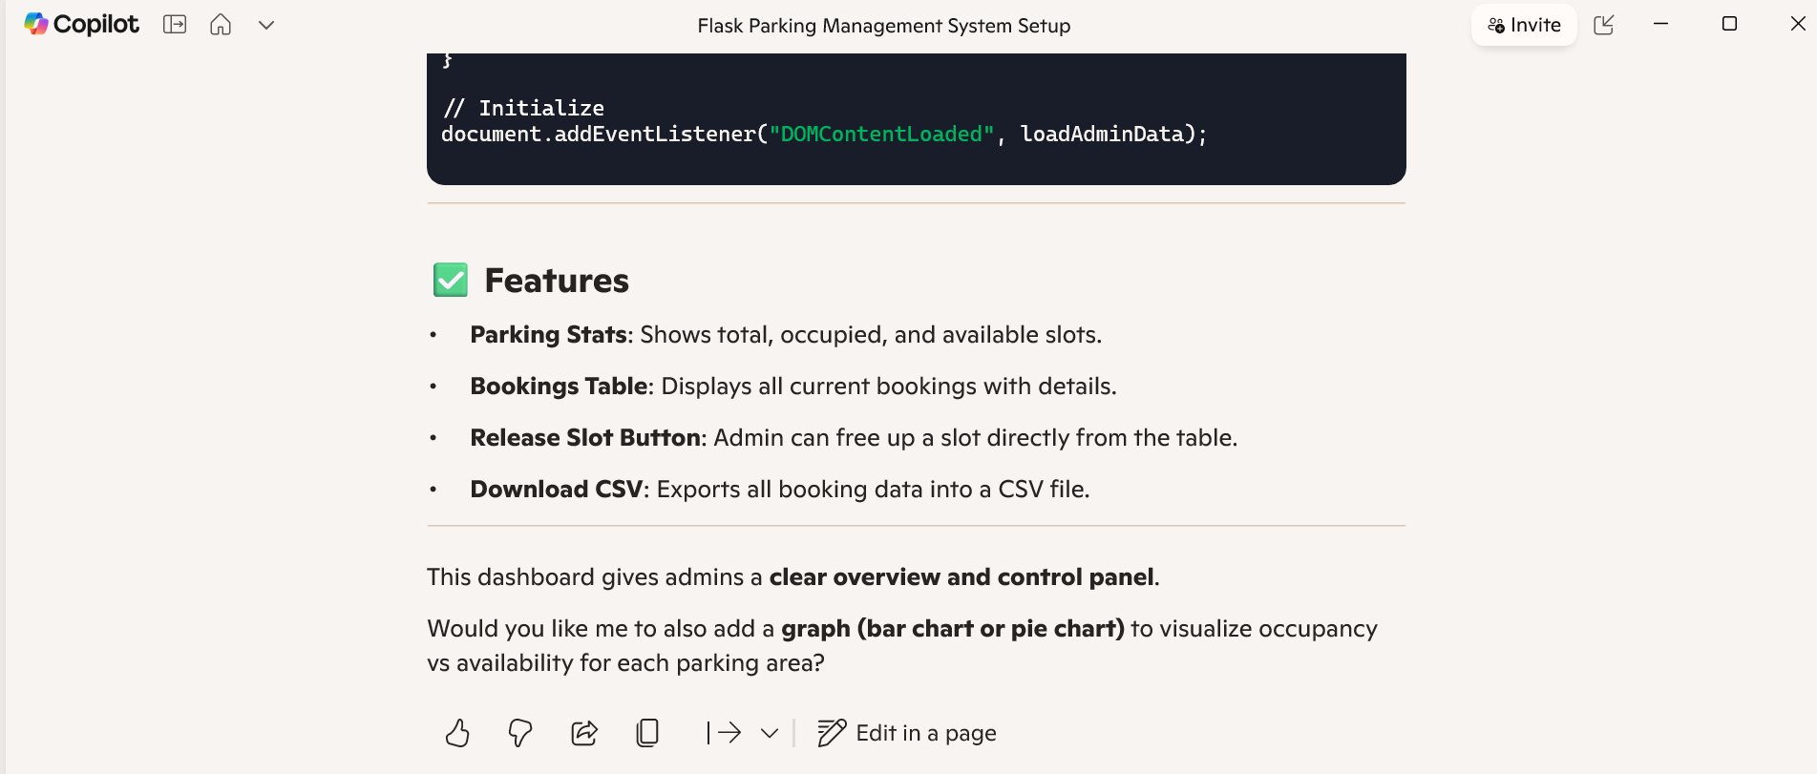
AI Prompts Used — Data & Dashboard
Prompts for JSON design and Admin Dashboard
JSON Structure Design
Admin Dashboard Prompt
Admin HTML Template Code

Slide 8
System Workflow
How Users and Admins interact with MetroPark
👤 USER FLOW
🛠 ADMIN FLOW
1
Open App / Enable GPS
1
Login to Admin Panel
2
Browse Parking Areas
2
View Parking Overview
3
Select Green Slot
3
Monitor Slot Grid
4
Fill Name & Vehicle No.
4
See Active Bookings
5
Confirm Booking
5
Release Slots Manually
6
Navigate to Parking
6
Download CSV Report
7
Release Slot When Done
7
Track Full History

Slide 9
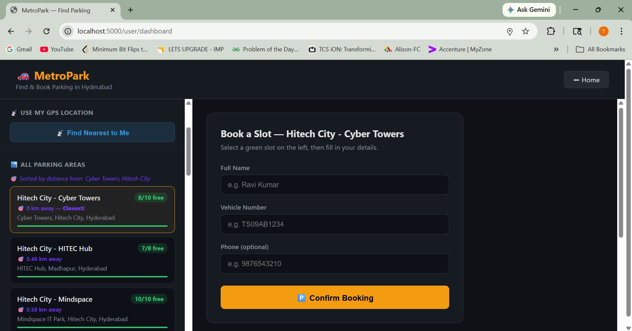
User Dashboard — Find & Book Parking
Real-time slot availability with booking form
GPS Location
One-click 'Find Nearest to Me' button
Area List
All parking areas sorted by distance
Free Slots
Live count shown as '8/10 free'
Booking Form
Name, Vehicle No., Phone (optional)
Confirm CTA
Bold 'Confirm Booking' button

Slide 10
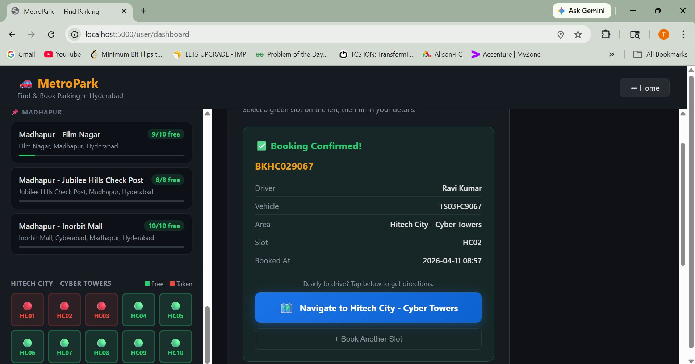
Booking Confirmed
Instant confirmation with slot details
✅ Booking ID
Unique ID e.g. BKHC029067
🧑 Driver Name
Entered at booking time
🚗 Vehicle No.
Registered plate e.g. TS03FC9067
📍 Area & Slot
Hitech City - Cyber Towers / HC02
🕐 Booked At
Timestamp of booking creation
🗺 Navigate
Launches Google Maps directions

Slide 11
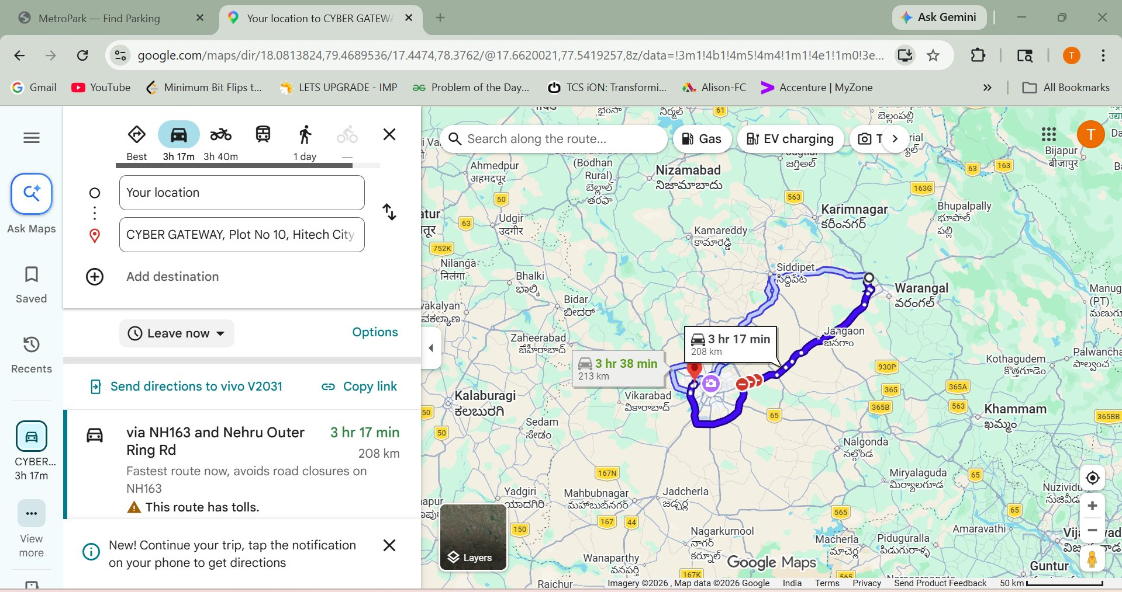
Google Maps Navigation
Navigate to booked parking area with one tap
Navigation Feature
Clicking 'Navigate' opens Google Maps automatically
Uses parking area's GPS coordinates
Shows best driving route & alternatives
Displays estimated travel time
Works on both desktop & mobile

Slide 12
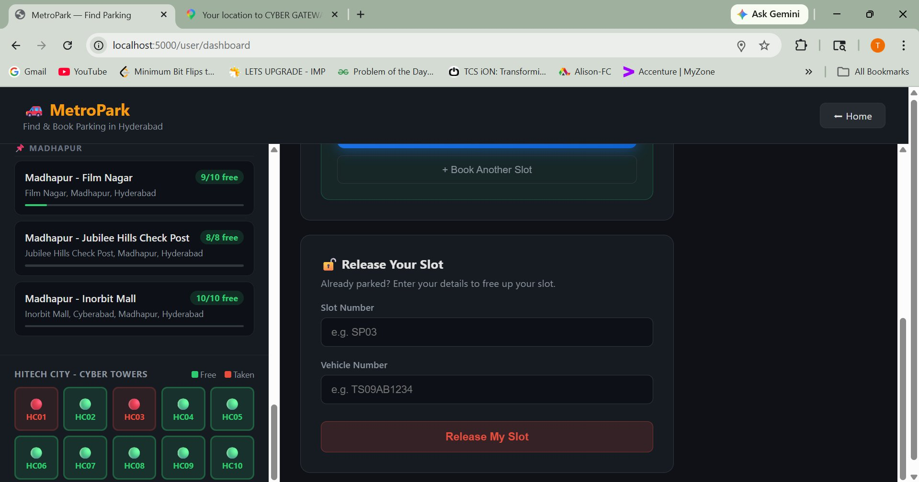
Release My Slot
Free up a parking slot after using it
How It Works
1
Enter Slot Number e.g. HC02
2
Enter your Vehicle Number
3
Click 'Release My Slot'
4
Slot turns green — available again
This keeps the slot grid accurate for all future users.

Slide 13
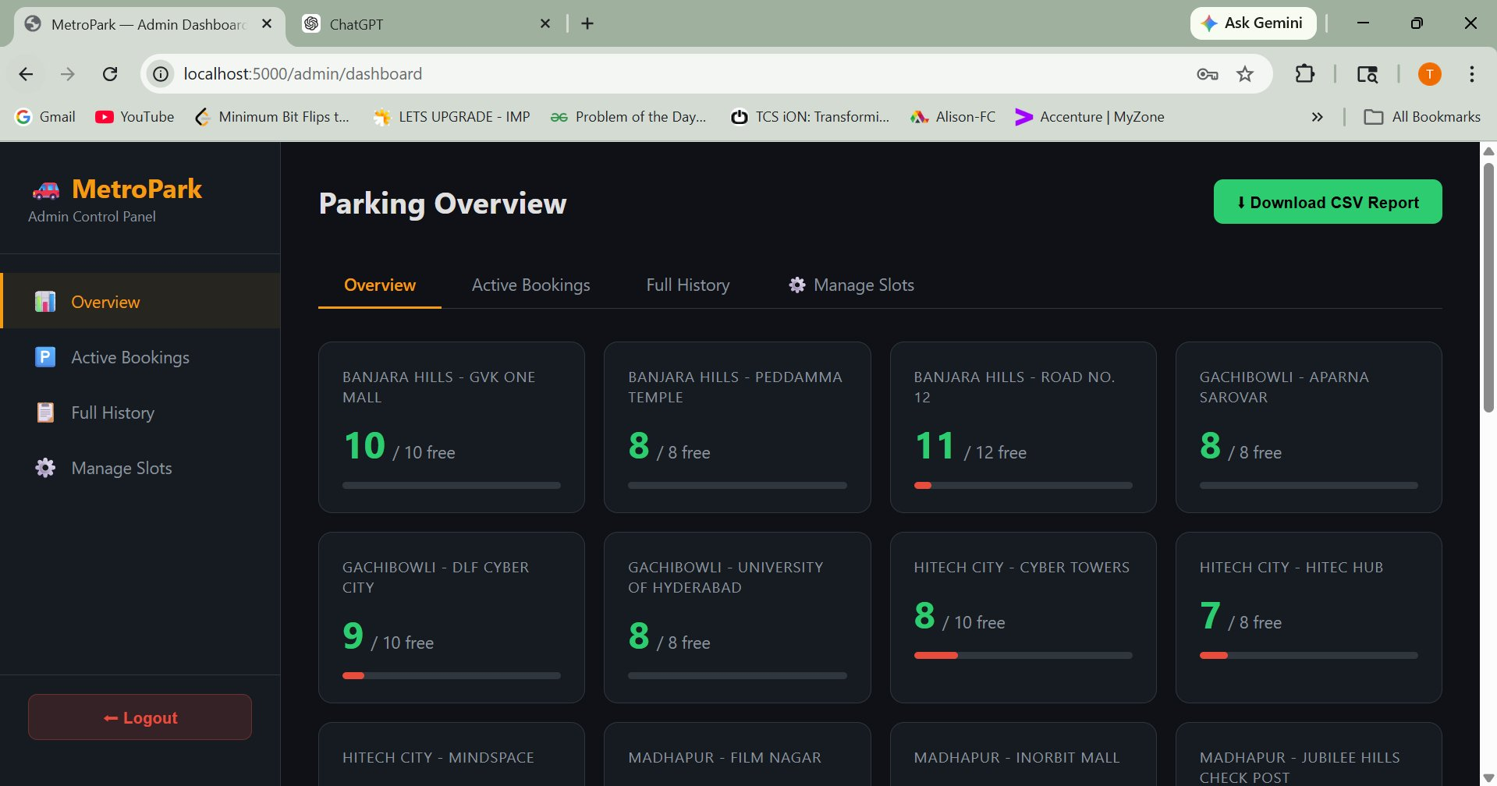
Admin Dashboard — Parking Overview
City-wide real-time slot monitoring
Admin Features
Overview
Cards showing free/total slots per area
Active Bookings
Live table of currently occupied slots
Full History
Complete log of all past bookings
Manage Slots
Add/modify parking slots per area
CSV Download
Export all data to spreadsheet

Slide 14
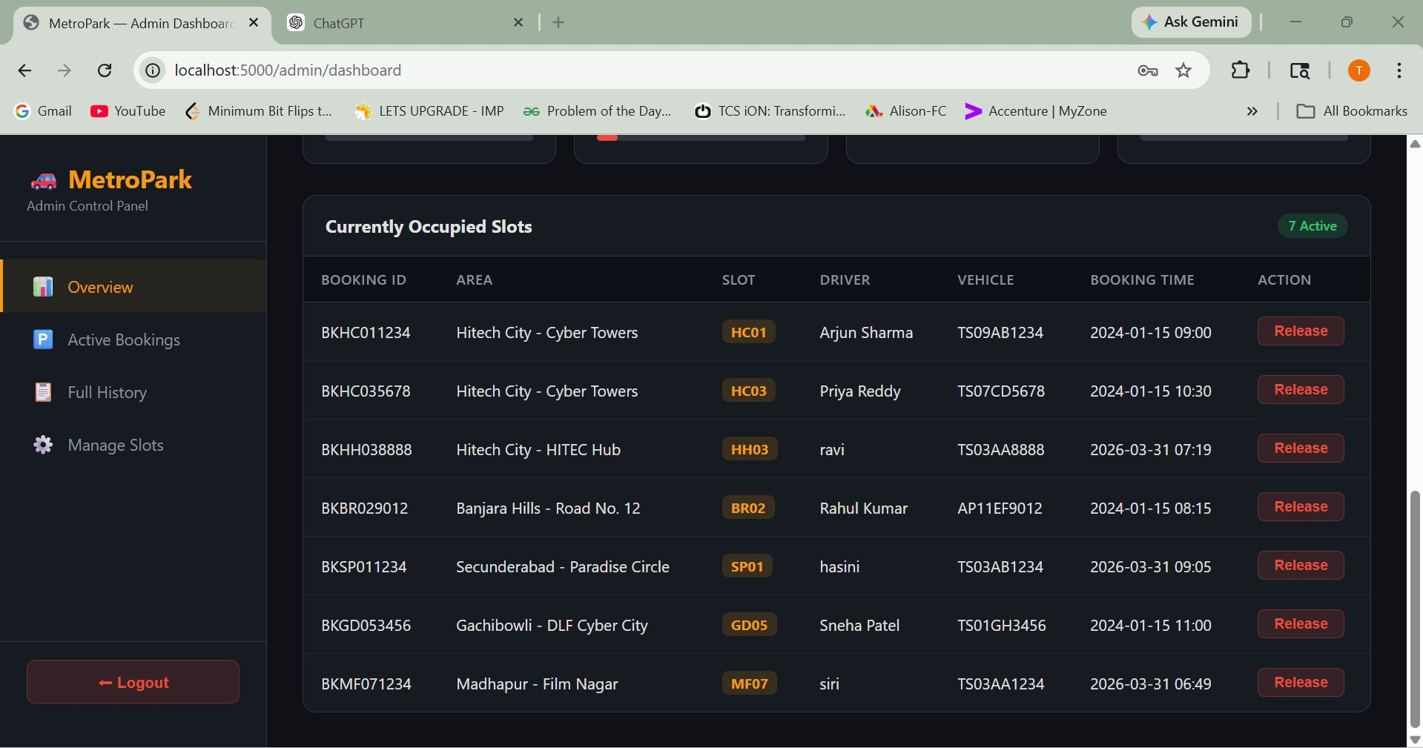
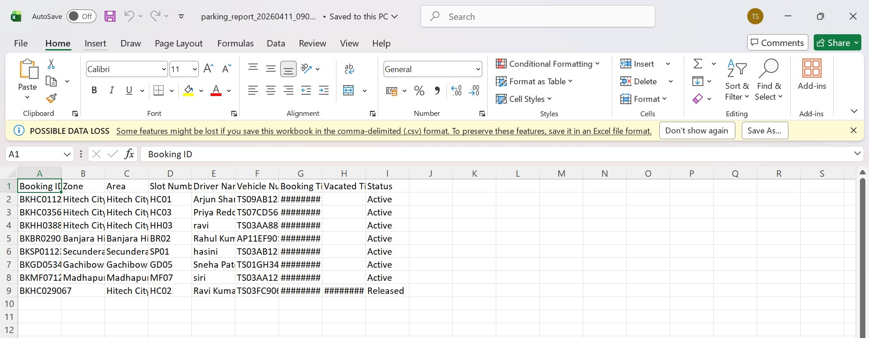
Active Bookings & CSV Export
Admin sees live bookings and exports reports
Currently Occupied Slots Table
CSV Report in Excel
Release Button
CSV Columns
Status Values
Admin can forcefully free any occupied slot directly from the table.
Booking ID, Zone, Area, Slot, Driver, Vehicle, Times, Status
'Active' for current occupants, 'Released' for completed bookings

Slide 15
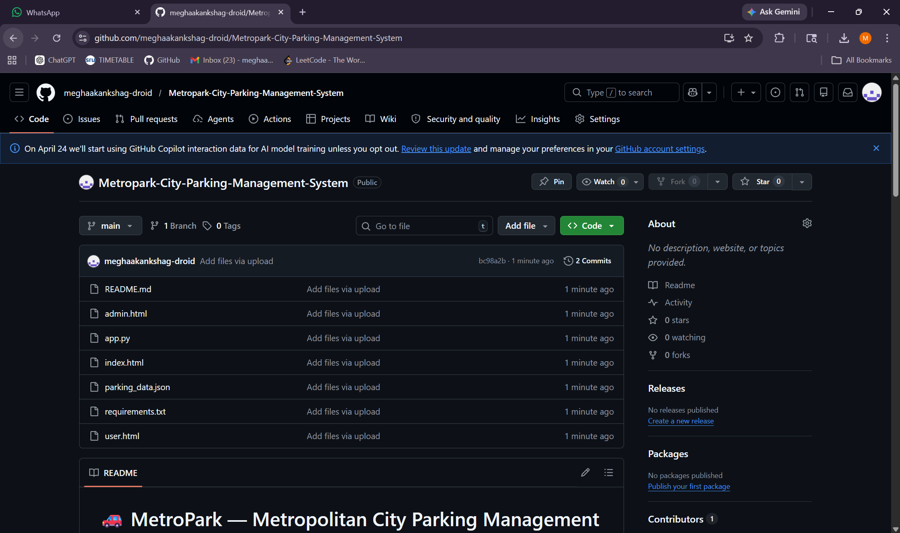
GITHUB
Status Values

Slide 16
Conclusion
Key Takeaways from MetroPark
🎯
Problem Solved
MetroPark directly addresses urban parking congestion by providing real-time slot visibility and instant booking in Hyderabad.
💻
Technology Stack
Built with Flask, Python, HTML/CSS/JS, and JSON storage — a lightweight yet fully functional web application deployable with minimal infrastructure.
🤖
AI-Assisted Development
GitHub Copilot and ChatGPT accelerated development of boilerplate code, data models, and feature implementations, showcasing practical AI integration.
📈
Future Scope
Future enhancements include payment integration, multi-city expansion, a mobile app, and IoT sensor support for automated slot detection.
MetroPark — Smarter Parking for a Smarter City | CSE (AI), SR University | 2026

Slide 17
References
1. Flask Documentation
https://flask.palletsprojects.com/
2. Python Documentation
https://docs.python.org/3/
3. MDN Web Docs (HTML/CSS/JS)
https://developer.mozilla.org/
4. GitHub – Version Control
https://github.com/
5. GitHub Copilot – AI Coding Tool
https://github.com/features/copilot
6. Google Maps Platform
https://developers.google.com/maps
7. PptxGenJS (Presentation Library)
https://gitbrent.github.io/PptxGenJS/

Slide 18
THANK YOU
SR University | Department of CSE (AI) | 2026

