Slide 1
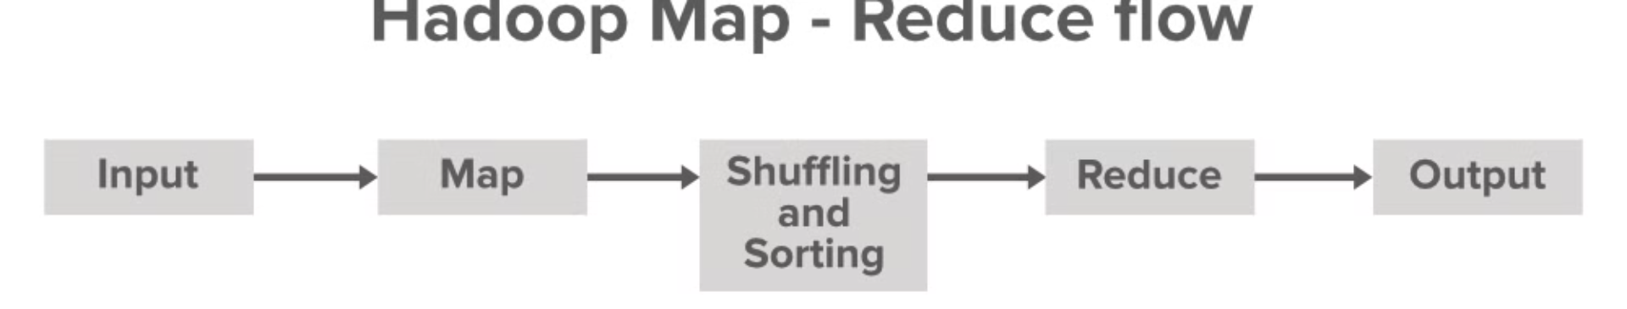

Introduction to Map Reduce Programming
Hadoop Map-Reduce is a programming model for processing large data sets. It provides a scalable and fault-tolerant framework for parallel computation.
Ma
by Meghana Anantam

Slide 2
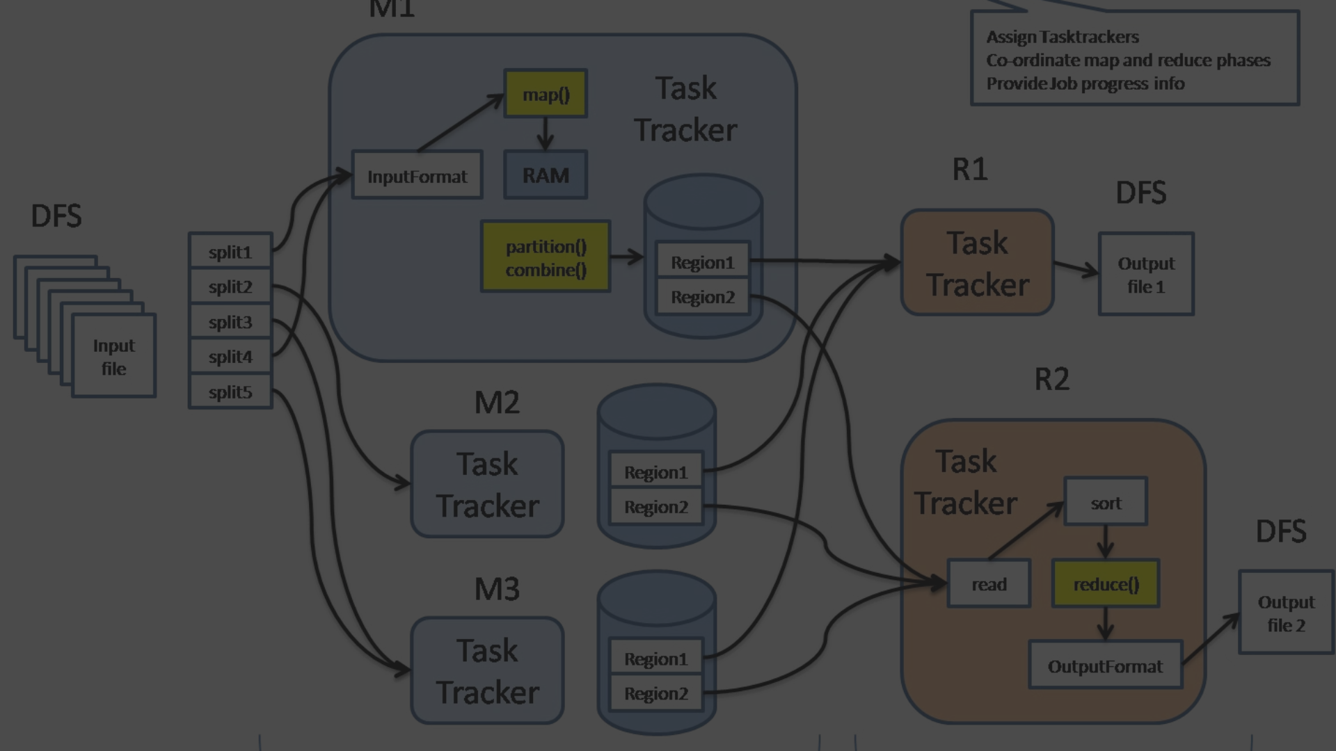
Overview of Hadoop Map-Reduce framework
1
Scalable Data Processing
The framework is designed for processing large-scale data effectively and efficiently.
2
Fault Tolerance
It provides fault tolerance, ensuring that data processing continues uninterrupted in case of failures.
3
Distributed Computing
It enables distributed computing for parallel processing of data across a cluster of machines.

Slide 3
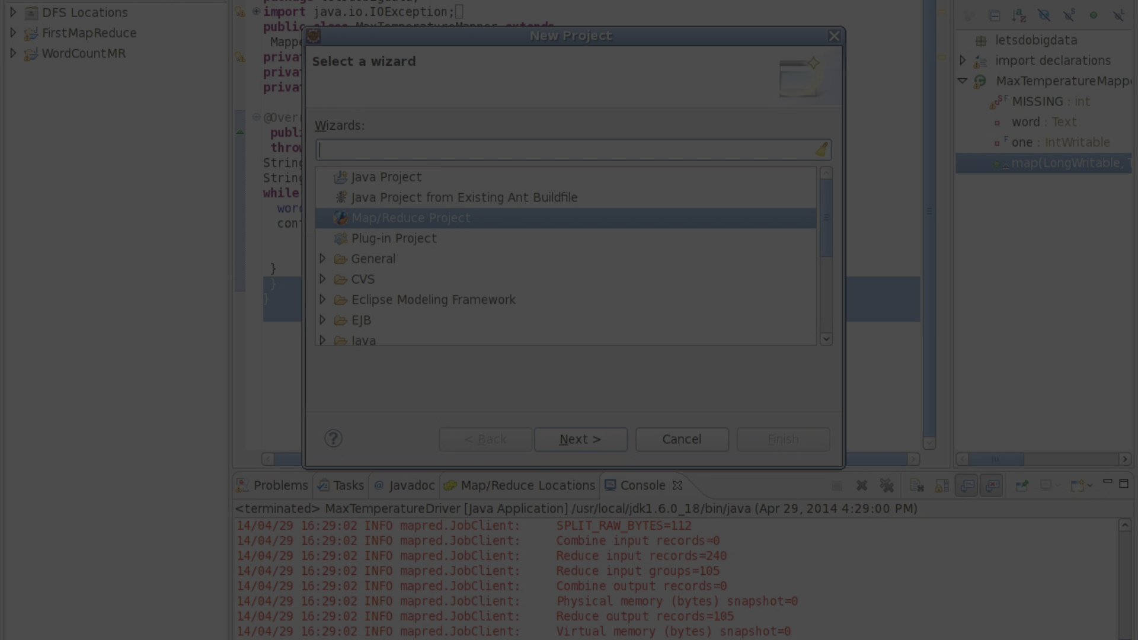
Writing Map Reduce programs in Java
1
Java Development
2
Understanding Map Reduce Logic
3
Testing and Debugging
Proficiency in Java is essential for creating Map Reduce programs using Hadoop.
Tools for testing and debugging Map Reduce programs are critical for efficient development.
Understanding the key principles and logic of Map Reduce is vital for effective programming.

Slide 4
Input and Output formats in Map Reduce
Input Formats
Output Formats
Different input formats, such as text, key-value, and custom formats, can be used for data input.
Versatile output formats like text, sequence, and custom formats are available for data output.

Slide 5



Key concepts in Map Reduce programming
Key
Parallel Processing
Data Aggregation
Understanding the concept of keys and key-value pairs is fundamental to Map Reduce.
Understanding parallel processing is crucial for optimizing Map Reduce programs.
Aggregation of data using reduce operations is a core concept in Map Reduce.

Slide 6
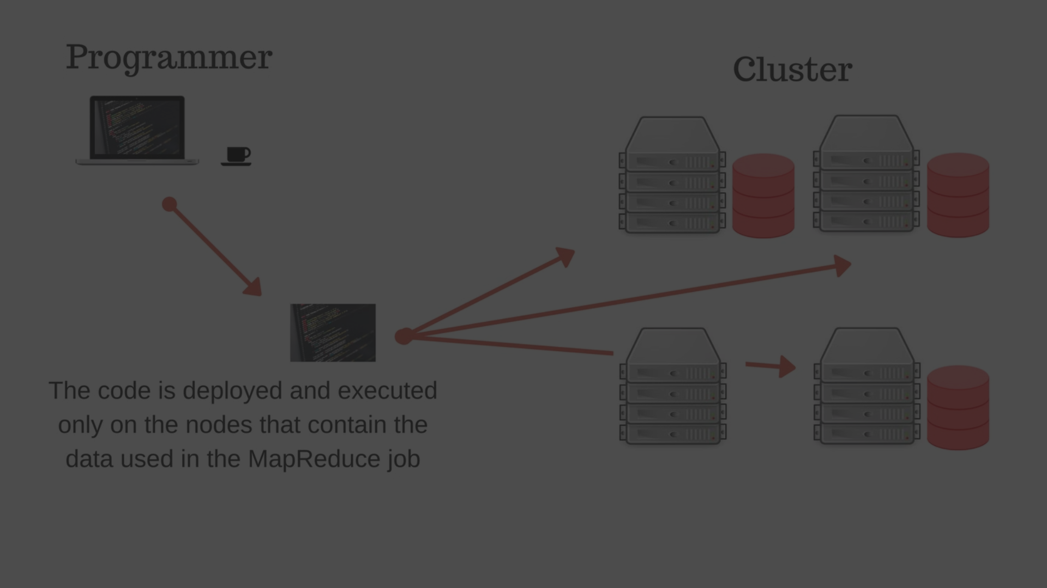
Data processing using Map Reduce
Scalable Processing
Efficient Computation
Map Reduce provides a scalable approach for processing large and complex data sets.
Efficient computation of complex algorithms can be achieved through Map Reduce.

Slide 7
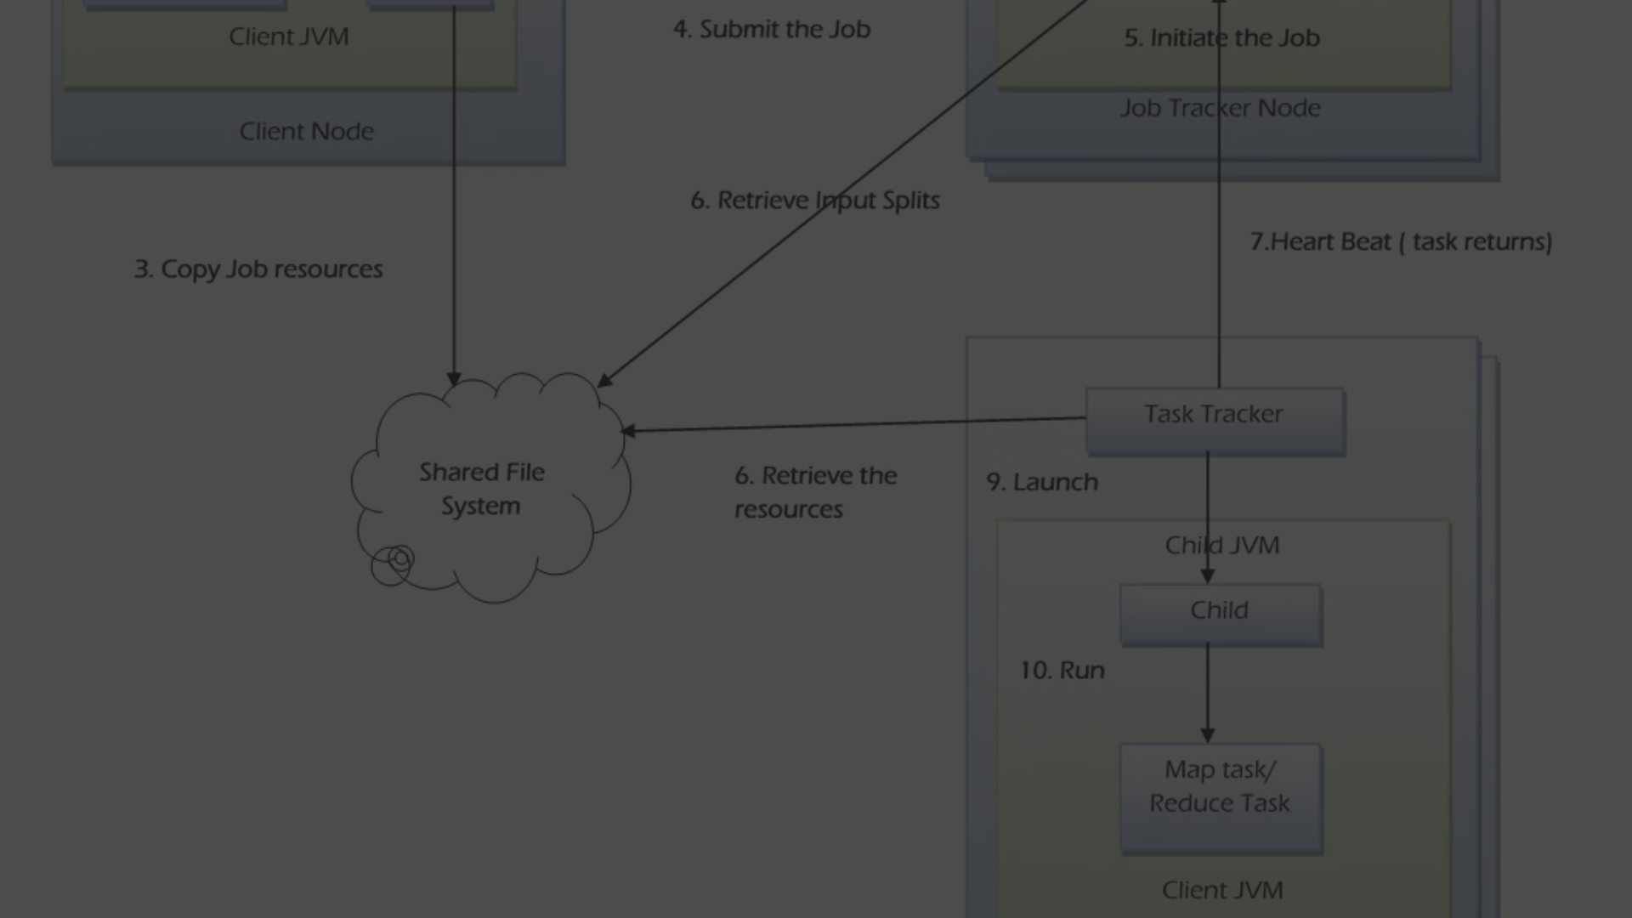



Map Reduce job execution
Job Submission
The process of submitting Map Reduce jobs for execution.
Processing Phases
Map, shuffle, sort, and reduce phases involved in job execution.
Output Generation
Generation of final output after the completion of the reduce phase.

Slide 8
Best practices and tips for Map Reduce programming
3
5
2K
Optimize Performance
Data Partitioning
Cluster Configuration
Utilize optimization techniques to enhance the performance of Map Reduce programs.
Effective data partitioning can greatly impact the efficiency of Map Reduce operations.
Understanding cluster configurations is crucial for successful Map Reduce execution.

