Slide 1

Top Ranked Data Science & Analytics Education Provider since 2007
Ivy Professional School – Top Ranked Corporate Education Provider
1

Slide 2
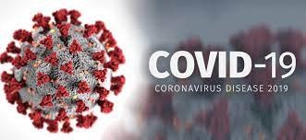
Covid19 Research project
By Megha Das

Slide 3
INDEX
Introduction
Objectives
Table analysis
Data analysis
Findings

Slide 4
Introduction
Project contains 2 Datasets
covid_19_india
covid_19_world
The first dataset consist of covid19 confirmed,cured and deaths cases in various states of India.
The second dataset consist of covid19 confirmed,active,recoverd and deaths cases in various countries.

Slide 5
Objectives
Analysis
Comparison of confirmed cases between 2020 and 2021
No. of people affected in covid19 in different state of India
Monthly comparison of deaths people in 2021
Comparison between active,recoverd and deaths cases in various countries
Rates of percentage of cured people in india than other country

Slide 6
Table Analysis
Covid19_india dataset consist of Cumulative total of confirmed,cured and deaths cases of various states in 2020 and 2021 where
confirmed- 42,30,3185,Cured- 41,081,261 and Deaths- 5,77,917
In covid19_world dataset consist of cumulative total of confirmed,Recovered,active and deaths cases of various country in 2020
where confirmed- 84,88,235,Recovered- 40,90,382,Active- 39,43,888 and Deaths- 4,53,965

Slide 7
Data Analysis
In data analysis of covid19_India dataset presents
cumulative total of confirmed,cured and deaths cases till december,2020 and till august,2021
and Covid19_world dataset presents cumulative total of Confirmed,recovered,active and deaths cases till june, 2020

Slide 8
Comparison between 2020 and 2021 till august
In 2020 confirmed cases-22,68,675
In 2021 confirmed cases-32,03,6511
So,in 2021, 29,76,7836 no. of
more people affected in covid than 2020

Slide 9
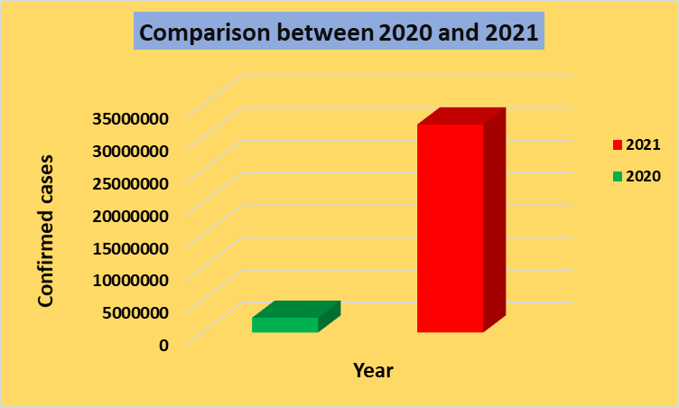

Slide 10
People affected in various states in 2020
Maharashtra-19,28,603
Karnataka-9,18,544
West Bengal-5,50,893
Assam-2,16,139
Lakshadweep-0

Slide 11
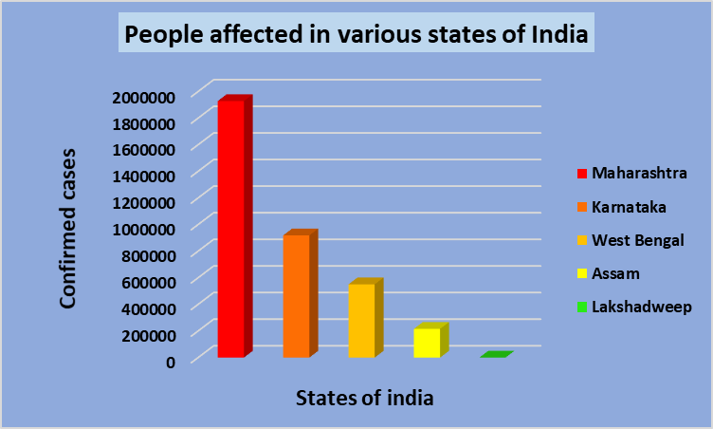

Slide 12
Comparison of Deaths in 2021
Months
January
February
March
April
May
June
July
August
Deaths
4709167
4359434
4935253
5340298
8390917
11155377
12781528
4694523
More no of people died in july 2021 in Covid

Slide 13
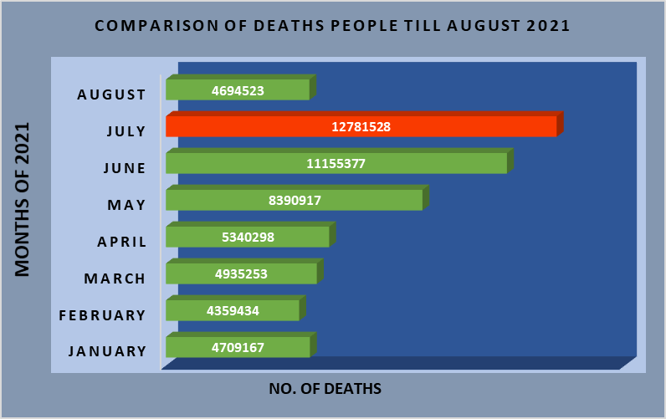

Slide 14
Worlds Covid Records in 2020
Confirmed- 84,88,235
Recovered- 40,90,382
Active- 39,43,888
Deaths- 4,53,965

Slide 15
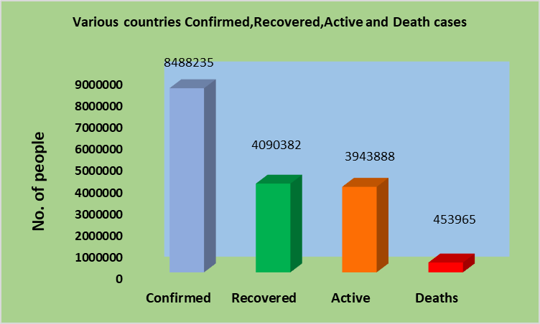

Slide 16
% Rate of Cured people
India- 54 %
Other Countries- 48%
Cured Percentage rate is 6% more in India than other country till june 2020

Slide 17
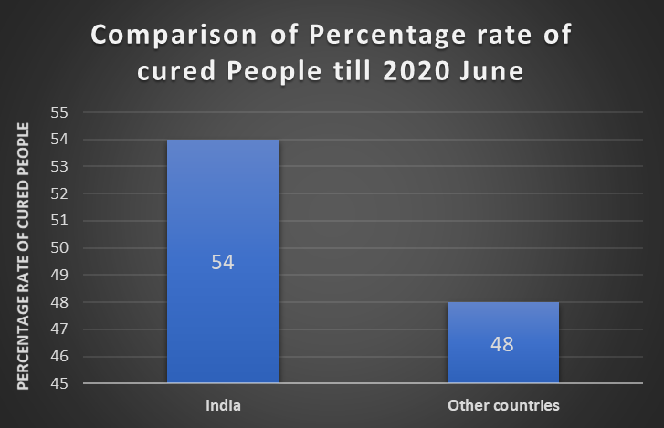

Slide 18
Findings
In 2021 more no of people affected in covid19 than 2020
Maharashtra had more confirmed and deaths cases than other states of india
More no of people died in the month of july of 2021 in Covid19
Cured Percentage rate is 6% more in India than other countries till june 2020
USA had more confirmed cases than other countries

Slide 19
Thank You

