Slide 1
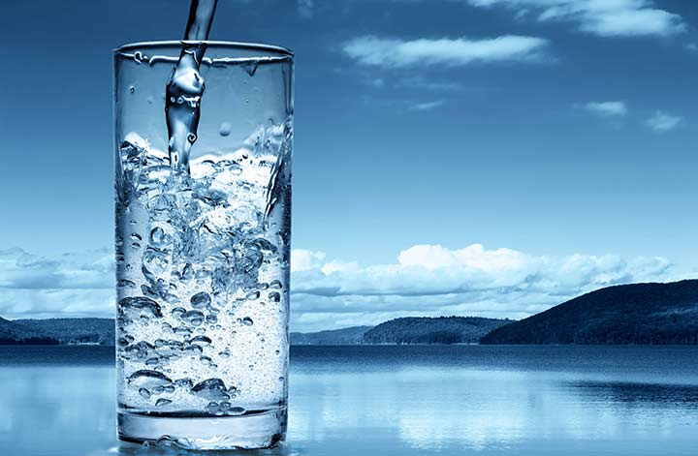
WATER QUALITY PREDICTION IN PYTHON
PYTHON project analysis BY MEGHA DAS

Slide 2
INDEX
INTRODUCTION
DATA DESCRIPTION
Steps to follow
problem statement
Visual Exploratory Data Analysis
Selected Features
MACHINE LEARNING Model BUILDING
Deployment of the Model
Conclusion

Slide 3

InTRODUCTION
It is essential for determining components of water and ensuring safe consumption for humans and the environment. Monitoring and managing water quality is crucial for preserving ecosystems and safeguarding public health.
The water_potability.Csv file contains water quality metrics for 3276 different water bodies.
The goal is to create a predictive model which can predict whether this water consumption safe or not..?

Slide 4
DATA DESCRIPTION
pH value: PH is an indicator of acidic or alkaline condition of water status.
Hardness: Hardness is mainly caused by calcium and magnesium salts
Solids (Total dissolved solids - TDS): High TDS value indicates that water is highly mineralized (containing potassium, calcium, sodium, bicarbonates).
Chloramine: chloramine uses as disinfectants in public water systems. Chlorine levels up to 4 milligrams per liter (mg/L) are considered safe in drinking water.
Sulfate: Sulfate is a chemical,ranges from 3 to 30 mg/L in most freshwater supplies, although much higher concentrations (1000 mg/L) are found in some geographic locations.
Conductivity: The amount of dissolved solids in water determines the electrical conductivity.
Organic_carbon: Total organic carbon(TOC) is a measure of the total amount of carbon in organic compounds in pure water.
Trihalomethanes: Trihalomethanes(THM) levels up to 80 ppm is considered safe in drinking water.
Turbidity: The turbidity of water depends on the quantity of solid matter present in the suspended state.It is a measure of light emitting properties of water
Potability: Indicates if water is safe for human consumption,where 1=Potable,0 = Not potable.

Slide 5
The below step we have to perform to create a Machine learning model for predicting water potability
10. Outlier treatment
11. Missing Values treatment
12. Visual correlation analysis
13. Statistical correlation analysis
14. Converting data to numeric for ML
15. Sampling and K-fold cross validation
16. Trying multiple classification algorithms
17. Selecting the best Model
18. Deploying the best model in production
Understanding the data (Data Description)
Reading the data in python
Defining the problem statement
Identifying the Target variable
Looking at the distribution of Target variable
Basic Data exploration
Rejecting useless columns
Visual Exploratory Data Analysis for data distribution (Histogram and Barcharts)
Feature Selection based on data distribution

Slide 6

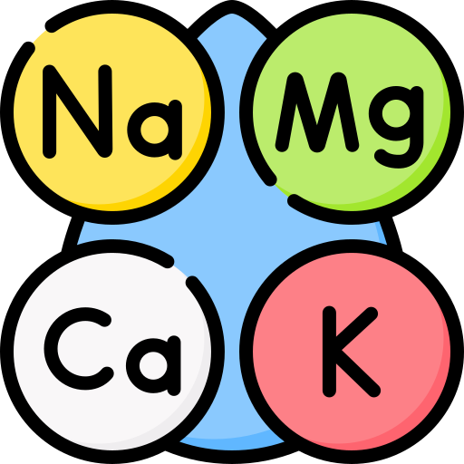




problem statement
Predictors
ph
Hardness
Solids
Chloramines
Sulfate
Conductivity
Organic_carbon
Trihalomethanes
Turbidity
Target Variable
Potability
Potability=0 Water is not safe
Potability=1 Water is safe

Slide 7
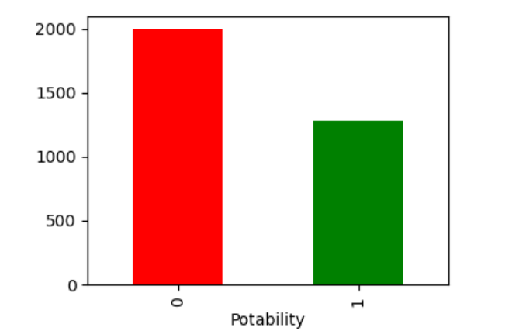
Determining the type of Machine Learning
Based on the problem statement we can understand that we need to create a supervised ML classification model, as the target variable is categorical.
Distribution of the target variable

Slide 8
Basic Data Exploration Results
DATA EXPLORATION
head() : This helps to see a few sample rows of the data
info() : This provides the summarized information of the data
describe() : This provides the descriptive statistical details of the data
nunique(): This helps us to identify if a column is categorical or continuous
DATA EXPLORATION RESULTS
ph- Continuous. Selected.
Hardness- Continuous. Selected.
Solids- Continuous. Selected.
Chloramines- Continuous. Selected.
Sulfate- Continuous. Selected.
Conductivity- Continuous. Selected.
Organic_carbon- Continuous. Selected.
Trihalomethanes- Continuous. Selected.
Turbidity- Continuous. Selected.
Potability- Categorical. Selected. This is the Target Variable!

Slide 9

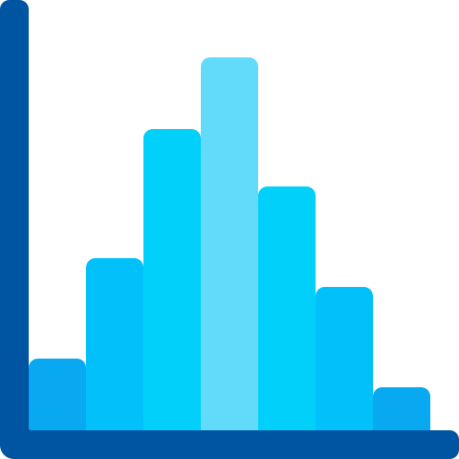
Visual Exploratory Data Analysis
Categorical variables: Bar plot
Continuous variables: Histogram

Slide 10
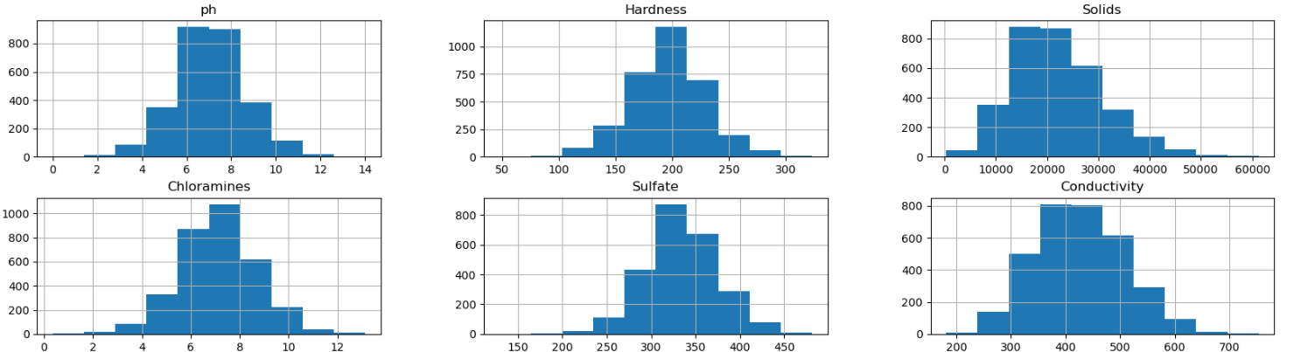
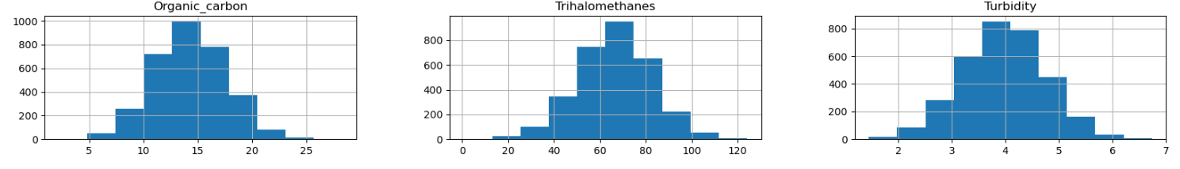
Histogram of the predictors

Slide 11
Histogram Interpretation
ph- Selected. The distribution is good.
Hardness- Selected. The distribution is good.
Solids- Selected. The distribution is good.
Chloramines- Selected. The distribution is good.
Sulfate- Selected. The distribution is good.
Conductivity- Selected. The distribution is good.
Organic_carbon- Selected. The distribution is good.
Trihalomethanes- Selected. The distribution is good.
Turbidity- Selected. The distribution is good.

Slide 12
Visual exploration of relationship between variables
Categorical Target Variable Vs Continuous Predictor
Visual exploration --Box Plot
Statistical Measurement-ANOVA TEST

Slide 13
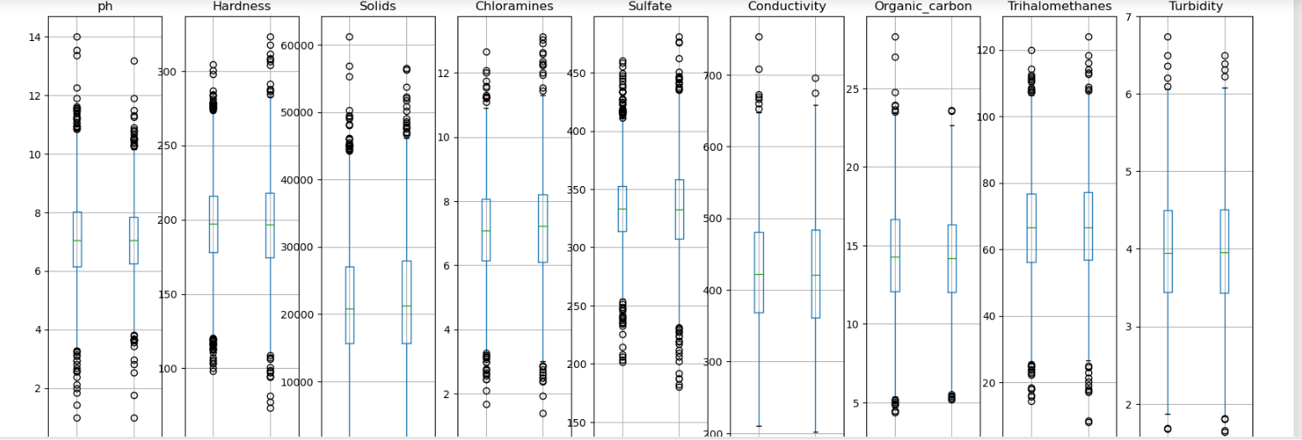
Categorical Vs Continuous -- Box Plots

Slide 14
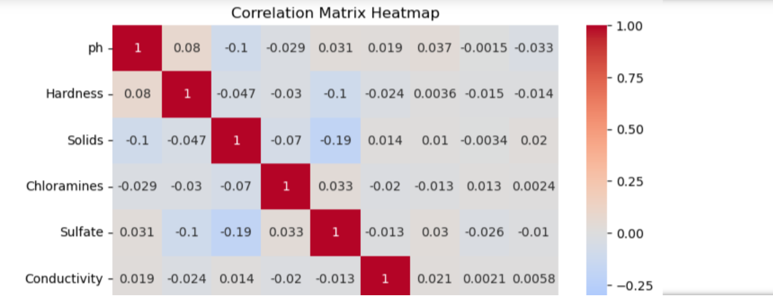
CORRELATION MATRIX HEATMAP

Slide 15
Selected FEATURES
ph
Hardness
Solids
Chloramines
Sulfate
Conductivity
Organic_carbon
Trihalomethanes
Turbidity
Potability

Slide 16

MACHINE LEARNING Model BUILDING
Logistic Regression
Decision Trees
Random Forest
AdaBoost
XGBoost
KNN
SVM
Naive Bayes

Slide 17
Result
KNN
Final selected predictors : PH, Hardness, Solids, Chloramines, Sulfate, Conductivity
Accuracy of the model on Testing Sample Data 0.6
Recall value for potability of water 0.49
Final Average Accuracy of the model 0.58

Slide 18
Deployment of the Model
Train the model using 100% data available
Save the model as a serialized file which can be stored anywhere
Create a python function which gets integrated with front-end to take all the inputs and returns the prediction

Slide 19
CONCLUSION
The Function WaterPotabilityPrediction can be used to produce the predictions that the water is potable or not
the factors which effects more in Water quality are ph, Hardness, Solids, Chloramines, Sulfate, Conductivity
After deployment, the Final Average Accuracy of the model is same as original KNN model which is 0.58

Slide 20
Thank YOU

