Slide 1
Top Streamed Songs Analysis
Spotify
Megha Rose Denny

Slide 2

Why we chose this data?
Our common
interest in music!
What does
it take to
hit the Charts?
Learn and
practice PowerBI
Data modelling
and dashboard
creation
Play
Shuffle

Slide 3
Steps we followed
Collect & Explore
Objective
Collect data and explore the dataset.
Dataset: Kaggle – most streamed song 2023
Analyze top Spotify songs of 2023 to uncover streaming trends
Prepare the data
Clean the data by removing duplicates, errors, etc.
Added a new unique id combining Track and Artist Name.
Semantic Model
Strategy
Identify key entities and establish relationships.
Separated Track and Artist as two different entities with Many to One relationship.
Added Custom columns and Measures like Top 10, Top 100, is_collab
Follow the lab and explore the data
Visualize
Visualize the data to uncover insightful discoveries.
Used different charts like Line Chart, Bar chart, Stacked Area Chart, Gauge chart, Donut Pie Chart, etc
Dataset Source
Kaggle: Spotify - Most streamed song 2023
Create Dashboard
Transform insights into interactive visual stories using slicers and color themes. Created Overview, Artist and Track wise reports.

Slide 4
Dataset Overview
track_name: Name of the song
artist(s)_name: Name of the artist(s) of the song
artist_count: Number of artists contributing to the song
released_year: Year when the song was released
streams: Total number of streams on Spotify
in_spotify_charts: Presence and rank of the song on Spotify charts
in_apple_charts: Presence and rank of the song on Apple Music charts
in_deezer_charts: Presence and rank of the song on Deezer charts
in_shazam_charts: Presence and rank of the song on Shazam charts
mode: Mode of the song (major or minor)
danceability_%: Percentage indicating how suitable the song is for dancing
valence_%: Positivity of the song's musical content
energy_%: Perceived energy level of the song
acousticness_%: Amount of acoustic sound in the song
instrumentalness_%: Amount of instrumental content in the song
liveness_%: Presence of live performance elements
speechiness_%: Amount of spoken words in the song

Slide 5
Key Questions?
Overall KPIs
Which songs are the most streamed globally?
Top 10 Most Streamed Songs
Top Artists by Streamed Songs
Who are the top artists by total streams?
Track KPIs
Do solo or collaboration tracks perform better?
Top Audio Features
Major vs Minor modes
How do audio features like energy, danceability influence streams?
Artist KPIs
How does release year affect streaming volume?
Key Audio Features
Solo vs Collab

Slide 6
Highlights
Blinding Lights is the most streamed song with 4 Billion Streams in 2023
Taylor Swift,
Ed Sheeran and The Weekend are the top artists
Dominant features of Top songs are Danceability, Energy & Valance
Solo tracks outperform Collaborations for Top songs
Multiplatform visibility clearly improve the total streams
Majority of Songs are in Major mode both overall and in Top songs

Slide 7
Key Challenges?
Missing or Incomplete
Data Quality Issues
This affects trend analysis, comparison charts, and can lead to inaccurate conclusions.
Errors, Duplicates can lead to incorrect aggregations, inflated totals, or wrong rankings.
Defining Relationships
Identifying what counts as Artist, Track or their attributes and measures

Slide 8
DEMO

Slide 9
Thank you !
“Music gives a soul to the universe, wings to the mind, flight to the imagination, and life to everything.”
— Plato

Slide 10
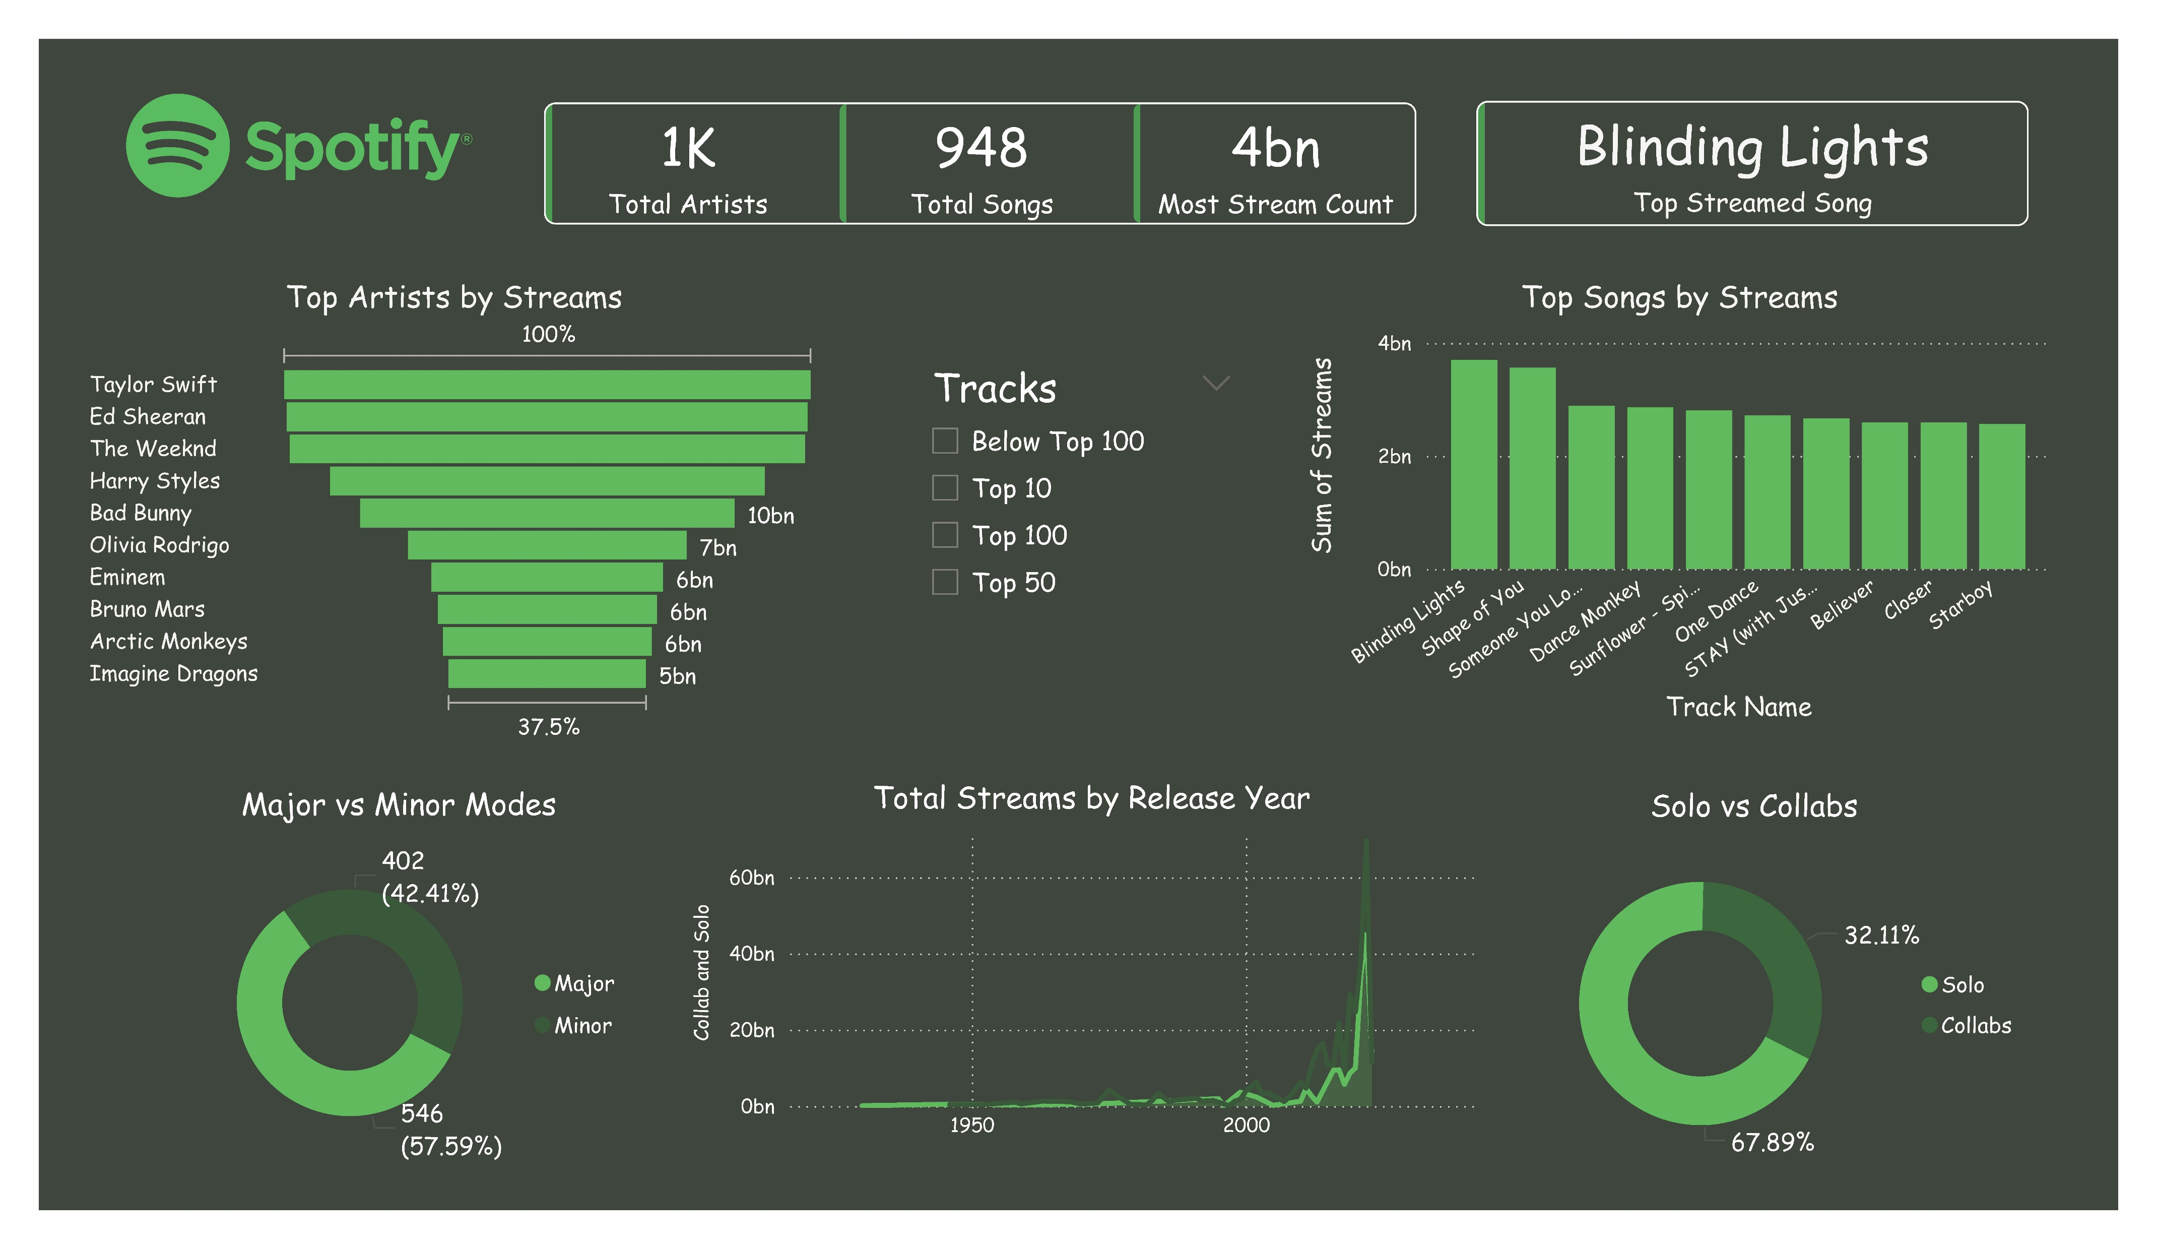

Slide 11
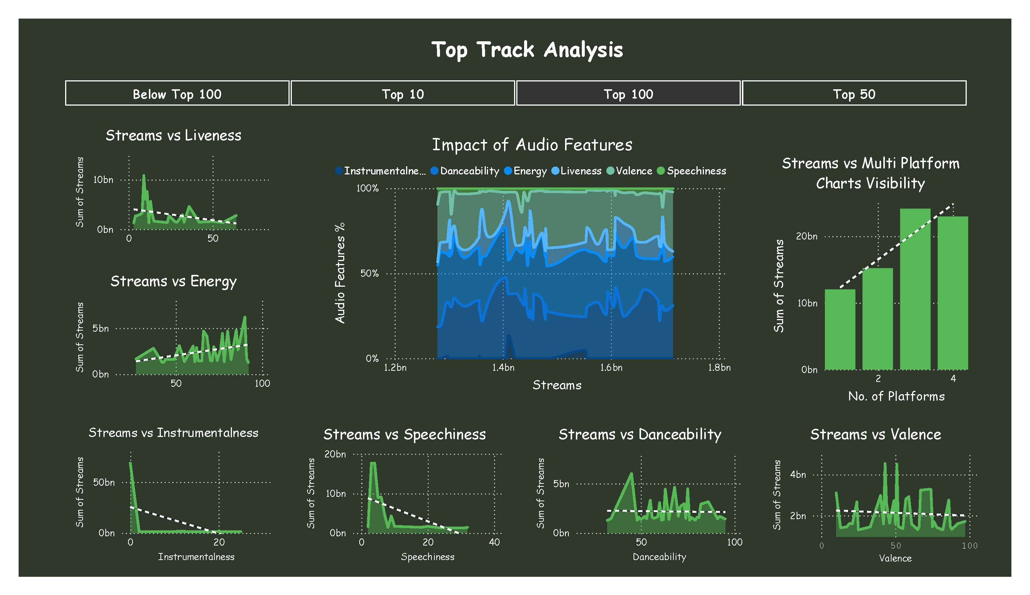

Slide 12
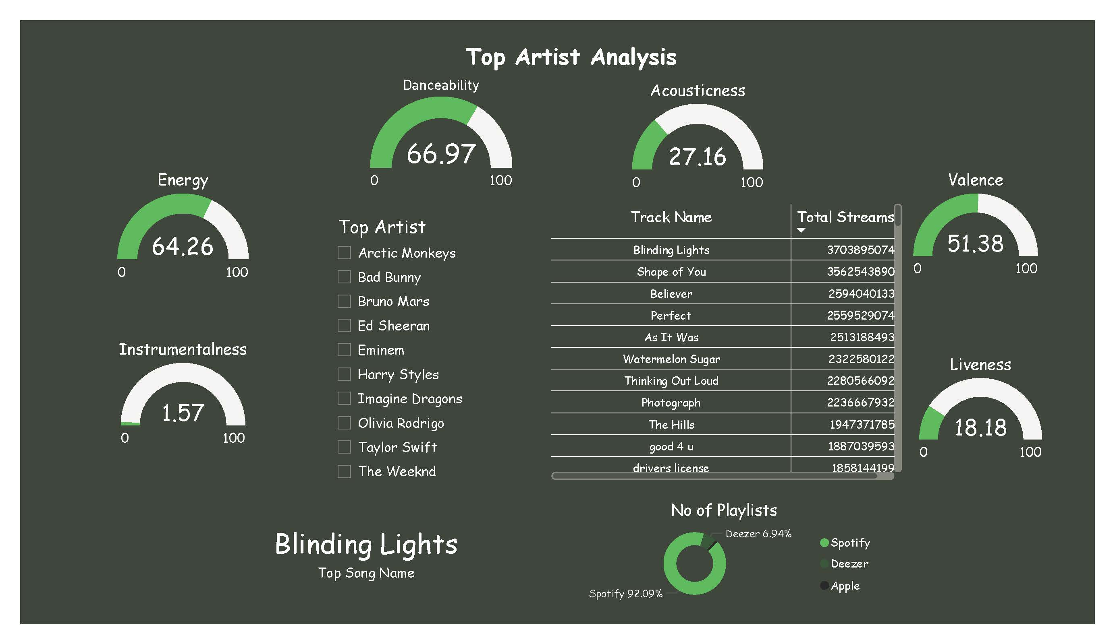

Slide 13
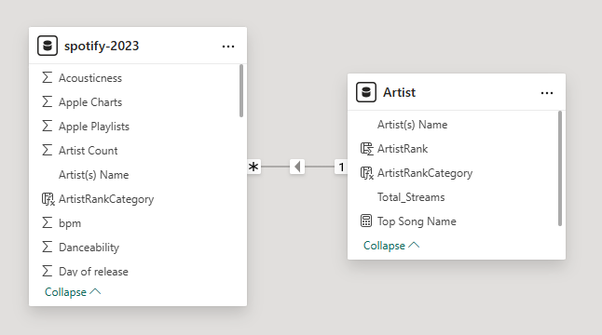
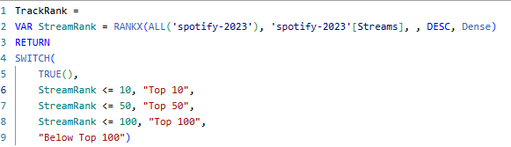

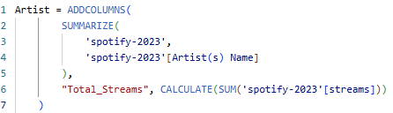
Behind the Scenes!

