Slide 1

RAJIV GANDHI INSTITUTE OF TECHNOLOGY
DEPARTMENT OF COMPUTER SCIENCE
AND ENGINEERING
PREDICTIVE SYSTEM FOR FETAL HEALTH AND PREGNANCY RISK
SUBMITTED BY :
  ADITI (1RG23CS002)
  CHAITHANYA KN (1RG23CS018)
  H PRIYANKA (1RG23CS023)
  MEGHANA NB (1RG23CS034)
UNDER THE GUIDANCE OF
Dr ARUDRA A
Associate professor and Head of Department
DEPT OF CSE

Slide 2
CONTENT:
  Abstract
  Introduction
  Problem Statement
  Objectives
  Proposed system
  Hardware Software Requirements
  Methodology
  Screenshots of Results/outcomes
  Gantt chart
  Conclusion
  Reference

Slide 3
ABSTRACT:
Uses machine learning to predict fetal and pregnancy health risks.
Analyzes maternal and fetal health parameters such as heart rate, bp, glucose, and clinical history.
Classifies pregnancies into low, medium, and high-risk levels.
Helps in early detection of pregnancy complications.
Supports timely medical intervention and monitoring of high-risk pregnancies.
Aims to provide a cost-effective, reliable, and real-time clinical decision-support system.

Slide 4
INTRODUCTION:
Pregnancy requires continuous monitoring for the safety of mother and fetus.
Complications like preeclampsia, gestational diabetes, and fetal distress can cause serious risks.
Traditional periodic check-ups may miss sudden health changes.
Machine learning and data analytics can identify patterns and potential risks from medical data.
The project develops a system for fetal health and pregnancy risk prediction.
It aims to support early detection, better clinical decisions, and improved maternal-fetal outcomes.

Slide 5
Problem statement:
Maternal and fetal risks are difficult to predict early.
Multiple health factors affect pregnancy outcomes.
Manual risk assessment can be time-consuming.
Early detection of high-risk pregnancies is important.
A predictive system is needed for early risk identification and better care.

Slide 6
Objectives:
To develop an AI/ML-based system for maternal and fetal health assessment.
To predict maternal health risk levels using clinical health parameters.
To predict fetal health status using CTG data.
To provide pregnancy tracking using LMP, trimester and estimated due date.
To provide trimester-based wellness guidance like diet and exercises.
To maintain assessment history and pregnancy data for continuous monitoring.

Slide 7
PROPOSED SYSTEM:
Uses machine learning–based predictive models for risk assessment
Analyzes maternal and fetal health data such as vital signs and medical history
Provides early prediction of pregnancy and fetal health risks
Classifies pregnancies into low, medium, and high-risk categories
Supports real-time or near real-time monitoring
Detects hidden patterns and trends in health data
Assists doctors in clinical decision-making
Improves maternal and fetal health outcomes through timely intervention

Slide 8
Hardware software requirements:
Hardware Requirements
Processor: intel i5 / equivalent
RAM: 8 GB or above
Storage: 256 GB SSD or above
Internet connection
SOFTWARE REQUIREMENTS:
Windows 11
Python
React.Js
FastApi
VS code
Scikit-learn, pandas, NumPy, Django

Slide 9
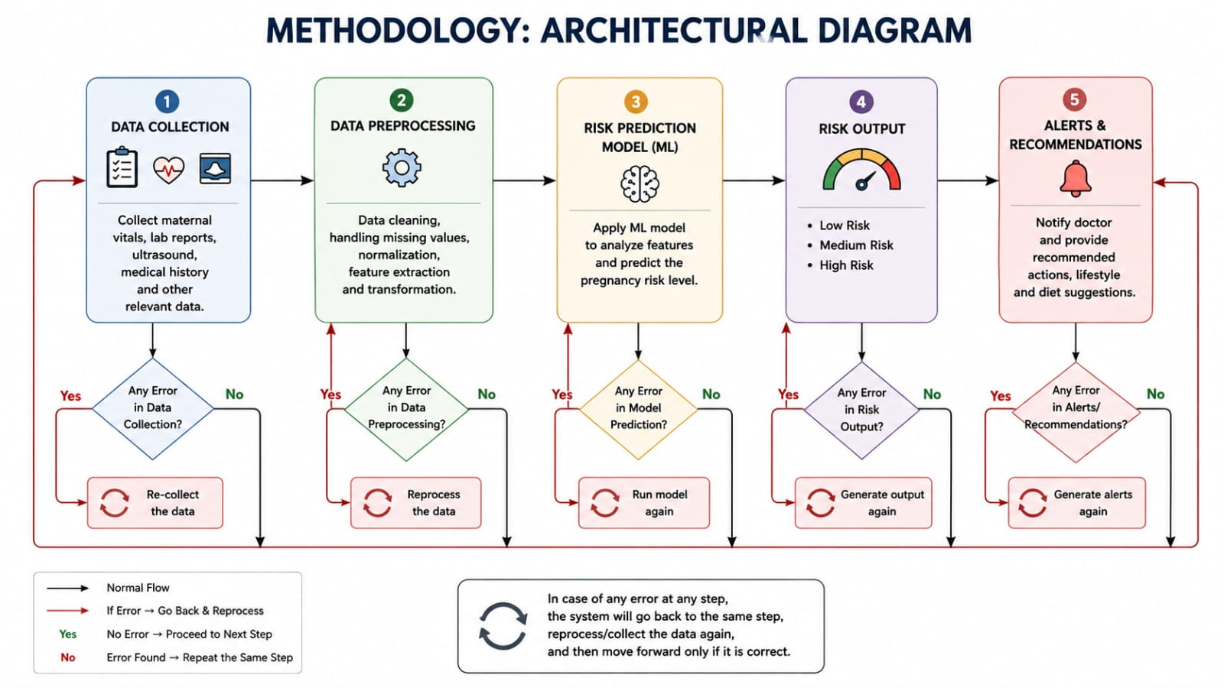
Methodology: architectural diagram:

Slide 10
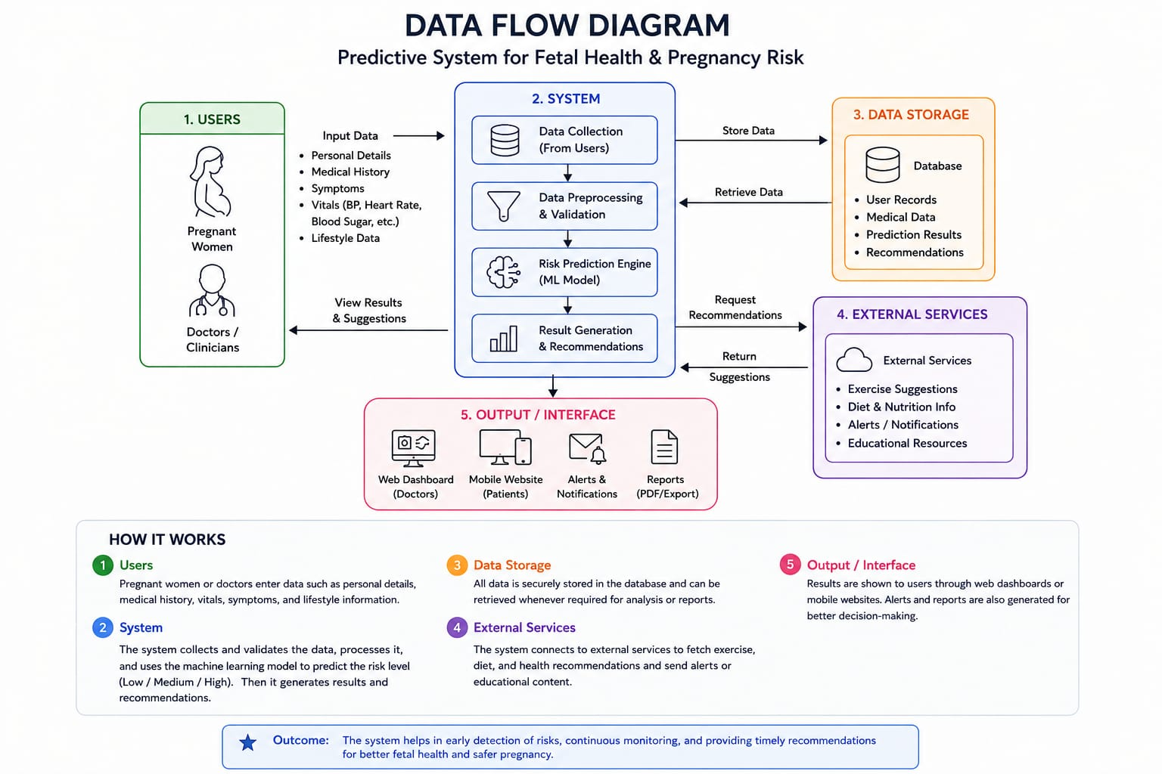
Data flow diagram:

Slide 11
Demonstration of first objective
Demo / how to run the system
Start backend → run fastapi server
Start frontend → npm run dev → open the vite URL
Home page → show the main dashboard
Pregnancy tracking → enter LMP → calculate → show results → refresh
Trimester wellness → open → switch 1st / 2nd / 3rd trimester
Daily wellness → open → demonstrate check-in → back to home
Maternal assessment → enter test data → run prediction
Fetal assessment → enter CTG data → run prediction
Assessment history → view saved results → open details → delete / clear
Finish → return to home via navigation / back button

Slide 12
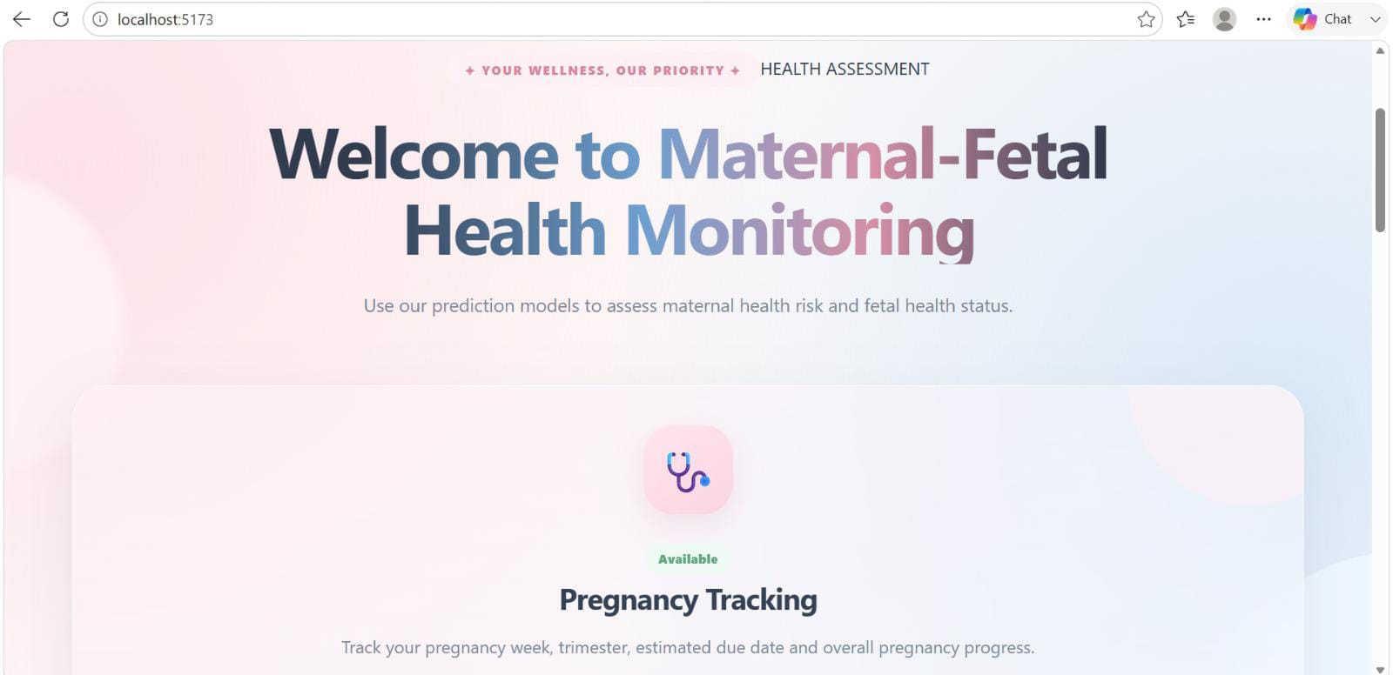
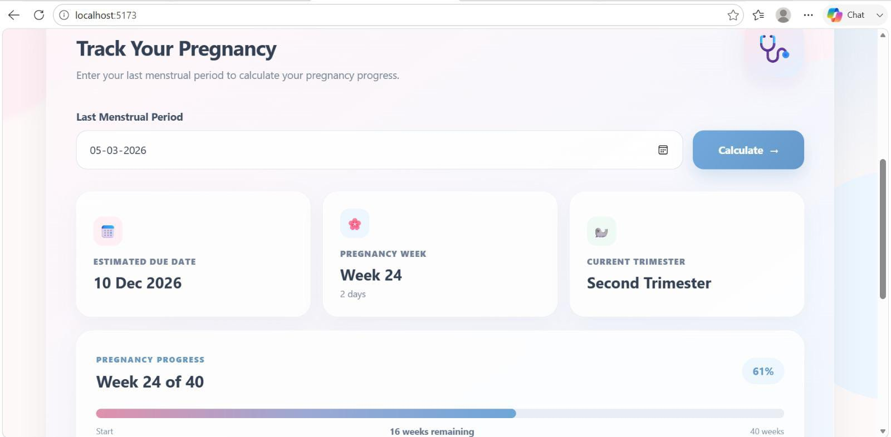
Screenshots of result

Slide 13
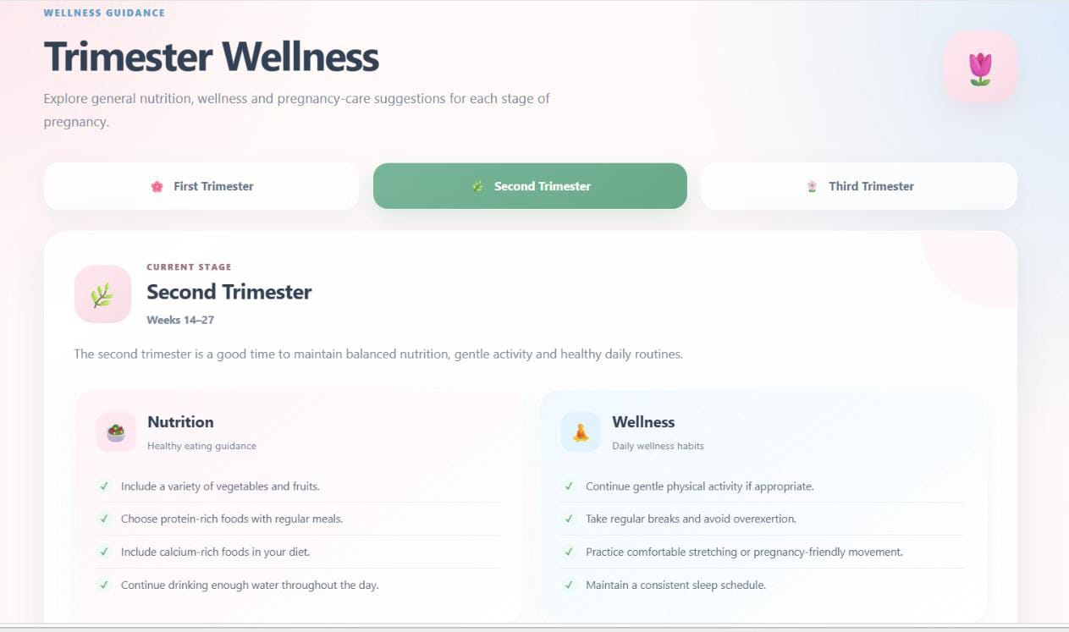
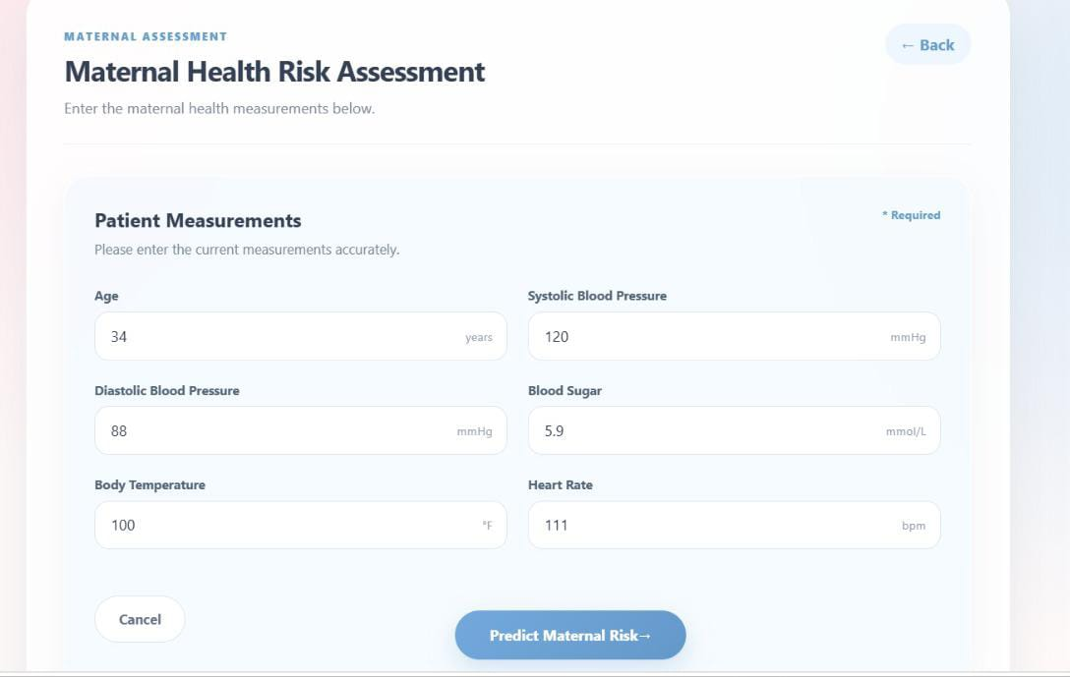
Screenshots of result

Slide 14
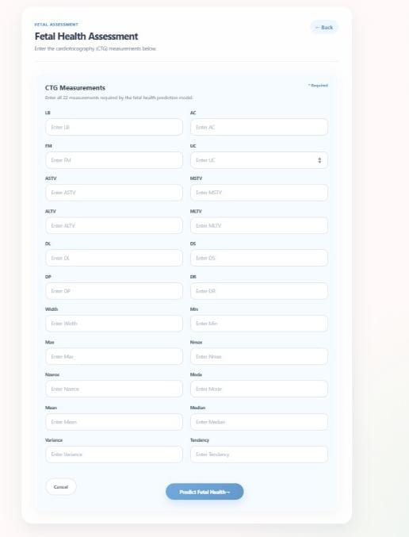
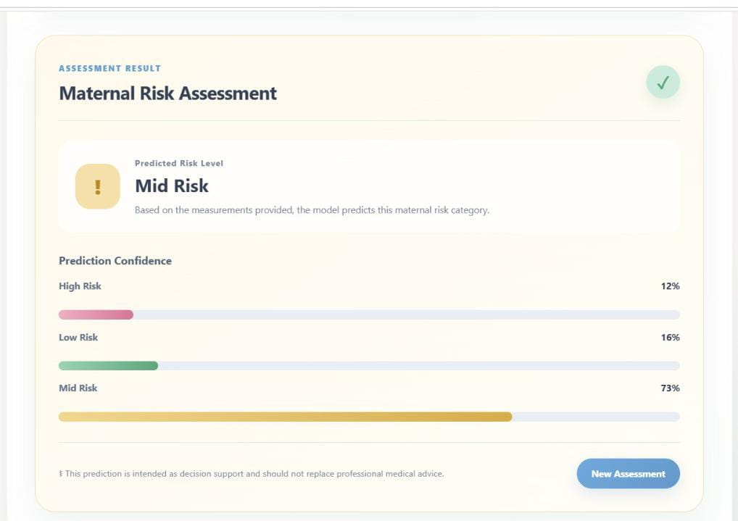
Screenshots of result

Slide 15
Gantt Chart
Weeks → 1–2 → 3–4 → 5–6 → 7–8 → 9–10 → 11–12
Planning & Research → ███
System Design & Setup → ░ ███
CTG / Fetal ML Model → ░ ███
Maternal Risk ML Model → ░ ░ ███
FastAPI Backend → ░ ░ ███
Frontend Development → ░ ░ ░ ███
Pregnancy Tracking → ░ ░ ░ ███
Trimester Wellness → ░ ░ ░ ░ ███
Daily Wellness Check-in → ░ ░ ░ ░ ███
Integration & Testing → ░ ░ ░ ░ ░ ███
Documentation & Presentation→ ░ ░ ░ ░ ░ ░

Slide 16
CONCLUSION:
A predictive system for fetal health and pregnancy risk enhances early detection of complications
Machine learning techniques enable accurate and reliable risk prediction
The system supports timely medical intervention and better clinical decisions
Helps in reducing maternal and fetal mortality rates
Enables personalized monitoring for high-risk pregnancies
Improves overall quality and efficiency of prenatal care
Can be extended for real-time and remote healthcare applications

Slide 17
REFERENCE:
[1]. Statista, 2024, consumer opinions on use of conversational AI for customer service worldwide
As of 2024statista, 2024, consumer opinions on use of conversational AI for customer service worldwide
[2]. As of 2024, https://www.Statista.Com/statistics/1538260/consumer-opinions-on-conversational-
Juniper research, 2023. Chatbots research report: AI & machine learning in customer
[3]. Service 2023-2025. Https://www.Juniperresearch.Com/researchstore/fintech-
[4]. Singh, g., & Singh, J., 2023. Enhancing customer experience and engagement on E
-Commerce platforms through ai-integrated chatbot solutions. Available at SSRN 4483813

Slide 18
Thank you

Slide 19
.
ANY QUESTIONS ?

