Slide 1
Bharat Aadhar Seeding Enabler(BASE)

Slide 2
National Payment Corporation lndia (NPCI) has developed a utility to facilitate a DBT beneficiary to manage the seeding progess seamlessly through "Bharat Aadhaar Seeding Enabler (BASE)".
BASE shall be the interface between various channels through which Aadhaar seeding request can be raised, NPCI mapper and the banks.
For Aadhaar Seeding with student's bank account by navigating https://wwwnpci.org.in/->consumer-> Bharath Aadhaar Seeding Enabler(BASE)

Slide 3
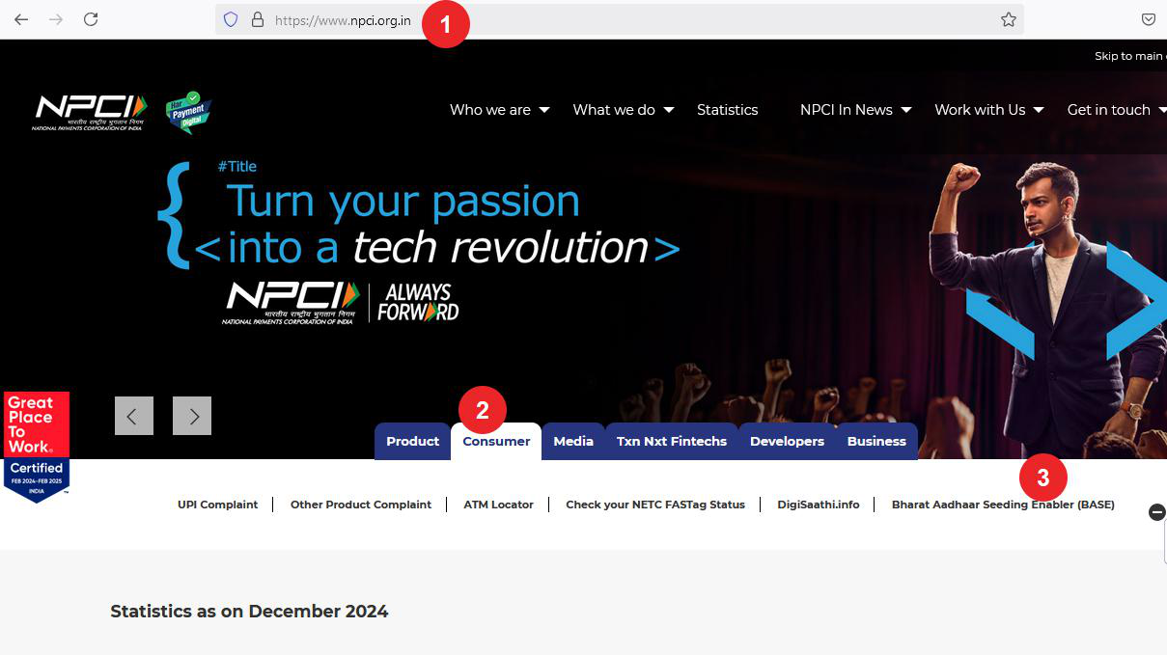
BASE
Step 1: Visit npci.org.in website
Step 2: Click on Consumer menu
Step 3: click on BASE submenu
Notes:
Step 1: Visit npci.org.in website
Step 2: Click on Consumer menu
Step 3: click on BASE submenu

Slide 4
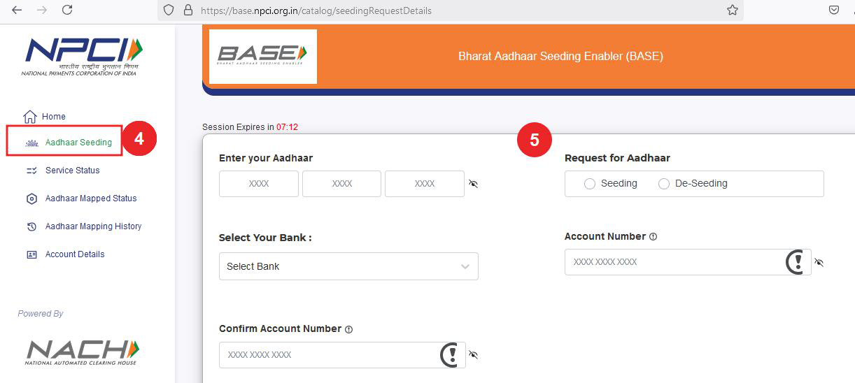
Step 4: Click on Aadhar Seeding
Step 5:Enter details for Aadhar seeding with bank account.

Slide 5
The beneficiary can raise seeding request to bank which are integrated with NPCI for BASE.
Seeding/De seeding can be done through this option using Aadhar OTP.
The list of Banks are available in Select your Bank details.
The banks which are not in the list, the student should visit the bank for Aadhar seeding if not done previously.

