Slide 1
USE OF ARTIFICIAL INTELLIGENCE IN EMOTION RECOGNITION BY ENSEMBLE BASED MULTILEVEL CLASSIFICATION
Authors: Sandeep Rathor, Megha Kansal, Mansi Verma, Madhav Garg and Rishabh Tiwari
PRESENTED BY:
RISHABH TIWARI, PAPER ID: 244
GLA UNIVERSITY, MATHURA, INDIA

Slide 2
PRESENTATION OUTLINE
Introduction
Related Work
Proposed Work
Results and Discussion
Conclusion
References

Slide 3
INTRODUCTION
Emotion is a part of communication.
Humans can detect emotions easily but machines cannot.
Emotions of the speaker changes with environment, culture, etc.
Machines can help humans by detecting emotions.
Currently we are using different speech recognition systems.

Slide 4
RELATED WORK
In past years, many researchers have suggested different techniques for speech emotion recognition.
Renjith et al.[1] have worked on Telugu and Tamil languages to detect emotions. He has extracted Hurst and LPCC features and used both KNN and ANN for classification. The paper shown that Hurst gives better results than LPCC.
Atreyee Khan[2] have used both spectral and prosodic features for emotion detection. Naïve Bayes classifier is used to classify 7-different emotion classes.
Rajasekhar et al.[3] have used SVM classifier to distinguish 4-different emotion classes.

Slide 5
RELATED WORK CONT’D…
Zheng et al.[4] have used a random forest and CNN based model. The results shown that CNN-RF model is better than CNN model.
An author [5] have used both verbal and non-verbal sounds. To train the model, SVM and CNN classifiers were used for both sounds.

Slide 6
PROPOSED WORK
The dataset used for model have 24 professional actors (12 male and 12 female) speaking in 8 different emotions.
Librosa library is used for feature extraction from speech signals.
MFCC, MEL and Chroma is used for extracting features.
Feature reduction using Principal Component Analysis.
Principal Component Analysis is applied to reduce features.
PCA ensures minimal loss of information and decreases computation time.

Slide 7
PROPOSED WORK CONT’D...
Initially five classifiers with different configurations were used to classify the emotions.
SVC, KNN, MLP, AdaBoost and GradientBoost.
An ensemble model with three best classifiers is used for training.
The figure below shows the proposed model:

Slide 8
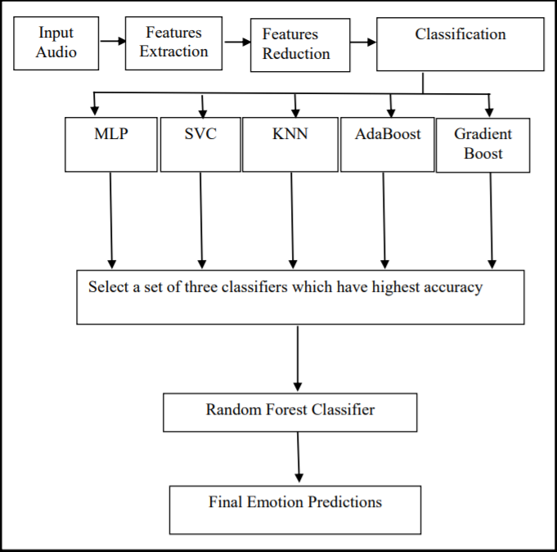
Proposed Ensemble based model for Emotion Classification

Slide 9
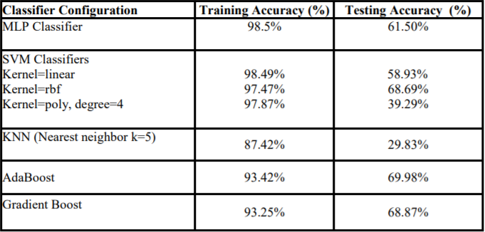
RESULTS AND DISCUSSIONS
The dataset LibriSpeech has total 2484 classes having emotions like happy, sad, angry, etc.
After selecting best suited features from all extracted, different classifiers were trained to detect speech emotion

Slide 10
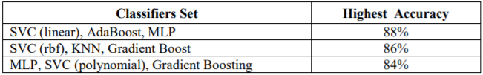
RESULT AND DISCUSSIONS CONT’D...
For better accuracy, different ensemble model are used to detect speech emotion.
The result of best three is:
The final classification model gives an accuracy of 88%.

Slide 11
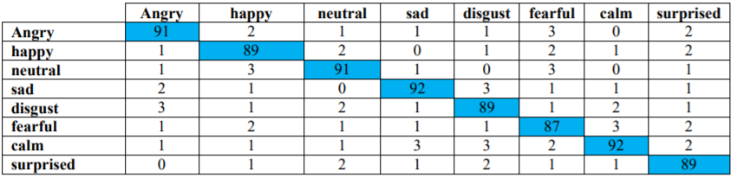
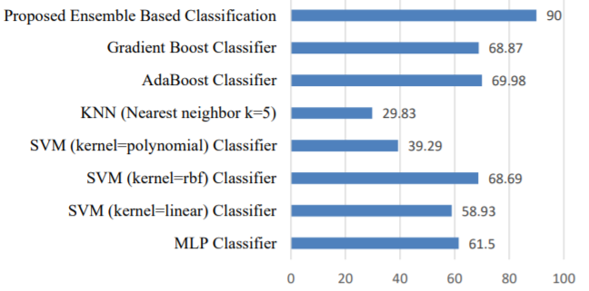
Confusion matrix for test data
Accuracy comparison for different models

Slide 12
Conclusion
In the above study we performed the Speech Emotion Recognition using four classifier MLP, KNN, SVM, Random Forest and Voting classifier to classify the emotions that are present in our dataset.
The best accuracy of 90% is achieved using a proposed ensemble based model.

Slide 13
REFERENCES
[1] Akçay, M. B., & Oğuz, K. (2020). Speech emotion recognition: Emotional models, databases, features, preprocessing methods, supporting modalities, and classifiers. Speech Communication, 116, 56-76.
[2] Kerkeni, L., Serrestou, Y., Mbarki, M., Raoof, K., Mahjoub, M. A., & Cleder, C. (2019). Automatic Speech Emotion Recognition Using Machine Learning. In Social Media and Machine Learning. IntechOpen.
[3] De Silva, L. C., & Ng, P. C. (2000). Bimodal emotion recognition. In Proceedings Fourth IEEE International Conference on Automatic Face and Gesture Recognition (Cat. No. PR00580) (pp. 332-335). IEEE..
[4] Liu, Z. T., Wu, M., Cao, W. H., Mao, J. W., Xu, J. P., & Tan, G. Z. (2018). Speech emotion recognition based on feature selection and extreme learning machine decision tree. Neurocomputing, 273, 271-280.

Slide 14
[5] Liu, Z. T., Xie, Q., Wu, M., Cao, W. H., Mei, Y., & Mao, J. W. (2018). Speech emotion recognition based on an improved brain emotion learning model. Neurocomputing, 309, 145-156.
[6] Renjith, S., & Manju, K. G. (2017). Speech based emotion recognition in Tamil and Telugu using LPCC and hurst parameters—a comparitive study using KNN and ANN classifiers. In 2017 International conference on circuit, power and computing technologies (ICCPCT) (pp. 1-6). IEEE.
[7] Khan, A., & Roy, U. K. (2017). Emotion recognition using prosodie and spectral features of speech and Naïve Bayes Classifier. In 2017 international conference on wireless communications, signal processing and networking (WiSPNET) (pp. 1017-1021). IEEE.
[8] Rajasekhar, A., & Hota, M. K. (2018, April). A study of speech, speaker and emotion recognition using Mel frequency cepstrum coefficients and support vector machines. In 2018 International Conference on Communication and Signal Processing (ICCSP) (pp. 0114-0118). IEEE.

Slide 15
[9] Li, Z., Li, J., Ma, S., & Ren, H. (2019, June). Speech Emotion Recognition Based on Residual Neural Network with Different Classifiers. In 2019 IEEE/ACIS 18th International Conference on Computer and Information Science (ICIS) (pp. 186-190). IEEE Computer Society.
[10] A. Christy, S. Vaithyasubramanian, A. Jesudoss & M. D. Anto Praveena (2020) Multimodal speech emotion recognition and classification using convolutional neural network techniques, International Journal of Speech Technology volume 23.
[11] Cai, L., Hu, Y., Dong, J., & Zhou, S. (2019). Audio-Textual Emotion Recognition Based on Improved Neural Networks. Mathematical Problems in Engineering, 2019.
[12] Jain, M., Narayan, S., Balaji, P., Bhowmick, A., & Muthu, R. K. (2020). Speech Emotion Recognition using Support Vector Machine. arXiv preprint arXiv:2002.07590.

Slide 16
[13] V. Panayotov, G. Chen, D. Povey, and S. Khudanpur, “Librispeech: An asr corpus based on public domain audio books,” in Librispeech: An ASR corpus based on public domain audio books, 04 2015, pp. 5206–5210.
[14] Sandeep Rathor & R.S. Jadon, “Acoustic Domain Classification and Recognition through Ensemble based Multilevel Classification”,Journal of Ambient Intelligence and Humanized Computing (2019), Volume 10, Issue 9, pp 3617–3627.

Slide 17
Thank You

