Slide 1

Speech Emotion Recognition
DEPARTMENT OF COMPUTER ENGINEERING AND APPLICATIONS Institute Of Engineering and Technology
GLA University Mathura-281406 2020-2021
Presented By:
Mansi Verma (B) 181500372 Megha Kansal (B) 181500382
Rishabh Tiwari (B) 181500566
Madhav Garg (B) 181500356

Slide 2


Objective
Speech Emotion Recognition, abbreviated as SER, is the act of attempting to recognize human emotion and affective states from speech.
To build a model to recognize emotion from speech using the librosa and sklearn libraries and the RAVDESS dataset.

Slide 3

Applications
It can be used to determine the emotions of a person by hearing his sound. So, it can be used for security purposes.
It can be used while talking with robots which makes it easier for robots to understand the human emotions.
It can help the employees to recognize customers’ emotions from speech, so they can improve their service and convert more people.

Slide 4

Determining the correct emotion of a person in his speech is sometimes difficult for a human being also, especially when the speaker is suppressing his emotions.
Identifying the features that impact the emotions of a person for feature extraction from a raw audio file.
Issues and Challenges

Slide 5


Dataset Used
The dataset used in this project is RAVDESS which has 24 professional actors (12 male and 12 female) vocalizing two lexically-matched statements. Each statement is produced at two levels of emotional intensity (normal and strong) having total 1440 audio files.
The two statements used are:
Kids are talking by the door
Dogs are sitting by the door

Slide 6
Libraries Used
Librosa- for analysing audio and music
Soundfile- to read sound file
numpy- for numerical computing, high performance
Sklearn- for classification, regression etc.
Pyaudio- to play and record audio on a variety of platforms

Slide 7
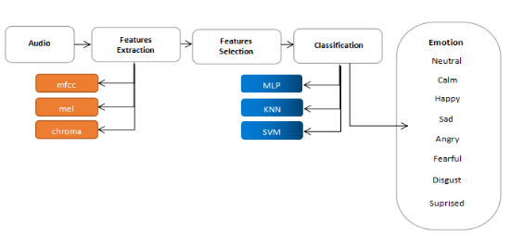
Block Diagram of SER

Slide 8
Classifiers Used

Slide 9
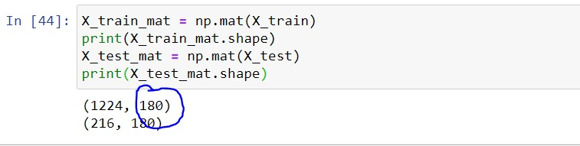
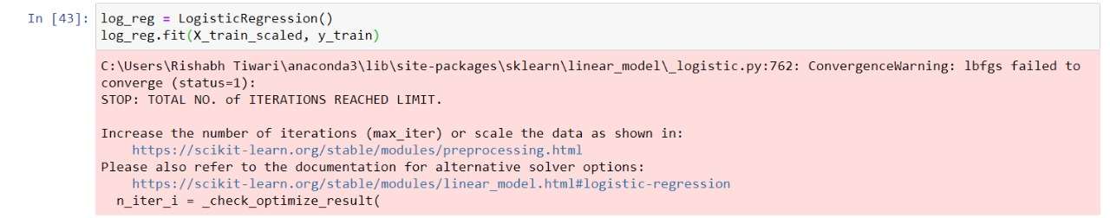
Logistic Regression Fails

Slide 10
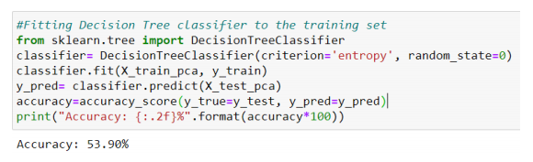
DECISION TREE
A decision tree is drawn upside down with its root at the top. Every node acts as a decision point and has two leaf nodes to act according to the decision.

Slide 11
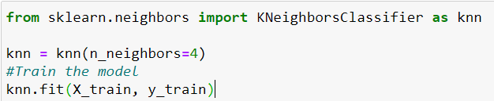


K-Nearest Neighbour
We will apply the KNN model with k=4 using sklearn. Firstly import the KNN classifier and then train the model and make predictions for the test dataset.

Slide 12
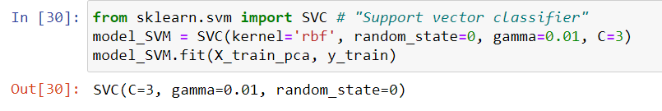

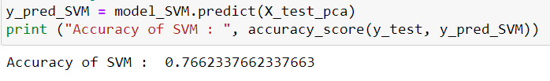
SUPPORT VECTOR MACHINE
The second applied model is SVM using sklearn with the ‘rbf’ kernel which gives an accuracy of 76.62%.

Slide 13
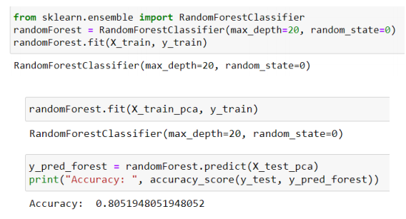
Random Forest
It is an ensemble model which combines random decision trees together.

Slide 14
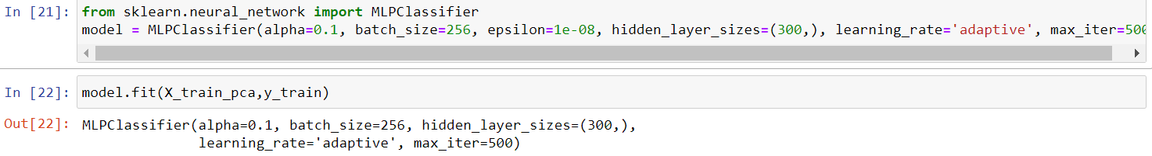
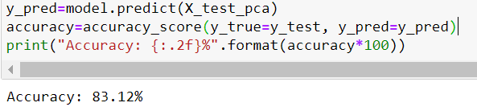
MLP CLASSIFIER
A multilayer perceptron classifier is a neural network based model. Here we have used 300 hidden layers for training the model. The accuracy is 83.12% which is the highest of all applied models.

Slide 15
By working on this project, we not only learned different models used in machine learning for classification tasks but also gained knowledge on how ML can be used to obtain the emotions of a person through his audio.
This system of recognizing emotion can be used in different places like with assistants for understanding command with emotions of the speaker can be used in audio surveillance, etc.
Conclusion

Slide 16
THANK YOU

