Slide 1
CSE 327 – IMAGE AND VISION COMPUTING PBL
SUBMITTED TO PROF. S. BHARATHI RAJA

Slide 2
TITLE :- Vehicle detection in traffic surveillance system using edge detection
TEAM MEMBERS :-
MEGHA MISHRA – 14BCE1252
MANISHA KUMARI – 14BCE1151
RADIA HARDIK DILSUKHBHAI – 14BCE1179

Slide 3
PROBLEM STATEMENT
In this fast paced world every one is in a hurry for something or the other.
We try to do things as quickly as possible, mainly going from one place to another. Also other than being in hurry, youngsters like the thrill of driving fast. We drive fast which can cause accidents.
In order to avoid accident due to excessive speeding we are trying to develop such a system that detects the vehicle going beyond the speed limit and try to catch as soon as possible.

Slide 4
Proposed System
To achieve the following objective we propose a system that can extract vehicle number from the vehicle’s number plate.
This system consists of 3 major processes :-
Edge detection
Zooming
Text Recognition

Slide 5
Technical Aspects
We will need to first capture the image of speeding vehicle.
In that image we will mainly focus on number plate of the vehicle.
Edge detection is one of the fundamental steps in image processing, image analysis, image pattern recognition so will first perform edge detection on image.
With appropriate zooming we will try to extract the part containing number plate of vehicle.
After that finally text recognition algorithm will be applied to extract the vehicle’s number.

Slide 6
Progress
Code for edge detection using Sobel filter
Reding the image and converting the color image into grey scale image
clc
clear all
I=imread('a.jpg');
I1=uint8(zeros(size(I,1),size(I,2)));
%rgb2gray
for i=1:size(I,1)
for j=1:size(I,2)
I1(i,j)=0.2989*I(i,j,1)+0.5870*I(i,j,2)+0.1140*I(i,j,3);
end
end

Slide 7
I2=double(I1);
%sobel fiter
for i=1:size(I2,1)
for j=1:size(I2,2)
if i-1<=0 && j-1<=0
%Sobel mask for x-direction:
Gx=(5*I2(i+1,j)+I2(i+1,j+1));
%Sobel mask for y-direction:
Gy=(I2(i+1,j+1)+5*I2(i,j+1));
elseif i-1<=0 && j>1 && j<size(I2,2)
%Sobel mask for x-direction:
Gx=(I2(i+1,j-1)+5*I2(i+1,j)+I2(i+1,j+1));
%Sobel mask for y-direction:
Gy=((I2(i+1,j+1)+5*I2(i,j+1))-(I2(i+1,j-1)+5*I2(i,j-1)));
elseif j-1<=0 && i>1 && i<size(I2,1)
%Sobel mask for x-direction:
Gx=((5*I2(i+1,j)+I2(i+1,j+1))-(5*I2(i-1,j)+I2(i-1,j+1)));
%Sobel mask for y-direction:
Gy=(I2(i+1,j+1)+5*I2(i,j+1)+I2(i-1,j+1));

Slide 8
elseif i+1>size(I2,1) && j+1>size(I2,2)
%Sobel mask for x-direction:
Gx=(I2(i-1,j-1)+5*I2(i-1,j));
%Sobel mask for y-direction:
Gy=(5*I2(i,j-1)+I2(i-1,j-1));
elseif i+1>size(I2,1) && j>1 && j<size(I2,2)
%Sobel mask for x-direction:
Gx=(I2(i-1,j-1)+5*I2(i-1,j)+I2(i-1,j+1));
%Sobel mask for y-direction:
Gy=((5*I2(i,j+1)+I2(i-1,j+1))-(5*I2(i,j-1)+I2(i-1,j-1)));
elseif j+1>size(I2,2) && i>1 && i<size(I2,1)
%Sobel mask for x-direction:
Gx=((I2(i+1,j-1)+5*I2(i+1,j))-(I2(i-1,j-1)+5*I2(i-1,j)));
%Sobel mask for y-direction:
Gy=(I2(i+1,j-1)+5*I2(i,j-1)+I2(i-1,j-1));

Slide 9
elseif j>1 && j<size(I2,2) && i>1 && i<size(I2,1)
%Sobel mask for x-direction:
Gx=((I2(i+1,j-1)+5*I2(i+1,j)+I2(i+1,j+1))-(I2(i-1,j-1)+5*I2(i-1,j)+I2(i-1,j+1)));
%Sobel mask for y-direction:
Gy=((I2(i+1,j+1)+5*I2(i,j+1)+I2(i-1,j+1))-(I2(i+1,j-1)+5*I2(i,j-1)+I2(i-1,j-1)));
end
%The gradient of the image
I1(i,j)=sqrt(Gx.^2+Gy.^2);
end
end
imshow(I1)

Slide 10
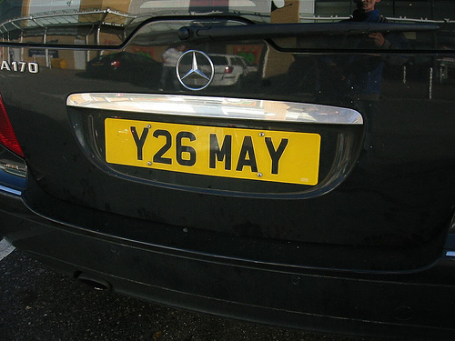
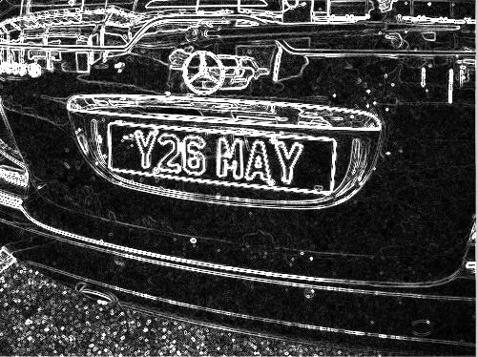
Before Edge detection
After Edge detection

Slide 11
THANK YOU

