Slide 1
Graphical Social Network analysis
- Meghan Garg

Slide 2
Topics to cover
Background
Centrality Measures
Types of Centrality Measures
Degree Centrality
Closeness Centrality
Betweenness Centrality
Eighenvector Centrality

Slide 3


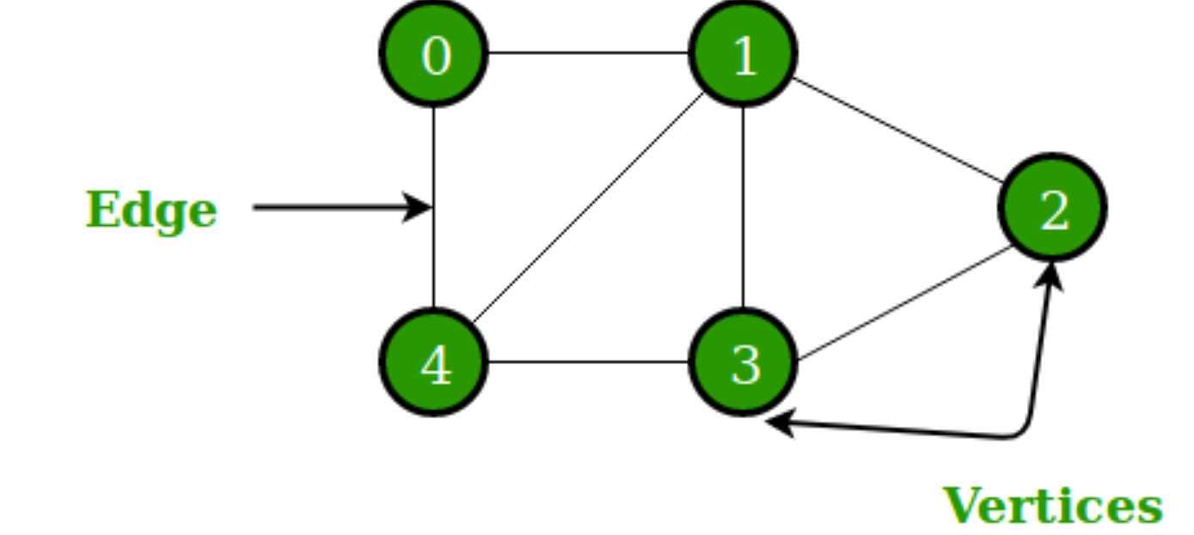
BackGround
Recall : vertices or nodes are the units or actors in a network (or a graph or a system).
Edges are the ties or connections between nodes.
Nodes (vertices) and Edges in an Undirected graph

Slide 4
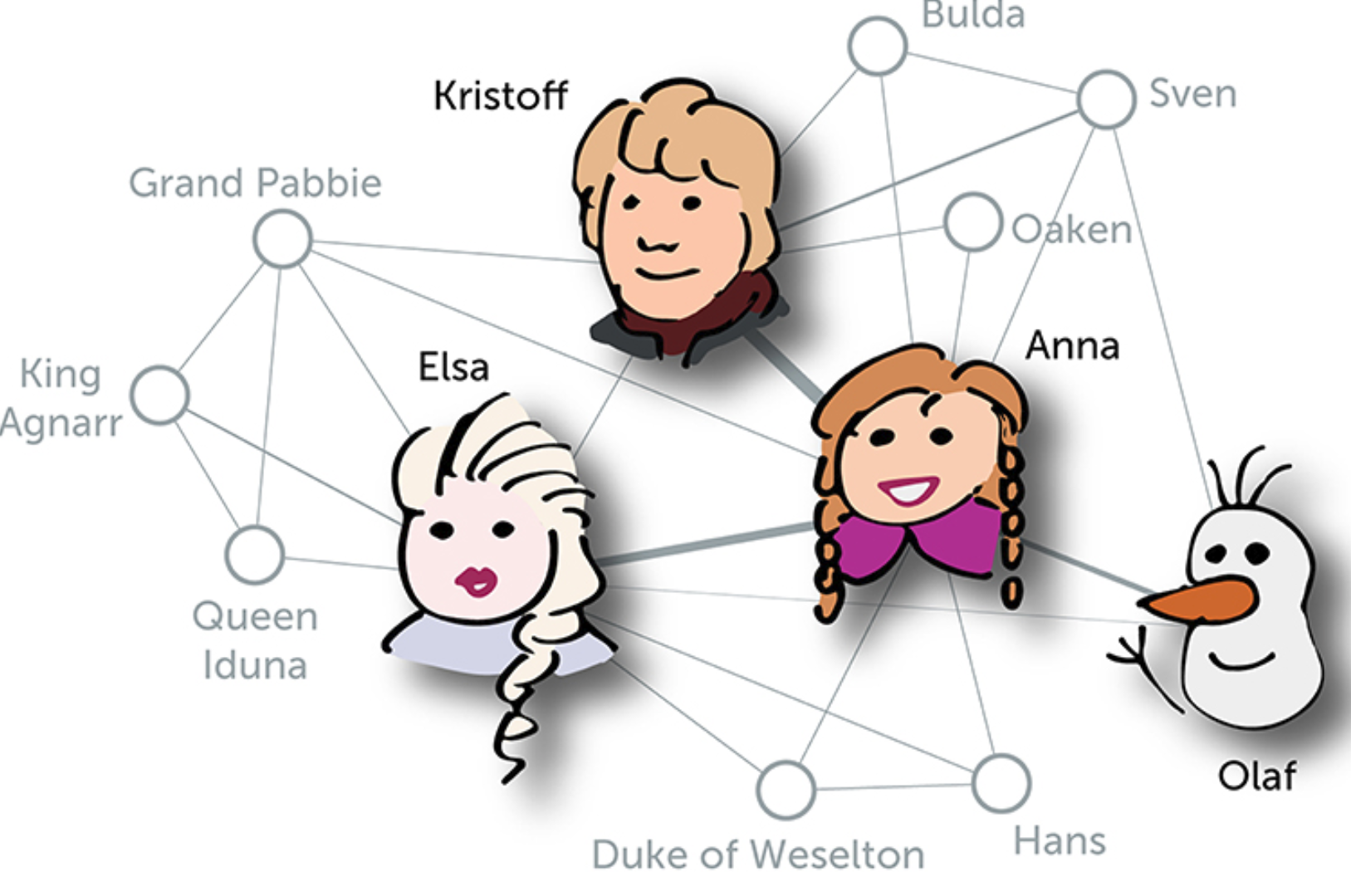
Centrality measures : Who is the most important person in this network?
It is a measure of how many connections one node has to other nodes.
It also identifies the most influential person(s) in a social network, key infrastructure nodes in the Internet or urban networks, and super-spreaders of disease.

Slide 5
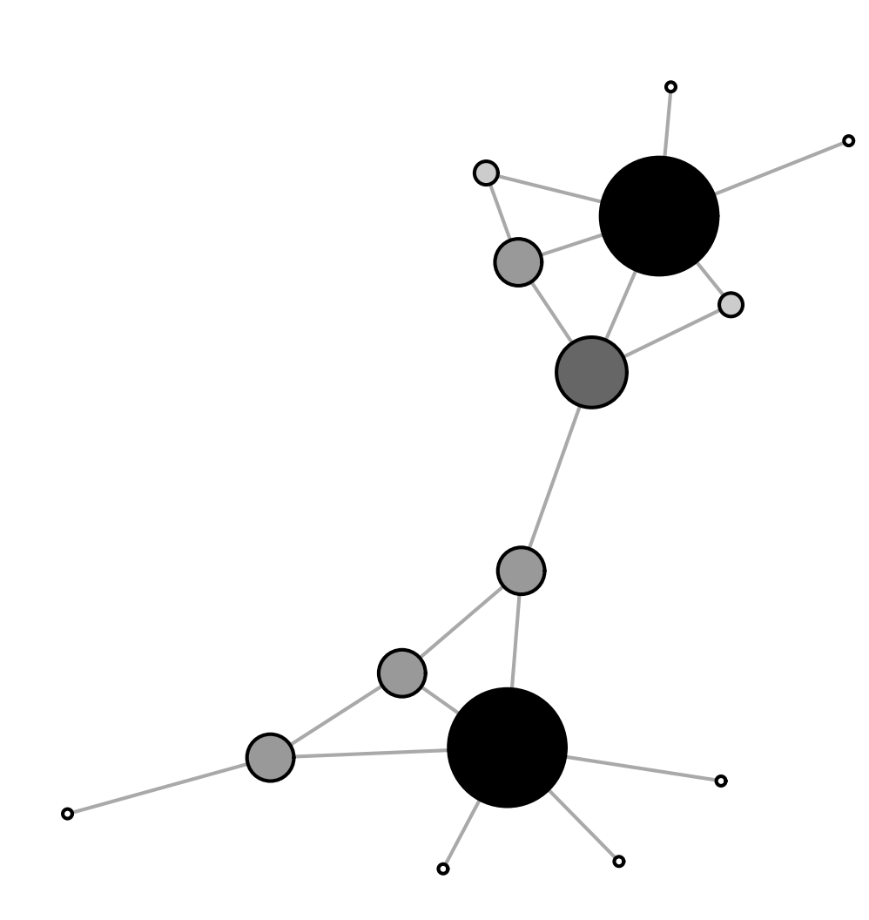
Degree Centrality
Degree centrality for an undirected graph is straightforward— It’s the number of ties (connections) a node has to other nodes.
Nodes who have more ties may have multiple alternative ways and resources to reach goals—and thus be relatively advantaged.
In the case of a directed network (where ties have direction), we usually define two separate measures of degree centrality, namely indegree and outdegree.
Accordingly, indegree is a count of the number of ties directed to the node and outdegree is the number of ties that the node directs to others.

Slide 6
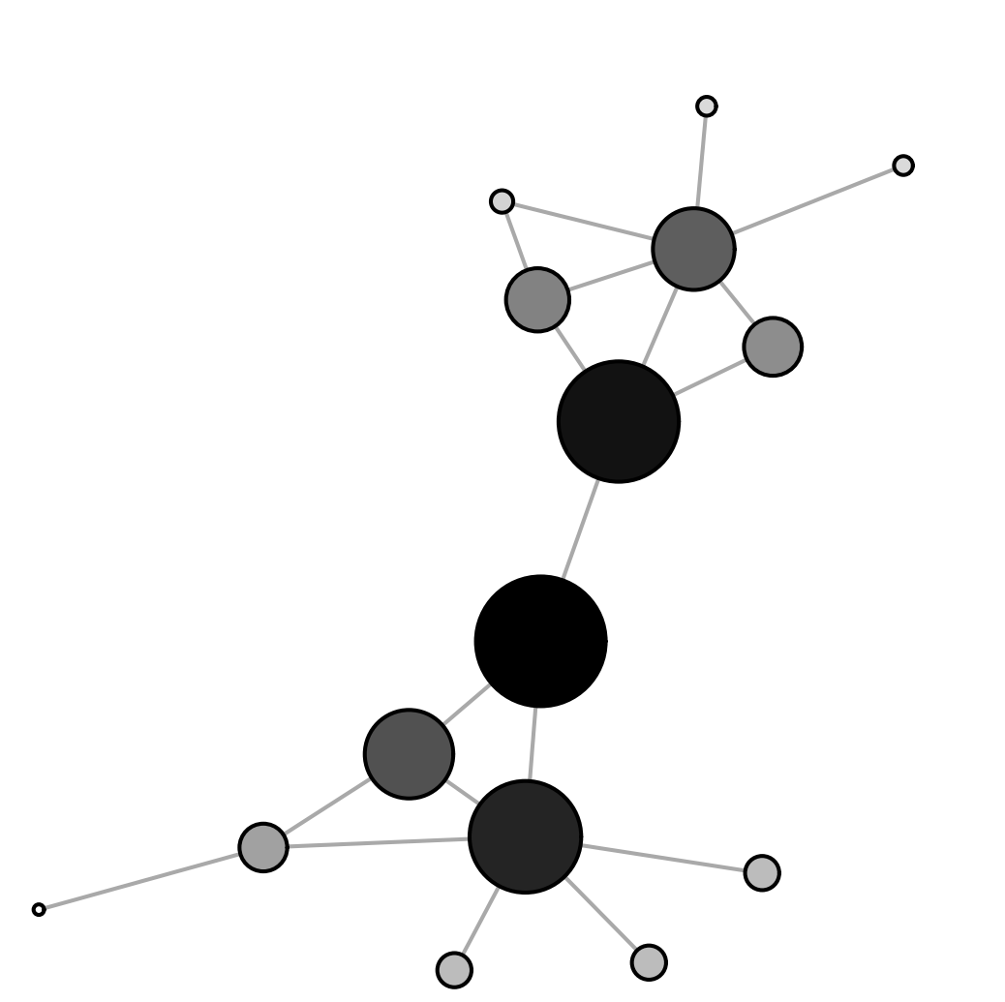
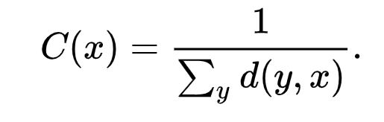

Closeness Centrality
Closeness centrality of a node is the reciprocal of sum of the length of the shortest paths between the node and all other nodes in the graph.
is the distance (farness) between vertices x and y
The more central a node is, the closer (inverse of farther) it is to all other nodes.

Slide 7
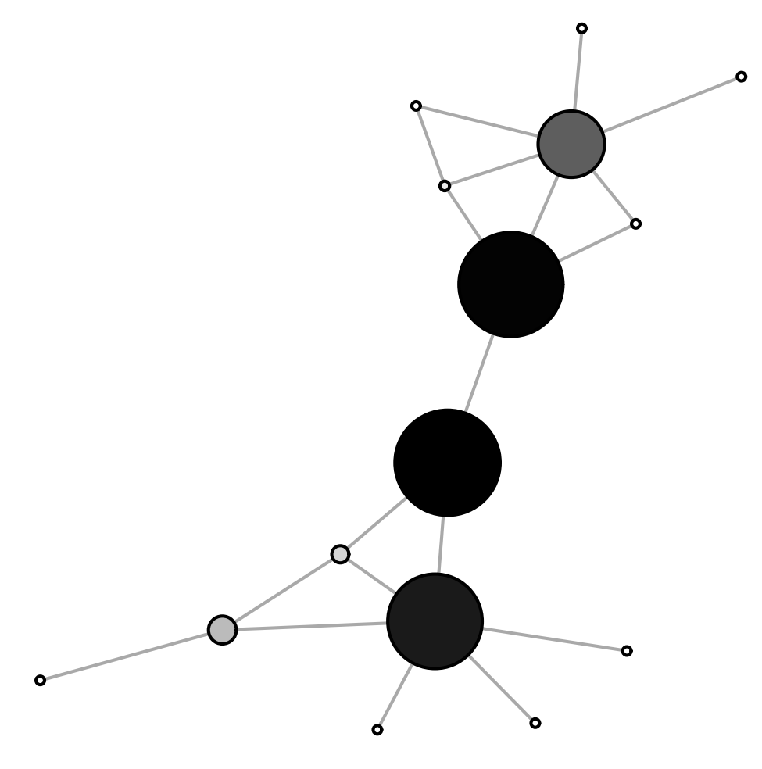
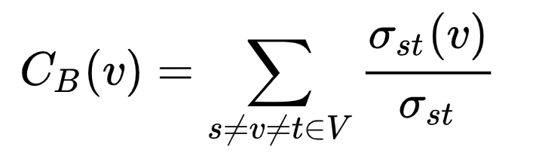


Betweenness centrality
Betweenness centrality quantifies the number of times a node acts as a bridge along the shortest path between two other nodes.
Where is total number of shortest paths from node s to node t and is the number of those paths that pass through v.
In other words, it measures the extent to which a node is connected to other nodes that are not connected to each other!

Slide 8
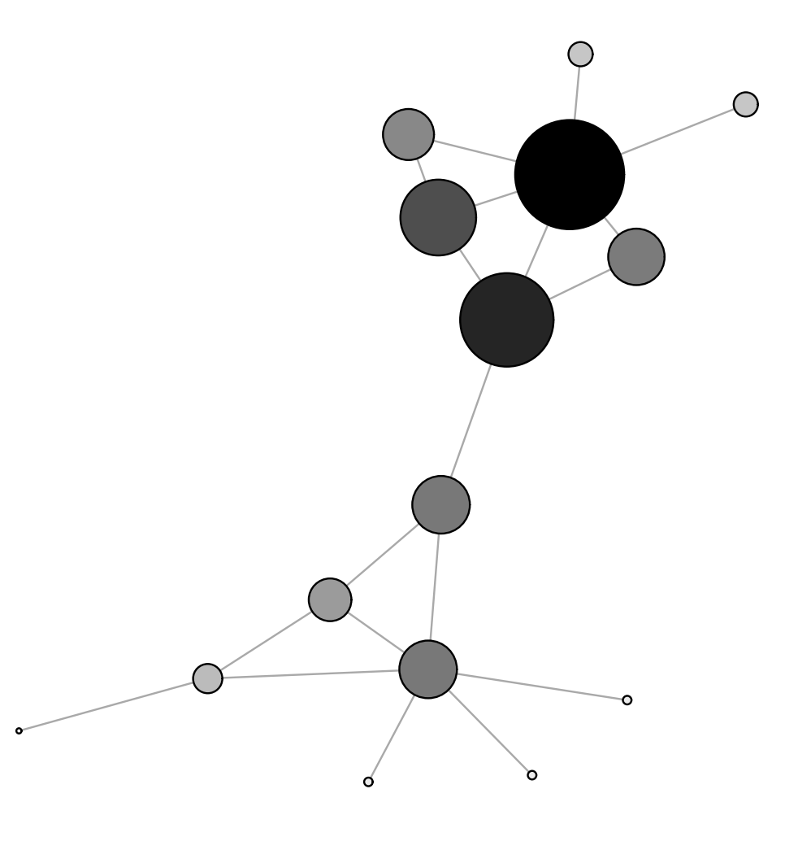
Eigenvector centrality
Until now we considered centrality based on connections of the node. What about connections of it’s neighbors? (- and its neighbors’ neighbors?)
Basic Idea behind eigenvector centrality: A central user is connected to other central users.
By definition, the eigenvector centrality of each vertex is proportional to the sum of the centralities of its neighbors.
A high eigenvector score means that a node is connected to many nodes who themselves have high scores.
Google’s PageRank is a variant of Eigenvector Centrality Measure.

Slide 9
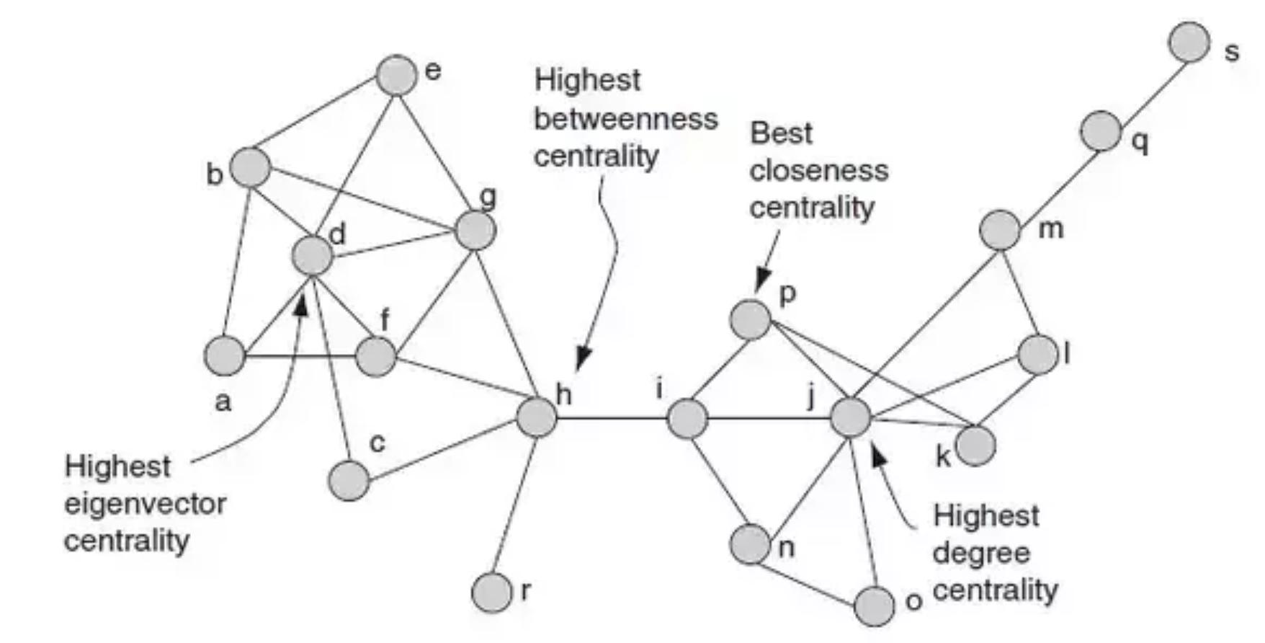
An example of how different Centrality Measures can vary when applied to the same Network

Slide 10
References
[1] Network centrality : An Inrtoduction https://arxiv.org/pdf/1901.07901.pdf
[2] Centrality Wiki : https://en.wikipedia.org/wiki/Centrality
[3] Network Basic Concept: https://www.lsu.edu/faculty/bratton/networks/closeness.ppt
[4] Eigenvector Centrality : https://en.wikipedia.org/wiki/Eigenvector_centrality

Slide 11
Thank You!!!

