Slide 1

DOMAIN NAME SYSTEM (DNS)

Slide 2
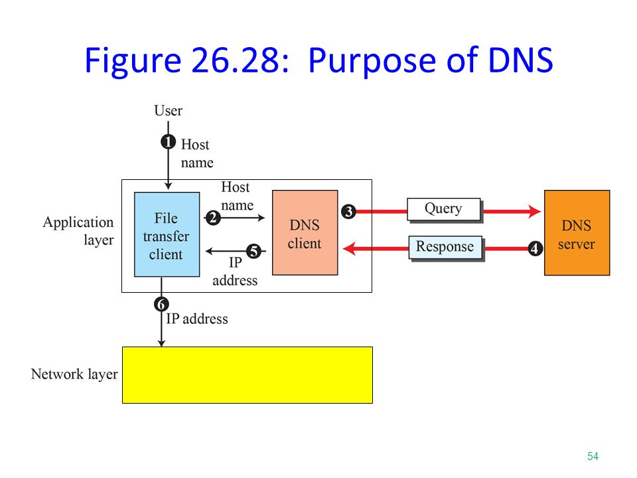

Slide 3
The steps that map the host name to an IP address are :
The user passes the host name to the file transfer client .
The file transfer client passes the host name to the DNS client.
Each computer, after being booted , knows the address of one DNS server. The DNS client sends a message to a DNS server with a query that gives the file transfer server name using the known IP address of the DNS server.
The DNS server responds with the IP address of the desired file transfer server.
The DNS server passes the IP address to the file transfer client.
The file transfer client now uses the received IP address to access the file transfer server.

Slide 4
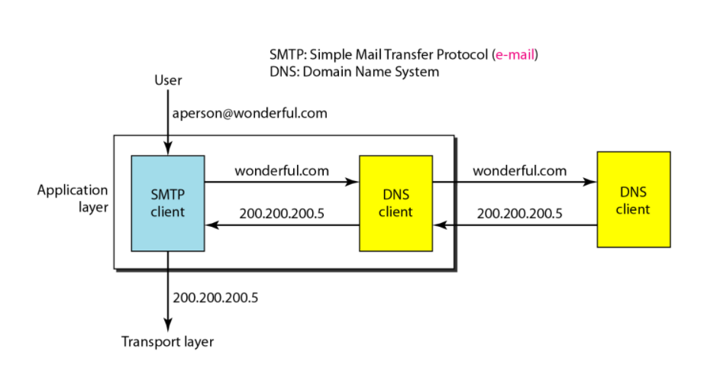
Example of using the DNS Service

Slide 5
Name Space
To be unambiguous, the names assigned to machines must be carefully selected from a name space with complete control over the binding between the names and IP addresses i.e. names must be unique because the addresses are unique.
Organization
FLAT
NAMESPACE
HIERARCHICHAL
NAMESPACE

Slide 6
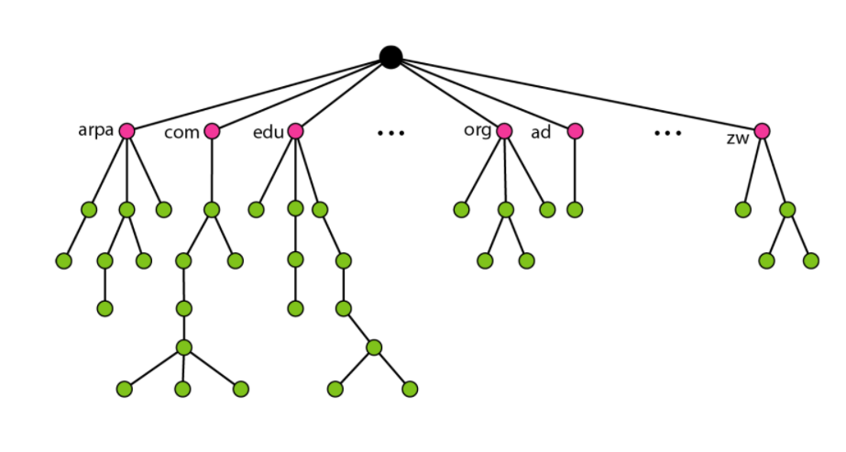

Domain Name Space
To have a hierarchical name space, a domain name space was designed. In this design the names are defined in an inverted-tree structure with the root at the top. The tree can have only 128 levels: level 0 (root) to level 127.
Root

Slide 7
Label
Each node in the tree has a label , which is a string with a maximum of 63 characters. The root label is a null string (empty string).
Domain Name
Each node in the tree has a domain name . A full domain name is a sequence of labels separated by dots(.)
Domain
A domain is a subtree of the domain name space . The name of the domain is the name of the node at the top of the subtree.

Slide 8
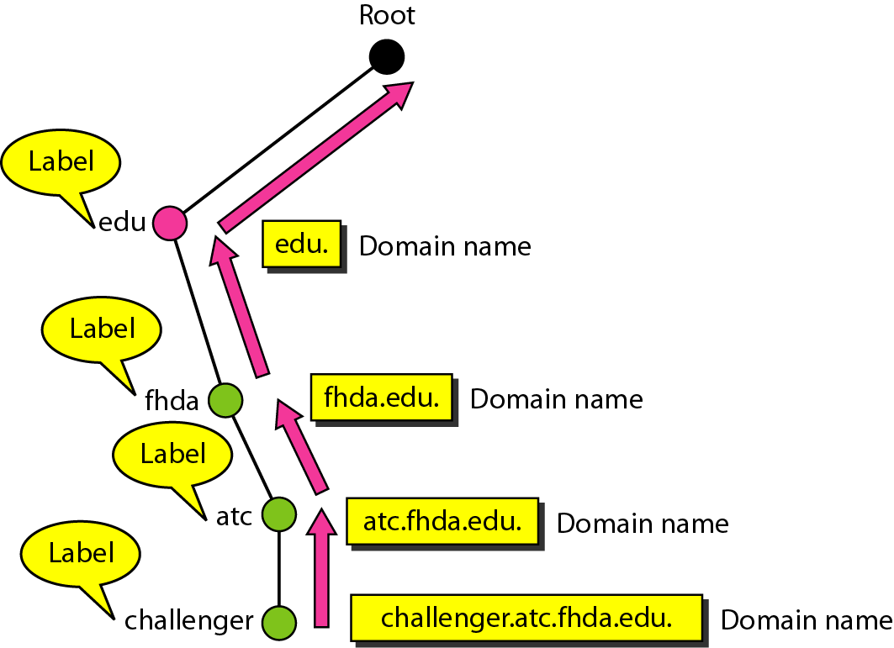
Distribution of Namespace

Slide 9

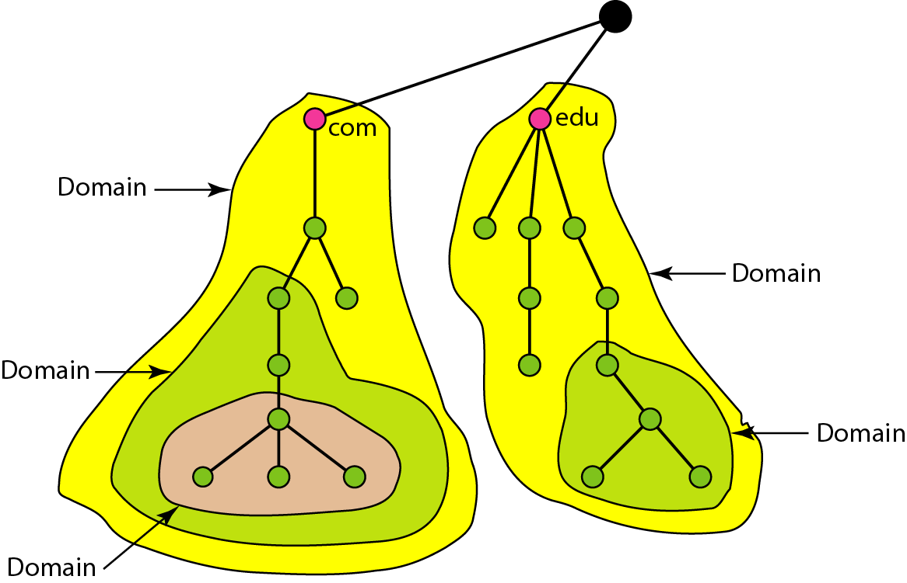

Slide 10
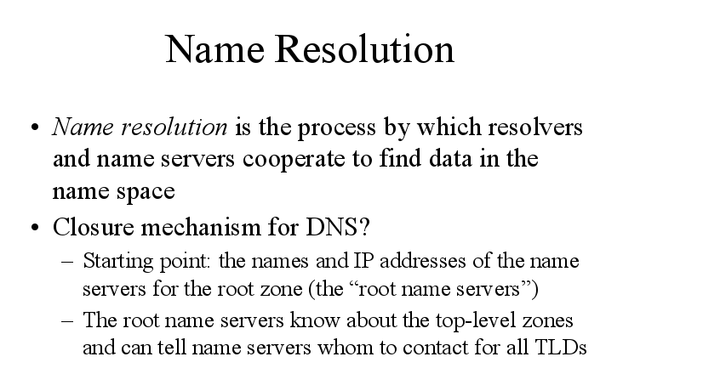

Slide 11
RESOLUTION
Mapping a name to an address or an address to a name is called name-address resolution.
DNS is designed as a client-server application.
A host that needs to map an address to a name or a name to an address calls a DNS client called a Resolver.
It can be either recursive or iterative.

Slide 12
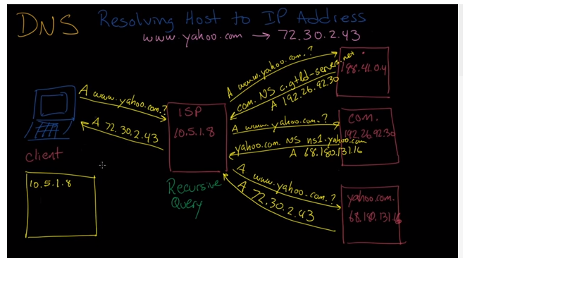
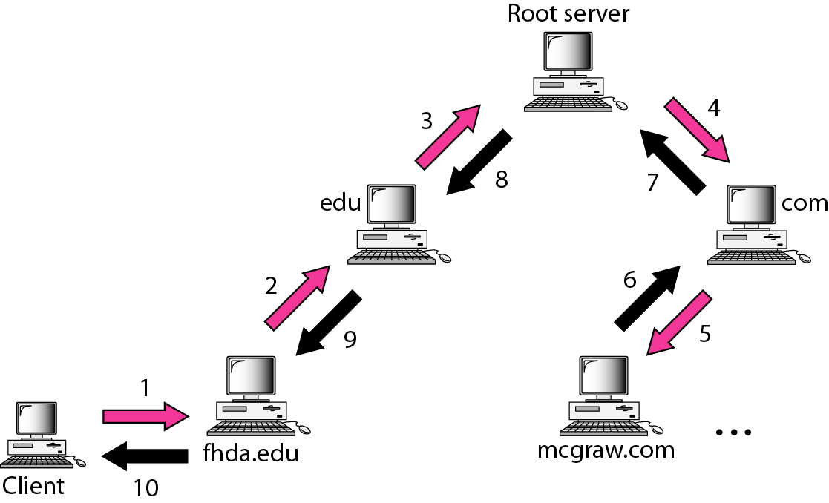
Recursive Resolution

Slide 13
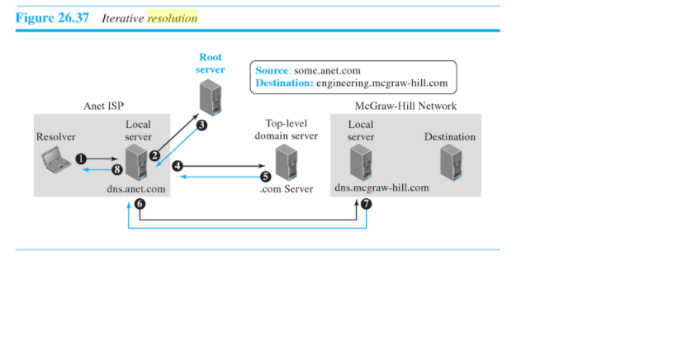
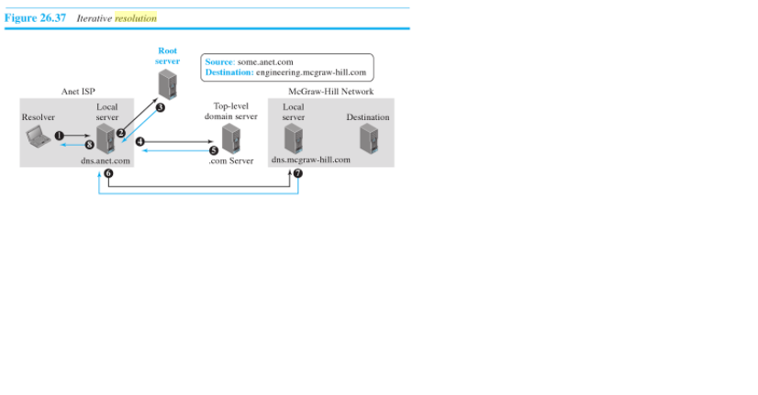
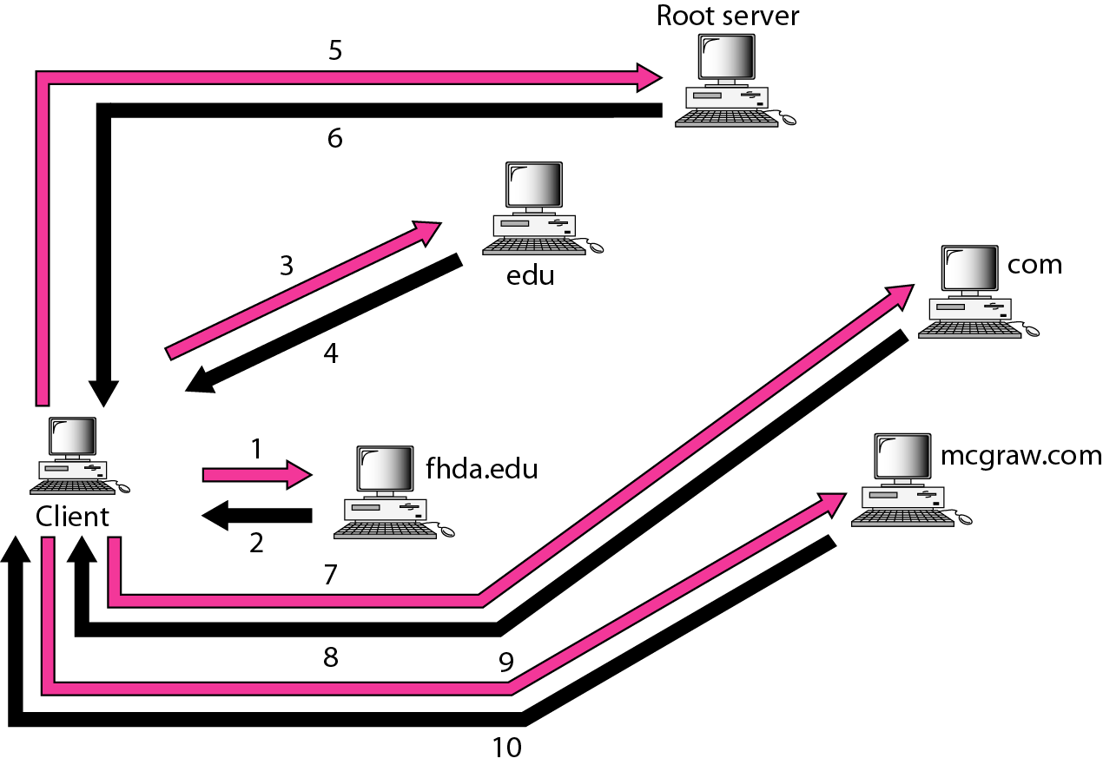
Iterative Resolution

Slide 14
Contrasting Iterative and Recursive Resolution
Lets take a real-world case to understand better. Suppose you are trying to find the phone number of your old friend Carol, with whom you haven't spoken in years. You call your friend Joe; he doesn't have Carol's number, but he gives you Debbie’s number, Carol's best friend. You call Debbie and she gives you Carol's information. This is an example of an iterative process. In contrast, suppose you called Joe and Joe said “I don't know, but I think I know how to find out “. He called Debbie and called you back with the phone number. That would be like recursive resolution.

Slide 15
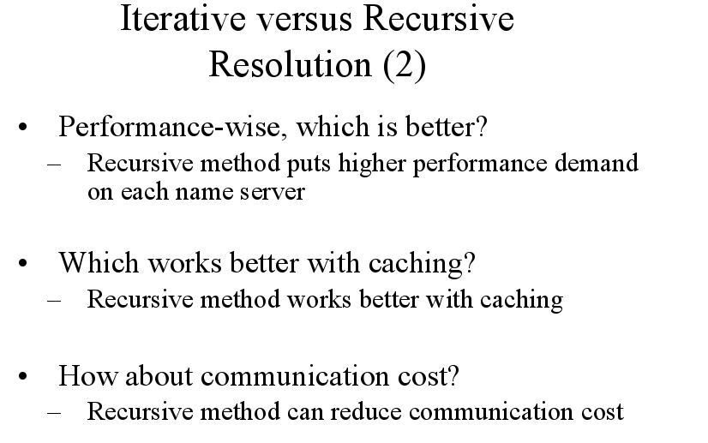

Slide 16
DNS Cache
A DNS cache (sometimes called a DNS resolver cache) is a temporary database, maintained by a computer's operating system, that contains records of all the recent visits and attempted visits to websites and other internet domains.

Slide 17
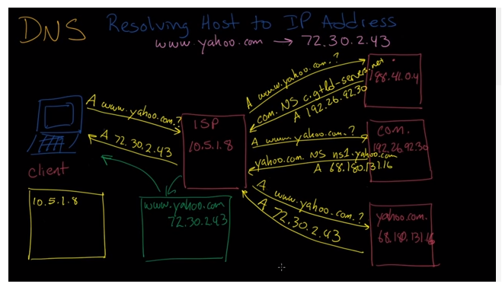

Slide 18
Purpose of DNS Cache
The internet relies on the DNS to maintain an index of all public websites and their corresponding IP addresses. You can think of it like a phone book.
With a phone book, we don't have to memorize everyone's phone number. In the same way, DNS is used so we can avoid having to memorize every website's IP address, which is the only way network equipment can communicate with websites.

Slide 19
How a DNS Cache Works
Before a browser issues its requests to the outside network, the computer looks up the domain name in the DNS cache database. The database contains a list of all recently accessed domain names and the addresses that DNS calculated for them the first time a request was made.
The contents of a local DNS cache can be viewed on Windows using the command ipconfig / displaydns

Slide 20
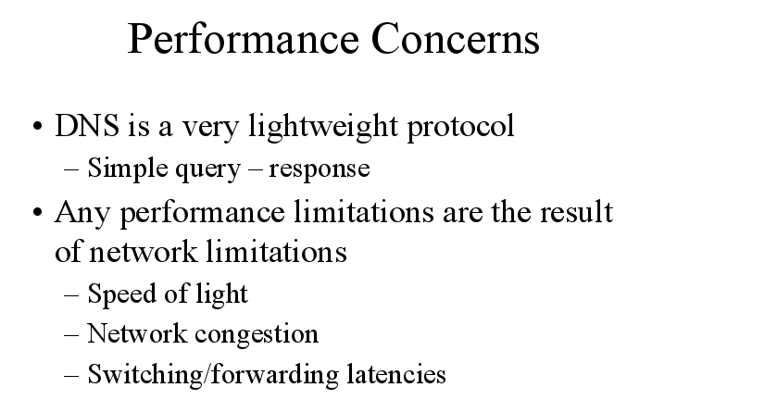

Slide 21
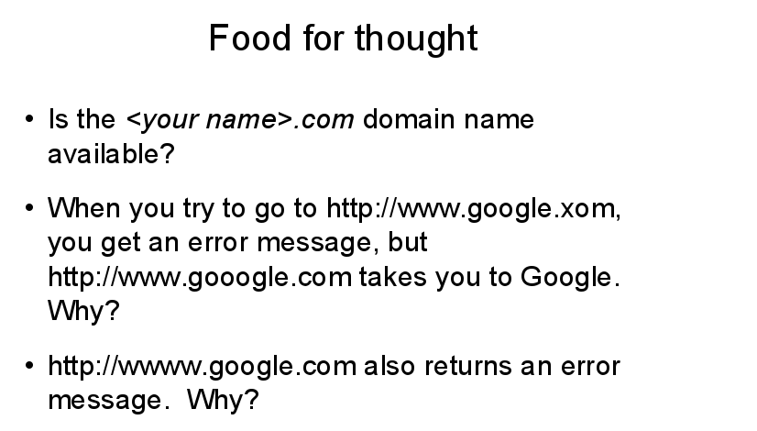
Ewer Tougt?

Slide 22


