Slide 1
AMAZON E-COMMERCE
STRATEGIES FOR CUSTOMER BENEFITS AND REWARDS

Slide 2
AGENDA
PROBLEM STATEMENT
APPROACH
KPIS
REPORTS

Slide 3
PROBLEM STATEMENT
Amazon, an E-commerce company currently performing well. The stakeholders wish to maintain this level of performance and seek an improvement with new strategies.
Other than discounts and Prime membership perks, the company wants additional methods to identify and reward customers and enhance their shopping experience.

Slide 4
APPROACH
REVENUE DISTRIBUTION ANALYSIS
PERIODIC AND GEOGRAPHICAL ANALYSIS
PRODUCT ANALYSIS
CUSTOMER SATISFACTION ANALYSIS
CUSTOMER SERVICE ANALYSIS

Slide 5

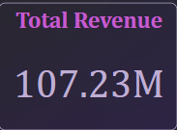
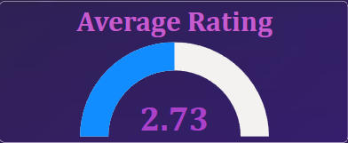
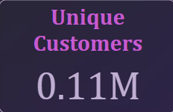
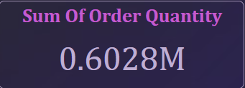


KEY PERFORMING INDICATORS
The total revenue generated
Overall Average Rating
The total number of Unique Customers
Total Number of Order Quantity.
Unique Products that are sold
Average Delivery Time taken to deliver the products.

Slide 6
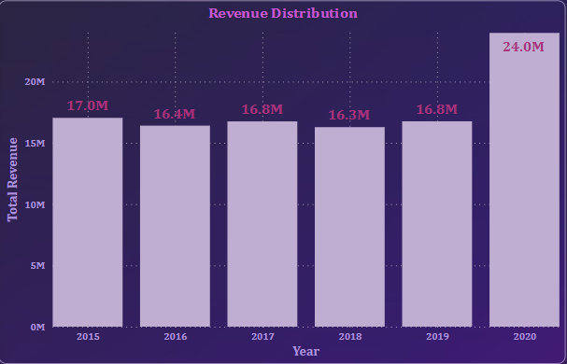
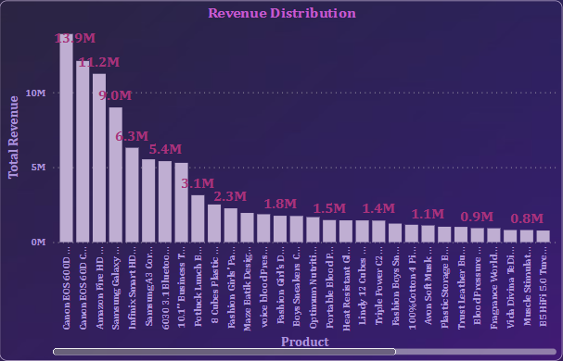
Revenue Distribution Analysis
With revenue distribution, we can understand which product contributing more to the revenue and also in which year revenue generated more.
INSIGHTS:
Revenue generated in the year 2020 is more compared to previous years.
Top revenue generated product is Canon EOS 600D 18MP DSLR Camera- Black with 13.9M sales.

Slide 7
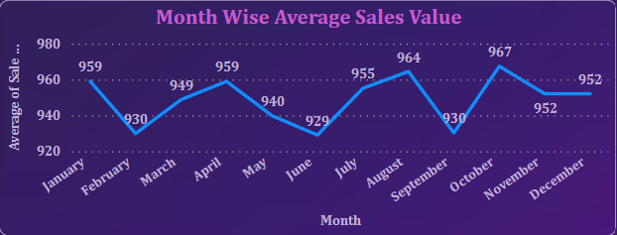
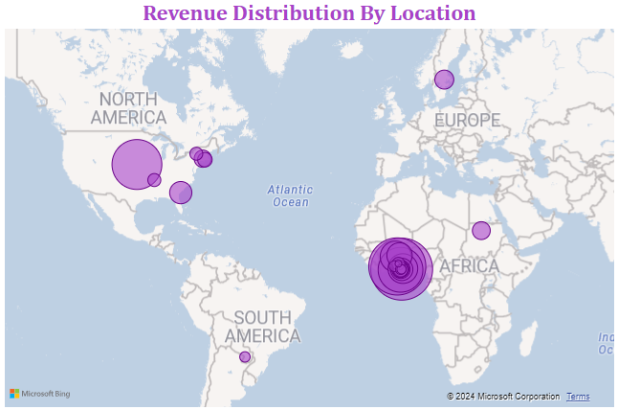
Periodic And Geographical Analysis
Periodic and Geographic analysis will help to devise target marketing and distribution strategies.
Insights:
The average sales value dropped for February, June and September.
North America and African regions are contributing more to revenue.
South America is the least revenue contributing region.

Slide 8
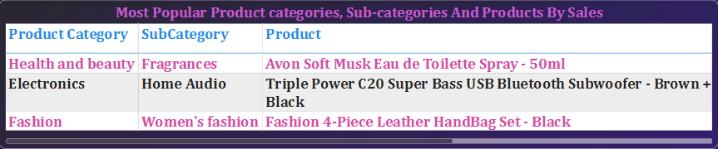
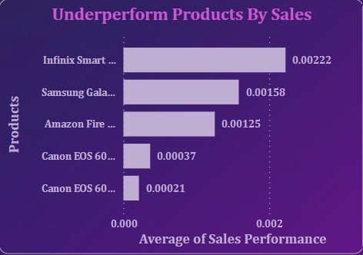
Product Analysis
In the product analysis, we can see the Most popular products and underperform products.
Insights:
We can see a clear distinction between the most popular, enjoying customer preference with high sales, and the underperforming products, indicating areas that may need targeted marketing efforts to enhance their overall sales.

Slide 9
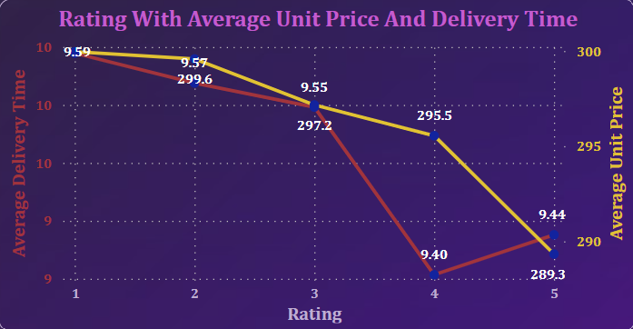
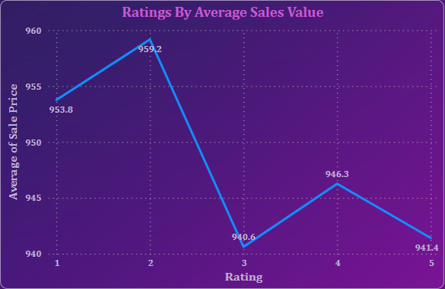
Customer Satisfaction Analysis
Customer satisfaction will help to understand how they are interested in the platform and how happy they are with shopping experience.
Insights:
Average rating given by customers is 2.73, which is above average.
Customers gave 4 & 5 rating for low unit price products
With less Delivery time, the ratings are very good compared to high delivery time.

Slide 10
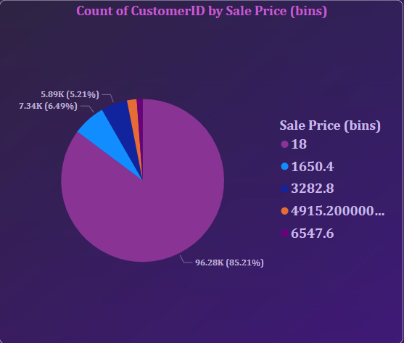
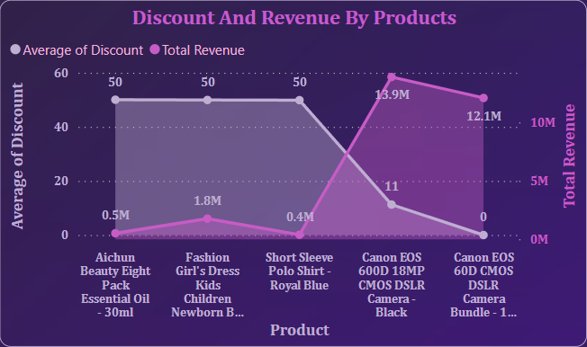
Customer Loyalty Program
Every company go for customer loyalty program to encourage customers engaging them to purchase more.
Insights:
Grouping the customers by their spending value, 85.21% customers spend low compared to others.
Despite their high revenue, these products have low average discount value. Giving discounts to these products will drive sales and revenue.

Slide 11
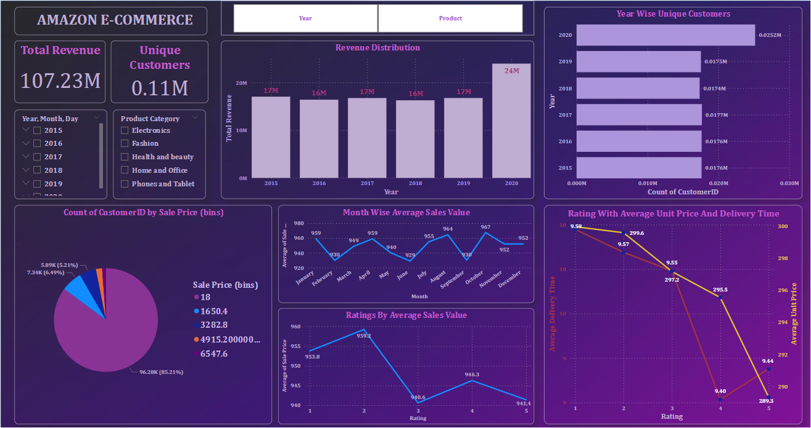
REPORT – MAIN TAB

Slide 12
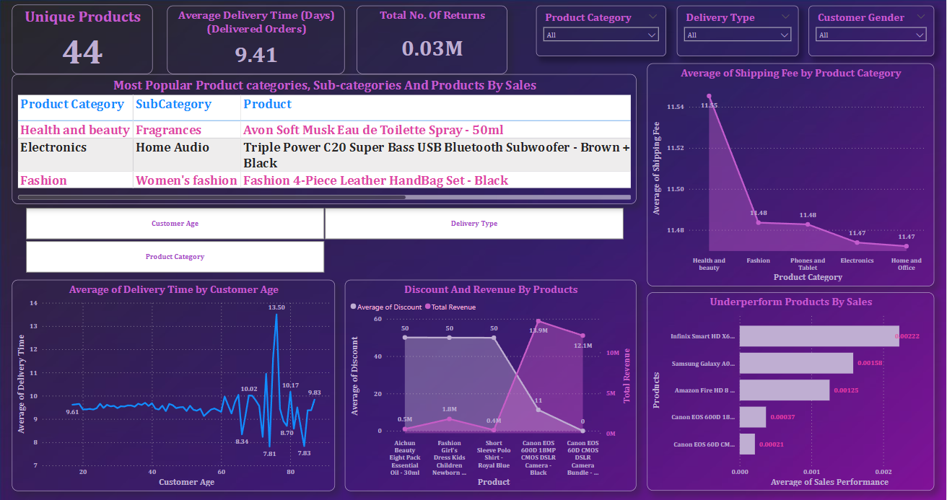
PRODUCT TAB

Slide 13
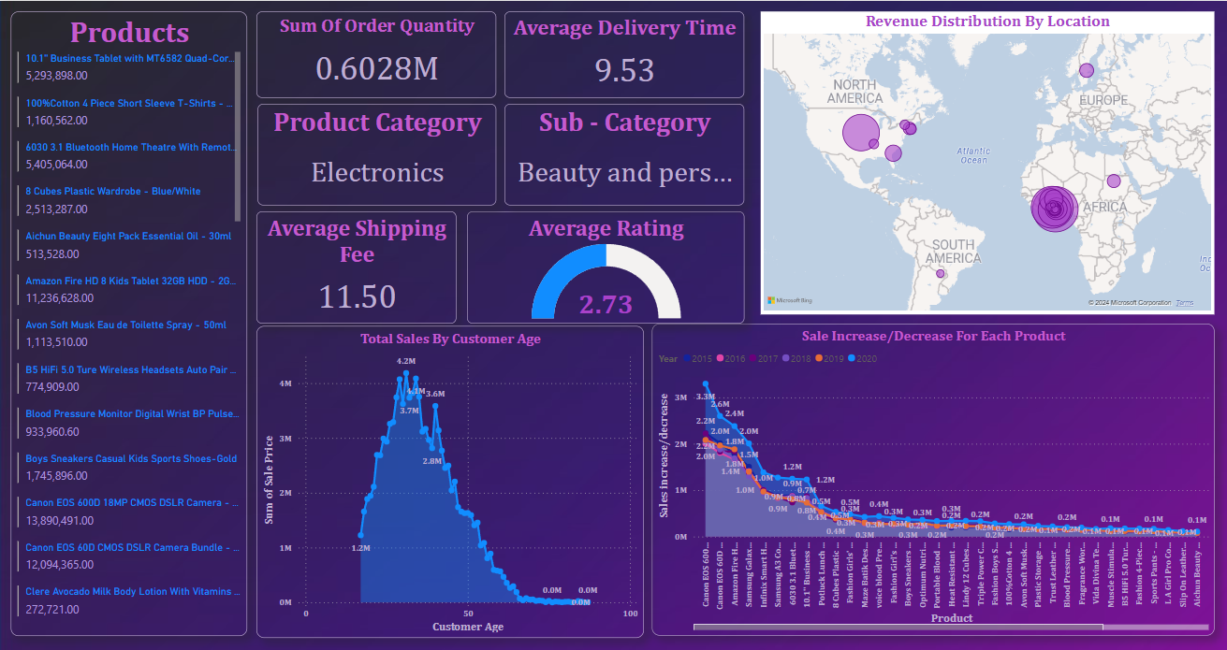
INDIVIDUAL PRODUCT TAB

Slide 14
THANK YOU

