Slide 1

GAYATRI VIDYA PARISHAD COLLEGE OF ENGINEERING FOR WOMEN(A)
TITLE:CLIMATE CHANGE AND ITS GLOBAL IMPACT
NAME:P.MEGHANA
BRANCH:CSE-3
ROLL.NO:325103210164

Slide 2
INTRODUCTION TO CLIMATE CHANGE : Climate change refers to long-term shifts in temperatures and weather patterns, primarily driven by human activities, particularly the burning of fossil fuels (coal, oil, and gas) since the Industrial Revolution.

Slide 3
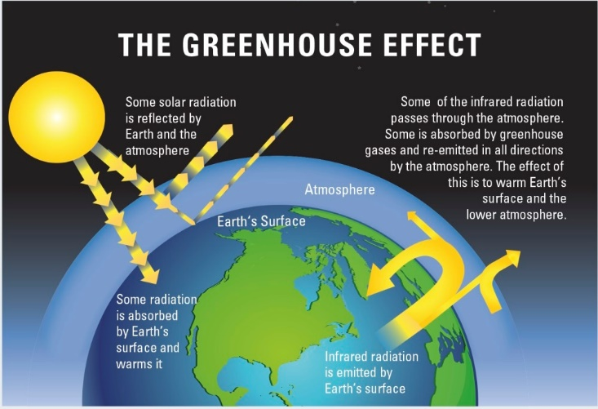

Slide 4
Causes of Climate Change:
.Deforestation: Cutting down forests reduces the Earth's ability to absorb (𝐶𝑂2).
Industrial Processes: Certain industrial activities release greenhouse gases.
Fossil Fuel Combustion: Burning coal, oil, and gas for energy, transportation, and industry is a major source of (Co2).
Evidence of Climate Change :
Warming and rising oceans.
Melting glaciers and ice sheets.
Rising global temperatures.

Slide 5
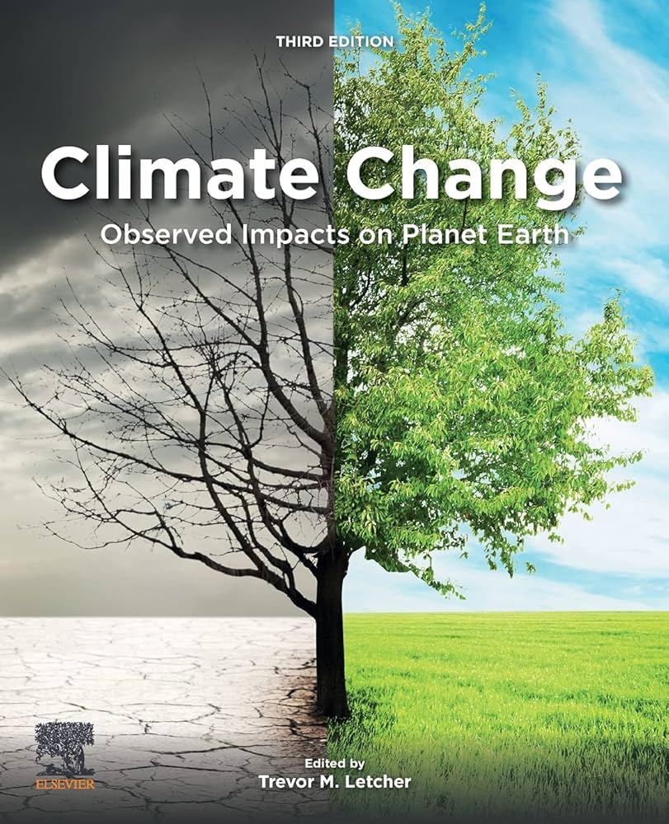
Global impacts on climate change: RisingTemperatures : Global temperatures are increasing, with the last decade being the warmest on world.
Extreme Weather: There is an increase in the frequency, intensity, and duration of extreme weather events like heatwaves, floods, droughts, and wildfires.
Melting ice and rising sea levels: Glaciers and sea ice are melting, leading to a rise in sea levels.
Human Health Impacts:
Heat-related illnesses
Spread of vector-borne diseases (malaria, dengue)
Respiratory issues due to pollution

Slide 6
Impacts on human systems:
Health: Exacerbates health risks through heat stress, malnutrition, and the spread of diseases like malaria and dengue fever.
Food security: Threatens agriculture through changing rain patterns, droughts, and extreme temperatures, leading to food shortages.
Water resources: Affects water availability through changes in rainfall and reduced streamflows in some areas.
Displacement and economy: Extreme her and sea-level rise can lead to displacement of populations and cause significant economic losses.

Slide 7
Solutions For Impact:
Improve energy efficiency (buildings, appliances, transport).
Promote sustainable transport: EVs, public transport, cycling.
Reforestation & afforestation.
Carbon capture and storage (CCS).
  Reduce methane emissions (agriculture & waste management) Shift to renewable energy: solar, wind, hydro, geothermal.

Slide 8
….THANK YOU….

