Slide 1
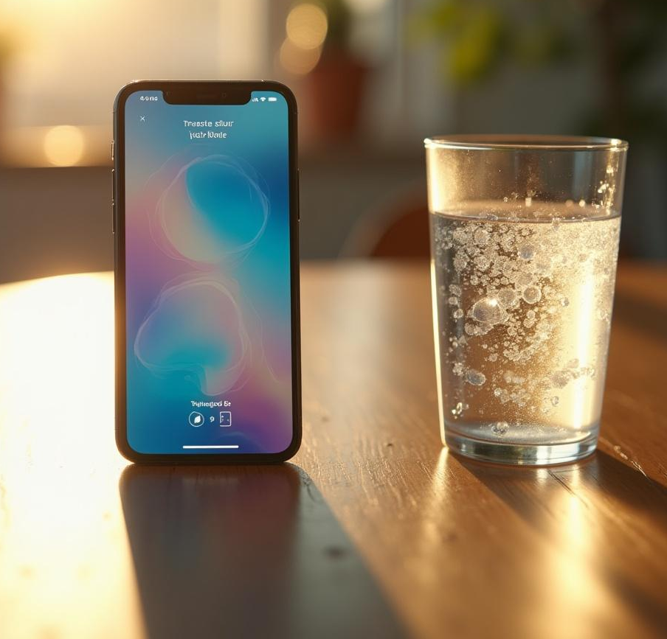
WATER REMINDER APP DEVELOPMENT

Slide 2
Individual Project
Meghana.Ane(22BCE9482)
App Development
Database collection
Images and ui/ux

Slide 3
Introduction
This presentation outlines the development of a water reminder app designed to help users maintain optimal hydration levels. The app will serve as an essential tool for monitoring daily water intake, providing timely reminders, and fostering better hydration habits.

Slide 4
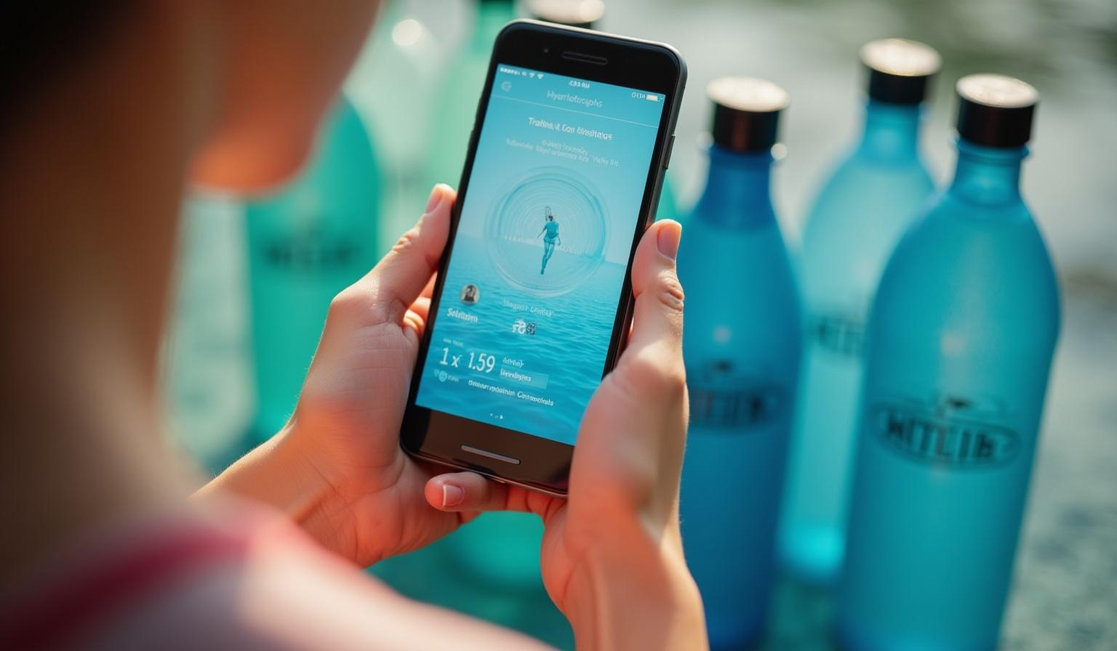
App Objectives
01
HYDRATION ON DEMAND

Slide 5
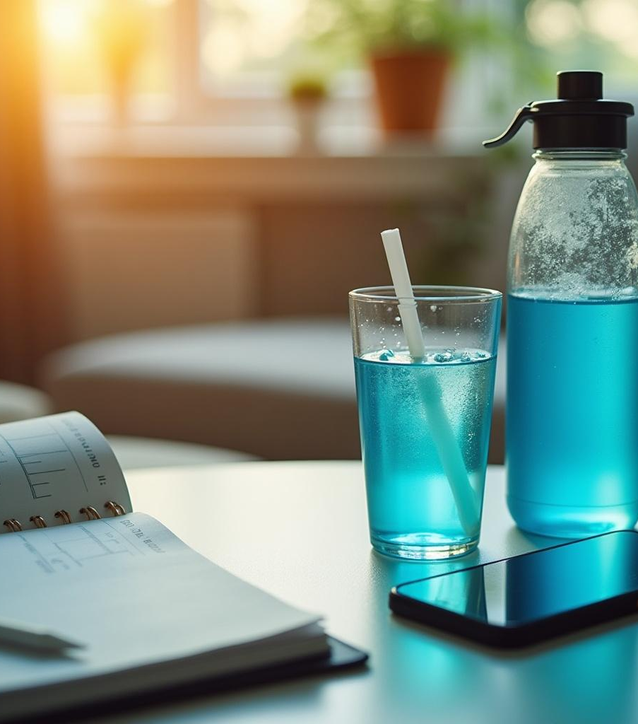
Encourage regular hydration
The primary goal of the app is to encourage users to develop a consistent hydration routine. By setting daily goals and sending reminders, users will be motivated to drink enough water throughout the day.

Slide 6
Track daily water intake
The app will have a built-in feature that allows users to log their daily water consumption easily. This tracking will help users visualize their hydration patterns and ensure they meet their personal goals.

Slide 7
Provide reminders and notifications
The app will feature customizable reminders and notifications to prompt users to drink water at optimal intervals throughout the day. This ensures that users stay on track with their hydration goals and develop a strong habit of drinking water regularly.

Slide 8
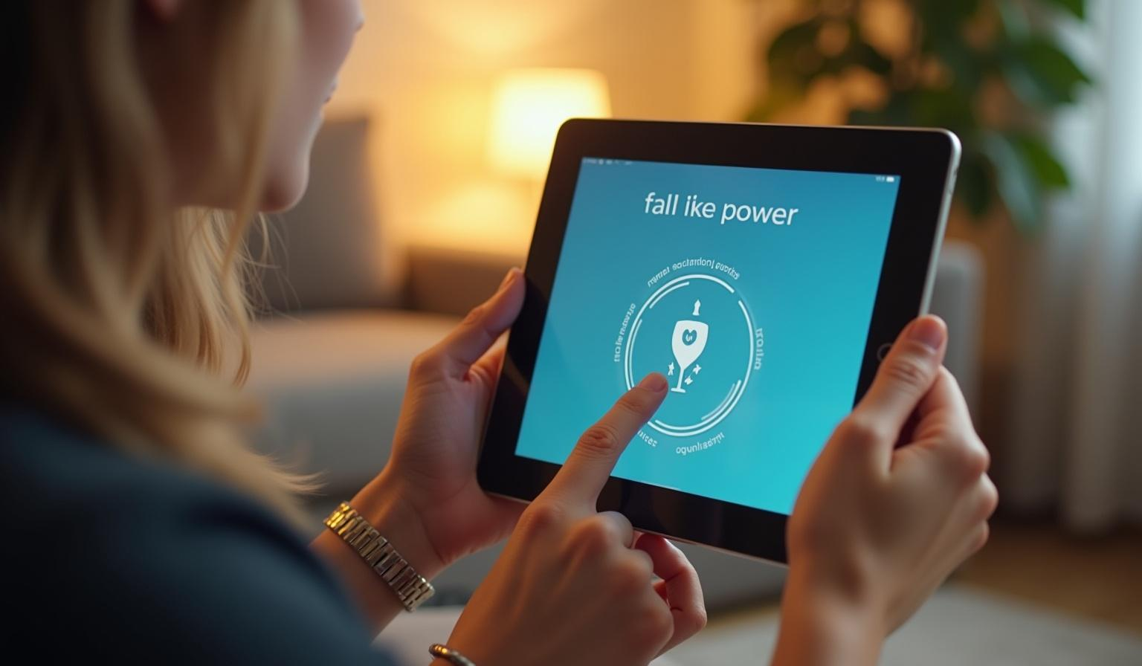
User Features
02
YOUR DAILY DOSE OF HYDRATION

Slide 9
Customizable daily goals
Users will have the ability to set personalized daily water intake goals based on their individual needs, activity levels, or health recommendations. This customization will help users maintain an effective hydration routine tailored to their lifestyle.

Slide 10
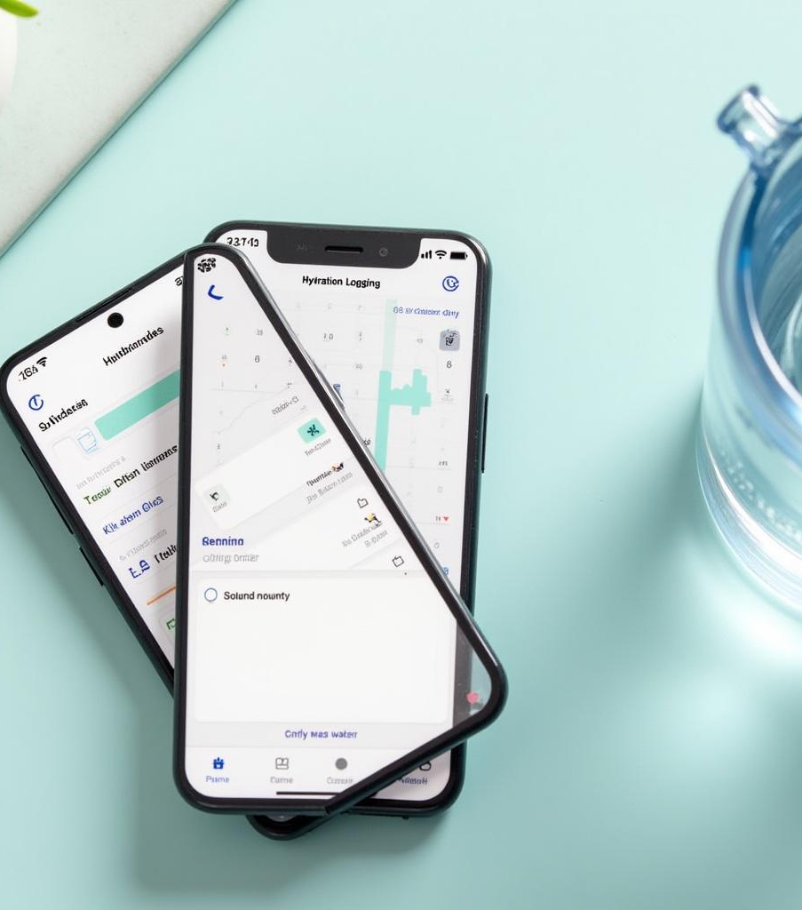
User-friendly interface
The app will boast an intuitive and user-friendly interface, making it easy for users of all ages to navigate and log their water consumption. This streamlined experience aims to encourage regular engagement with the app.

Slide 11
Integration with health apps
To enhance usability, the app will integrate with popular health applications and devices, allowing for seamless data sharing. Users will be able to sync their hydration data with fitness trackers and overall health apps for a comprehensive view of their wellness.

Slide 12
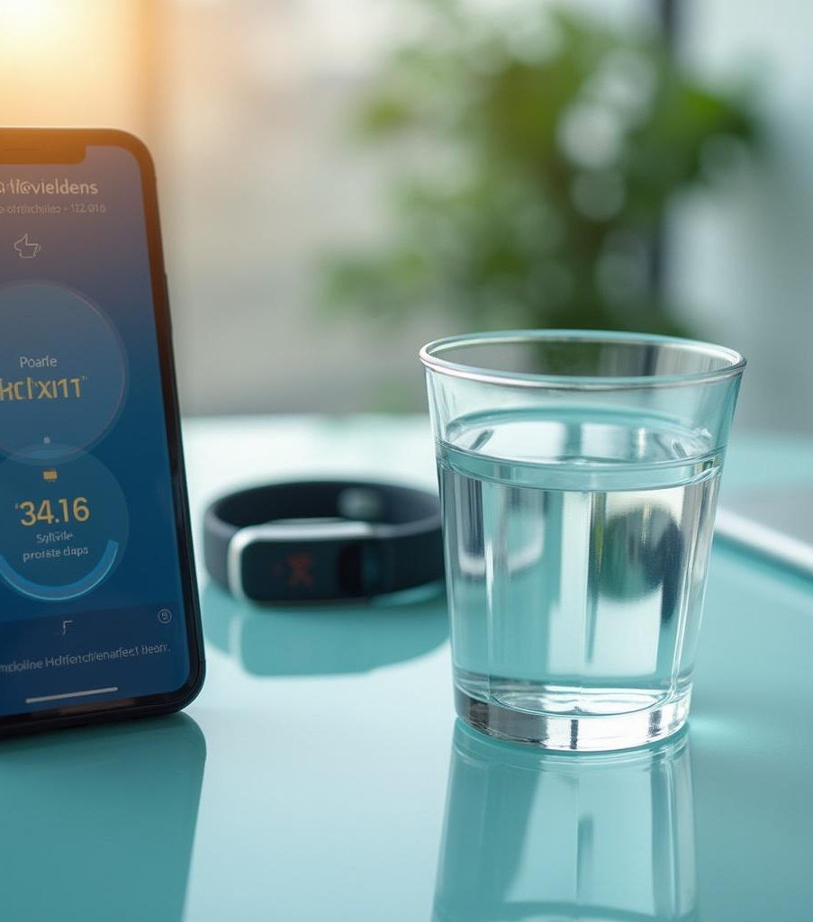
Conclusions
In summary, the water reminder app aims to promote healthy hydration habits through effective reminders, user-friendly features, and seamless integration with existing health and fitness applications. By addressing personal hydration goals, the app will support users in maintaining optimal health.

