Slide 1

JOB MARKET INTELLIGENCE
Data Analyst
Job Market
Intelligence Dashboard
Analyzing Hiring Trends, Skill Demand, and Salary Insights
Dataset Size
Analysis Tools
2,000+ Jobs
Snowflake + Power BI

Slide 2
PROJECT OVERVIEW
Understanding the Data Analyst Job Market
Project Objectives
Market Context
Transform raw job market data into actionable intelligence for career planning and workforce strategy development.
In the modern digital economy, organizations increasingly rely on data to drive decision-making. As a result, the demand for data analytics professionals has grown significantly across industries.
Key Goals
↑
↗
1
Analyze hiring patterns for Data Analyst roles across industries
Growing Demand
Skill Evolution
2
Identify most demanded technical skills and competencies
3
Understand salary trends across locations and industries
Project Value
4
Discover actively hiring companies and their preferences
This dashboard enables job seekers , training institutions , and organizations to make data-driven decisions about career planning, skill development, and hiring strategies.

Slide 3
DATA FOUNDATION
Dataset & Methodology
Dataset Overview
Tech Stack
Snowflake
2,000+
10+
5
Data warehouse & SQL
Job Postings
Key Fields
Core Skills
Power BI
Visualization & DAX
Julius AI
Core Fields
Skill Indicators
AI-powered analysis
Job Title, Company, Location, Industry, Salary Range
SQL, Python, Excel, Tableau, Power BI (Boolean)
Analysis Capabilities
Data Preparation Pipeline
Skill demand frequency
Skill combinations
Skills vs. salary
Industry patterns
Cleaning
Engineering
Modeling
Analysis
Geographic trends
Remove duplicates, standardize names
Create metrics, skill counts
Fact & dimension tables
SQL queries, aggregations

Slide 4
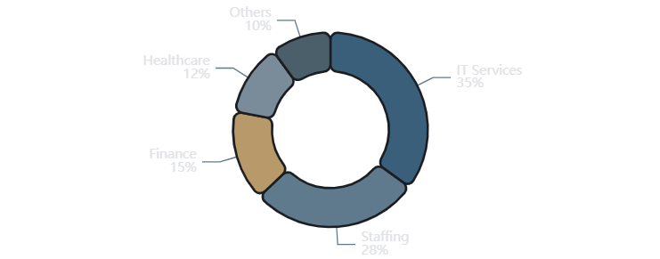
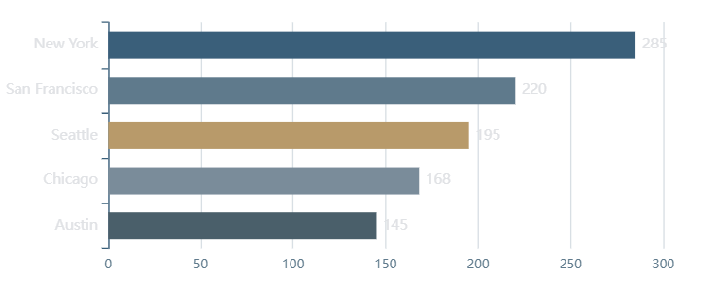
MARKET LANDSCAPE
Job Market Overview
Total
Average
Hiring
Cities
2,000+
$75K
500+
100+
Job Postings
Annual Salary
Companies
Locations
Industry Distribution
Top Hiring Cities
Key Insight:
IT Services and Staffing firms dominate hiring volumes, while major metropolitan areas show the highest concentration of opportunities.

Slide 5

COMPETENCY REQUIREMENTS
Skills Demand Analysis
Technical Skill Demand Comparison
Skill Demand Frequency
SQL
68%
Excel
62%
Python
45%
Tableau
38%
Power BI
35%
Popular Skill Combinations
SQL
+
Excel
52%
SQL
+
Python
38%
SQL remains the most demanded skill, appearing in 68% of all job postings, followed by Excel at 62%.
SQL
+
Tableau
31%

Slide 6
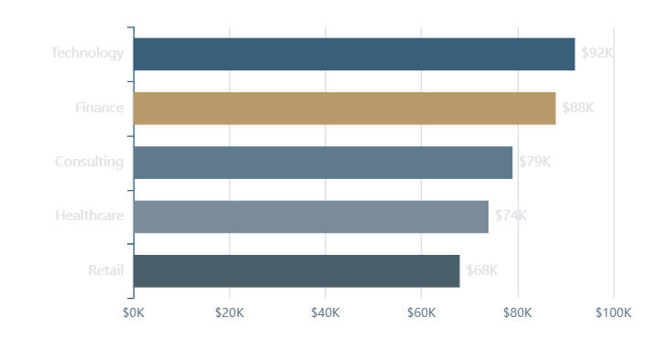
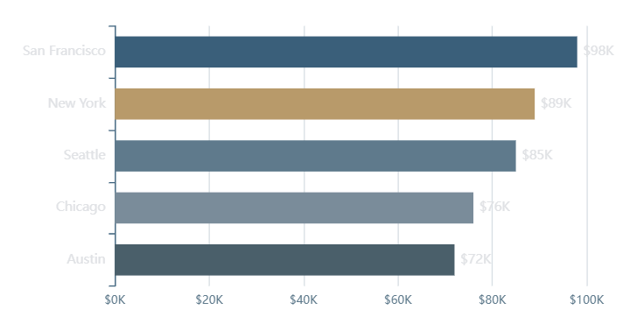
COMPENSATION ANALYSIS
Salary Insights
Average Salary by Industry
Salary by Location
Skills Impact on Salary
Python
+15% premium
$86K
SQL + Tableau
+12% premium
$84K
Finance and Technology industries offer the most competitive compensation, with average salaries exceeding $85K.
Excel Only
Base level
$72K

Slide 7
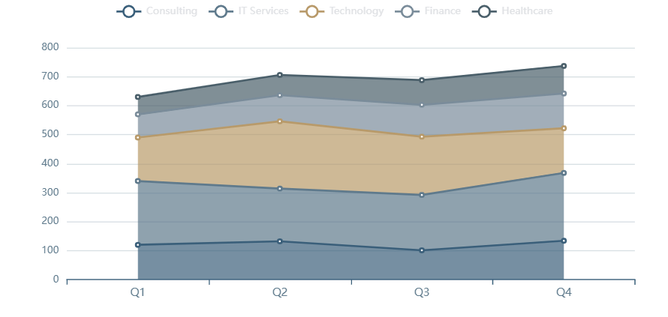
EMPLOYER LANDSCAPE
Company Hiring Trends
Top Hiring Companies by Industry
A small number of companies account for a significant portion of job postings, indicating concentrated hiring among large organizations.
Hiring Concentration
Top 10 companies represent 28% of all job postings in the dataset.

Slide 8
STRATEGIC FINDINGS
Key Market Insights
Skill Demand
Geographic Insights
SQL remains the most demanded skill, appearing in 68% of job postings as the foundational data querying language.
Major metropolitan cities show higher concentrations of data analyst job opportunities.
Excel continues widespread use across industries with 62% demand, proving its enduring relevance.
San Francisco leads in both job volume and average salary ($98K annually).
Python shows strong demand at 45%, particularly for analytical and automation tasks.
New York and Seattle follow closely, offering strong markets for analysts.
Industry Patterns
Hiring Concentration
IT Services companies contribute the largest portion (35%) of data analyst job postings.
Relatively small number of companies account for a significant portion of job postings.
Staffing and consulting firms frequently hire analysts to support diverse client projects.
Top 10 companies represent 28% of all opportunities, indicating concentrated hiring.
Finance and Technology sectors offer the most competitive compensation packages.
Large organizations and consulting firms drive most recruitment activity.

Slide 9
ACTIONABLE GUIDANCE
Recommendations & Conclusion
Skill Development Priorities
Strategic Recommendations
Develop Skill Combinations
1
Master SQL
SQL + Excel (52%), SQL + Python (38%), or SQL + Tableau (31%) increase marketability.
Foundational skill required in 68% of postings. Essential for data extraction and manipulation.
Target High-Activity Cities
Focus on NYC, SF, Seattle, Chicago, Austin for maximum opportunities and competitive salaries.
2
Excel Proficiency
Build Practical Portfolio
Widely used across industries (62%). Master pivot tables, formulas, and data analysis features.
Create dashboards and analysis projects demonstrating real-world problem-solving abilities.
3
Learn Python
Project Conclusion
High-growth skill (45% demand) associated with +15% salary premium. Focus on pandas, numpy.
This dashboard demonstrates how business intelligence tools transform raw job market data into actionable insights for career planning and workforce strategies.
4
Visualization Tools
Using SQL-based analysis and Power BI visualization, the project reveals critical patterns in hiring demand, skill requirements, and compensation trends—empowering data-driven decision making for aspiring analysts and organizations alike.
Tableau (38%) or Power BI (35%). Choose one and build expertise in dashboard creation.

Slide 10

Thank You
Questions & Discussion
2,000+ Jobs
Actionable
Data-Driven
Analyzed
Insights
Decisions
Prepared by Meghana M
Bachelor of Engineering, Computer Science

