Slide 1


Asset Management System (AMS)
IGATE is now a part of Capgemini

Slide 2
Team Members
Tech Fires
Tech Fires
Meghana Yalamanchili
Siri Chandana Bollepalli
Harsha Vardhan Bandaru
Mohammed Rawoof Ahmed

Slide 3
Contents
Overview
Actors
Testcase
Requirement Itemization
Usecase
Defects
Application Link
Test Case Adequacy
Test Case Effectiveness
Project Statistics
Traceabality Matrix
Tech Fires

Slide 4
OVERVIEW OF THE PROJECT
The word Asset Management System is becoming more common, but there is confusion about what it actually means and what the purpose of Asset Management is. Why should we do it?
Asset management is an on-going process of improvement and refinement. For this reason it is important to have a review and update process.
Asset Management has been accurately described as being a business model that is particularly suited to organizations that use assets to provide services. Asset Management practices are particular tasks or procedures that assist an organization to make better decisions so that the provision of their services will be sustainable long term.

Slide 5
ACTORS
Admin
User

Slide 6
TEST CASES
A test case is a set of conditions or variables under which a tester will determine whether a system under test satisfies requirements or works correctly.
The process of developing test cases can also help find problems in the requirements or design of an application.
Link: ..\..\Tech Fires(Project)\TestcaseAMS.xlsx
Author: Harsha Vardhan Bandaru

Slide 7
TEST CASES
LOGIN
Admin
View Status
Add/modify
Approve/Reject Request
Delete
Export Data into CSV/Excel sheet
Manager
Raise Request
View Status

Slide 8
REQUIREMENT ITEMIZATION
Requirements validation is an iterative process which takes place throughout the lifecycle of the project.
During elicitation, analysis and specification you should constantly be questioning and clarifying the data given to you in order to check its validity.
This will ensure that the SRS that you produce is complete, consistent and ready for the formal validation process.
LINK:..\..\Tech Fires(Project)\RVFD.xlsx
AUTHOR: Meghana Yalamanchili

Slide 9
Requirements Validation And Functional Decomposition
Termination
End process
File Handling
Storage of information
Invocation
Start process
Implicit
Efficiency
RVFD
System
Minimum specifications
Explicit
User specified
Query
improvements
Error Handling
consistency
Security
For confidentiality

Slide 10
USE CASES
A use case is a written description of how users will perform tasks on website.
A use case is a methodology used in system analysis to identify, clarify, and organize system requirements.
The use case is made up of a set of possible sequences of interactions between systems and users in a particular environment and related to a particular goal.
A use case can be thought of as a collection of possible scenarios related to a particular goal, indeed, the use case and goal are sometimes considered to be synonymous.
LINK:..\..\Tech Fires(Project)\Use Case Specification.docx
Author: Mohammed Rawoof Ahmed

Slide 11
USE CASE DIAGRAM
1. For Successful Login
2. For Successful Raise A Request

Slide 12
USE CASE DIAGRAM
3. For Viewing The Asset Status
4. For Successful Addition Of Asset

Slide 13
USE CASE DIAGRAM
5. For Successful Modification Of Asset
6. For Successful Deletion Of Asset

Slide 14
USE CASE HYPERLINKS
Login:
AMS Manager Login
AMS Admin Login
Functionalities:
AMS Manager Raise Request
AMS Manager View Request
AMS Admin Add Asset
AMS Admin Modify Asset
AMS Admin Delete Asset
AMS Admin View Asset
AMS Admin Accept/Reject Asset

Slide 15
DFDR
A defect is an error or a bug, in the application that causes it to produce an incorrect or unexpected results.
A programmer while designing and building the software can make mistake or error.
These mistakes or errors mean that there are flaws in the software, these are called defects and the report written for logging these defects is called a defect report.
LINK: ..\..\Tech Fires(Project)\Defect Reporting.xlsx
Author: Siri Chandana Bollepalli

Slide 16
DEFECTS FOUND
Manager
The system does not display appropriate error message on entering invalid username and invalid password
On entering the employee number in the portal it is not navigating the user to proper web page
On clicking the submit button in the login page, no error message is being displayed for entering invalid credentials.
Negative numbers are also accepted in the asset quantity in the "raise a request" page.
The user is able to view status of raised request even with entering invalid Employee No
Only one name is present in the dropdown list of the field asset name.

Slide 17
DEFECTS FOUND
Admin
The system does not display appropriate error message on leaving both the username and password fields as blank
The system does not display appropriate error message on entering invalid username and invalid password
Some of the links present in all the pages is not navigating the user to proper web page
There are some common spelling mistakes in all the pages
The system does not display appropriate error message on leaving asset details fields as blank
The system does not display appropriate error message on entering invalid values in asset details fields

Slide 18
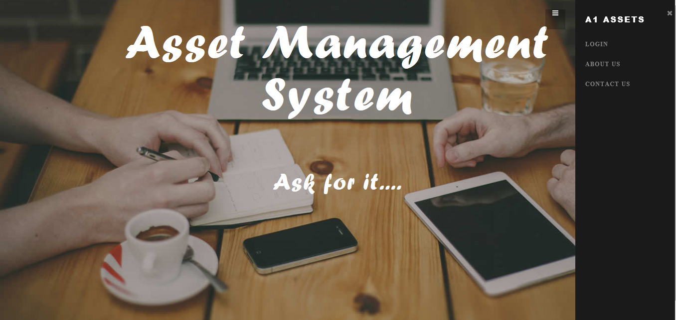
Application link
http://ndafile:8081/AssetManagementSystem_Spring/index.html
..\..\Tech Fires(Project)\New Folder\Asset ManSystem\Login.html

Slide 19
Test Case Adequacy
This defines the number of actual test cases created vs estimated test cases at the end of test case preparation phase. It is calculated as
Test Case Adequacy = No. of actual Test cases*100/No. of estimated Test cases estimated
=(159*100)/200
=79.5

Slide 20
Test Case Effectiveness
This metrics defines the effectiveness of the test cases which is measured in terms of the number of defects found in testing with using the test cases.
Test Case Effectiveness = No. of defects detected using test cases*100)/total no of defects detected in testing
=(53*100)/70
=75.71

Slide 21
Project Statistics
Number of Test Cases = 159
Number of Test Cases Passed = 106
Number of Test Cases Failed = 53
Number of Defects Logged = 44
Number of Use Cases = 9

Slide 22
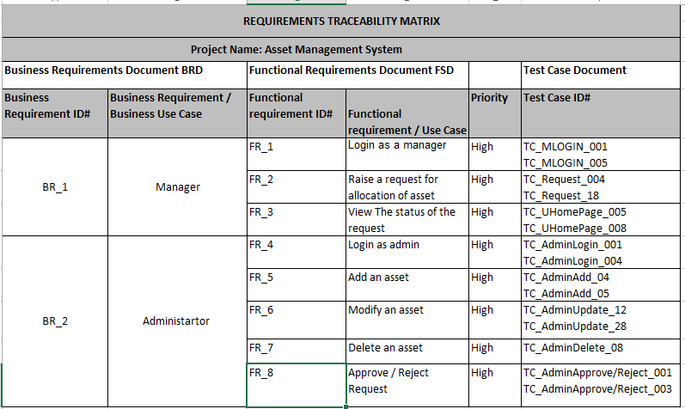
Traceability Matrix

Slide 23
THANK YOU

