Slide 1

1st REVIEW
BLOOD BANK MANAGEMENT SYSTEM
B. Vida Swetha | 2520030100
T. Meghana Sai | 2520030245
K. Akshitha Reddy | 2520030233
Under the Guidance
of
Dr. Y Prasanthi
Assistant Professor
Department of Computer Science and Engineering
KONERU LAKSHMAIAH EDUCATION FOUNDATION

Slide 2
GROUP NUMBER:1
Name of Candidate | Role
B. Vida Swetha | Backend Development & API Design: Developed the Node.js/Express.js backend, created REST APIs for blood donors, blood stock, blood requests and users, and implemented server-side request handling.
T. Meghana Sai | Database & Backend Integration: Designed the MySQL database schema and integrated it with the Express.js backend. Developed SQL queries and backend services for CRUD operations and database communication.
K. Akshitha Reddy | Backend Features, Validation & Testing: Implemented backend modules for blood availability, donor/request management and user operations. Added input validation, error handling, and tested backend APIs using Postman.

Slide 3
ABSTRACT
The Blood Bank Management System is a web-based application designed to manage blood donors, blood inventory, blood requests, and user information efficiently.
The system uses Node.js and Express.js for backend development and MySQL for database management. REST APIs are used to connect the application components with the database and perform operations such as adding donors, updating blood stock, searching blood availability, and managing blood requests.
The system reduces manual record keeping, improves data accuracy, and provides faster access to blood-related information.

Slide 4
INTRDOUCTION
Blood banks handle large amounts of information related to donors, blood groups, blood units, requests, and availability. Managing this information manually can be time-consuming and may lead to errors or difficulty in retrieving updated records.
The proposed Blood Bank Management System provides a centralized backend and database system to manage these operations.
The Express.js backend handles business logic and REST API requests, while MySQL securely stores and manages the data.
This allows blood bank operations to be performed in a structured, reliable, and efficient manner.

Slide 5
EXISTING SYSTEM
Existing blood bank management methods commonly include:
Manual registers and paper-based records.
Spreadsheet-based blood inventory management.
Separate systems for donors, blood stock, and requests.
Manual searching and updating of blood availability.
Limited integration between application and database.
Higher possibility of duplicate or outdated records.
Difficulty in tracking blood requests and inventory changes.

Slide 6
PROBLEM
Traditional or partially computerized blood bank systems may not provide centralized and real-time data management.
Maintaining donor details, blood inventory, and blood requests separately can result in data duplication, delays, and human errors.
There is therefore a need for a system that can centralize blood bank data and provide reliable backend APIs for managing and retrieving information efficiently.

Slide 7
SOLUTION(Contribution)
The proposed Blood Bank Management System provides a centralized platform for managing the complete blood bank process. It maintains organized records of donors, blood groups, blood units, requests, and users.
The system allows authorized users to add and manage donor information, monitor blood stock, check blood availability, process blood requests, and update records whenever changes occur. This provides a more organized and reliable way of managing blood bank operations while reducing dependency on manual record keeping.

Slide 8
Objectives
To make blood bank management simple, organized, and efficient.
To maintain accurate and updated information about donors and blood availability.
To help staff quickly identify the required blood group and available units.
To make blood request and donor management easier.
To reduce manual work, errors, and loss of important records.
To improve the overall speed and efficiency of blood bank operations.

Slide 9
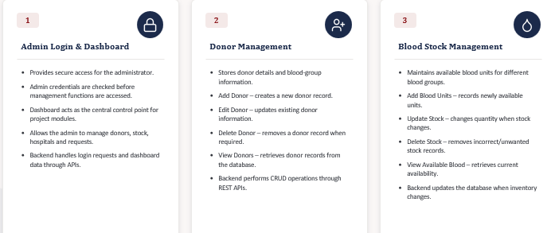
Modules

Slide 10
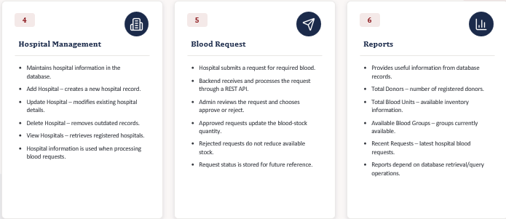
Modules

Slide 11
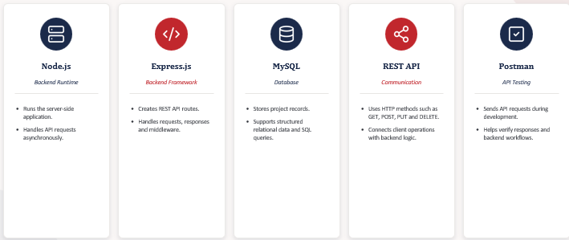
SOFTWARE REQUIREMENTS

Slide 12
CONCLUSION AND FUTURE SCOPE
Conclusion :
Provides an organized platform for managing blood bank activities.
Simplifies handling of donor, blood stock, and request information.
Reduces manual record keeping and improves accessibility.
Supports faster and smoother blood bank operations.
Future Scope :
Emergency alerts for urgent blood requirements.
Donor appointment scheduling and reminders.
Tracking of donor donation history.
Blood expiry monitoring to reduce wastage.
Blood demand and availability reports.
Connecting multiple blood banks and hospitals.

Slide 13
THANK YOU

