Slide 1
MACHINE LEARNING MINI PROJECT

Slide 2

PRESENTED BY:
Name: Meghana
Reg.no: 19BCE7628
Under the Guidance of:
Dr. Srinivas Battula

Slide 3
ABOUT MY DATA SET
I have taken health care stroke dataset with 800 instances.The Attributes are id, gender, age of the patient. Whether the patient has any hypertension and heart disease. And patients marital status, work type, residence type, average glucose level, BMI, smoking status and heart stroke status.

Slide 4
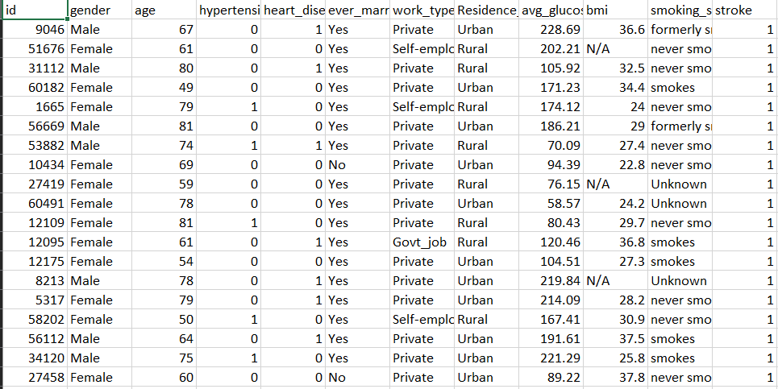
DATASET

Slide 5
Algorithms I have used
SVM Linear Kernel
Knn
Logistic regression,
Decision tree
Random forest

Slide 6
Procedure
Step1: Data Cleaning
Step2: Encoding
Step3: Changing Attribute Values
Step4: Splitting data for test and train

Slide 7
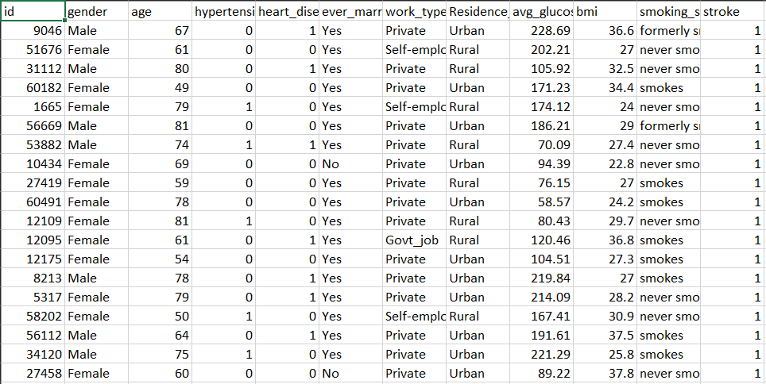
Results of Data Cleaning

Slide 8
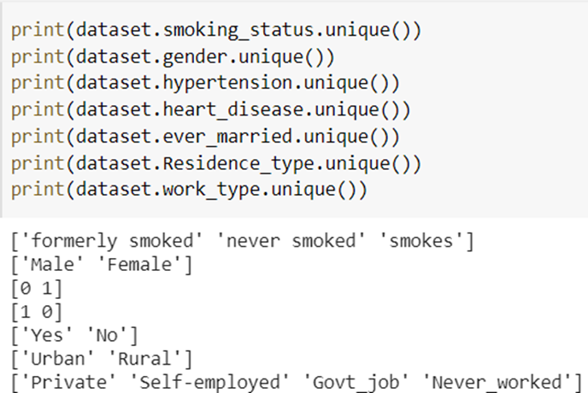
Results after Encoding

Slide 9
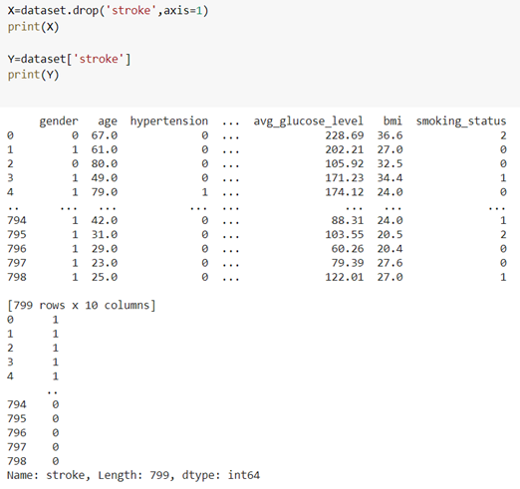
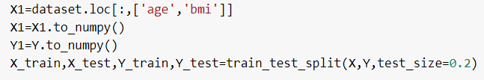
Splitting data for test and train

Slide 10
ACCURACY
SVM Linear Kernel-
Knn -
Logistic regression -
Decision tree -
Random forest -

Slide 11
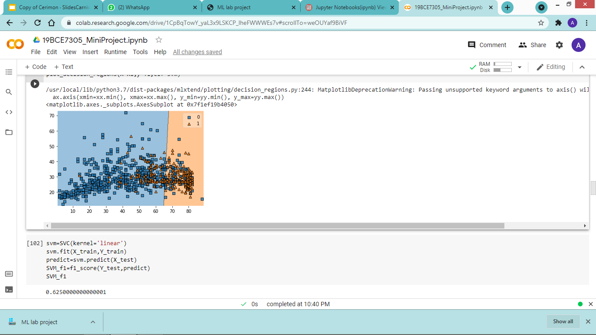
SVM LINEAR

Slide 12
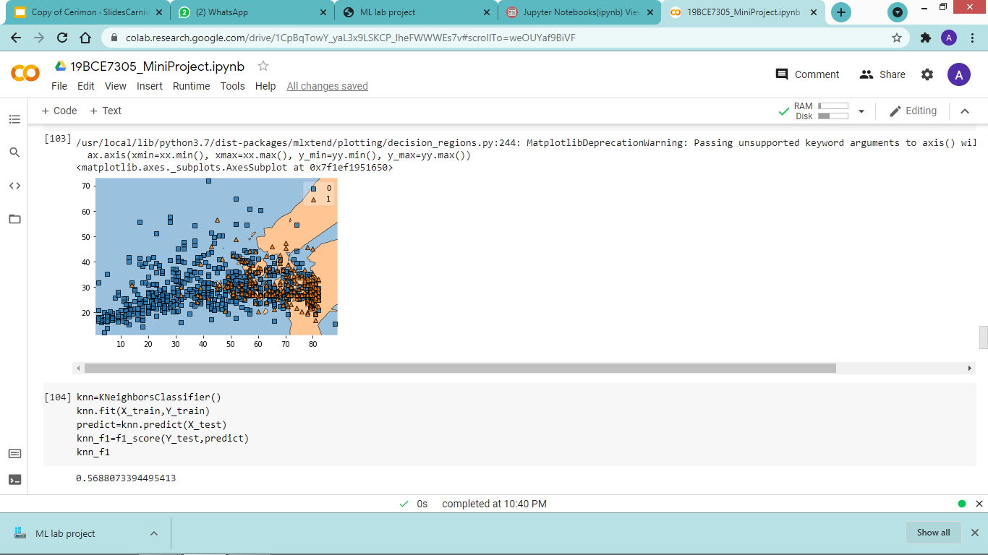
KNN

Slide 13
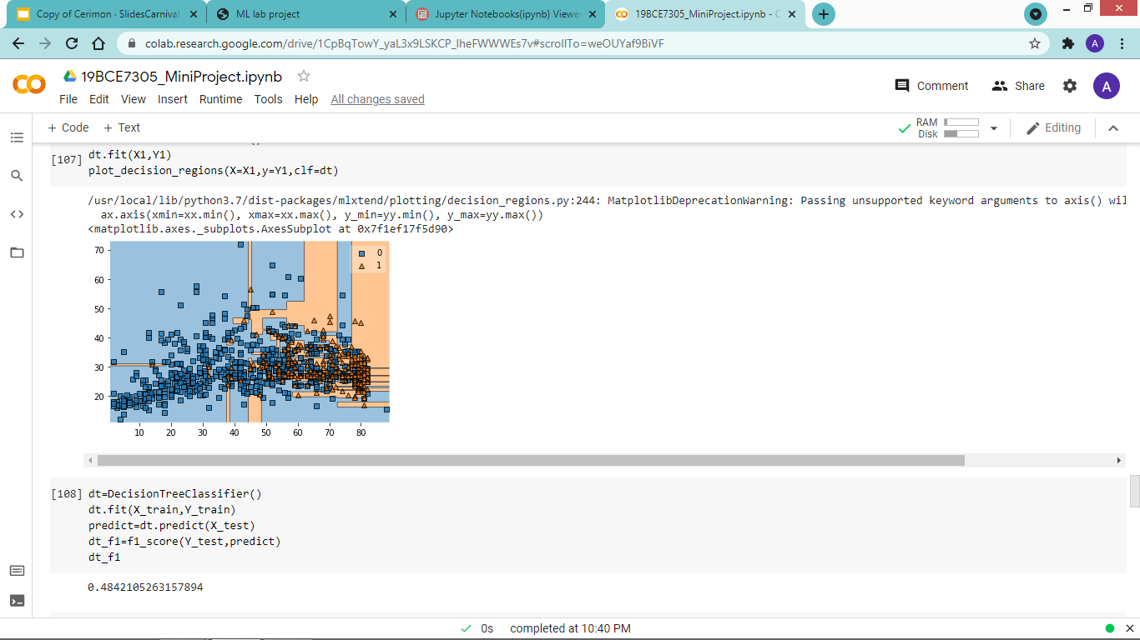
DECISION TREE

Slide 14
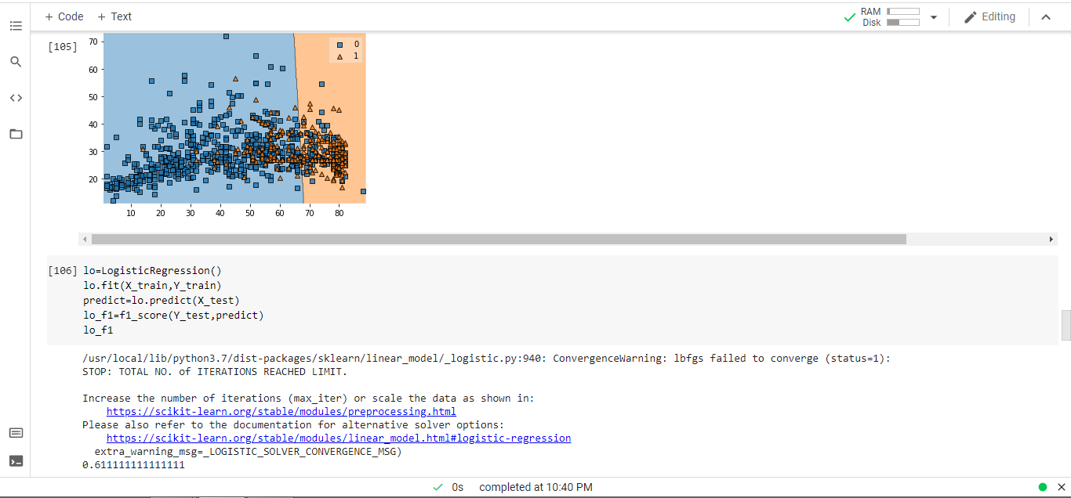
LOGISTIC

Slide 15
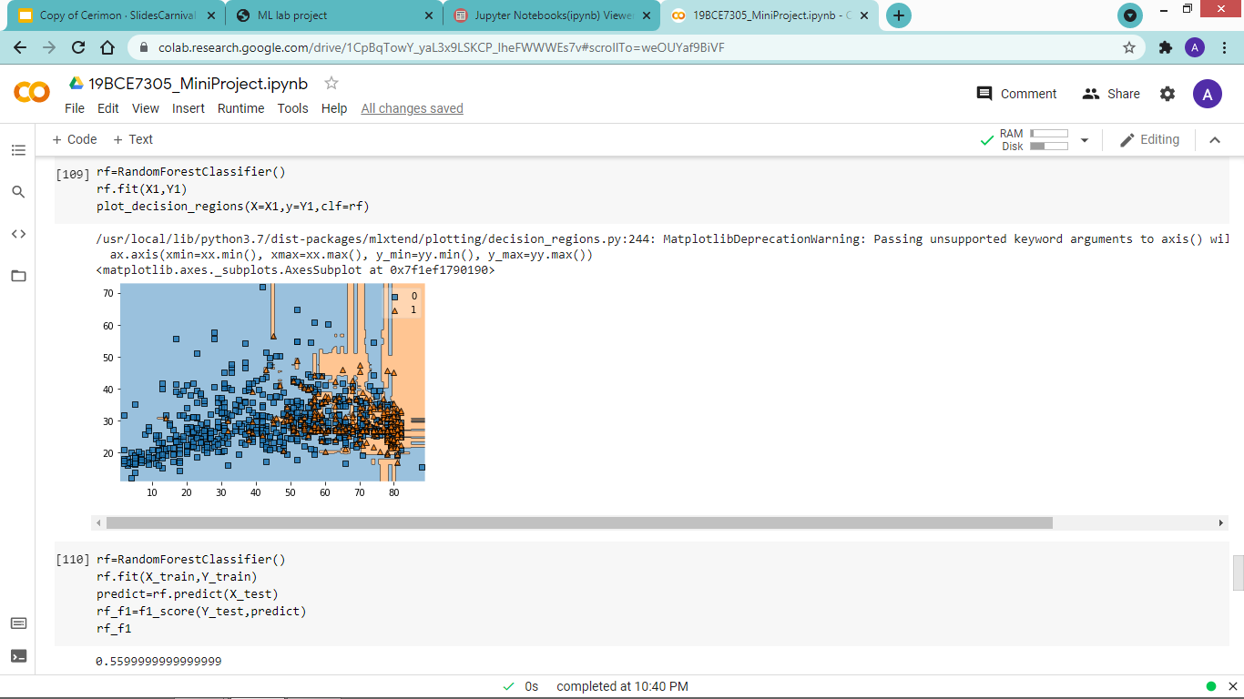
RANDOM FOREST

Slide 16
OBSERVATION
I have taken all the f1 score values and assigned to variables.
Using the pyplot function I plotted all the f1 score values in a bar graph.
I have labelled Algorithms on x-axis and f1 scores on y-axis.

Slide 17
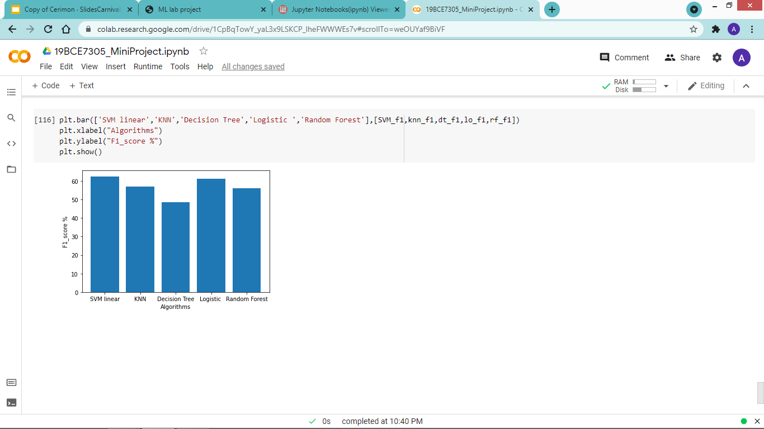
Total success!

Slide 18
THANK
YOU

