Slide 1
SECURE DATA HIDING IN IMAGE STEGANOGRAPHY
CAPSTONE PROJECT
Presented By
Student Name: MEGHANA H
College Name & Department : EAST WEST COLLEGE OF MANAGEMENT

Slide 2
OUTLINE
Problem Statement
Technology used
Wow factor
End users
Result
Conclusion
Git-hub Link
Future scope

Slide 3
Problem Statement
With the increasing demand for secure communication, the need for confidential data transmission has become critical. Traditional encryption techniques secure data but make it obvious that encryption is being used, which can attract attackers' attention. Steganography provides an alternative by embedding secret information within digital images in a way that conceals the existence of the data.
This project aims to design and implement, ensuring:
Confidentiality – Only the intended recipient can extract the hidden data.
Robustness – The hidden data should withstand common image processing operations (compression, resizing, noise addition, etc.).

Slide 4
Technology used
LIBRARIES: Open CV2
String
OS
PLATFORM: Python IDLE
OPERATING SYSTEM: WINDOWS
TECHNOLOGY USED: Python

Slide 5
Wow factors
This project has some unique features that make it stand out from other similar projects:
1. Simple and Lightweight Implementation
2. Pixel-Level Data Encoding
3. Password-Based Access Control
4. Dynamic Encoding Across RGB Channels
5. Real-Time Image Preview After Encryption
6. No External Dependencies for Decryption
7. Minimal Image Distortion

Slide 6
End users
End Users of the Secure Data Hiding in Image Using Steganography Project
1. Cybersecurity Professionals & Ethical Hackers
2. Journalists & Whistleblowers
3. Government & Military Organizations
4. Corporate & Business Sector
5. Privacy-Conscious Individuals
6. Digital Forensics & Law Enforcement
7. Researchers & Academicians
8. Secure Messaging & Communication Apps

Slide 7
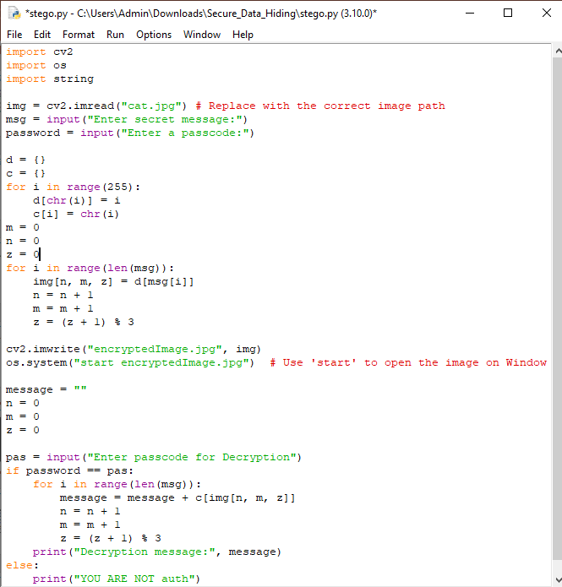
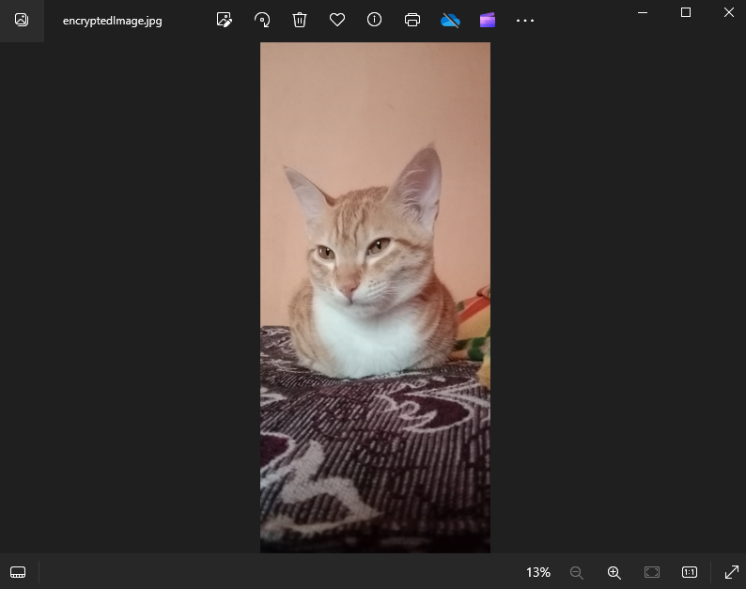
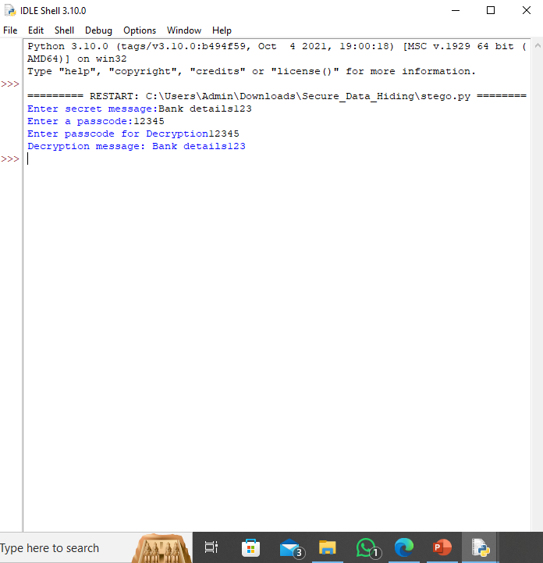
Results

Slide 8
Conclusion
The Secure Data Hiding in Image Using Steganography project successfully demonstrates a method for embedding secret messages within digital images, ensuring confidentiality, security, and imperceptibility. By utilizing pixel manipulation techniques, the system allows for secure communication while keeping the existence of hidden data undetectable.
This project highlights the effectiveness of steganography as a powerful tool for covert data transmission, making it useful for cybersecurity professionals, journalists, government agencies, and privacy-conscious users. The integration of password-based decryption enhances security, ensuring that only authorized individuals can retrieve the hidden message.

Slide 9
GitHub Link
Github Link:
https://github.com/meghana467/Secure_Data_Hiding_In_Image

Slide 10
Future scope
The Secure Data Hiding in Image Using Steganography project has significant potential for future enhancements to improve security, robustness, and efficiency. One major advancement would be the integration of encryption techniques such as AES or RSA before embedding data, ensuring that even if extracted, the hidden message remains protected. Additionally, improving robustness against image processing attacks like compression, resizing, and noise addition can be achieved by utilizing transform domain techniques such as Discrete Cosine Transform (DCT) or Discrete Wavelet Transform (DWT). Increasing data hiding capacity while maintaining imperceptibility is another crucial improvement, which can be optimized through adaptive steganography based on pixel intensity variations.

Slide 11
THANK YOU

