Slide 1
Data Science Final project
Meghana Anne
Bigmart sales predictions using product and store properties

Slide 2
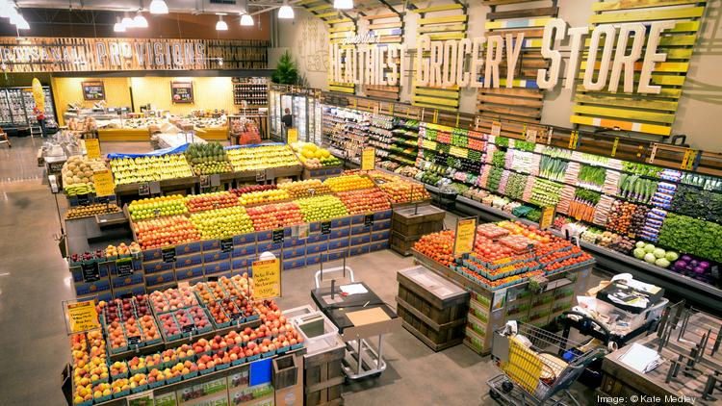
Bigmart Sales predictions

Slide 3
Problem Statement
The data scientists at BigMart have collected 2013 sales data for 1559 products across 10 stores in different cities. Also, certain attributes of each product and store have been defined. The aim is to build a predictive model and find out the sales of each product at a particular store.
Using this model, BigMart will try to understand the properties of products and stores which play a key role in increasing sales.

Slide 4
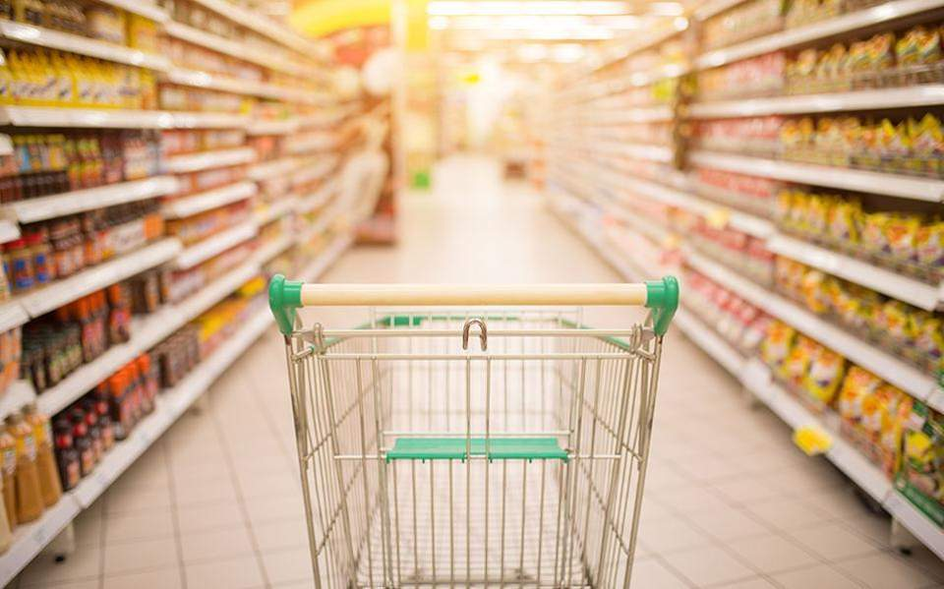
Goal
Based on the dataset create a model to show how the products and stores influence sales and determine the factors that impact increased sales.

Slide 5
Data
The Data we have: train (8523) and test (5681) data set, train data set has both input and output variable(s). We need to predict the sales for test data set.

Slide 6
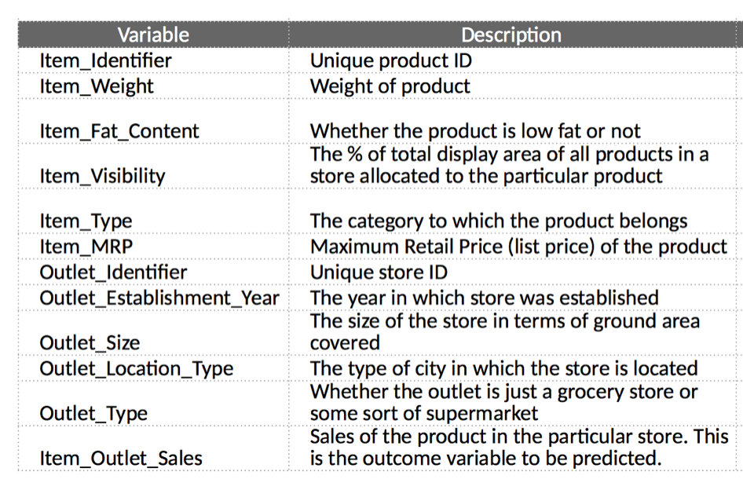
Data contd.

Slide 7
Steps involved.
Hypothesis Generation – understanding the problem better by brainstorming possible factors that can impact the outcome
Data Exploration – looking at categorical and continuous feature summaries and making inferences about the data.
Data Cleaning – imputing missing values in the data and checking for outliers
Feature Engineering – modifying existing variables and creating new ones for analysis
Model Building – making predictive models on the data

Slide 8
Hypothesis
1) City type: Stores located in urban or Tier 1 cities should have higher sales because of the higher income levels of people there.
2) Population Density: Stores located in densely populated areas should have higher sales because of more demand
3) Customer Behavior: Stores keeping the right set of products to meet the local needs of customers will have higher sales.Healthy foods have more sales
4)Competitors: Stores having similar establishments nearby should have less sales because of more competition.
5)Store size: Supermarkets have more sales6)Advertising: Better advertising of products in the store will higher sales in most cases.
7) Promotional Offer: Discounts/Promotional offers attract more customers and increase sales
8) Online shopping portal: If a store has online shopping portal with home delivery services sales will increase
9) Stores with Pharmacy: More sales

Slide 9
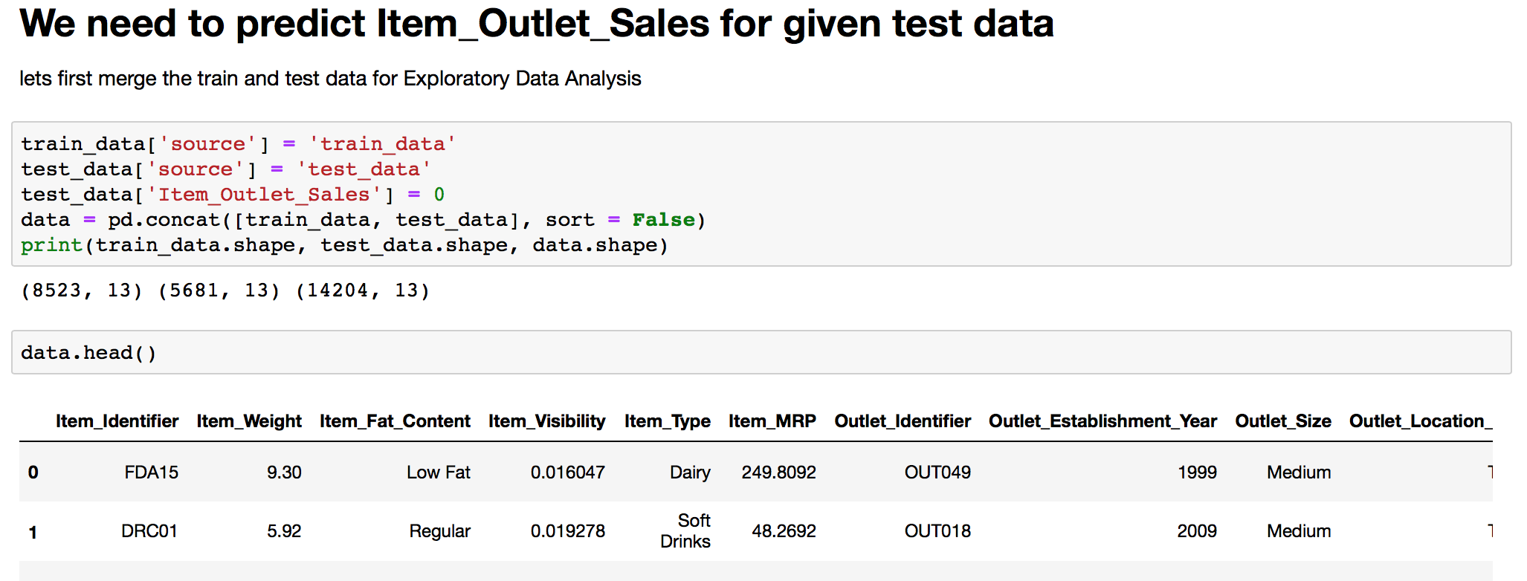
Data exploration

Slide 10
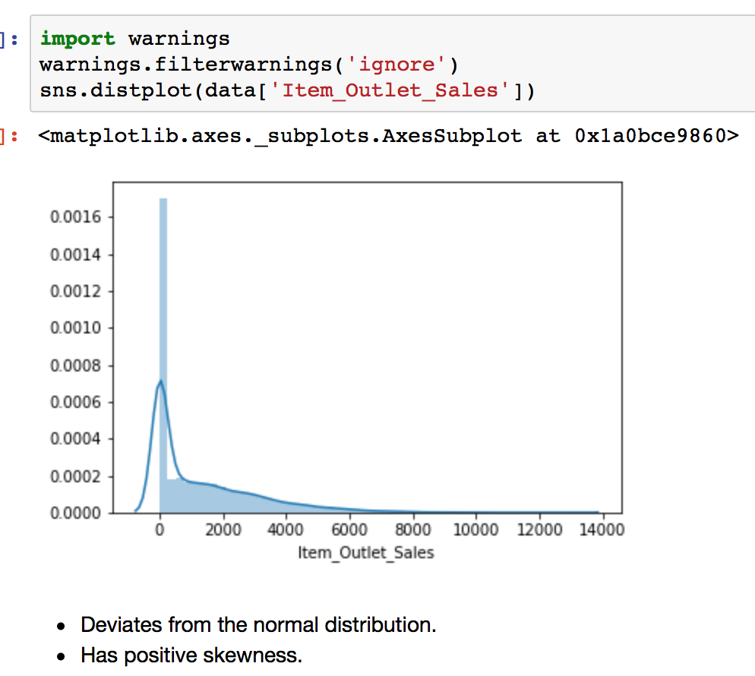
Data exploration

Slide 11
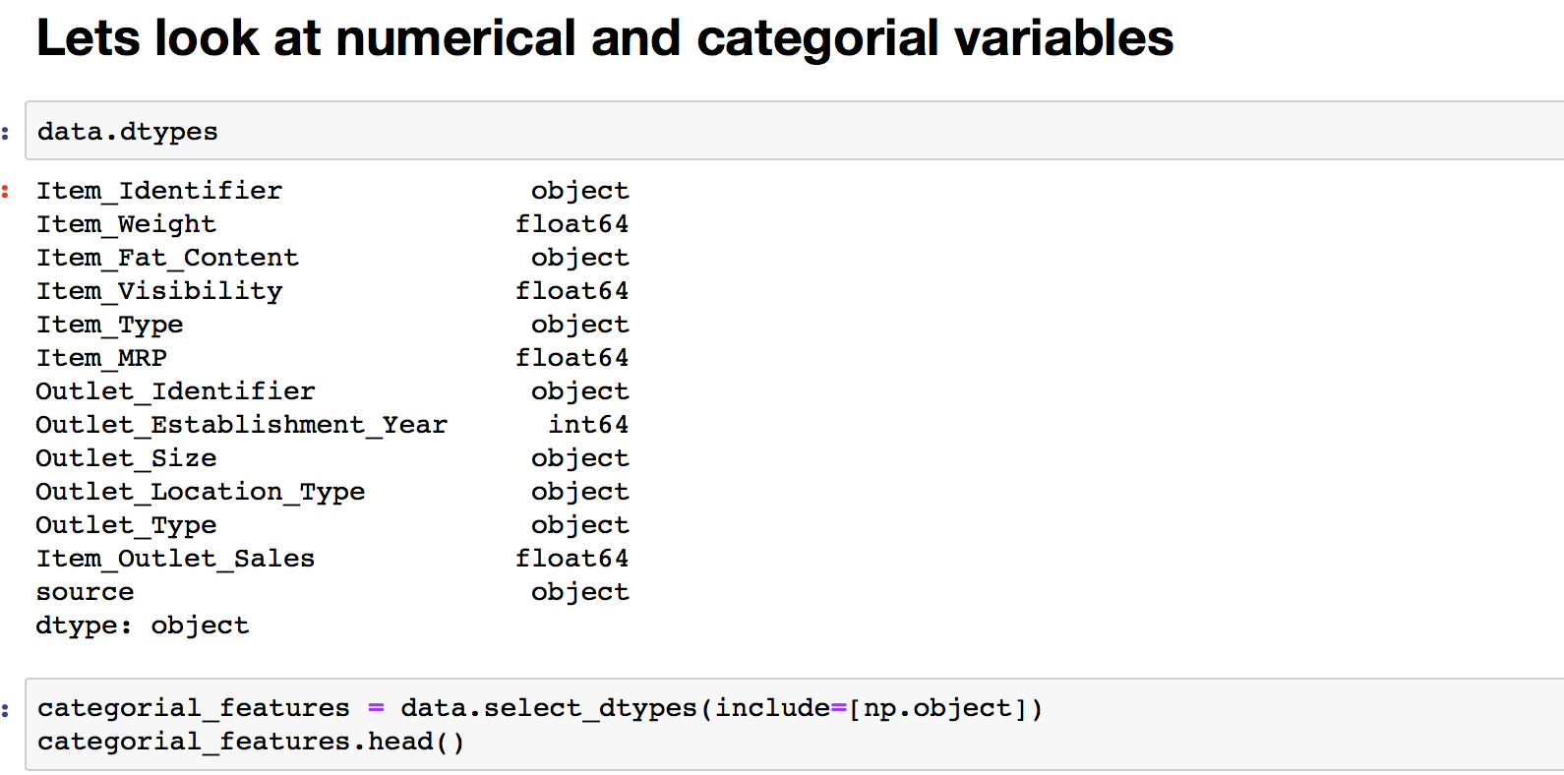
Data exploration

Slide 12
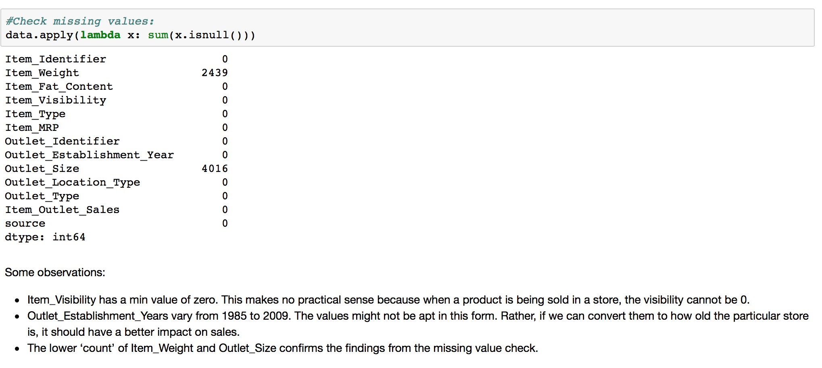
Data exploration

Slide 13
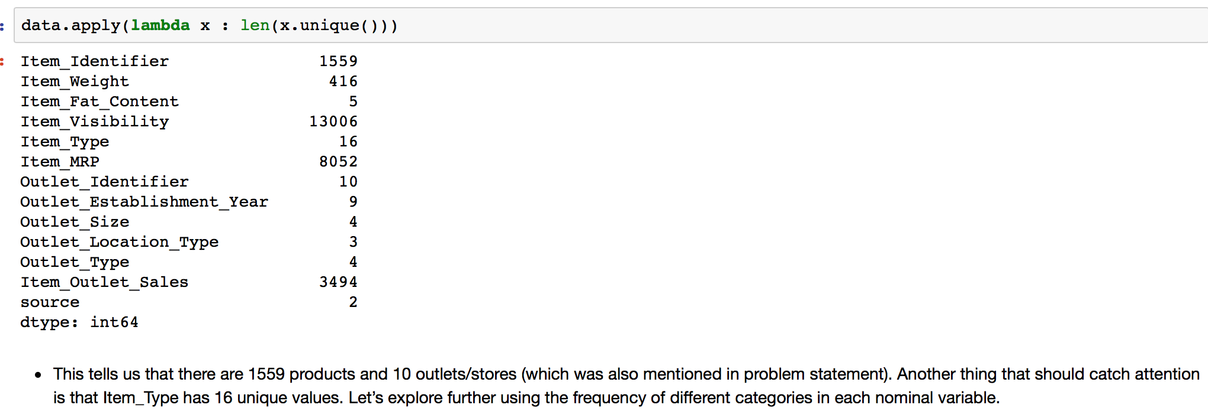
Data exploration

Slide 14
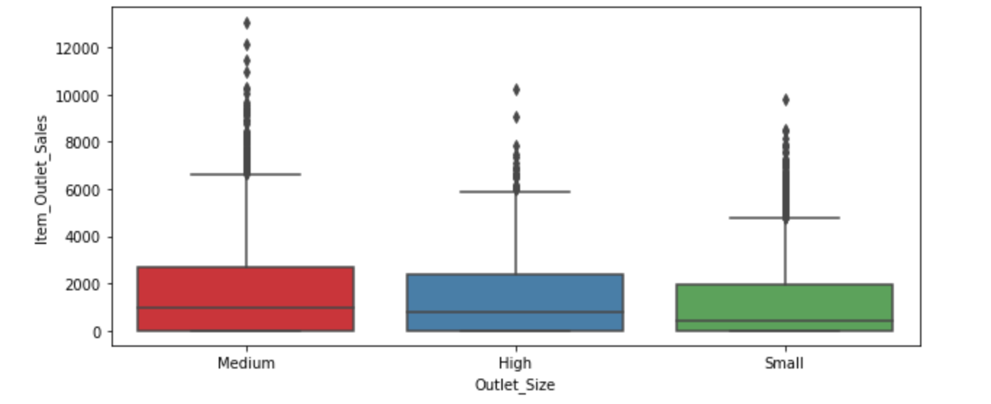
Data exploration: Outlet_Size VS Item_Outlet_Sales

Slide 15
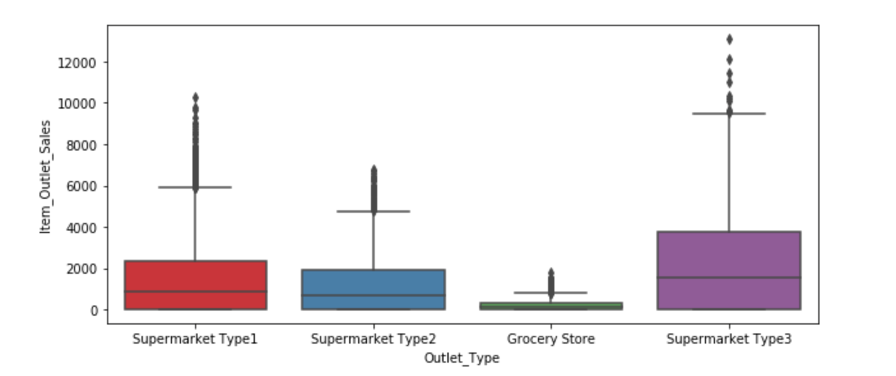
Data exploration: Outlet_Type VS Item_Outlet_Sales

Slide 16
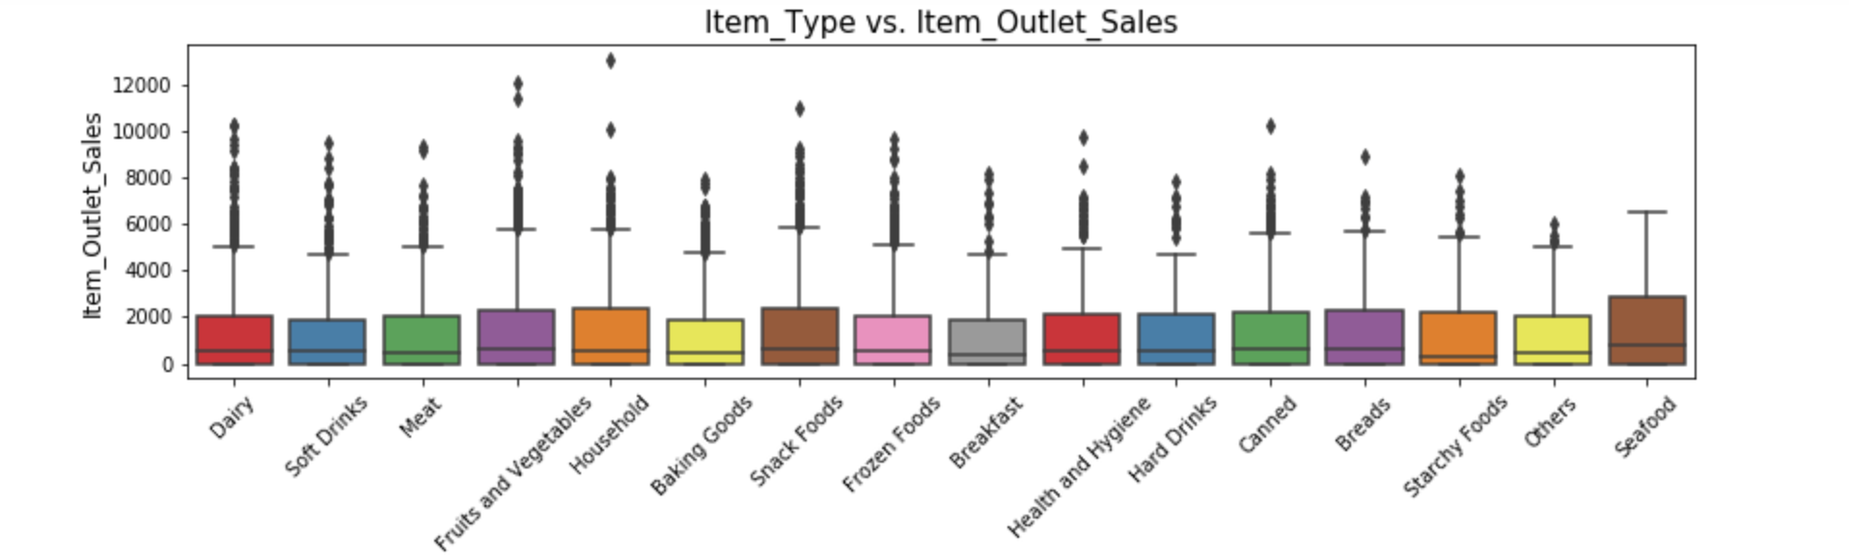
Data exploration: Item_Type VS Item_Outlet_Sales

Slide 17
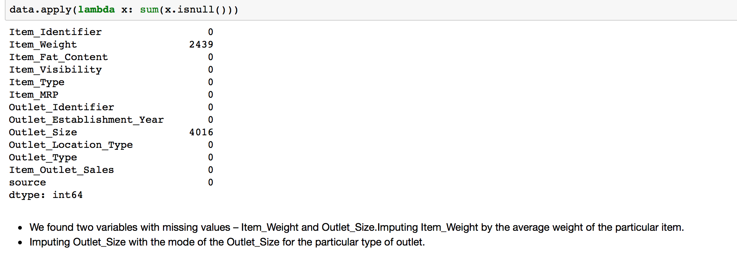
Data Cleaning and Missing values

Slide 18
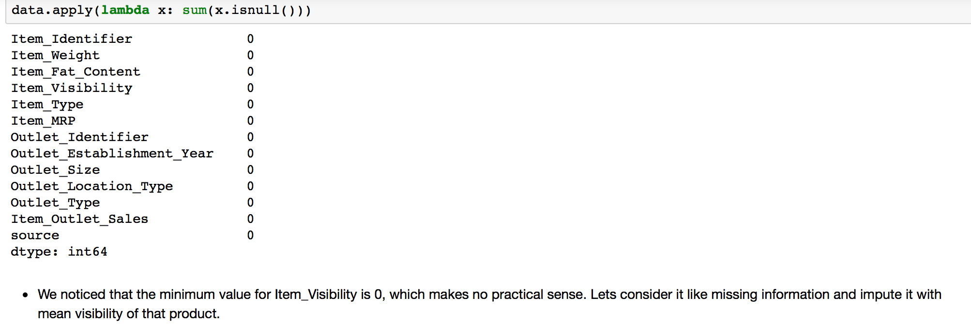
Data cleaning

Slide 19
Data cleaning :Create a broad category of Type of Item and change categories of Item fat content
Create a broad category of Type of Item and change categories of Item fat content
Earlier we saw that the Item_Type variable has 16 categories which might prove to be very useful in analysis. So its a good idea to combine them. One way could be to manually assign a new category to each. But there’s a catch here. If you look at the Item_Identifier, i.e. the unique ID of each item, it starts with either FD, DR or NC. If you see the categories, these look like being Food, Drinks and Non-Consumables. So I’ve used the Item_Identifier variable to create a new column

Slide 20
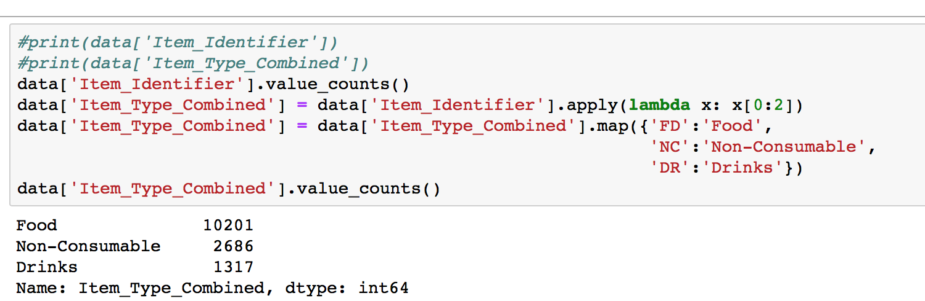
Data cleaning

Slide 21
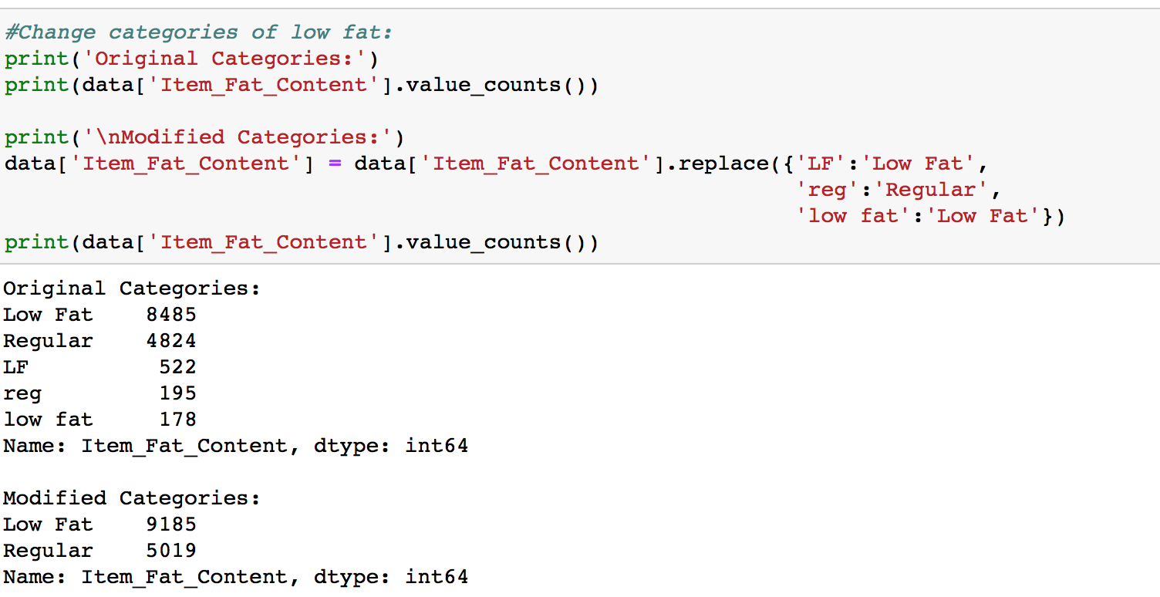
Data cleaning
We found typos and difference in representation in categories of Item_Fat_Content variable. (example Low fat is represneted as LF and Low Fat)

Slide 22
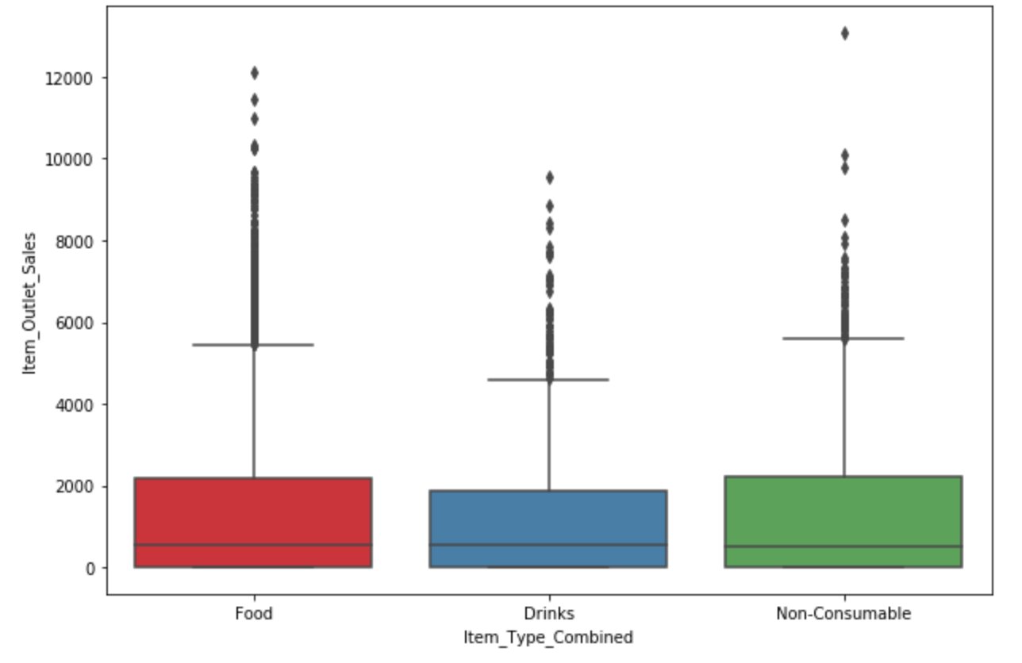
Item_Type_Continued VS Item_Outlet_Sales

Slide 23
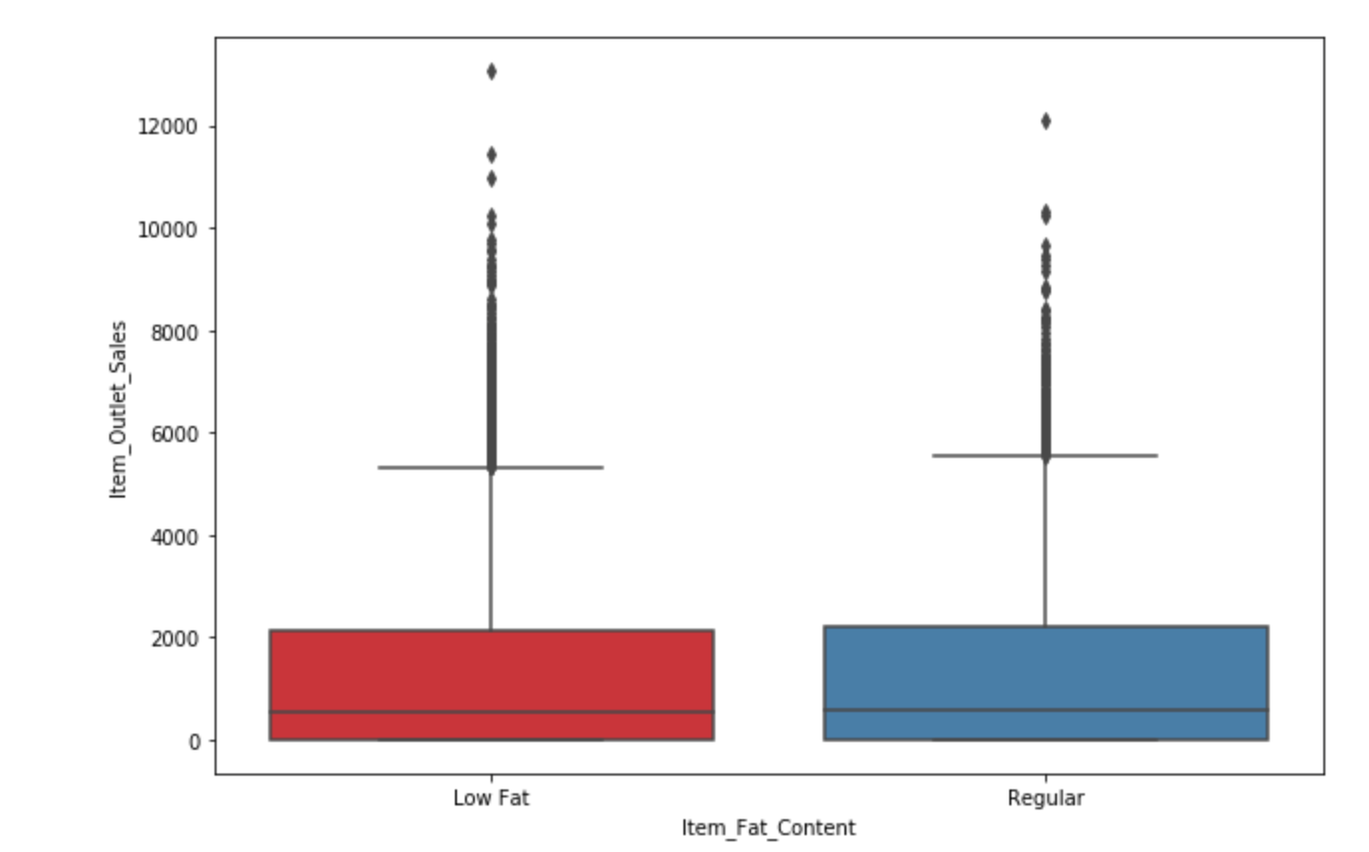
Item_Fat_Content VS Item_Outlet_Sales

Slide 24
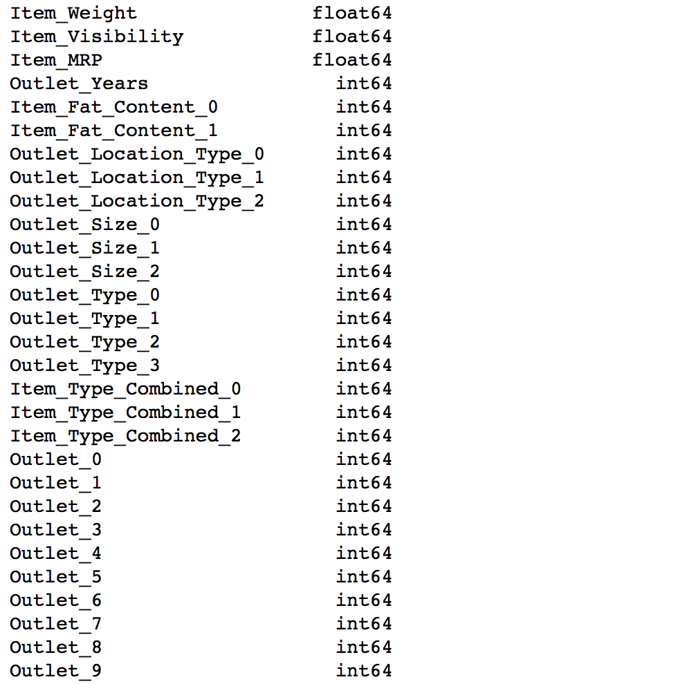
Model building
Now that we have the data ready, its time to start making predictive models.
Feature columns------------→
Target: Item_Outlet_Sales

Slide 25
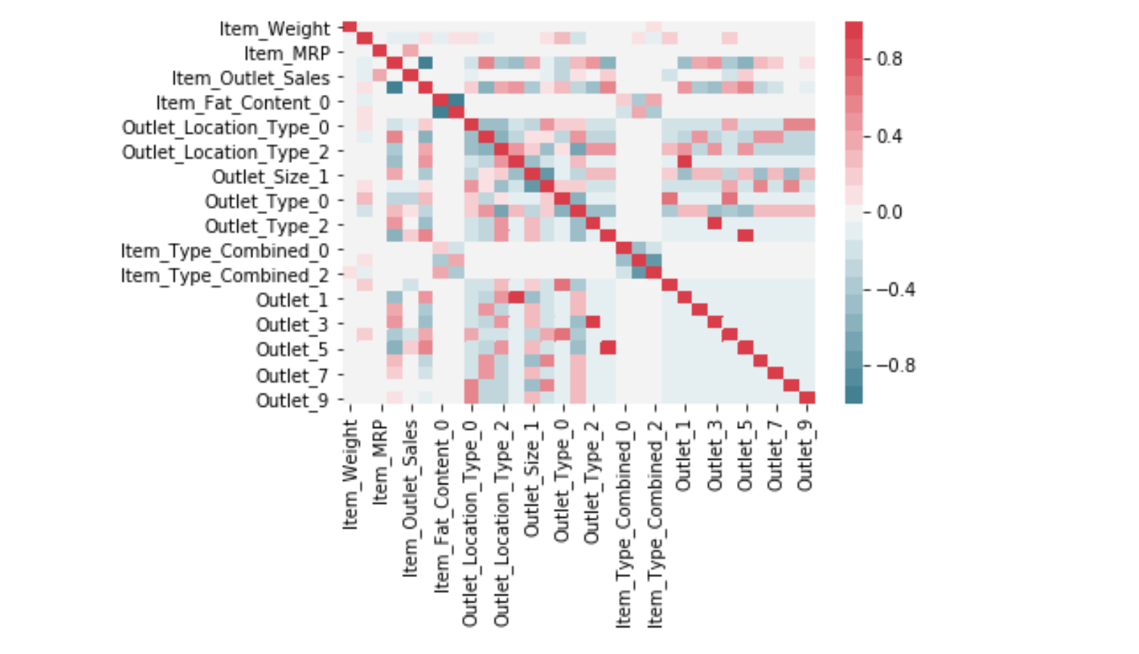
Correlation Matrix

