Slide 1

DS PROJECT
28th Novemeber,2024
GOOGLE FILE SYSTEM
With Multiple Master Nodes
Meghana Chitturi -2021101006
Tirumareddy Abhishek - 2021102010

Slide 2
Background
What is a Distributed File System?
A system that manages storage across multiple servers, ensuring fault tolerance, scalability, and data consistency.
Challenges in Distributed Systems:
Maintaining consistency across servers.
Handling failures in a fault-tolerant manner.
Efficient data storage and retrieval.
Motivation for the Project:
Implement a GFS-like system with multimaster coordination.
Real-world applicability in cloud storage and distributed computing.

Slide 3
"Google File System (GFS) is a distributed file system designed to provide efficient, reliable access to large datasets across clusters of commodity hardware, allowing Google to store and process massive amounts of data for its various services, even when dealing with hardware failures."

Slide 4
PrOJECT DESCRIPTION
Objective of the Project:
Build a scalable and fault-tolerant distributed file system that provides:
File uploads, downloads, and lease management.
Strong consistency using Raft consensus.
High-Level Architecture:
Backend: Master Server, Chunk Server, and WebSocket Server.
Frontend: React-based UI for user interaction.
Key Features:
Multimaster architecture for high availability.
Chunk-based storage with replication for fault tolerance.
Leases for exclusive file access to avoid conflicts.

Slide 5
solution approach
Backend Design:
Multiple master nodes with Raft consensus.
Chunk servers store data with redundancy.
Heartbeats keep track of active servers.
Checksums validate data integrity.
Frontend Design:
Modular React components for user operations.
Dynamic state management using useGFSOperations.
Core Functionalities:
File uploads, downloads, and storage monitoring.
Leases for write operations to prevent conflicts.

Slide 6
Milestones
1
2
3
Consensus Algorithm Implementation
Backend Design
Frontend Integration
Designed the system with three main components:
Master Server
Chunk Server
Client
Selected Python for backend implementation due to its simplicity and rich networking libraries.
Built the frontend using React and Vite for a responsive and efficient design.
Created reusable components such as modals for upload/download, file listing, and lease management.
Integrated the frontend with the backend via a WebSocket Server offering RESTful APIs.
Developed key functionalities for Raft:
Leader Election
Log Replication
Heartbeat Mechanism
Simulated server failures to test leader election and log consistency.

Slide 7
Milestones
4
5
6
Storage Management
Fault Tolerance Testing
Optimization
Implemented chunking of files into smaller, manageable parts.
Added replication logic to ensure data redundancy.
Developed a mechanism to monitor storage usage in real-time and display it on the frontend.
Tested leader re-election and log consistency under master failures.
Verified data integrity with checksum validation during file uploads and downloads.
Simulated network partitions to ensure proper Raft recovery.
Improved chunk replication by balancing load across chunk servers.
Reduced response time for API calls by optimizing backend logic.
Refined the frontend for faster state updates and better responsiveness.

Slide 8
Implementation
Backend Modules:
Master Server: Handles metadata, Raft consensus, and chunk server coordination.
Chunk Server: Stores chunks and communicates with the master for replication and data integrity.
WebSocket Server: Provides APIs for frontend integration.
Client: Manages chunk uploads/downloads and leader discovery.

Slide 9
Consensus algorithm
Problem with Distributed Systems:
Multiple nodes must agree on the state of shared data, ensuring consistency across the system.
Master nodes need a mechanism for coordination and fault tolerance.
Chosen Solution: Raft Algorithm, Why Raft?
Leader-based approach: One master node is elected as the leader, ensuring a consistent state across the system.
Log replication: Changes are propagated from leader to followers, maintaining consistency.
Key Features:
Leader Election: Determines which master node will manage file operations.
Log Replication: Ensures all master nodes have the same data.
Safety Guarantees: Prevents inconsistent state during failures.

Slide 10
Consensus algorithm
The Raft consensus algorithm is designed to ensure that a distributed system of nodes (often called "replicas") agree on the same state, even in the presence of failures. It operates on a leader-follower model, where one node (the leader) is responsible for managing log entries and coordinating actions, while the other nodes (followers) replicate the leader’s log entries.
Overview:
Leader Election
Heartbeat Mechanism
Log Replication and Consistency
Safety and handling failures

Slide 11
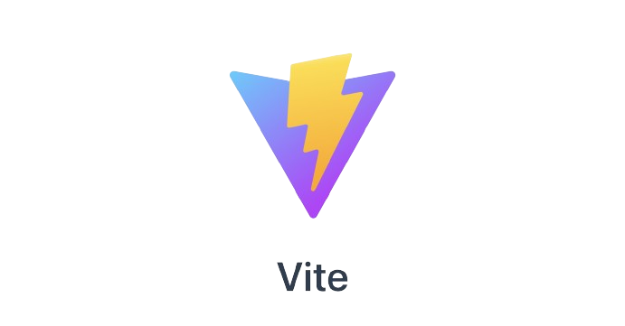

FRontend
Key Features:
Upload, download, and manage files through an intuitive UI.
Real-time updates for file lists and storage usage.
Lease management for exclusive file operations.
Core Technologies:
React and Vite for a responsive and efficient frontend.
useGFSOperations hook for centralized backend communication

Slide 12
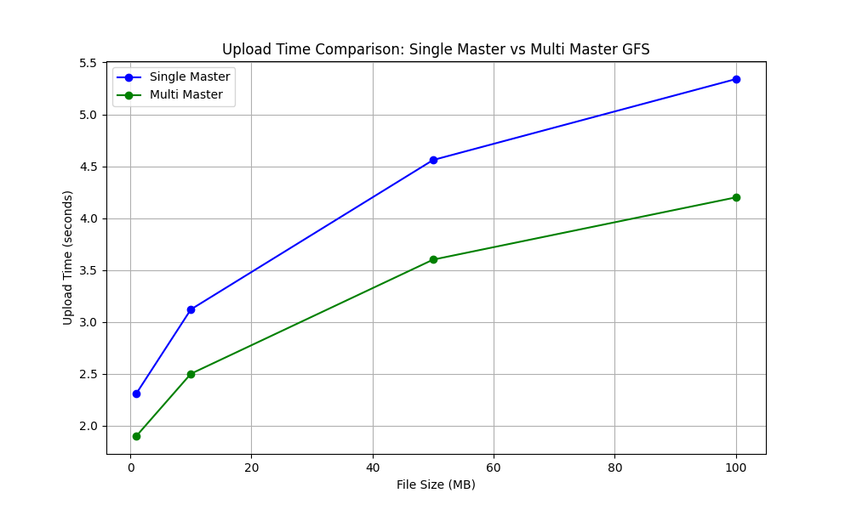
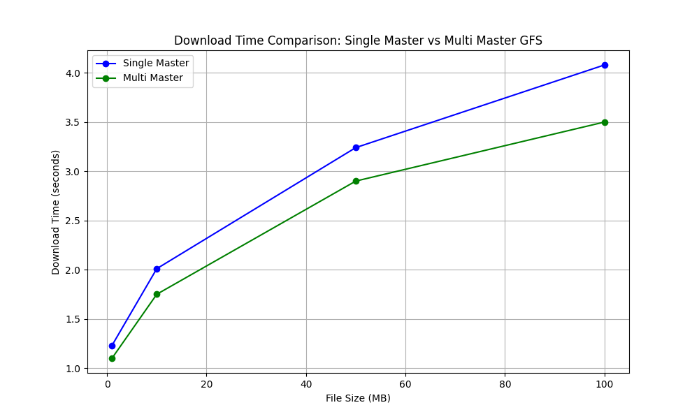
Benchmarking Plots
Upload Time vs File Size
Download Time vs File Size

Slide 13
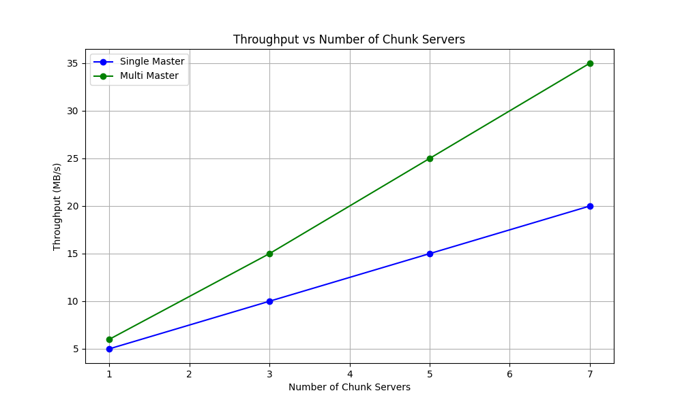
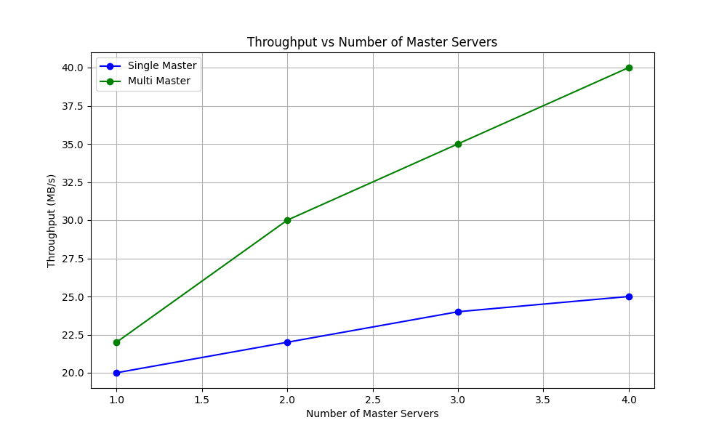
Benchmarking Plots
Throughput vs No. of Chunk Servers
Throughput vs No. of Master Servers

Slide 14
DS PROJECT
28th Novemeber,2024
THANK YOU
For Listening

