Slide 1
Trees
Dr K Adi Narayana Reddy
Dr Vinay Raj

Slide 2
PROBLEM STATEMENT
We called it as Jumping Beetle
A beetle on a board of size M X M squares. Each square has coordinates, a pair of integers (i,j), where i is the row number and j is the column number. Associated with each square is the coordinates of the square it jumps to when it lands there. as an example , in the 6 X 6 board below, the beetle jumps to (2,3) from (1,1), and jumps to (5,2) from (6,4) .
If the starting location is given, the target is to see the position of the beetle after a large NO. of jumps.

Slide 3
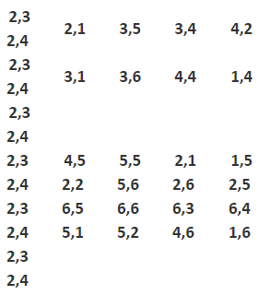
PROBLEM STATEMENT

Slide 4
PROBLEM STATEMENT
Input Format
1st Line: Input has 3 comma separated positive integers M,A,B. M is the length of a side of the board (the board is of size M X M). The NO.of jumps the beetle makes is AB (A multiplied by B)
The next M lines
consist of M pairs of comma separated positive integers, each pair separated by a semicolon(;). The Mth pair in each line i.e k shows the coordinates of the square it jumps to if and only if it lands on square (k,m).
Finally, there is one line with a comma separated pair of no. giving the initial position of the Jumping Beetle
Output Format
The output is the coordinates of the beetle’s position after A,B moves

Slide 5
PROBLEM STATEMENT
Input
6,2,3
2,3;2,4;2,1;3,5;3,4;4,2
4,2;4,1;3,1;3,6;4,4;1,4
1,2;1,3;4,5;5,5;2,1;1,5
6,2;6,1;2,2;5,6;2,6;2,5
3,2;3,3;6,5;6,6;6,3;6,4
5,3;5,4;5,1;5,2;4,6;1,6
1,2
Output
6,3

Slide 6
PROBLEM STATEMENT
Example 2
Input
6,12,2
2,3;2,4;2,1;3,5;3,4;4,2
4,2;4,1;3,1;3,6;4,4;1,4
1,2;1,3;4,5;5,5;2,1;1,5
6,2;6,1;2,2;5,6;2,6;2,5
3,2;3,3;6,5;6,6;6,3;6,4
5 ,3;5,4;5,1;5,2;4,6;1,6
4 ,3
Output
6,1

Slide 7
Limit Order Book
In Stock trading, exchanges like NYSE (New York Stock Exchange) maintains an order book for every security or stock which is traded on their exchange e.g. GOOG, which is a symbol of Google's stock. There are mainly two kinds of orders customers can send, a buy order, and a sell order.
When we use Limit Price, which means buy order with a limit price of $50 can be executed if it found a sell order of $50 or an order of lower price says $49, but it can not be executed with a sell order of price $51. Similarly, a sell order can execute for a price, which is either equal to or higher than the limit price. In general, a LIMIT order executes if it found a specified price or better price(lower in the case of a buy, and higher in the case of sell).

Slide 8
Limit Order Book
Orders are executed on a first come first serve basis, so exchange also maintains a time priority. Now, let's see the flow, an order comes to exchange, exchange looks order book for that symbol, if it found a match it executes order otherwise, it adds that order at the end of a price queue, which represents time priority, head of the queue represents the order with highest time priority i.e. the order which comes before all the order below it.
Now our goal is to perform the above operation as quickly as possible. If you look at it closely, it involves finding the opposite order of matching the price, which is equal to or less/greater than the specified price, removing the order from the order book if it matched or canceled, adding order into the order book at an appropriate place if not matched.

Slide 9
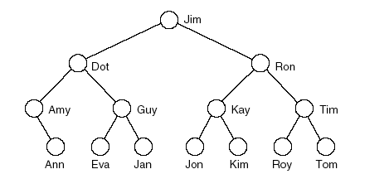
Tree
Tree represents hierarchy.
Examples of trees:
- Directory tree
- Family tree
- Company organization chart
Table of contents
structure resembles branches of a “tree”, hence the name.

Slide 10
Tree
A tree is a data structure similar to a linked list but instead of each node pointing simply to the next node in a linear fashion, each node points to a number of nodes.
Tree is an example of non-linear data structures.
In trees ADT, the order of the elements is not important.
If we need ordering information, linear data structure like linked lists, stacks, queues etc. can be used.

Slide 11
Trees: More Definitions
Trees that we consider are rooted. Once the root is defined (by the user) all nodes have a specific level.
Trees have internal nodes and leaves. Every node (except the root) has a parent and it also has zero or more children.
root
level 0
level 1
internal nodes
level 2
parent
and
child
level 3
leaves

Slide 12
Tree Terminology (1)
A vertex (or node) is a object that can have a name and can carry other associated information
• The first or top node in a tree is called the root node.
• An edge is a connection between two vertices
• A path in a tree is a list of distinct vertices in which successive vertices are connected by edges in the tree.
• The defining property of a tree is that there is precisely one path connecting any two nodes.
• A disjoint set of trees is called a forest
• Nodes with no children are leaves, terminal or external nodes

Slide 13
Tree Terminology (2)
Child of a node u :- Any node reachable from u by 1 edge.
Parent node :- If b is a child of a, then a is the parent of b.
- All nodes except root have exactly one parent.
Subtree:-any node of a tree, with all of its descendants.
Depth of a node :
- Depth of root node is 0.
-Depth of any other node is 1 greater than depth of its parent.

Slide 14
Binary Trees
Definition: A binary tree is either empty or it consists
of a root together with two binary trees called the
left subtree and the right subtree.
A binary tree is a tree in which each node has atmost
2 children

Slide 15
Types of Binary Trees
Full Binary Tree
Strict Binary Tree
Complete Binary Tree
Skewed Binary Tree
Left Skew
Right Skew

Slide 16
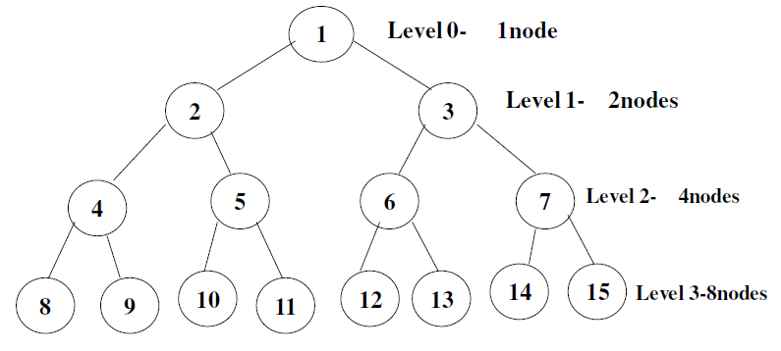
Full Binary Tree
It is a binary tree in which every node other than the leaves has two children.
Note: All leaves are at same level and all other nodes each have two children.
A full binary tree of height h has exactly 2^{h+1}-1 nodes

Slide 17
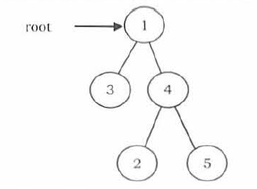
Strict Binary Tree
A binary tree is called strict binary tree if each node has exactly two children or no children.

Slide 18
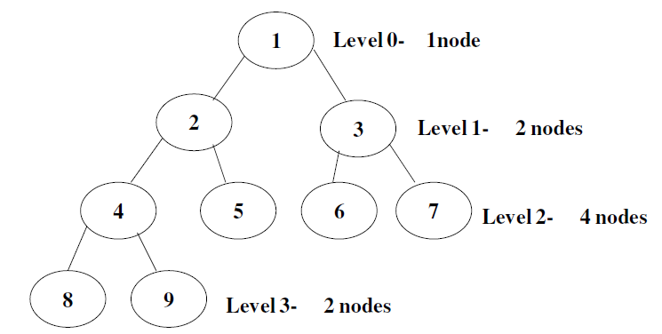
Complete Binary Tree
It is a binary tree in which every level is completely filled except last level
The number of nodes n in a complete binary tree is between 2^{h} (minimum) and 2^{h+1} -1 (maximum).
The number of NULL links in a complete binary tree of n nodes is n+1

Slide 19
Skewed Binary Tree
Left Skewed
Binary Tree without right sub tree
Right Skewed
Binary Tree without Left sub tree
Left Skewed
Right Skewed

Slide 20
Binary Tree Representation
Array
Linked List

Slide 21
Binary Tree Representation using Array
Root at stored at index 0
If a node is at location i then its left child is located at 2 * i + 1 and right child is located at 2 * i + 2
The required space for a binary tree of height h is 2^{h}-1

Slide 22
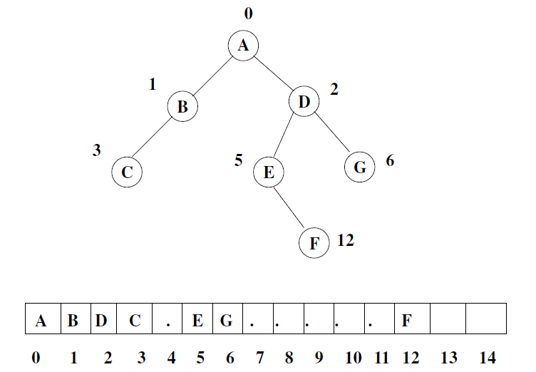
Example

Slide 23
Advantages and Disadvantages
Advantages
Easy of access any node
No pointer overhead
Disadvantages
Wastage of memory
Size is static
Insertion and deletion requires lots of data movement

Slide 24
Binary Tree Representation using Linked List
Node creation
struct node
{
struct node *lchild;
data_type data;
struct node *rchild;
};
lchild points to the left child of the node
rchild points to the right child of the node

Slide 25
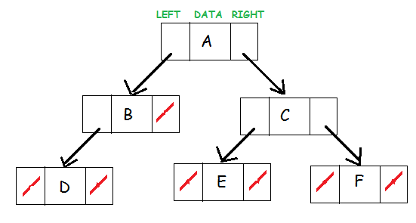
Example

Slide 26
Advantages and Disadvantages
Advantages
No wastage of memory
Dynamic memory allocation
Insertion and Deletion operations doesn’t required any data movement
Disadvantages
Direct access is not possible
Needs additional space

Slide 27
Height of Binary Tree
The number of nodes n in a complete binary tree is between 2^{h} and 2^{h+1} – 1, where h is height
The number of nodes in full binary tree is 2^{h+1} – 1

Slide 28
Maximum in Binary Tree
Int Max(struct BTNode *root){
int root_val, left_val, right_val, max = INT_MIN;
if(root != NULL){
root_val = root->data;
left_val = Max(root->left);
right_val = Max(root->right);
if(left_val > right_val)
max = left_val;
else
max = right_val;
if(root_val > max)
max = root_val;
}
return max;
}

Slide 29
Size of binary tree
Int SizeOfBT(struct BTNode *root){
if(root == NULL)
return 0;
else
return SizeOfBT(root->left) + SizeOfBT(root->right) + 1;
}

Slide 30
Height of Binary Tree
Int HeightOfBT(struct BTNode *root){
int leftheight, rightheight;
if(root == NULL)
return 0;
else{
leftheight = HeightOfBT(root->left);
rightheight = HeightOfBT(root->right);
if(leftheight > rightheight)
return leftheight + 1;
else
return rightheight + 1;
}
}

Slide 31
Question
How many different binary trees are possible with n nodes?
A binary tree T has n leaf nodes. The number of nodes of degree 2 in T is?

Slide 32
Binary Tree Traversals
The process of visiting all nodes of a tree is called tree traversal.
Each node is processed only once but it may be visited more than once.
As we have seen already in linear data structures, the elements are visited in sequential order.
But in tree structures there are many different ways

Slide 33
Classifying the Traversals
Preorder Traversal
Inorder Traversal
Postorder Traversal
There is another traversal method which does not depend on the above orders:
Level Order Traversal: This method is inspired from Breadth First Traversal

Slide 34
Preorder Traversal
Preorder traversal is defined as follows:
Visit the root.
Traverse the left subtree in Preorder.
Traverse the right subtree in Preorder.
void PreOrder(struct BTNode *root) {
if(root) {
printf("%d",root->data);
PreOrder(root->left);
PreOrder(root->right);
}
}

Slide 35
Inorder Traversal
Inorder traversal is defined as follows:
Traverse the left subtree in Inorder.
Visit the root.
Traverse the right subtree in Inorder.
void InOrder(struct BTNode *root) {
if(root) {
InOrder(root->left);
printf("%d",root->data);
InOrder(root->right);
}
}

Slide 36
Postorder Traversal
Inorder traversal is defined as follows:
Traverse the left subtree in Postorder.
Traverse the right subtree in Postorder.
Visit the root.
void PostOrder(struct BTNode *root) {
if(root) {
PostOrder(root->left);
PostOrder(root->right);
printf("%d",root->data);
}
}

Slide 37
Level Order Traversal
Inorder traversal is defined as follows:
Visit the root.
While traversing level l , keep all the elements at level l+1 in queue.
Go to the next level and visit all the nodes at that level.
Repeat this until all levels are completed.

Slide 38
Binary Search Tree
In the previous tree representations, to search for an element we need to check both in left subtree and in right subtree.
Due to this, the worst case complexity of search operation is O(n).
The main use of Binary Search Trees(BST) representation is for searching.
In this, we impose restriction on the kind of data a node can contain.
As a result, it reduces the worst case average search operation to O(logn).

Slide 39
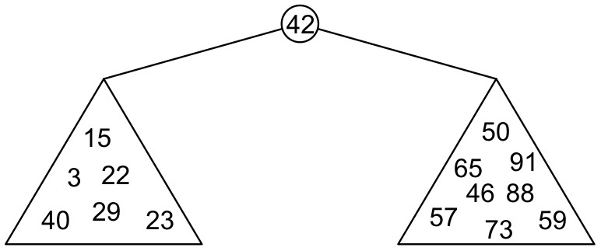
Binary Search Tree
Graphically, we may show the relationship as
Each of the two sub-trees will themselves be binary search trees

Slide 40
Definition
Thus, we define a non-empty binary search tree as a binary tree with the following properties:
The left sub-tree (if any) is a binary search tree and all elements are less than the root element, and
The right sub-tree (if any) is a binary search tree and all elements are greater than the root element

Slide 41
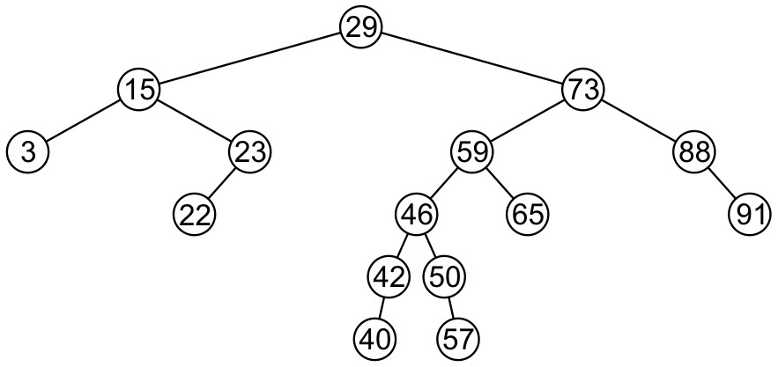
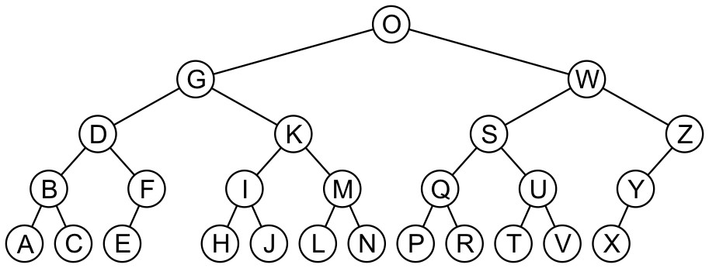
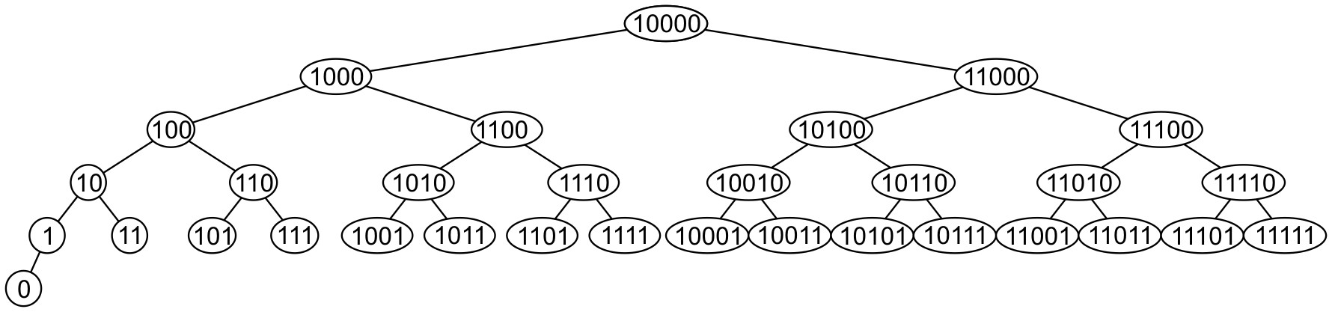
Binary Search Trees Examples

Slide 42
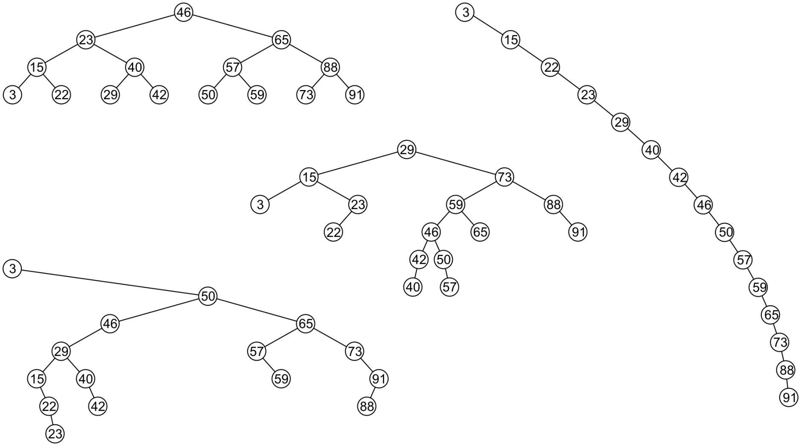
Examples

Slide 43
Creation of Binary Search Tree
31 45 36 14 52 42 6
31
14
45
6
36
52
42

Slide 44
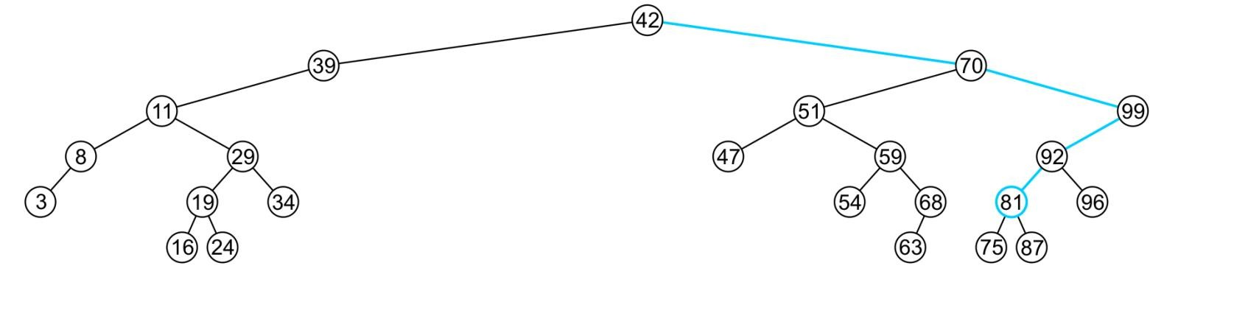
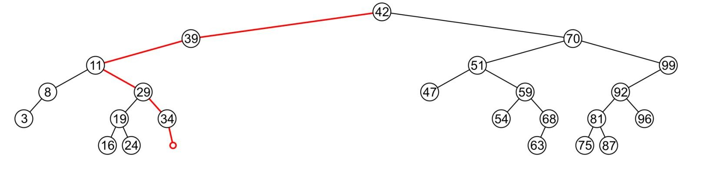
Search
To determine membership, traverse the tree based on the linear relationship:
–If a node containing the value is found, e.g., 81, return 1
If an empty node is reached, e.g., 36, the object is not in the tree:
The run time is O(h)

Slide 45
Search Algorithm
struct BNode* search(struct BTNode *root, int x)
{
if(root==NULL || root->data==x)
//if root->data is x then the element is found
return root;
else if(x>root->data)
// x is greater, so we will search the right subtree
return search(root->right_child, x);
else
//x is smaller than the data, so we will search the left subtree
return search(root->left_child,x);
}

Slide 46
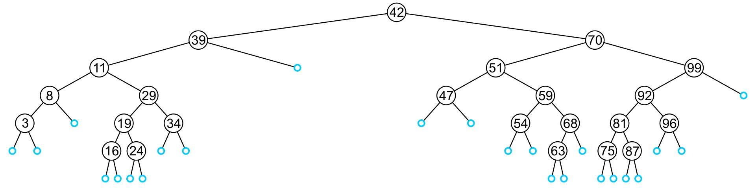
Insertion
An insertion will be performed at a leaf node:
– Any empty node is a possible location for an insertion

Slide 47
Insert
Like find, we will step through the tree
If we find the object already in the tree, we will return
The object is already in the binary search tree (no
duplicates)
Otherwise, we will arrive at an empty node
The object will be inserted into that location
The run time is O(h)

Slide 48
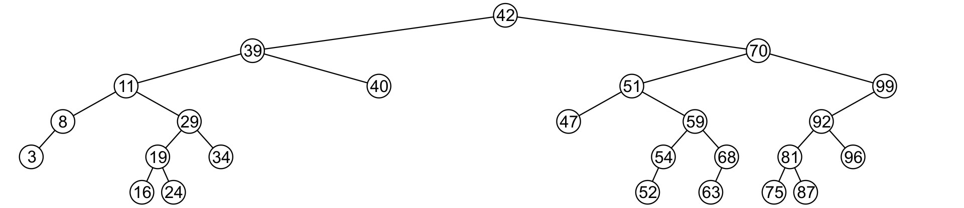
Delete
A node being deleted is not always going to be a leaf node
There are three possible scenarios:
The node is a leaf node,
It has exactly one child, or
It has two children (it is a full node)

Slide 49
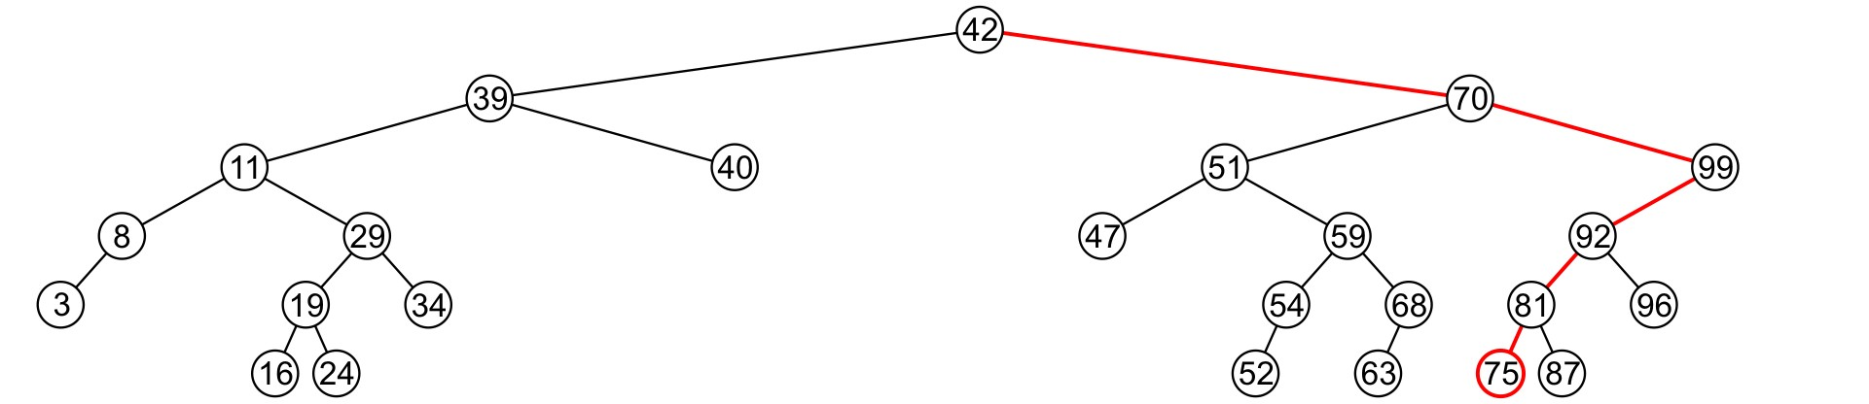
Delete
A leaf node simply must be removed and the appropriate member variable of the parent is set to NULL
– Consider removing 75

Slide 50
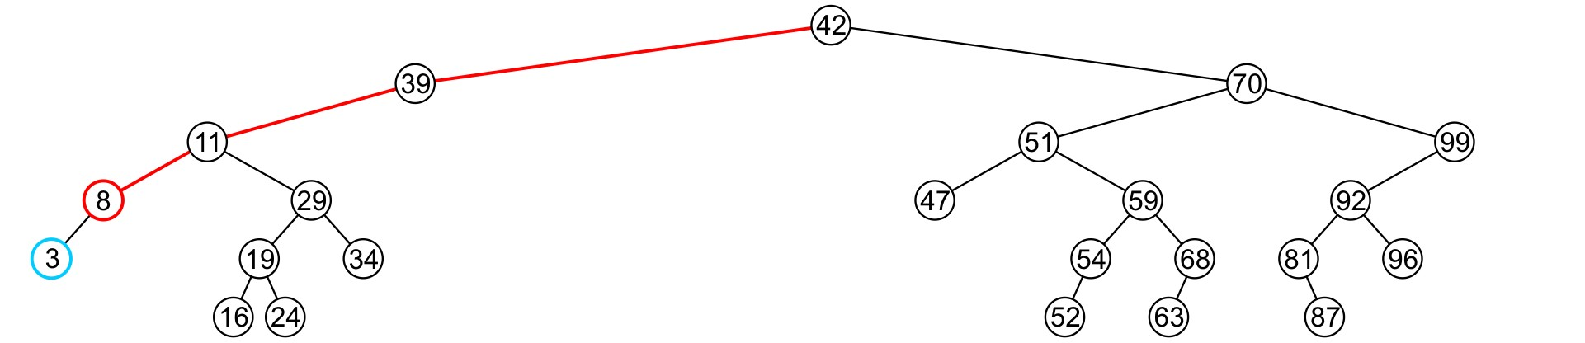
Delete
If a node has only one child, we can simply promote the sub-tree associated with the child
– Consider removing 8 which has one left child

Slide 51
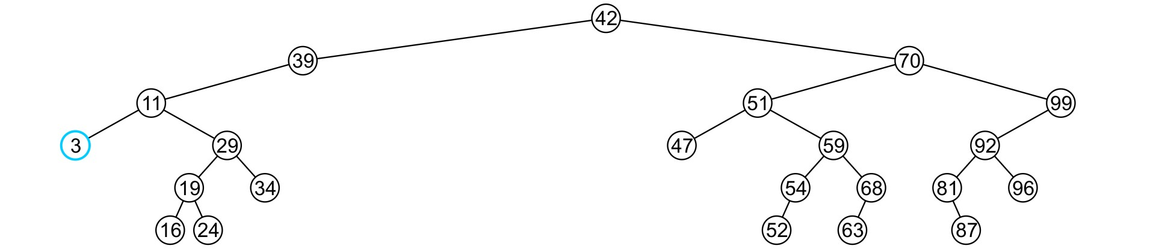
Delete
The node 8 is deleted and the left_tree
of 11
is updated to point to 3

Slide 52
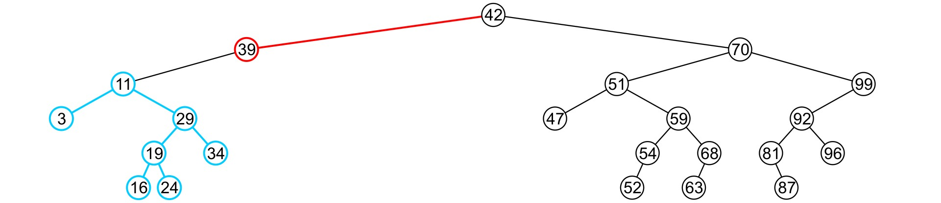
Delete
There is no difference in promoting a single node or a sub-tree
– To remove 39, it has a single child 11

Slide 53
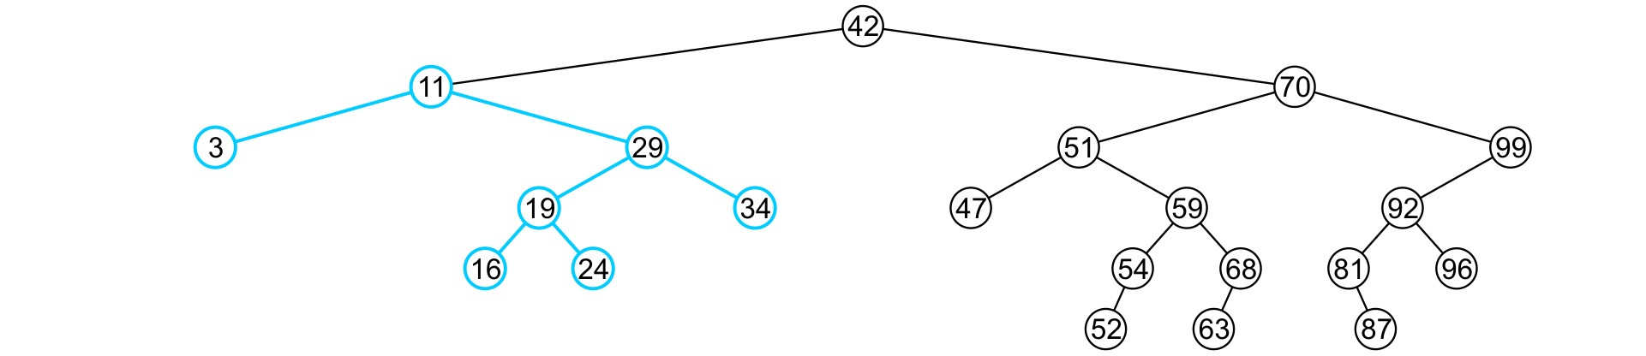
Delete
The node containing 39 is deleted and
left_node of 42 is updated to point to 11
– Notice that order is still maintained

Slide 54
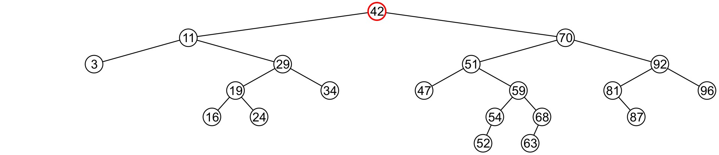
Erase
Finally, we will consider the problem of erasing a full node, e.g., 42
We will perform two operations:
– Replace 42 with the minimum object in the right sub-tree
– Erase that object from the right sub-tree

Slide 55
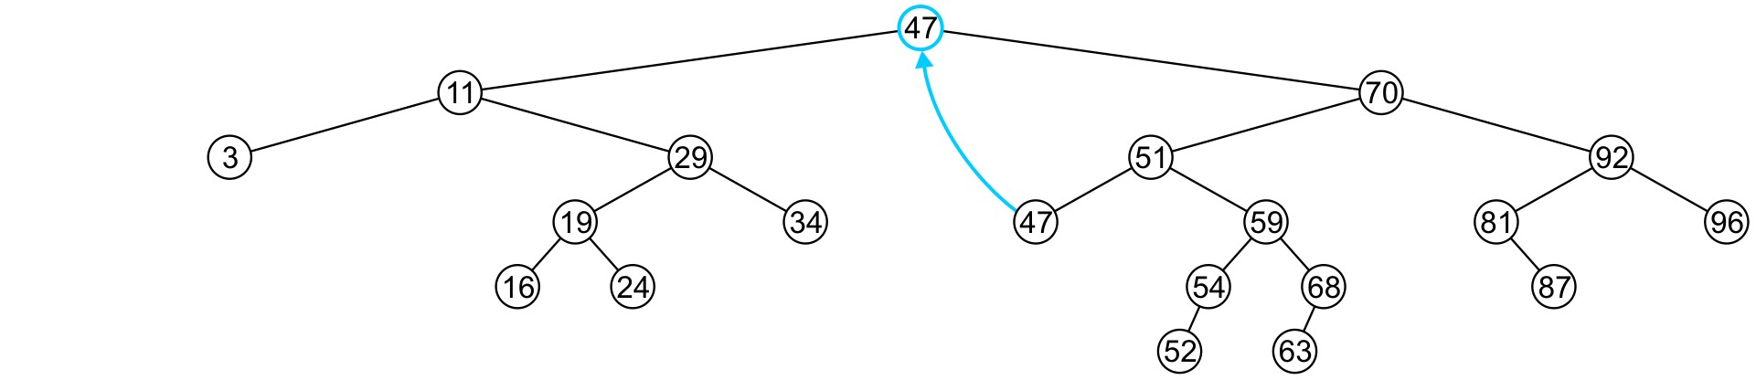
Delete
In this case, we replace 42 with 47
– We temporarily have two copies of 47 in the tree

Slide 56
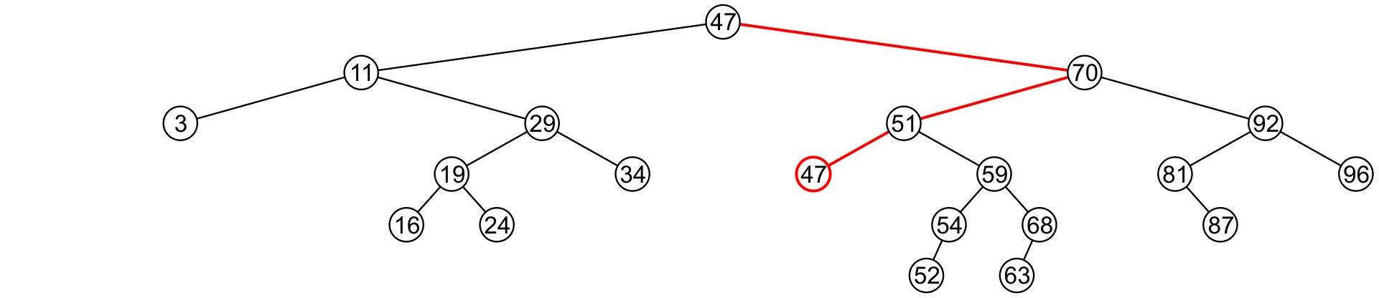
Delete
We now recursively erase 47 from the right sub-tree
– We note that 47 is a leaf node in the right sub- tree

Slide 57
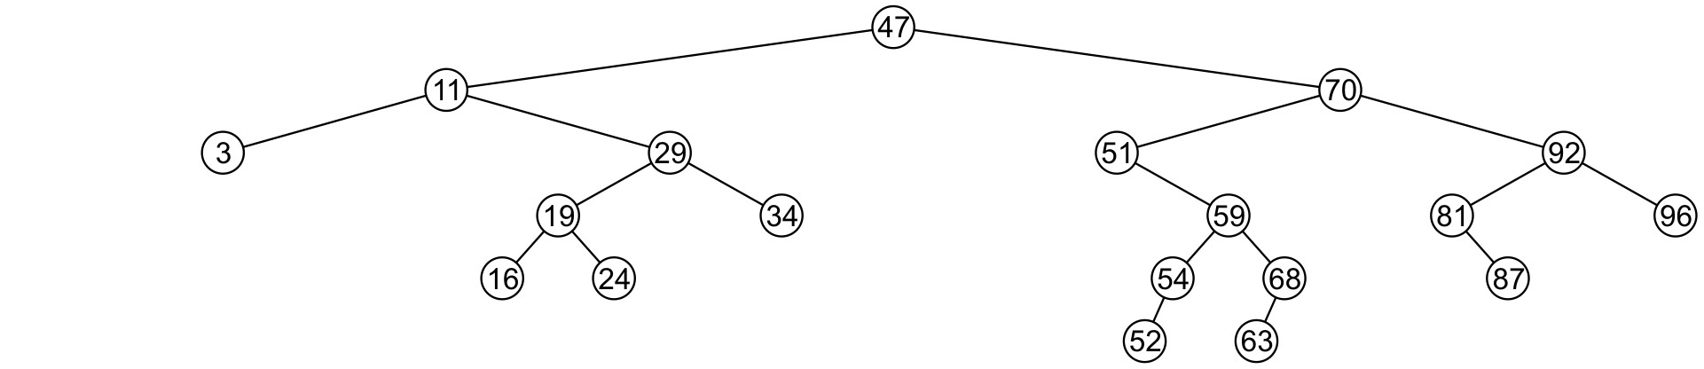
Delete
Leaf nodes are simply removed and
left_tree of 51 is set to nullptr
– Notice that the tree is still sorted:
47 was the least object in the right sub-
tree

Slide 58
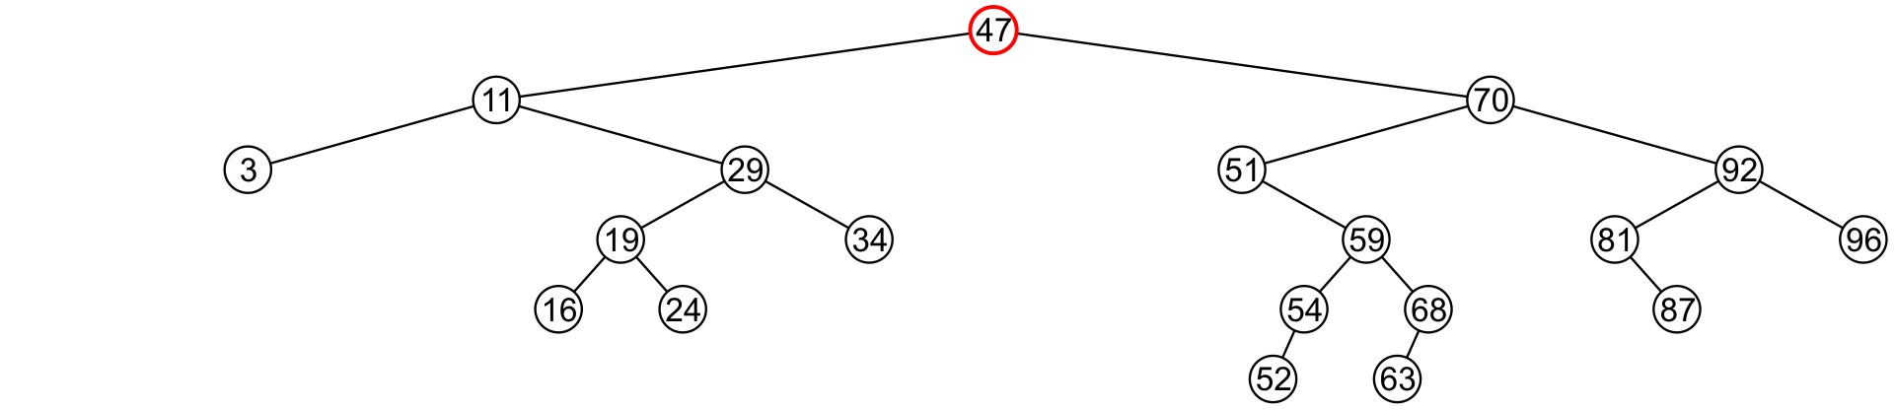
Delete
Suppose we want to erase the root 47 again:
We must copy the minimum of the right sub- tree
We could promote the maximum object in the left sub-tree and achieve similar results

Slide 59
Multiple Choice Questions

Slide 60
1. Identify the Traversal code below
void traversal(struct BTNode *node)
{
if(root) {
traversal(root->left);
printf(“%d”,root->data);
traversal(root->right);
}
}

Slide 61
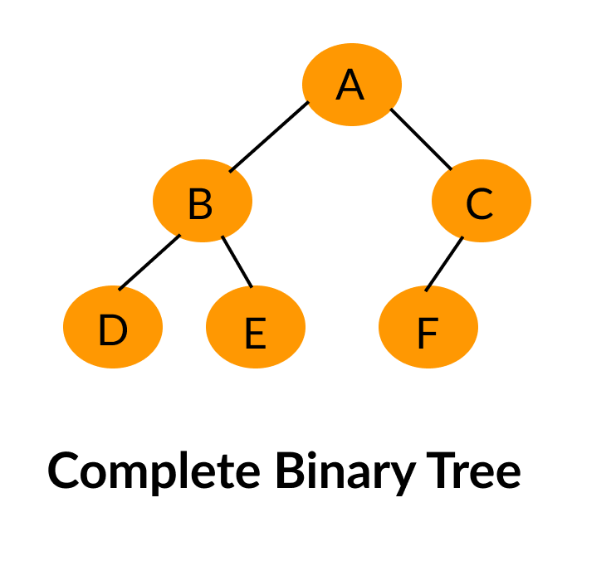
2. Identify type of the tree.

Slide 62
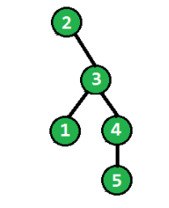
3. What is the height of the tree.

