Slide 1
Fake-News Detection
BATCH : 8
1. D. Meghana - 19K41A04A6
2. Anju Haliya - 19K41A0563
3. B. Sreshta - 19K41A0565

Slide 2
CONTENTS
01
02
03
04
05
06
OBJECTIVES
DATASET
LITERATURE SURVEY
METHADOLOGY
RESULTS
DESIGN
07
08
CONCLUSION
REFERENCES

Slide 3

01
OBJECTIVES
Inhibit the threat to democracy
Restore public trust
Reliable justice
Understanding the intuition behind the machine learning algorithms of Natural language processing tool kit and its packages.

Slide 4
02
DATASET
Dataset has been acquired from kaggle :
The thus collected news has features of :
Input features :
id: unique id for a news article
title: the title of a news article
author: author of the news article
text: the text of the article
Output feature :
label: a label that marks the article as potentially unreliable
1: unreliable(fake)
0: reliable(real)
Output feature :

Slide 5
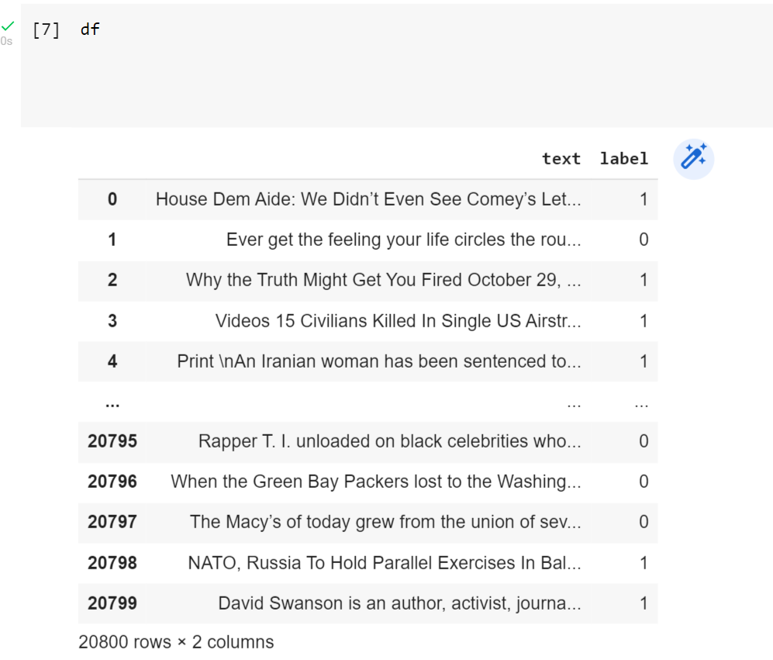
02
DATASET
we have acquired dataset from kaggle of 20799 samples of fake and true text news

Slide 6
03
LITERATURE SURVEY
SI NO | DATE OF PUBLICATION | AUTHORS | NAME | METHADOLOGY | DATASET | ACCURACY
1 | 29 July, 2021. | Arvin Hansrajh Timothy T. Adeliyi Jeanette Wing1 | Detection of Online Fake News Using Blending Ensemble Learning | logistic regression support vector machine linear discriminant analysis stochastic gradient descent and ridge regression | LIAR ISOT | 60.8 98.4
2 | 29 November, 2018. | Akshay Jain Amey Kasbe | Fake News Detection | Naive Bayes classification | GIT HUB - Labelled as authentic. | Title : 80 Text : 93
3 | April, 2021. | Jamal AbdulNasirOsama SubhaniKhan IraklisVarlamis | Fake news detection: A hybrid CNN-RNN based deep learning approach | Deep learning : CNN - RNN | FA-KES ISOT | 60 99
4 | June, 2022. | Hemalatha A Karpahalakshmi S Thanga Sri R Vaishnavi M Bhavani N | Fake News Detection Using Machine Learning | Feature extraction vectorization : Count Vectorizer and Tiff Vectorizer From Python scikit-learn library SVM Naive Bayes | fake and real news from the online media. | 98.6
5 | April, 2021. | Tejaswini Yesugade Shrikant Kokate Sarjana Patil Ritik Varma Sejal Pawar | Fake News Detection Using LSTM | LSTM | From Kaggle | 91.5

Slide 7
03
LITERATURE SURVEY
SI NO | DATE OF PUBLICATION | AUTHORS | NAME | METHADOLOGY | DATASET | ACCURACY
6 | July, 2021. | kajal Kumari | Detecting Fake News with Natural Language Processing | TfidfVectorizer Count Vectorizer Hash Vectorizer | From Kaggle | 93.2
7 | May, 2021. | Nabanita Roy | Predicting Fake News using NLP and Machine Learning/Scikit-learn/GloVe/Keras/LSPM | Tf-idf and count vectorizer Using logistic regression Random Forest Decision Tree Gradient and Adaboost | Kaggle fake news dataset | 96.5
8 | October, 2021. | Barbara Probierz Piotr Stefański Jan Kozak | Rapid detection of Fake News based on Machine Learning Method | TfidfVectorizer Random Forest SVM CART Adaboost Bagging | Kaggle | 99.6
9 | August, 2021. | Phayung Meesad | Thai Fake News Detection Based on Information Retrieval, Natural Language Processing and Machine Learning | Naïve Bayesian Logistic Regression K-Nearest Neighbor Multilayer Perceptron Support Vector Machine Decision Tree Random Forest Rule-Based Classifier LSPM | Real, Fake and Suspicious | 90.0
10 | June, 2020. | Joyce Annie George | Fake News Detection Using NLP Techniques | SVM Count Vectorizer TfidfVectorizer | Fake and real news from Kaggle | 99.6

Slide 8
04
METHADOLOGY AND PROCEDURE
DATA PREPROCESSING:
Data pre-processing is essential while working on large dataset because algorithms could only be applied on the vectorized text. Data pre - processing thereby aims at covertin text into vectorized simple form which means tokenizing. Tokenizing means dividing the text into units of words or sentences. Tokenizing is the fundamental step for stemming and lemmatizaion.
We have elimated stop wards from the dataset as they have no significance in deciding the meaning of the text. Stemming has been applied to correlate the words belonging to same root.
Then we would proceed with label encoding, the label encoding is to signify the categorical data for the semi-structured or unstructured data. The label encoding means giving the labels for the data in numericals.

Slide 9
04
METHADOLOGY AND PROCEDURE
DATA PREPROCESSING:
4. Next, stemming is done to produce morphological variants of a root/base word. Stemming programs are commonly referred to as stemming algorithms or stemmers. These algorithms are
5. used to give the domain vocabularies in domain analysis.
6. Neural networks requires to have inputs with the same size. Therefore sentence inputs are padded with 0’s after defining the max length and words are dropped and added accordingly.

Slide 10
04
METHADOLOGY AND PROCEDURE
After Data pre-processing we are going to perform word embedding using the Word2Vec vectorizer.
Word2Vec
Word2vec is not a singular algorithm, rather, it is a family of model architectures and optimizations that can be used to learn word embeddings from large datasets. Embeddings learned through word2vec have proven to be successful on a variety of downstream natural language processing tasks. These papers proposed two methods for learning representations of words
After word embedding, we are going to load the LSTM model for text classification.
LSTM
LSTM (Long Short-Term Memory) network is a type of RNN (Recurrent Neural Network) that is widely used for learning sequential data prediction problems. As every other neural network LSTM also has some layers which help it to learn and recognize the pattern for better performance. The basic operation of LSTM can be considered to hold the required information and discard the information which is not required or useful for further prediction.

Slide 11
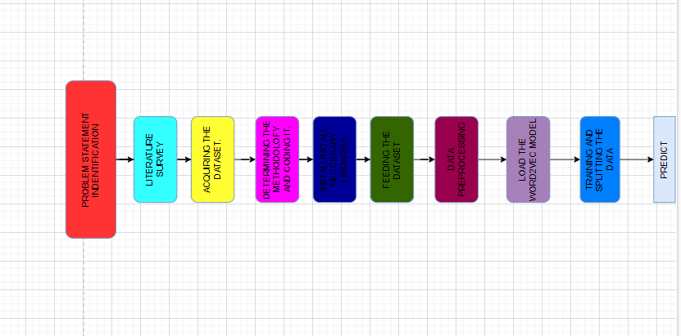
04
METHADOLOGY AND PROCEDURE
FLOWCHART

Slide 12
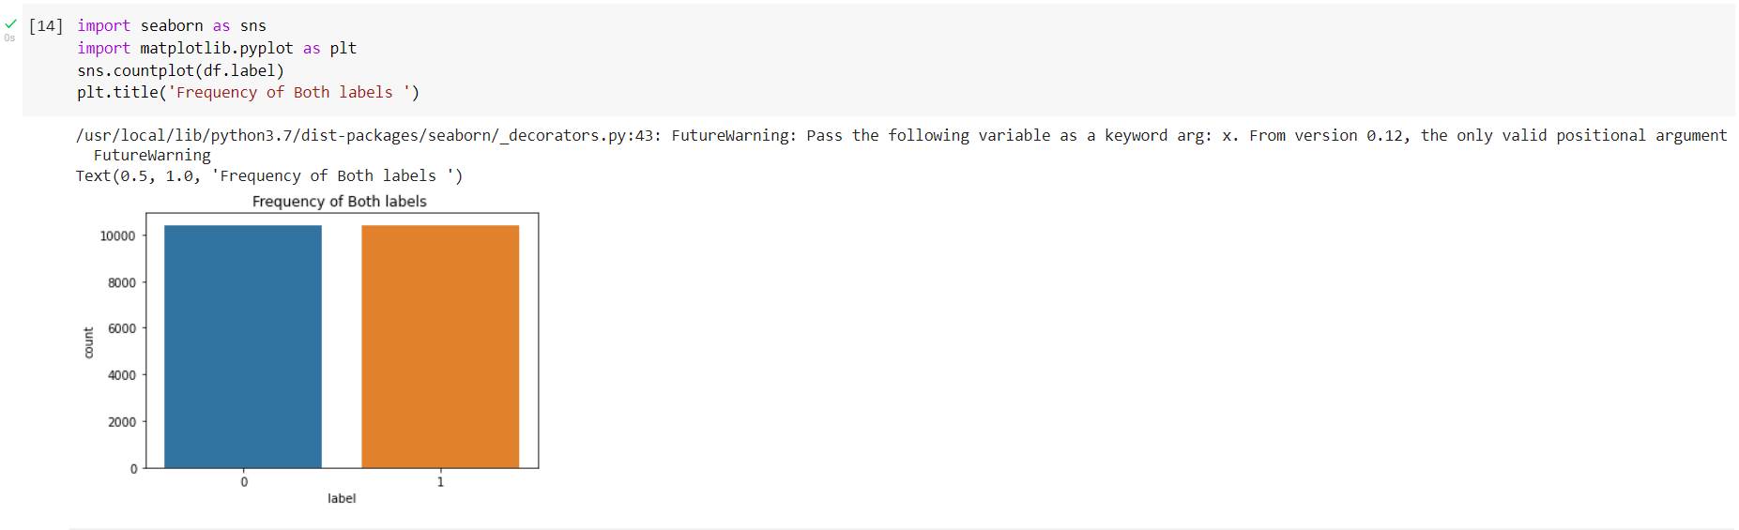
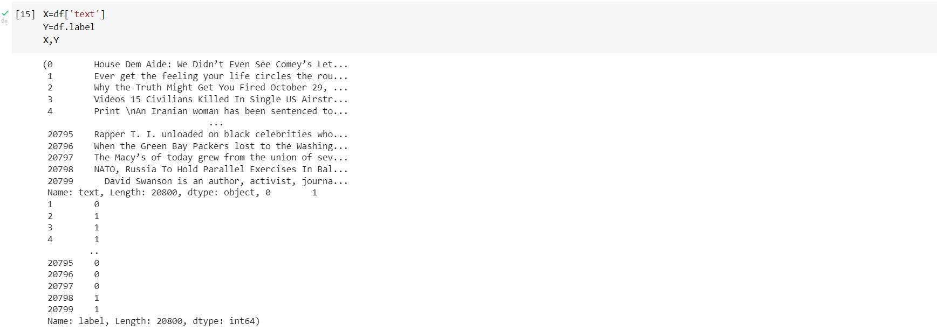
05
RESULTS
Our project gave out the accuracy of 95%
The output labels are the predictions if the data sample is real or not.
The dataset containing samples of real and fake news.

Slide 13
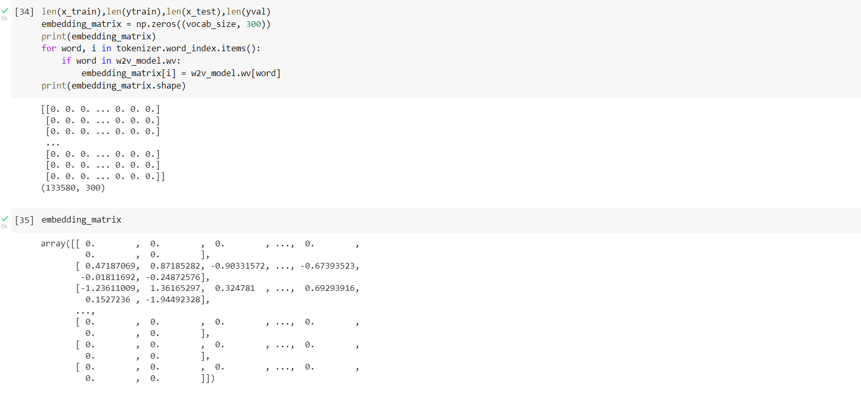
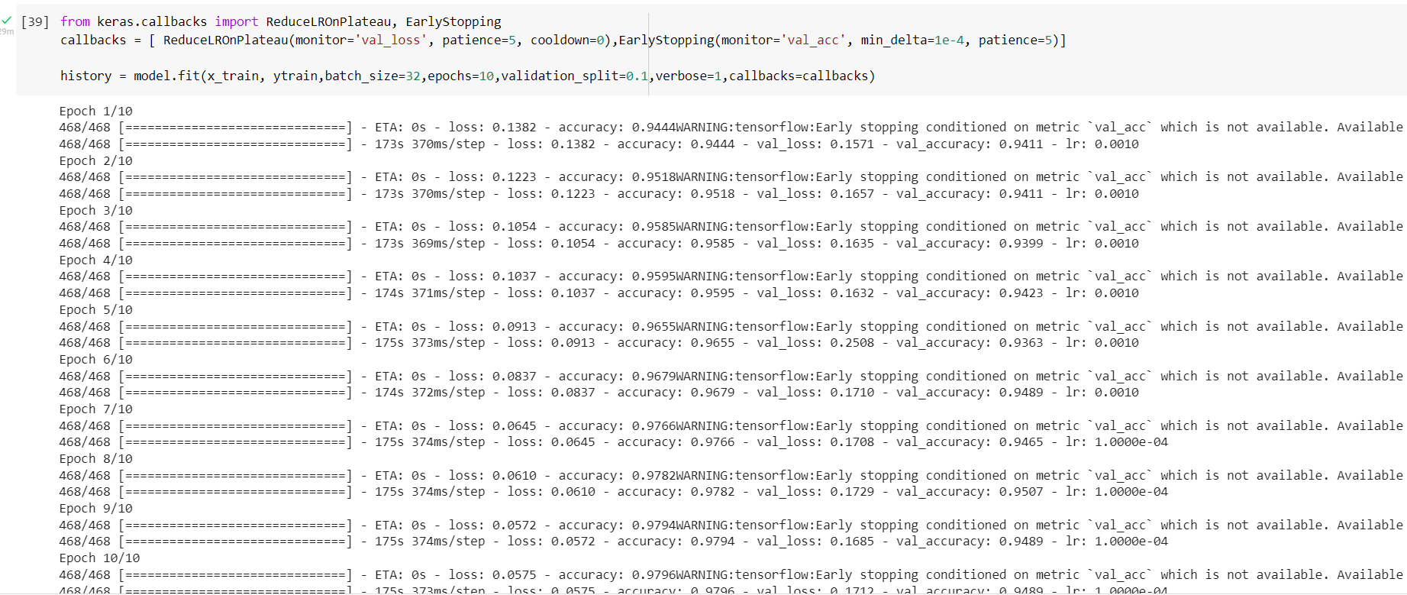
05
RESULTS
Word embedding results
LSTM model results

Slide 14
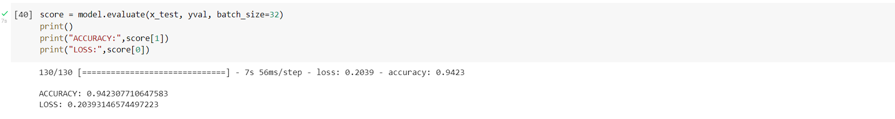
05
RESULTS
RESULT

Slide 15
06
DESIGN
Requirement Specifications (S/W & H/W)
Hardware Requirements
ü System : Processor Intel(R) Core (TM) i5-8265U CPU @ 1.60GHz, 1800 MHz, 4 Cores, 8 Logical Processors
ü RAM : 8 GB
ü Hard Disk : 557 GB
ü Input : Keyboard and Mouse
ü Output : PC
Software Requirements
ü OS : Windows 10
ü Platform : Google Colaboratory / Jupyter Notebook
ü Program Language : Python

Slide 16
07
CONCLUSION
To conclude, our project meets its objective of countering the threat to deomocracty through the fake news and restore the public trust and give them access to real news for proper awareness and decision making. Our model uses the tensorflow and keras libraries for data preprocessing, text, embedding and classification. The data preprocessing has been done by tokenizing, label encoding, stemming, pad sequencing methods and word embedding is done by word2vec model from Gensim and text classification between true and fake by LSTM - long short term memory libabry. Our model accounts for an accuracy of 95%.

Slide 17
08
REFERENCES
[1] https://www.ijraset.com/research-paper/paper-on-fake-news-detection-using-machine-learning
[2] https://ieeexplore.ieee.org/document/8546944
[3] https://www.sciencedirect.com/science/article/pii/S2667096820300070
[4] https://www.ijraset.com/research-paper/paper-on-fake-news-detection-using-machine-learning
[5] https://www.academia.edu/es/51346745/Fake_News_Detection_using_LSTM
[6] https://www.analyticsvidhya.com/blog/2021/07/detecting-fake-news-with-natural-language-processing
[7] https://towardsdatascience.com/predicting-fake-news-using-nlp-and-machine-learning-scikit-learn-glove-keras-lstm-7bbd557c3443?gi=4de371a5a91e
[8] https://www.sciencedirect.com/science/article/pii/S187705092101797X
[9] https://link.springer.com/article/10.1007/s42979-021-00775-6
[10] https://medium.com/analytics-vidhya/fake-news-detection-using-nlp-techniques-c2dc4be05f99

Slide 18
THANKS

