Slide 1



Selenium GUI
@BeforeSuite
setUp() {
new ChromeDriver
driver.get(URL)
}
@Test(priority=1)
tc01_Name() {
enterName(...)
Assert.assertEquals
test.pass("✔")
}
Automation Framework
SDET Capstone Project · Wipro Limited · June 2026
Meghanadh Yarramsetty
Trainer: Navin CK · SDET Training Program
Java 11
Selenium
GitHub
1

Slide 2





About Me
Meghanadh Yarramsetty
SDET Trainee · Wipro Limited
Role
Organization
SDET Trainee
Wipro Limited
Program
Trainer
Software Development Engineer in Test
Navin CK
2

Slide 3







Training Journey Overview
SDET Training Program – Topics Covered
1
Core Java → Advanced Java
2
SQL and JDBC
3
Selenium WebDriver
4
TestNG Framework
5
Maven Build Tool
6
REST Assured – API Tests
7
Page Object Model (POM)
3

Slide 4
What is SDET?
SDET = Software Development Engineer in Test
Manual Tester
SDET
Developer
Executes tests manually
No coding required
Slow feedback loop
Only test reports
Builds automation frameworks
Codes like a developer
CI/CD pipeline ready
Full quality ownership
Builds product features
May write unit tests
Minimal QA focus
Feature-centric tools
💡 SDETs bridge the gap between development and quality — critical for fast, reliable modern software delivery.
4

Slide 5
Project Introduction
Project Name:
Selenium GUI Automation Framework
Project Type:
Capstone Project
App Under Test:
testautomationpractice.blogspot.com
Purpose:
Automate all interactive GUI elements on the website
Technology:
Java 11 + Selenium WebDriver 4.18.1 + TestNG + Maven
IDE / Build:
Eclipse IDE | Apache Maven 3.x
5

Slide 6
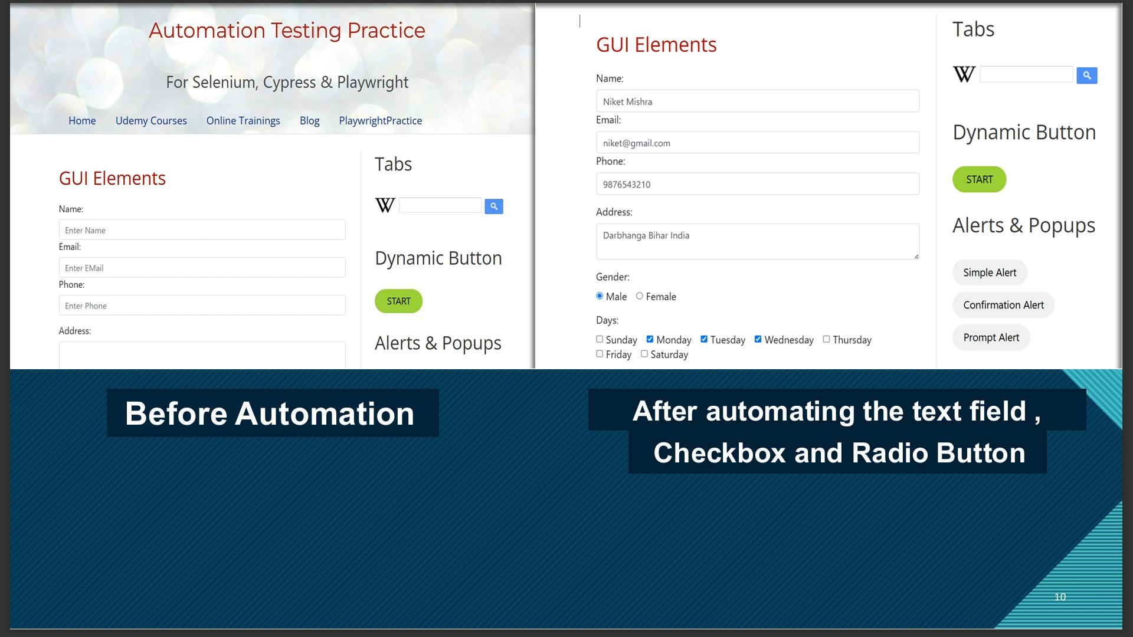
Application Under Test
testautomationpractice.blogspot.com — all GUI element types available for practice
Text Fields (Name / Email / Phone / Address)
Radio Buttons (Gender: Male / Female)
Checkboxes (Days of the week: Mon–Sat)
Dropdowns (Country · Colors · Sorted Animals)
Date Pickers (jQuery UI – 2 date formats)
File Upload (Single & Multiple files)
Alerts (Simple · Confirmation · Prompt)
Mouse Hover (Dropdown sub-menu links)
Drag & Drop (jQuery UI)
Slider (Price range widget)
Double Click (Copy text between fields)
Dynamic Button & Wikipedia Search Widget
6

Slide 7







Tech Stack
Java 11
Selenium WebDriver
TestNG
Language
v4.18.1
v7.9.0
Apache Maven
WebDriverManager
ExtentReports
3.x – Build Tool
v5.7.0
v5.1.1
Log4j2
Eclipse IDE
GitHub
v2.23.1 – Logging
Development IDE
Version Control
7

Slide 8
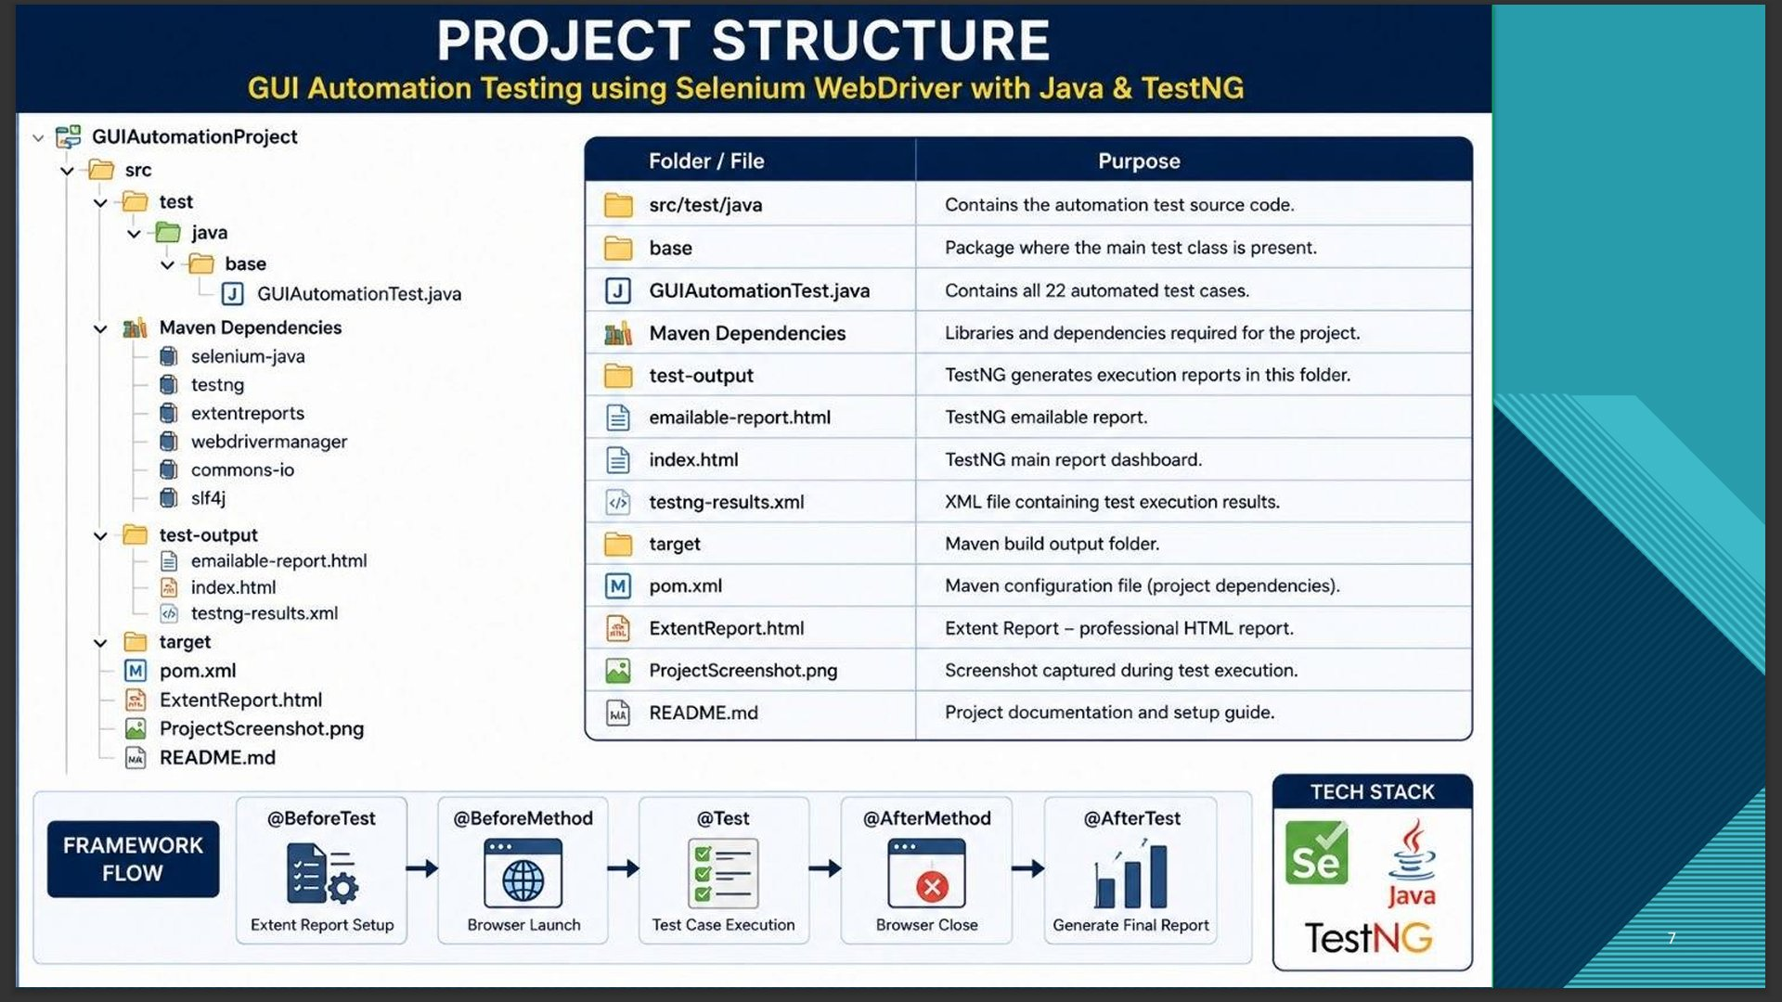
Project Architecture – POM Framework
TEST LAYER
GuiElementsTest.java – 18 Test Cases + Screenshots
Eclipse IDE – Actual Project
PAGE LAYER
GuiElementsPage.java – All Locators & Action Methods
BASE LAYER
BaseTest.java – Browser Setup & Teardown
UTILITY LAYER
ExtentReportManager.java · ScreenshotUtil.java
CONFIG
testng.xml · log4j2.xml · pom.xml
8

Slide 9
Project Folder Structure
selenium-gui-automation/
├── pom.xml
├── screenshots/
├── test-output/
│ └── ExtentReport.html
└── src/test/
├── resources/
│ ├── testng.xml
│ └── log4j2.xml
└── java/com/automation/
├── tests/
│ ├── BaseTest.java
│ └── GuiElementsTest.java
├── pages/
│ └── GuiElementsPage.java
└── utils/
├── ExtentReportManager.java
└── ScreenshotUtil.java
POM Design
Page & Test layers cleanly separated
HTML Reports
Extent dark-theme → test-output/
Screenshots
Before + After + OnFail per test
Config-driven
testng.xml controls suite execution
9

Slide 10
Page Object Model (POM)
Design pattern: each page = one Java class with all locators & methods
What is POM?
POM is a design pattern where each web page has its own Java class with all its locators and action methods. Tests only call these methods — they never locate elements directly.
Test Class
Page Class
Browser
→
→
GuiElementsTest.java
GuiElementsPage.java
Chrome via WebDriver
Benefits
Easy to maintain — change locator in one place, all tests updated automatically
Code reusability across multiple test methods and test classes
Clean, professional test code that reads like plain English
Scales to hundreds of test cases without any duplication
10

Slide 11





Key Java Files Explained
BaseTest.java
@BeforeSuite launches Chrome · @AfterSuite closes browser and flushes ExtentReport to disk
GuiElementsPage.java
All 30+ locators and iframe-switch helpers — every action method (enterName, selectGender…) lives here
GuiElementsTest.java
18 @Test methods with priorities, assertions (assertEquals/assertTrue) and before/after screenshots
ExtentReportManager.java
Singleton pattern — creates and owns one HTML report for the entire run; dark theme configured
ScreenshotUtil.java
Captures full-page PNG via TakesScreenshot; auto-creates screenshots/ folder; timestamps file names
11

Slide 12
Selenium Concepts Used
WebDriver:
Launches and drives the Chrome browser instance
By Locators:
id · name · xpath · cssSelector · tagName
Select Class:
Handles all dropdown interactions via selectByVisibleText()
Actions Class:
Mouse hover · Double-click · Drag & Drop · Slider arrows
JavascriptExecutor:
Scroll into view, interact with JS-rendered widgets and sliders
Alert Handling:
switchTo().alert() → accept() / dismiss() / sendKeys()
Implicit Wait:
10-second global poll applied to entire WebDriver session
Explicit Wait:
WebDriverWait + ExpectedConditions for specific elements
TakesScreenshot:
Full-window PNG captured and saved for every test step
12

Slide 13
TestNG Annotations Used
@BeforeSuite
Runs ONCE before all tests — launches Chrome, initialises ExtentReport
@AfterSuite
Runs ONCE after all tests — quits browser, flushes HTML report to disk
@BeforeClass
Runs before each test class — initialises the GuiElementsPage POM object
@Test(priority=1)
Marks a test method and controls execution order (lowest number = first)
@Test(description=)
Adds a description shown as the node title in the ExtentReport HTML
Assert.assertEquals
Validates expected value matches actual value — test FAILS if different
Assert.assertTrue
Validates a boolean condition is true — e.g. isSelected(), !isEmpty()
13

Slide 14
Test Cases Overview — TC01 to TC09
TC # | Test Name | Locator / Method | Status
TC01 | Page Title Validation | driver.getTitle() → Assert.assertEquals | PASS
TC02 | Name Text Field | name="name" → sendKeys() | PASS
TC03 | Email Text Field | name="email" → sendKeys() | PASS
TC04 | Phone Text Field | name="phone" → sendKeys() | PASS
TC05 | Address Textarea | id="textarea" → sendKeys() | PASS
TC06 | Radio Button – Gender | //input[@type='radio' @value='male'] | PASS
TC07 | Day Checkboxes | id="monday","wednesday","friday" | PASS
TC08 | Dropdowns (3) | Country · Colors · Animals – Select class | PASS
TC09 | Date Pickers | id="datepicker" + id="datepicker2" | PASS
14

Slide 15
Test Cases Overview — TC10 to TC18
TC # | Test Name | Locator / Method | Status
TC10 | File Upload | id="singleFileUpload" → sendKeys(absPath) | PASS
TC11 | Wikipedia Search | Wikipedia widget → sendKeys + click search | PASS
TC12 | Dynamic Button | class-based XPath → START/STOP toggle state | PASS
TC13 | Mouse Hover | id="hoverButton" → Actions.moveToElement() | PASS
TC14 | Double Click | id="copyButton" → Actions.doubleClick() | PASS
TC15 | Drag and Drop | id="draggable" → id="droppable" | PASS
TC16 | Slider | #slider .ui-slider-handle → ARROW_RIGHT × 15 | PASS
TC17 | Alert Handling | Simple · Confirmation · Prompt – accept() | PASS
TC18 | Misc Features | ComboBox · Table · Scroll · Hyperlink count | PASS
18 / 18 PASS · 0 Failures · 0 Skipped 🎉
15

Slide 16
Steps to Build the Framework
1
Create Maven project in Eclipse IDE
2
Create package structure: tests/ · pages/ · utils/
3
Add all dependencies in pom.xml (Selenium, TestNG, ExtentReports, WDM)
4
Write ExtentReportManager.java — singleton HTML report setup
5
Write ScreenshotUtil.java — screenshot capture and naming
6
Write BaseTest.java — browser lifecycle (@BeforeSuite / @AfterSuite)
7
Write GuiElementsPage.java — all 30+ locators and action methods
8
Write GuiElementsTest.java — 18 @Test methods with assertions
9
Configure testng.xml and log4j2.xml
10
Run via TestNG Suite or mvn test
16

Slide 17
Automation in Action — Text Fields · Radio Button · Checkboxes
17

Slide 18
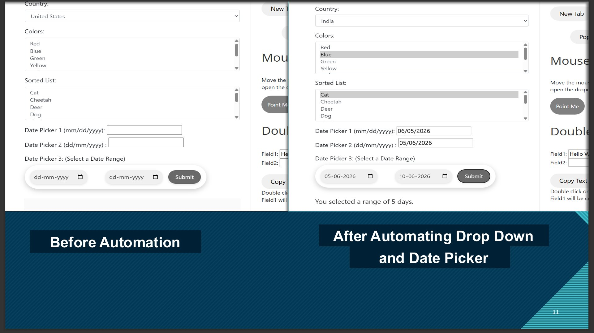
Automation in Action — Dropdowns & Date Pickers
18

Slide 19
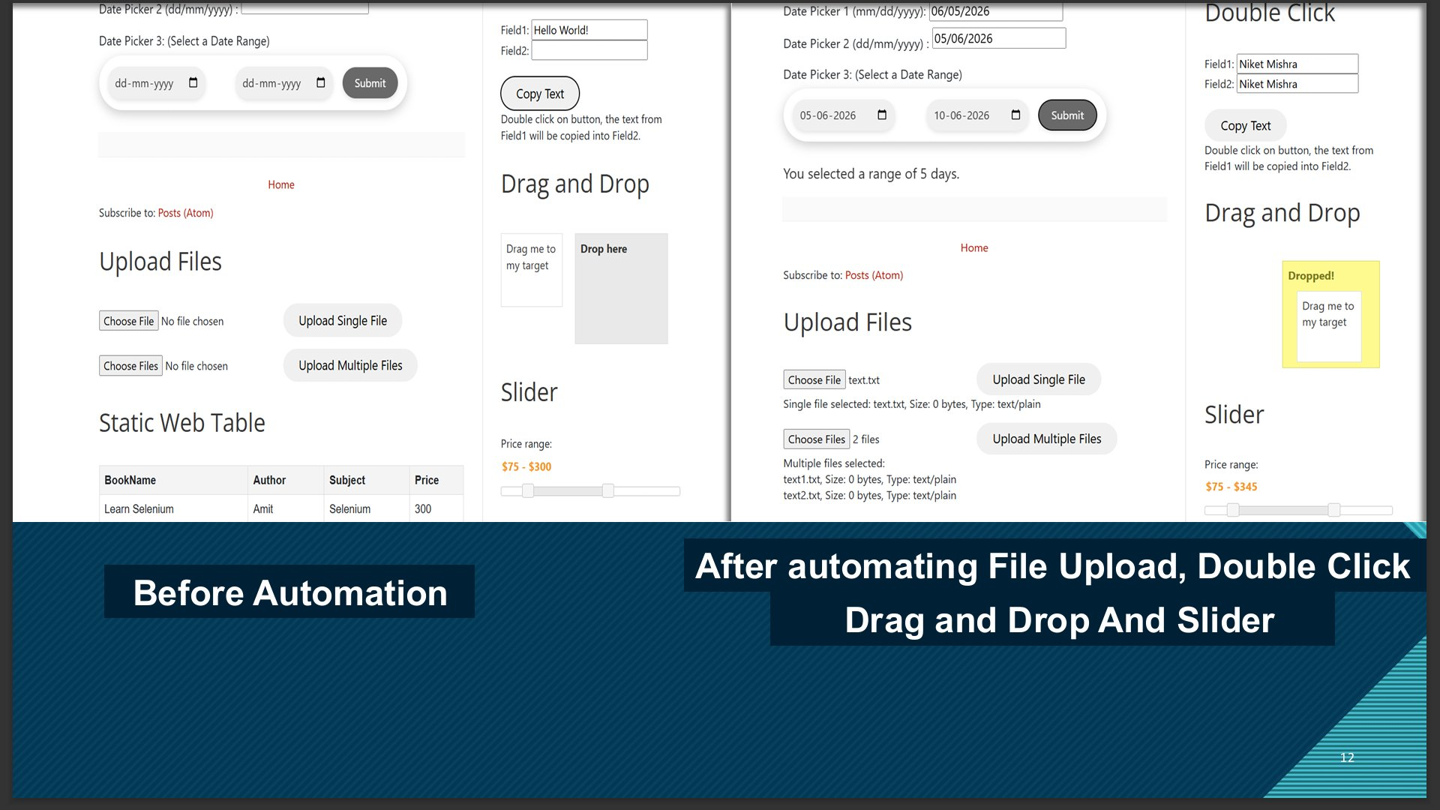
Automation in Action — File Upload · Double Click · Drag & Drop · Slider
19

Slide 20
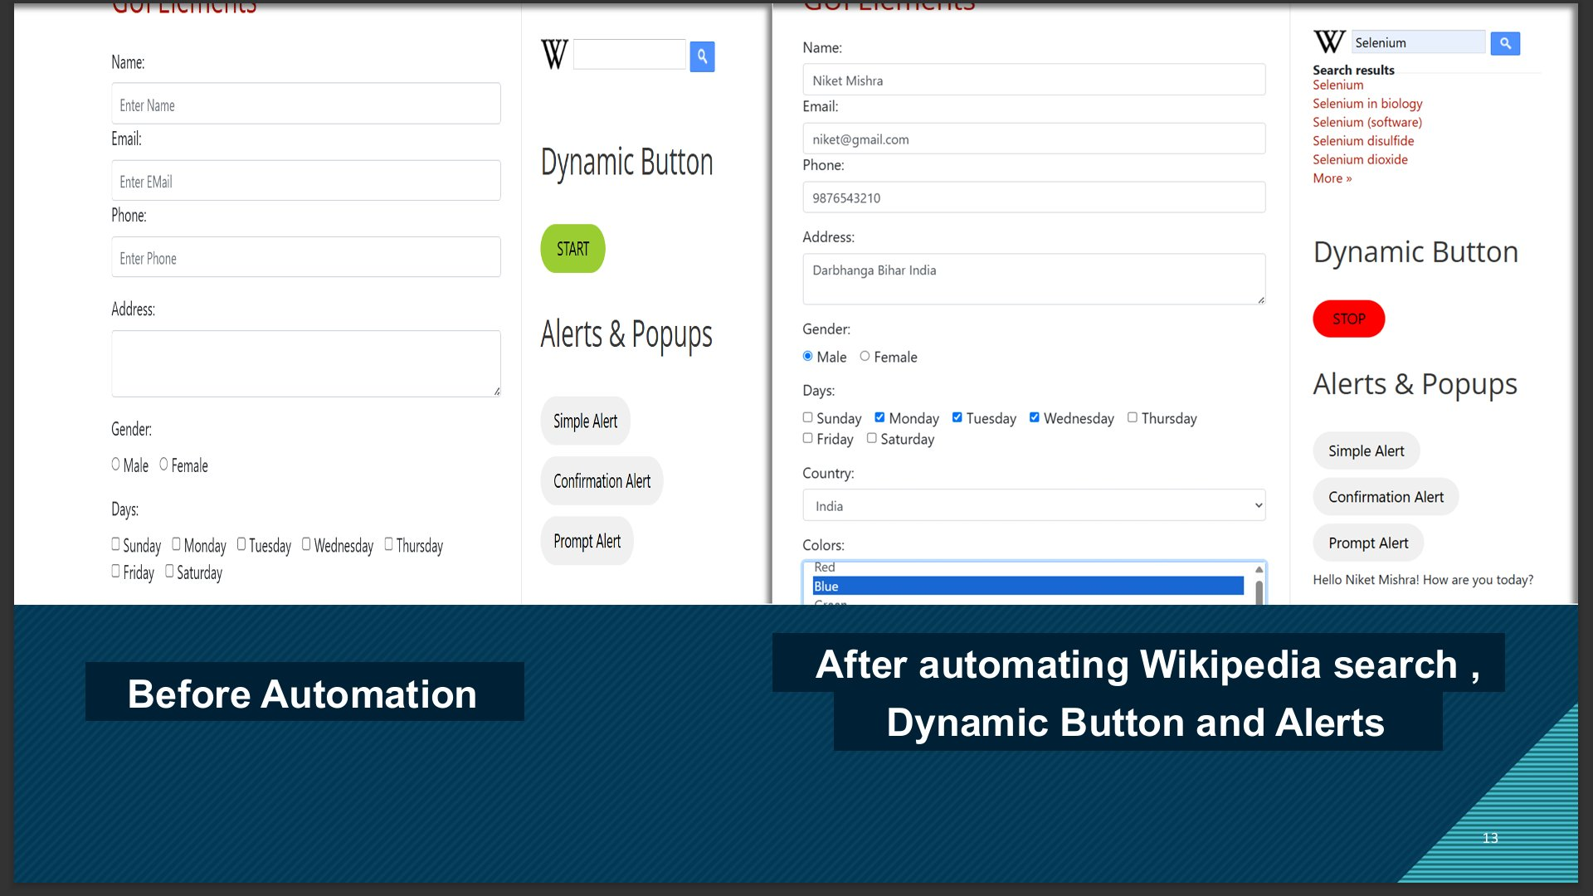
Automation in Action — Wikipedia Search · Dynamic Button · Alert Handling
20

Slide 21
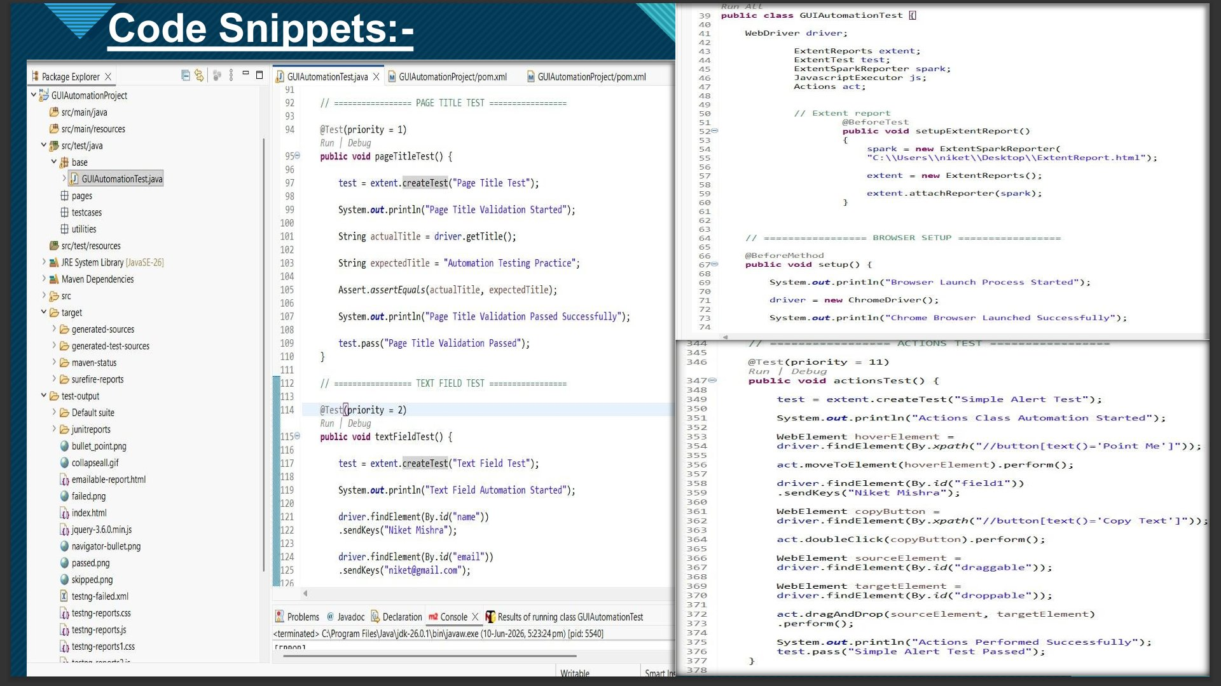
Code Snippets — Eclipse IDE
21

Slide 22
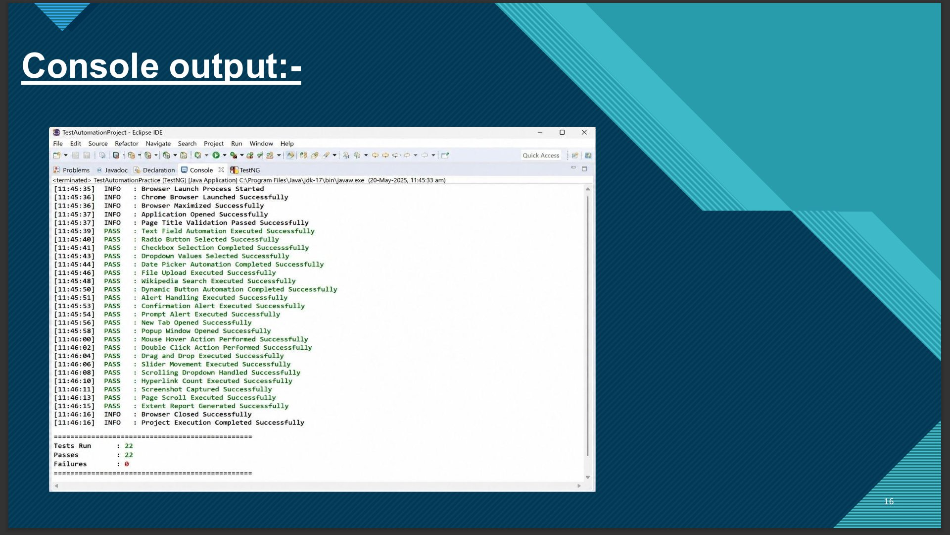
Console Output — All 18 Tests PASS
18
Total TCs
18
Passed
0
Failed
54+
Screenshots
22

Slide 23
Challenges Faced & Bug Report
BUG-001
Fixed
Severity: Medium
Dynamic Button – NoSuchElementException after first click
Fix: Name attribute changed from 'start' → 'stop'. Fixed by re-locating element via class attribute XPath
BUG-002
Fixed
Severity: Low
Right-click context menu stayed open, blocking next action
Fix: Context-click not required by the use case — removed from test scope entirely
BUG-003
Open
Severity: Low
CDP version mismatch warning: Selenium 4.18.1 vs Chrome 149
Fix: No functional impact on test execution — logged as open, pending version alignment
BUG-004
Fixed
Severity: Low
driver and wait fields not accessible from GuiElementsTest class
Fix: Changed to public static fields in BaseTest → accessed via BaseTest.driver and BaseTest.wait
23

Slide 24







Future Enhancements
Cross-Browser Testing
Parallel Execution
Add Edge and Firefox support via WebDriverManager
TestNG parallel=methods with configurable thread count
Data-Driven Testing
CI/CD with Jenkins
Excel-based input using Apache POI library
Auto-trigger test suite on every Git push
REST Assured API Tests
Retry Analyzer
Add an API test layer alongside the GUI suite
TestNG IRetryAnalyzer for auto-retry on flaky tests
Allure Reports
Docker Execution
Modern interactive dashboard as alternative to Extent
Containerised headless test runs for portability
24

Slide 25
Conclusion & Thank You
Successfully automated 18 GUI element types using Selenium WebDriver
Built a production-ready POM framework with HTML reporting and screenshot evidence
Identified and resolved 3 bugs during execution — 18/18 test cases PASS, 0 failures
Framework is scalable, maintainable, and CI/CD-ready for real-world projects
54+ screenshots captured per run · ExtentReport.html · GitHub repository published
🔗 github.com/meghanadh278-crypto/Automating-GUI-Elements-using-Selenium
Meghanadh Yarramsetty · SDET Trainee · Wipro Limited · Trainer: Navin CK
25

