Slide 1




ATHENA
ONLINE NOTES SHARING SYSTEM

Slide 2
PRESENTED BY:
PRODUCT OWNER:VINDHYA J K
SCRUM MASTER: SYED AWAIZ AHMED
TEAM MEMEBERS:
ABHISHEK GOWDA
ALAM SHAIKH
MEGHANA H M
MEGHANA S
NAGARATHNA P
NISHANTH M
YALLAPPA CHALWADI
VINAY G

Slide 3
INTRODUCTION
In this project “Athena” student and faculty can upload/download notes. through the notes sharing process, users can upload, download and also view the notes uploaded by others.
User can also edit the notes uploaded by him. In this project two major modules that have been provided are administrator module and user module.

Slide 4
FEATURES
USER SIGN UP:
First Name
Last Name
Contact Number
Email Address
Password
Select Branch
Role

Slide 5
USER LOGIN: Email ID Password ADMIN LOGIN: User Name Password Assign Status Change passwordadmin Unread Queries Read Queries View Queries CONTACT US: Full Name Email Contact Number Subject Send Message
VIEW MY NOTES: S.NO Uploading Date Branch Subject Download Notes File Type Description Status Action VIEW ALL NOTES: S:No Uploaded By Uploading Date Branch Subject Download Notes File Type Description Status

Slide 6
Profile: Edit profile Change password About: Index Contact User login Login admin Signup Admin home Logout
Notes: Upload notes View my notes Delete my notes View all notes Accepted Notes Rejected Notes All Notes Users: View Users Delete Users Pending Users

Slide 7
SCOPE REQUIREMENTS
The project has a wide scope, as it is not intended to a particular organization.
This project is going to develop generic software, which can be applied by any businesses organization.
More over it provides facility to its users. Also the software is going to provide a huge amount of summary data.

Slide 8
FUTURE SCOPE
This web application involves almost all the features of the online file sharing.
The future implementation will be online help for the users and chatting with website administrator.

Slide 9
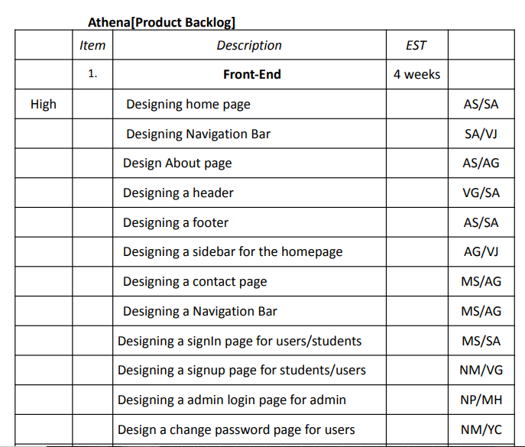
PRODUCT BACKLOG

Slide 10
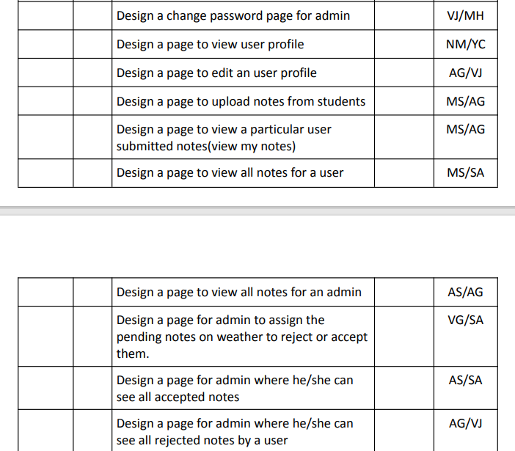

Slide 11
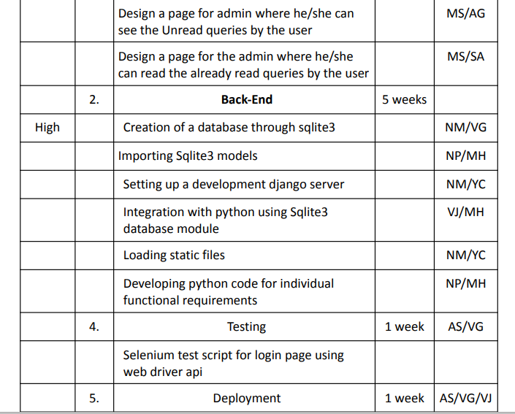

Slide 12
SUB TEAMS: GITHUB TEAM: ALAM SHAIKH NISHANTH M SYED AWAIZ AHMED VINAY G SELENIUM TEAM: ABHISHEK GOWDA MEGHANA H M MEGHANA S NAGARATHNA P YALLAPPA CHALWADI
Notes:
When conducting research, it is easy to go to one source: Wikipedia. However, you need to include a variety of sources in your research. Consider the following sources:
Who can I interview to get more information on the topic?
Is the topic current and will it be relevant to my audience?
What articles, blogs, and magazines may have something related to my topic?
Is there a YouTube video on the topic? If so, what is it about?
What images can I find related to the topic?

Slide 13


DEVOPS TOOLS
GITHUB:
Git is a distributed version control system designed to track changes in a project’s files
Version control systems are a software tool that manage changes to a computer program, document, or collection of files. They help a user or a group of users track changes made to a project over time.
More than 87% of developers use Git as a control system.
GitHub is a platform that can be used to host code online. Think of GitHub as a platform that stores the whole codebase in a remote repository. It comes with tools to collaborate on projects of any size.

Slide 14
Status:
We have created remote repository in github which contains our project source code
By enabling the creation of remote repositories, GitHub allows developers to have a unified source of truth for their source code
Benefits:
Simplify code review
Modify code efficiently
Revert changes that introduce bugs
Maintaining multiple versions of the project
Better collaboration and improved team productivity

Slide 15

SELENIUM:
Status Of Selenium Tool:
We Are Done With Login Page
Other Functions Are Still Developing
Benefits Of Selenium Tool:
Selenium is an automated testing tool used to test web applications across various browsers.
Using selenium we can execute tests in parallel, so that we can reduce the test execution time.
Selenium supports multiple languages like Java, Perl, Ruby, Python, C#, and JavaScript. And Frameworks
Easy To Implement.

Slide 16
THANK YOU

