Slide 1
Spark4Mind
Team : 4
Aishvwarya Iyer
Gayathree Iyer
Barath Naravula Loganathan
Megha Nagabhushan

Slide 2
Introduction
Stress within your comfort zone can help you perform under pressure, motivate you to do your best, even keep you safe when danger looms. But when stress becomes overwhelming, it can damage your mood and relationships, and lead to a host of serious mental and physical health problems. The trouble is that modern life is so full of frustrations, deadlines, and demands that many of us don’t even realize how stressed we are. By recognizing the symptoms and causes of stress, you can take the first steps to reducing its harmful effects and improving your quality of life.

Slide 3


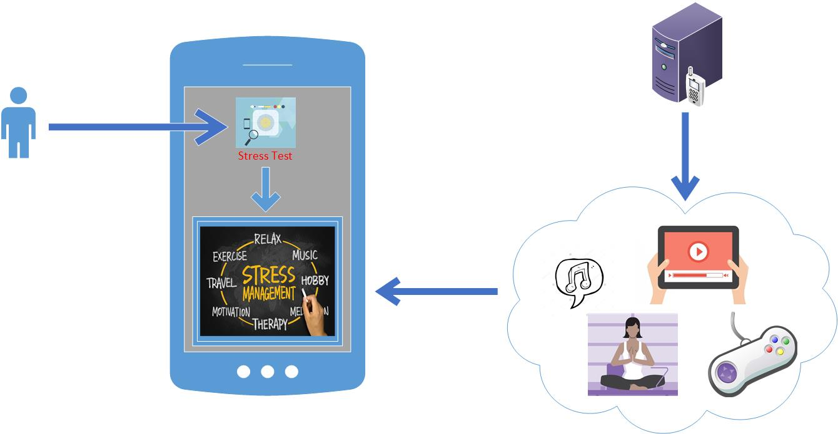


Architecture
Login

Slide 4


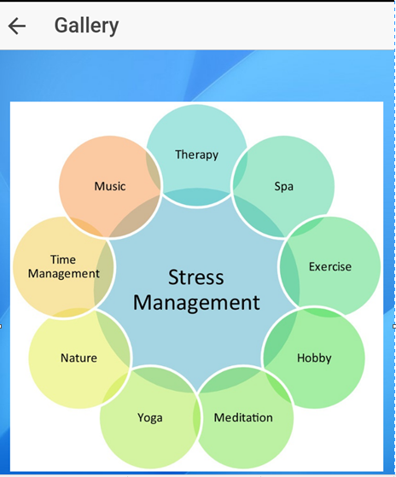
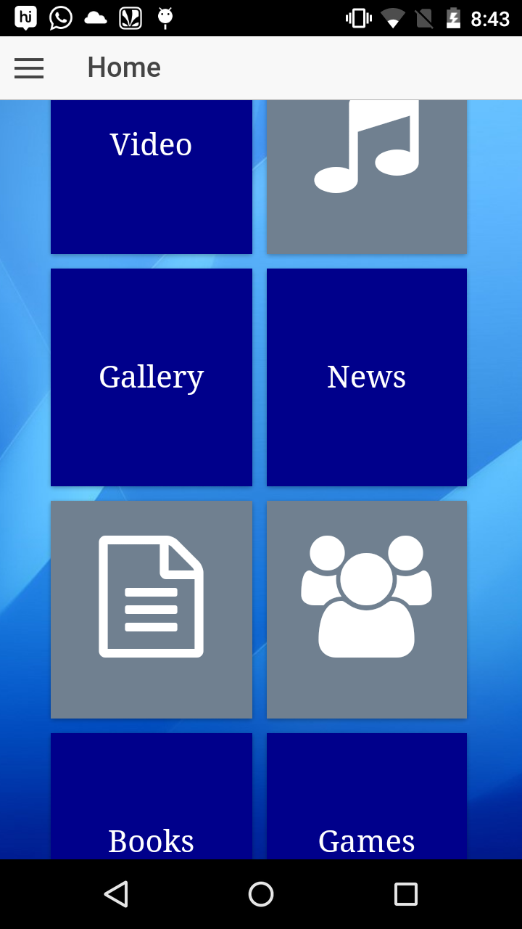
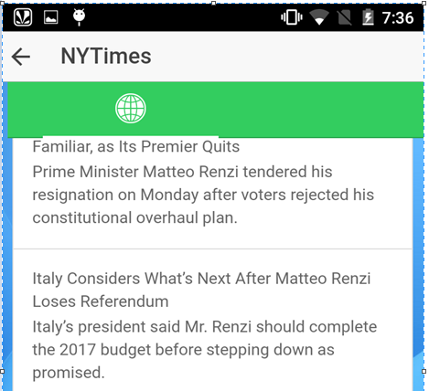




App Features

Slide 5
Thank you!!

