Slide 1
AUDITING
BRUNDA M S

Slide 2
INTRODUCTION TO AUDITING
INTRODUCTION TO AUDITING
The Practise of auditing existed even in the Vedic period. Historical records show that Egyptians, Greek and Roman used to get this public account scrutinized by and independent uofficial Kautalya in his book “arthashastra” has stated that “all undertakings depend onfinance, hence foremost attention should be paid to the treasury”
The term auditing is derived from Latin word “audire” which means “to hear”. In olden days a person was appointed to audit cash transaction only. But now a day’s audit is a wider Meaning. Auditing is verification of financial position and earning position of concerns.
Meaning of Auditing
Audting is the intelligent and critical test of accuracy, adequacy and dependability of accounting data and accounting statements.
2

Slide 3

DEFINITIONS OF AUDITING
In the words of L.R.Dicksee “Audting is an examination of accounting records under taken with a view of establishing whether they correctly and completely reflect the transaction to which the purpose to relate”.
According to R.K.Mamtaz “Auditing is concerned with the verification of accounting data determining the accuracy and reliability of accounting statements and reports”.
3

Slide 4
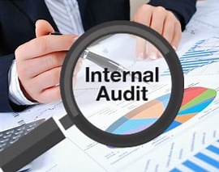
OBJECTIVES OF AUDITING
Objectives of an auditing change with the advancement of business techniques, earlier it was only correct checking of transactions, but now the auditing process is more than normal correcting and checking.
4

Slide 5
MAIN OBJECTIVES
To check the arithmetical accuracy.
To check the assets and liabilities.
Verify the accuracy of posting, balancing etc.
5

Slide 6
MAIN OBJECTIVES
To verify the supporting documents and this validity.
To check all the requirements of books of accounts.
To check the internal control.
5

Slide 7
SECONDARY SECONDARY OBJECTIVES
1. DETECTION AND PREVENTION OF ERRORS
Errors are not made intentionally by mistake as a human error we can find. Here there is no intention to cheat or manipulate the auditor or the organization. During the course of auditing errors may be detected by an auditor are as follows:
1. ERRORS OF PRINCIPLE
Treatment of capital expenses into revenue expenses..
Treatment of revenue expenses into capital expenses.
Over valuation of opening stock & vice-versa.
Charging surplus or detect depreciation.
Wrong provision for prepared exp & incomes.
8

Slide 8
SECONDARY OBJECTIVES
2. ERRORS OF OMOSSION
A transaction left out fully or partially from the account such errors are called as errors of omission. EX;
Omission of receipt in receipt book.
Omission of sales in sales book.
Omission of purchase from purchase book.
Omission of depreciation in the book.
8

Slide 9
SECONDARY OBJECTIVES
3. ERRORS OF COMMISSION
The entered ledger of original entry is incorrect either partially or fully is called as errors of commission. Ex;
Entering 1500 in place of 150.
Wrong posting.
Debit entry should credited & credit entry is debited.
Wrong totals and balances.
Wrong carry forward of balances.
9

Slide 10
SECONDARY OBJECTIVES
4. ERRORS OF DUPLICATION
When a transaction entered and posted twice is called as errors of duplication. Ex;
Twice entry of voucher and receipt.
Double entry of purchase or sales.
Twice entering of wages.
10

Slide 11
SECONDARY OBJECTIVES
5. COMPENSATION ERRORS
When an errors offsetting the effect of another error such errors are known as compensating errors. Ex;
Under casting of one account to compensate another.
Entered debit side Rs.100 and same to credit side.
11

Slide 12
SECONDARY OBJECTIVES
2. DETECTION AND PREVENTION OF FRAUD
The kind of frauds are done intentionally and knowingly to mislead the auditors.
1. MISAPPROPRIATION OF CASH
Recording fictitious purchase.
. Escaping either cash sales or cash purchase
Escaping the amount of showing dummy numbers.
Under recording of sales or purchase.
Over recording of depreciation.
11

Slide 13
SECONDARY OBJECTIVES
2. MISAPPROPRIATION OF GOODS
This is easy to mislead the goods which are less bully of high value. While receiving the goods while issuing and balancing the available goods can be misappropriated by an accountant.
3. MANIPULATION OF ACCOUNTS
Showing loss to avoid tax.
Showing loss to avoid tax.
Showing high profit to pay dividends,
11

Slide 14
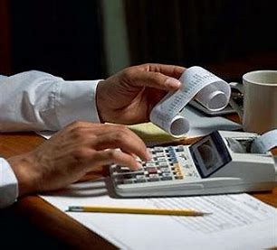
THANK YOU

