Slide 1


Frontend web developer Internship
at Spotmies LLP
S.HIMA MEGHANA
(322103310214)
Internship Coordinator : Dr. CH.Sitha Kumari
Internship Mentor : Sathish Kumar Saride
2nd July 2024

Slide 2
INDEX
01
02
03
04
05
Learning Objectives & Goals
Functionalities Implemented
Steps, Challenges & Solutions
Internship Overview
Introduction

Slide 3
INTERNSHIP OVERVIEW:
Real time Web Applications
Front end developer tools
Collaboration tools
Explored tools like Browser developer tools,.
Ensuring all teams of the project collaborate with git
Learned how real time web applications manage code bases

Slide 4
LEARNING OBJECTIVES & GOALS:
Build UI’s using React JS
State Management using Mobx
Working on API integrations
API testing (postman)
Using Version Control System Like Git

Slide 5
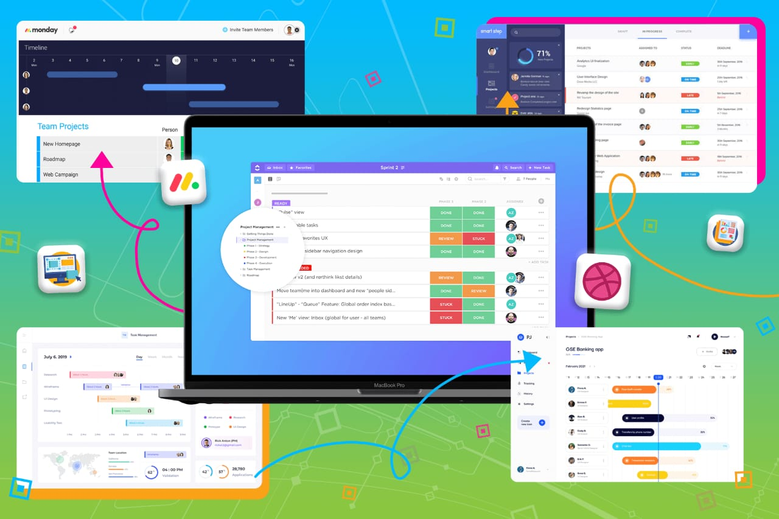
Build UI’s using React JS
Develop reusable components
Manage component state - using hooks
Passing props
Use CSS frameworks
Incorporate third party libraries
Implement responsive design

Slide 6
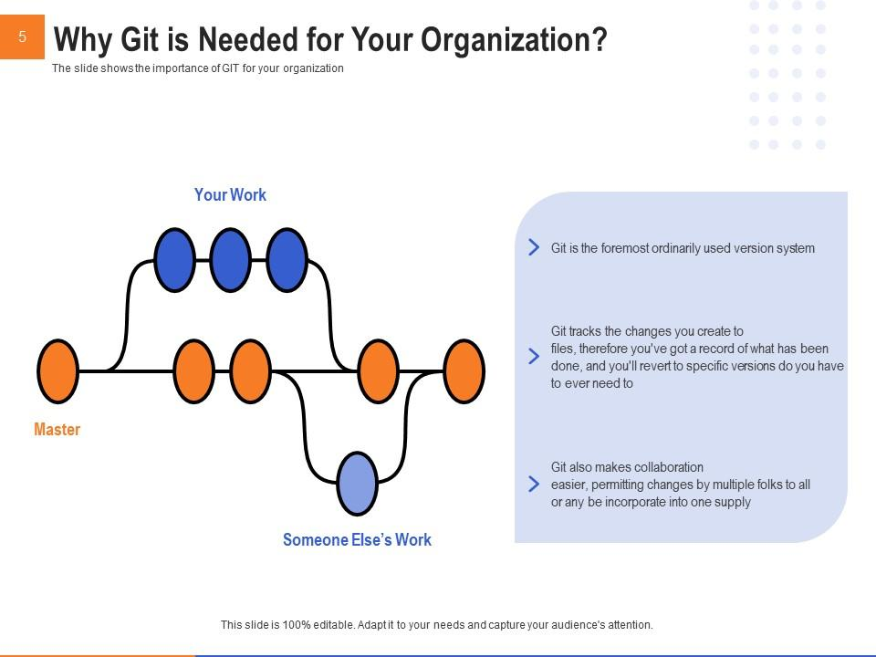
Using Version Control System Like Git
Initialize a git repository
Track changes with git
collaborate using git
push changes to a remote repo
pull updates from a remote repo
Resolve merge conflicts
Branching and Merging

Slide 7
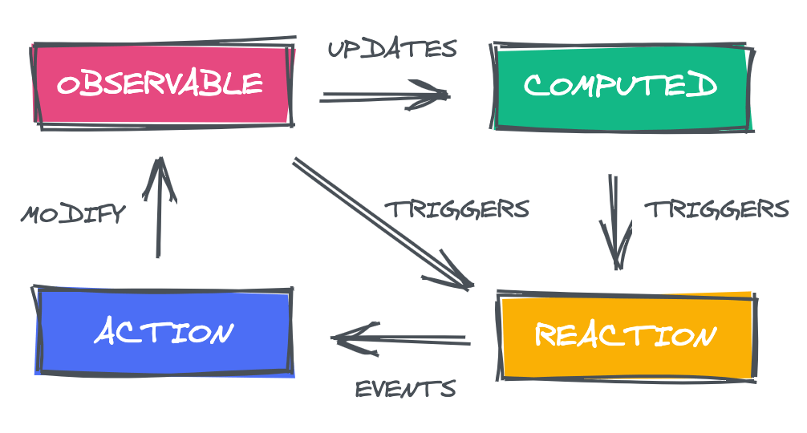
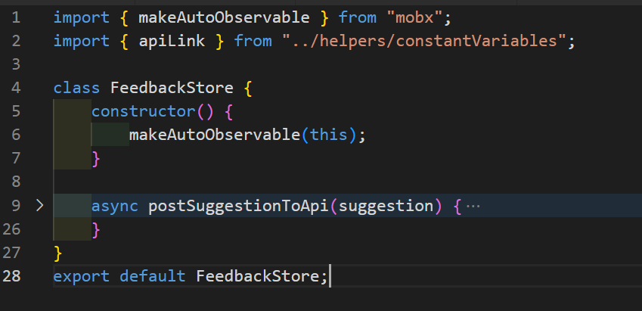
State Management using Mobx
Create observable state
Use actions to modify state
Derive states in react components
Organize and structure Mobx stores

Slide 8
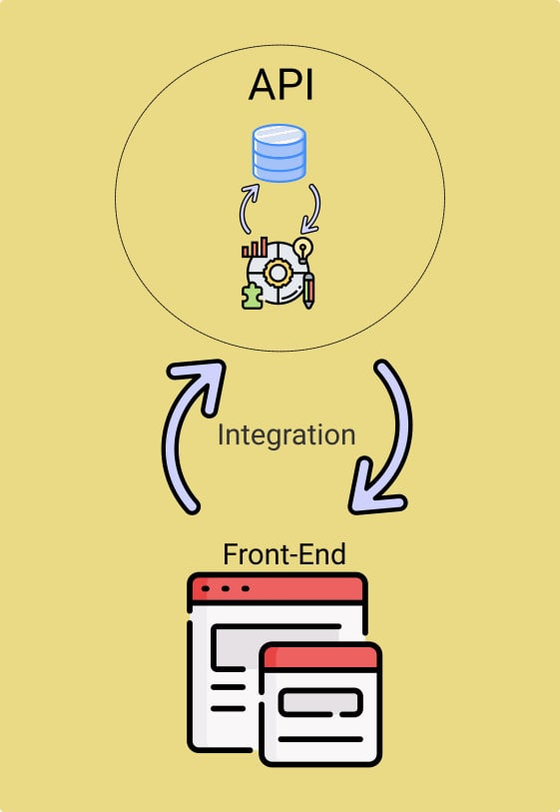
Working on API integrations
Make GET requests (fetch data from an API and display it in the react components)
Implement POST,PUT requests
Using postman for testing API endpoints

Slide 9
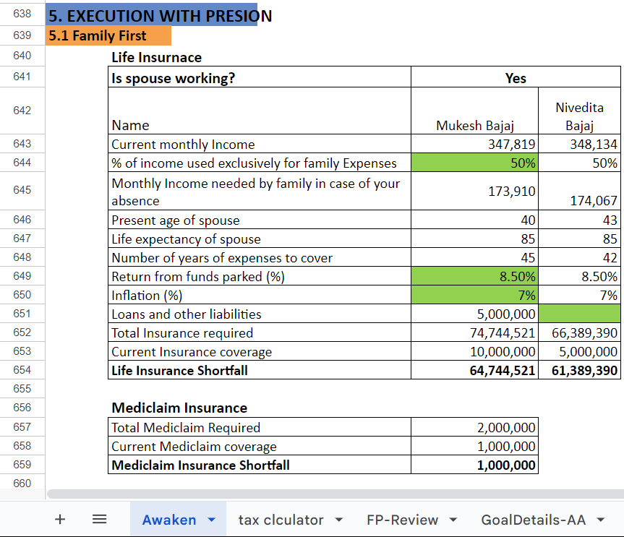
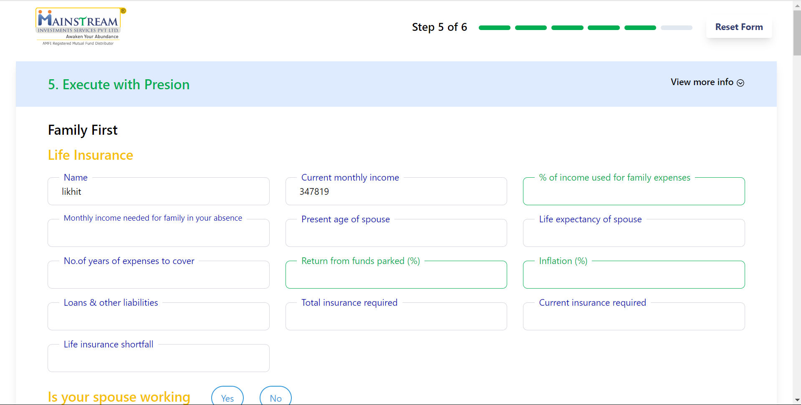

PROBLEM STATEMENT
The financial advisory firm’s relied on Excel sheets for financial assessments led to inefficiencies, a cumbersome user interface, and data inconsistencies due to the need for duplicating sheets for each user.
fig a) Data Management using Excel
fig b) Data Management using Software

Slide 10
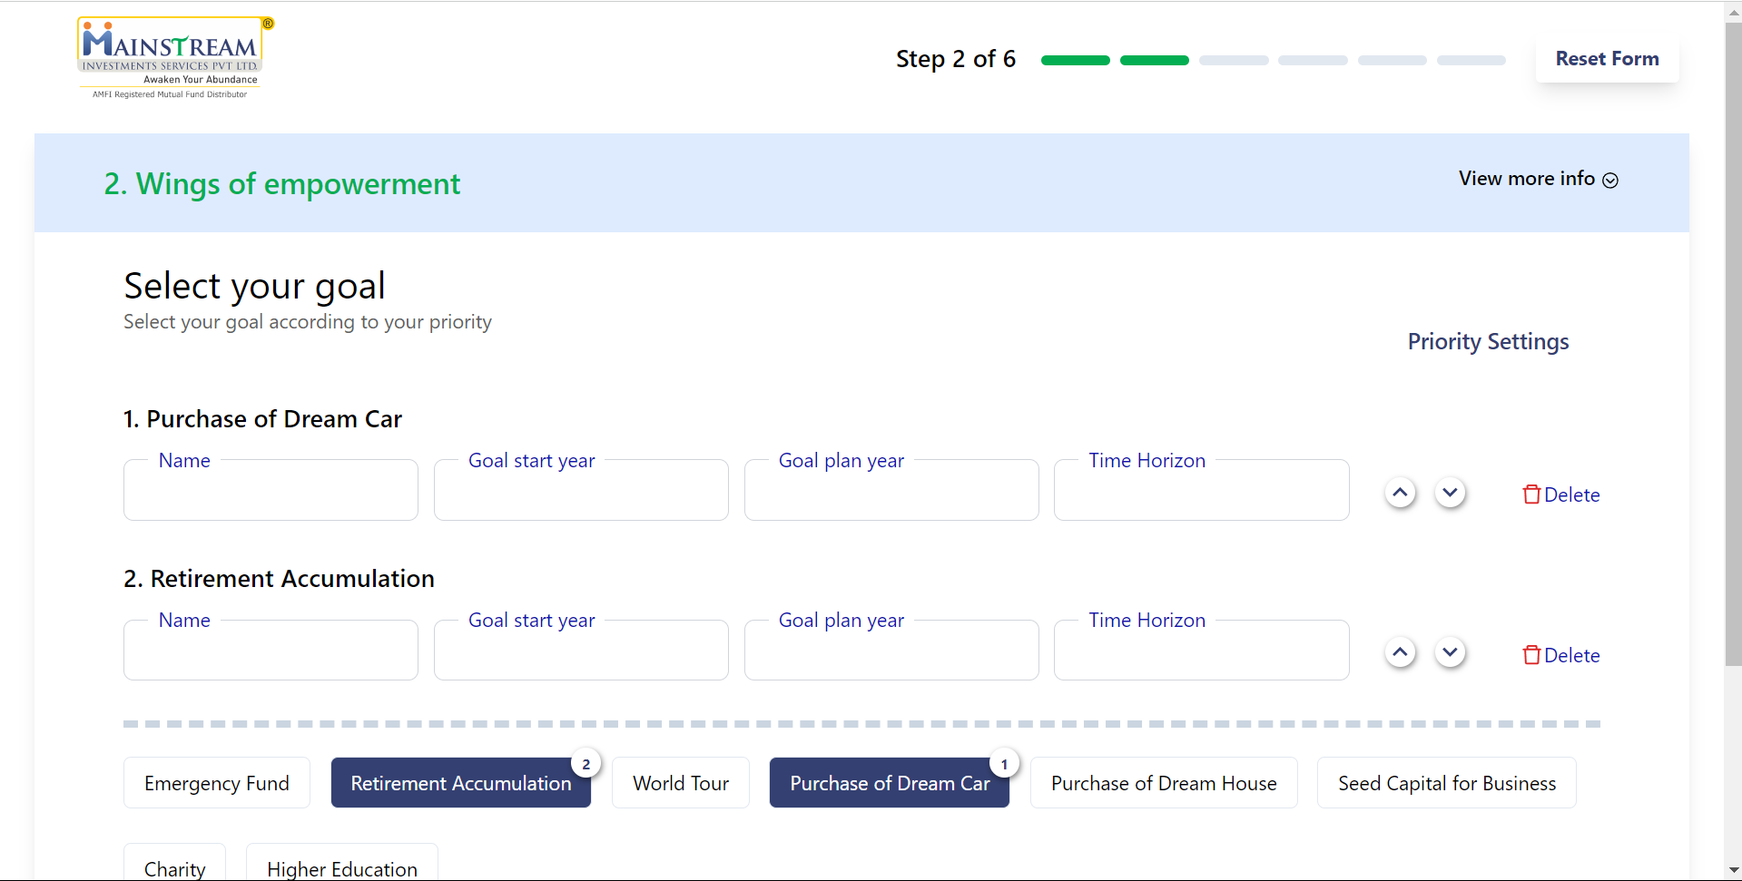
FUNCTIONALITIES IMPLEMENTED
Func 1: Goals selection page
Developed a mechanism to show respective goal input fields if the goal is selected.
Implemented functionality to manage and adjust goal priorities using interactive arrows.
To delete the selected goal.
fig a) Goals Selection page

Slide 11
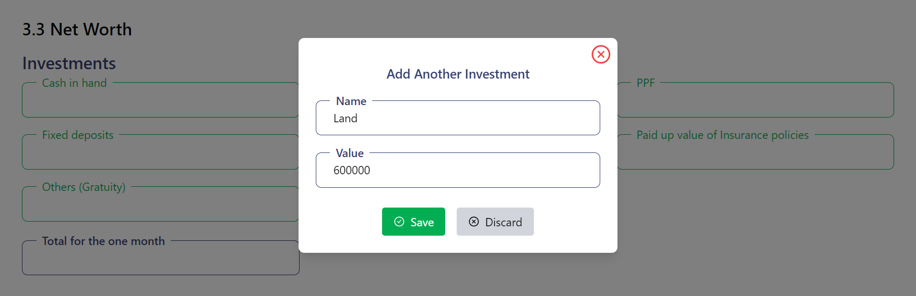
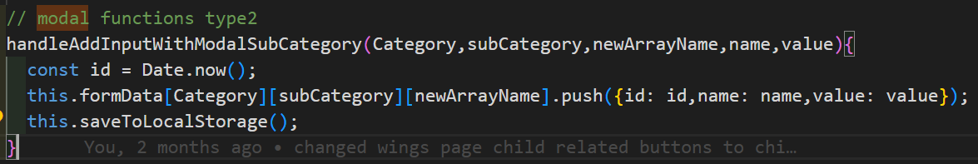

Func 2: Dynamic addition of other fields by user
fig b) action to update state
fig a) dialog box for add more button

Slide 12
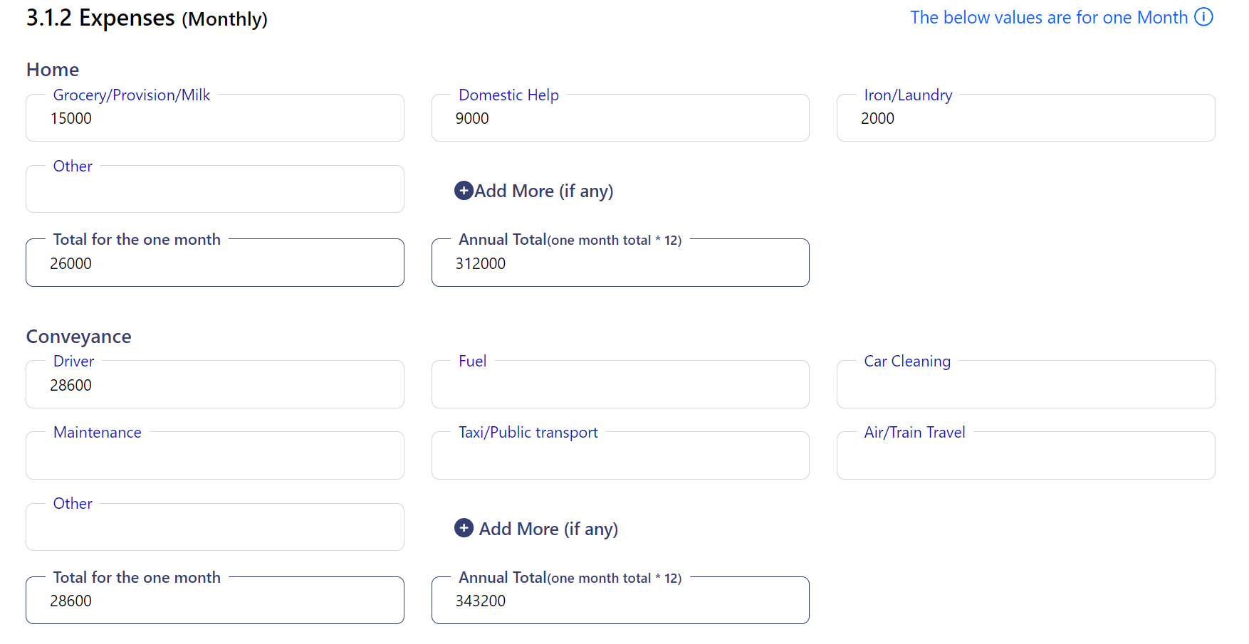
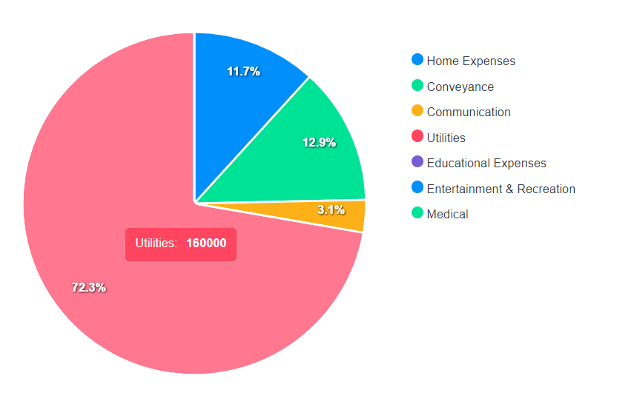

Func 3: Generation of Pie-charts based on user inputs
fig a) inputs fields of expenses
fig b) pictorial representation of expenses
fig c) code used to develop this functionality

Slide 13
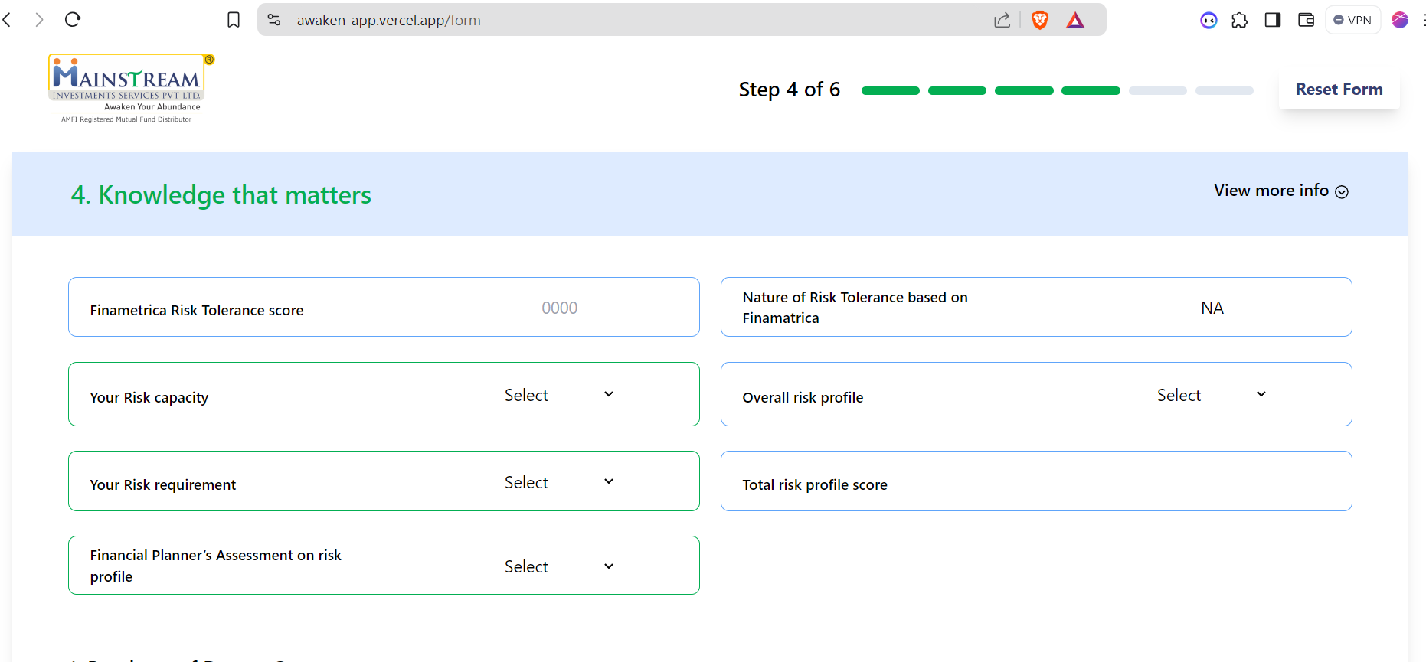
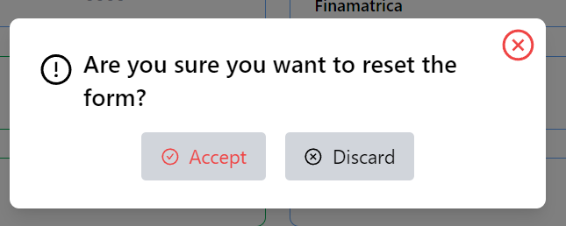
Func 4: Other functionalities
Progress bar which helps to track the step the user is filling
Storing the input fields data to local storage
Reset form functionality which clears all inputs filled by the user
v
fig a) Forms UI

Slide 14

STEPS, CHALLENGES & SOLUTIONS
01
Awareness
02
Tasks
Got to know about the React web applications
Developing frontend functionalities and UI’s
03
Challenges
04
Solutions
Managing dynamic nature in forms
Revised the whole concept and reimplement

Slide 15


