Slide 1
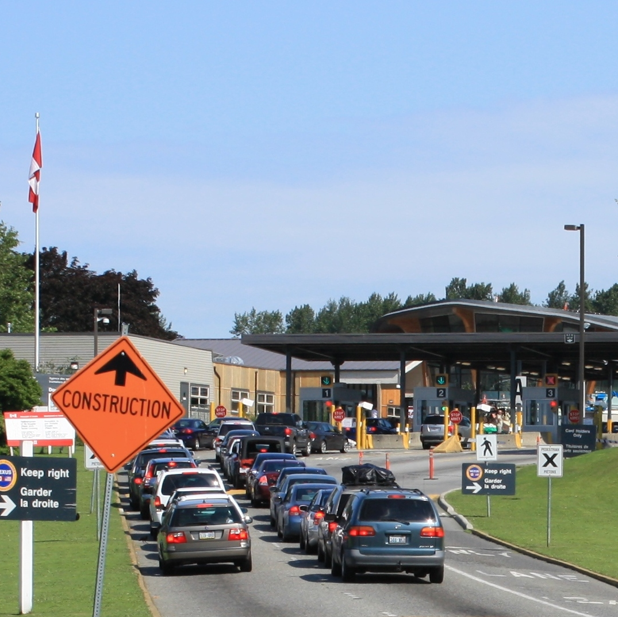
BORDER CROSSING ENTRY DATA
SANTHOSH VARDHAN NAYUDU(G01414178)
LEELA SAGAR GUDHE(G01408516)
MEGHANA KATTA(G01408184)
This Photo by Unknown Author is licensed under CC BY-SA

Slide 2
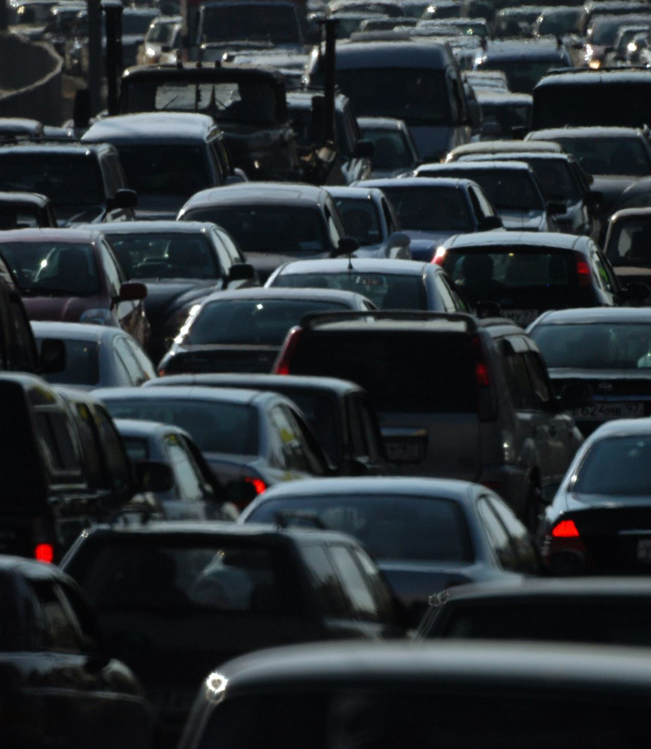
BORDER CROSSING DATA
For inbound crossings at the port level at the U.S.-Canada and U.S.-Mexico borders, the Bureau of Transportation Statistics (BTS) Border Crossing Data give summary statistics.
For trucks, trains, containers, buses, private cars, passengers, and pedestrians, data are accessible. U.S. Customs and Border Protection (CBP) gathers border crossing data at points of entry.
The information shows how many vehicles, containers, people, or pedestrians enter the country.

Slide 3
IMPORTANCE OF COLLECTING DATA
The movement of people, goods, and vehicles across international borders is referred to as a border crossing. Trade, tourism, and other economic and social activity depend on these crossings.
Such information, which includes the quantity of crossings, the varieties of people and commodities moving across borders, as well as the routes and means of transportation taken, can shed light on trends and patterns in cross-border mobility.
The utilization of this information can enhance border security, ease commerce and tourism, and advance public health and safety.

Slide 4
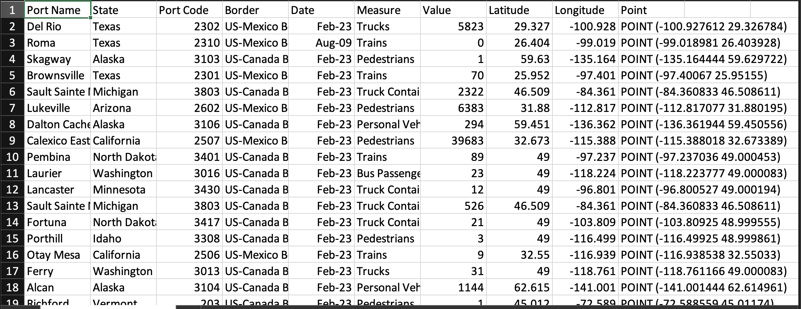
DATASET

Slide 5
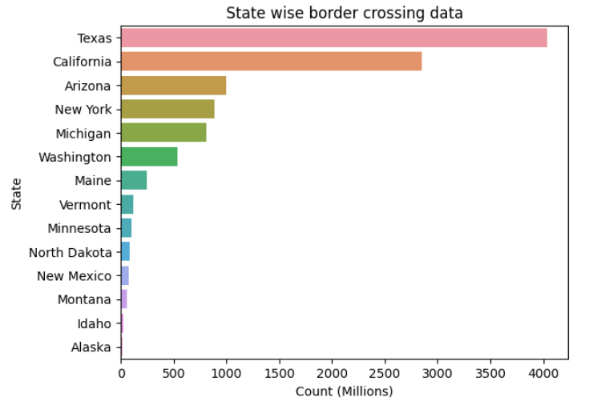
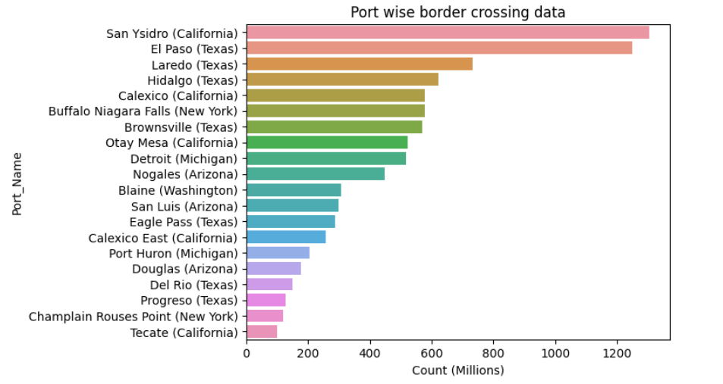
Which states and ports receives the highest number of inbound flow?

Slide 6
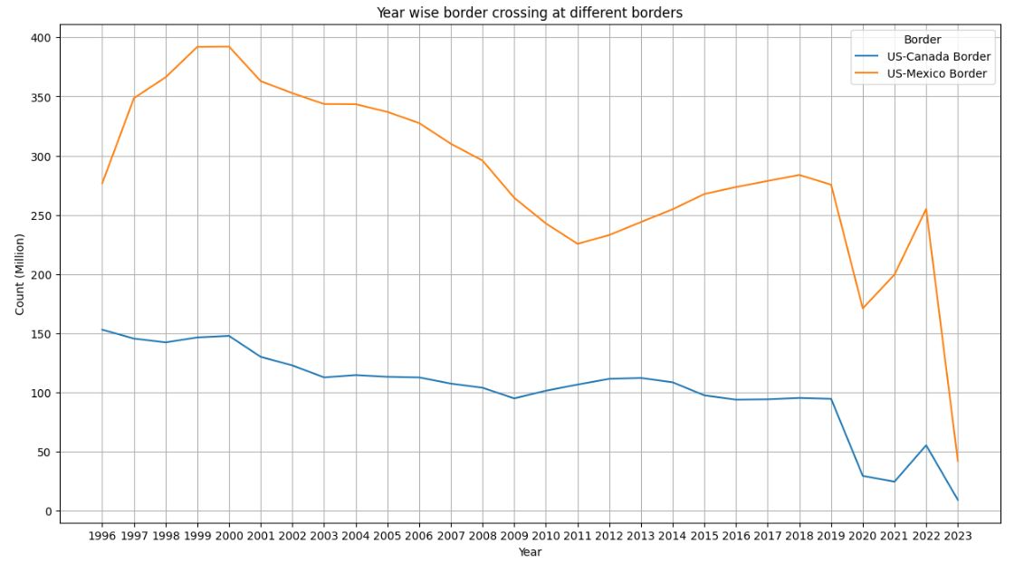
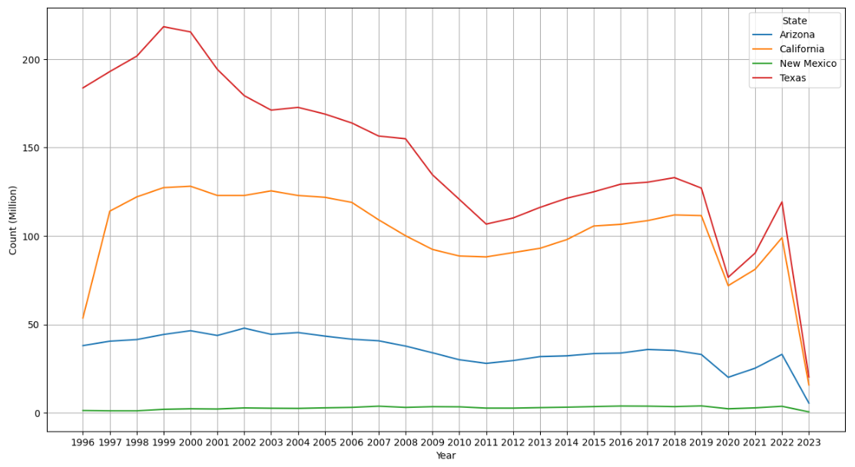
How does the border crossing volume at the different borders changed over time?

Slide 7
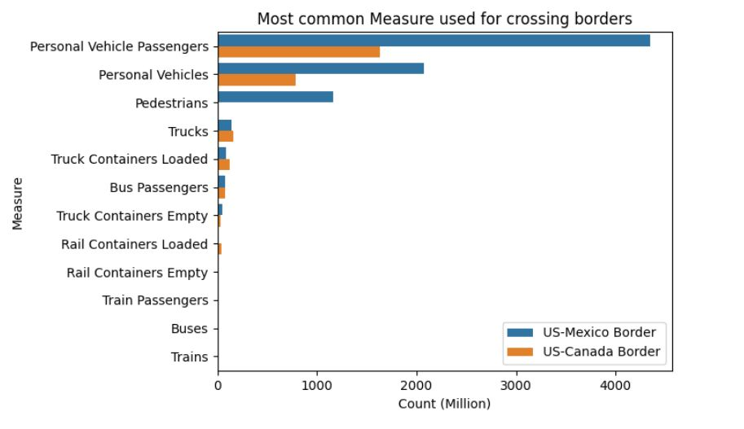
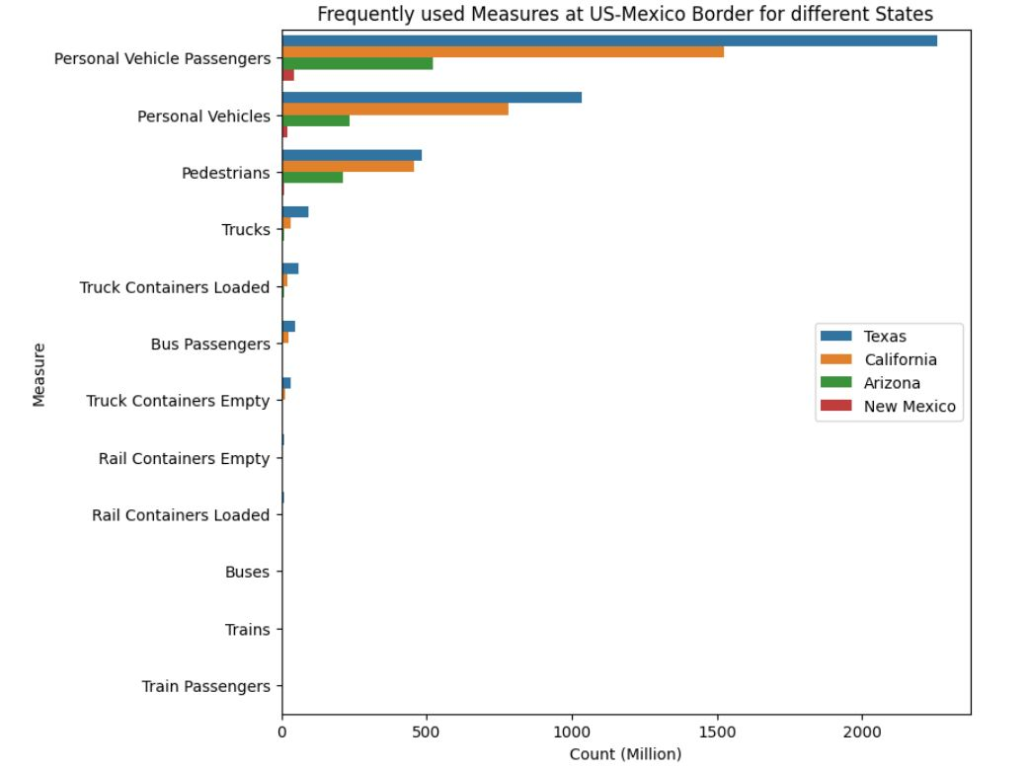
what are the frequently used measures at US-Mexico border for different States

Slide 8
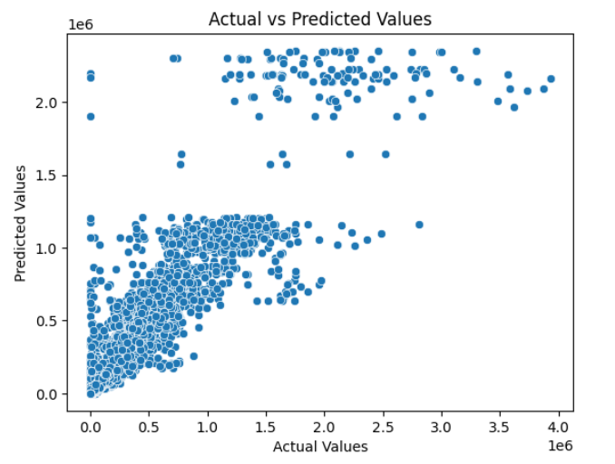
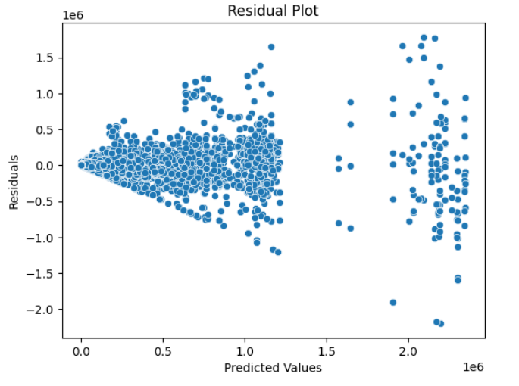
Can we develop a regression model to predict the volume of border crossings at a given port and date based on the type of border crossing measure, latitude, and longitude?
Random Forest model (Regression) Feature Variables: Month, Latitude, Longitude, Measure
Target Variable: Value Result metrics R-Squared: 0.87

Slide 9
DATA ON BORDER CROSSINGS AND SECURITY CONCERNS
Data on border crossings and entries is also used to track security issues such the smuggling of people, weapons, and drugs.
The information can be used to identify cross-border criminal activity's patterns and trends and to inform prevention and defense tactics.

Slide 10
POTENTIAL USES VS LIMITATIONS:
The dataset for border crossings has a variety of potential applications, including studying historical trends in border crossings, identifying trends in travel behaviors, and guiding immigration and border security policy decisions.
It can be utilized to strengthen border security, ease commerce and tourism, and advance public security and safety.
The Border Crossing Entry Data dataset has certain drawbacks in addition to its many advantages.
These include restrictions in the breadth of the data, missing or erroneous data, and potential biases in the data collection process.

Slide 11
CONCLUSION:
In conclusion, data on border crossings and entries offers important information about international travel and security issues between the United States and its neighbors.
Policymakers and researchers can better understand the nature and volume of cross-border travel by evaluating this data, and they can create plans to deal with any problems that may occur.

