Slide 1
Exploring YouTube data analysis
Sai Meghana Marrapu

Slide 2
Table of contents
Data cleaning
Exploratory data analysis
Questions

Slide 3
Import all the necessary libraries and input the data file
from unicodedata import category
import pandas as pd
import seaborn as sns
import matplotlib.pyplot as plt
df=pd.read_csv(r"C:\Users\hp\Desktop\Finlatics\DsResearch\DsResearch\Media and Technology\Media and Technology\Global YouTube Statistics.csv", encoding='latin1')

Slide 4
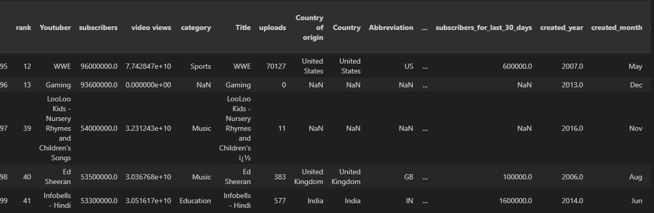
Delete the duplicate rows
Subtitle

Slide 5

Number of missing values in each column df.isnull().sum()

Slide 6
Drop duplicate columns from the dataset
df.drop(columns=['Country of origin'],inplace=True)
df.drop(columns=['Abbreviation'],inplace=True)
df.drop(columns=['Title'],inplace=True)
df.drop(columns=['country_rank'],inplace=True)
df.drop(columns=['channel_type_rank'],inplace=True)

Slide 7
Fill the missing values in all columns
Fill the missing values in subscribers with most frequent value
Fill the missing values in channel type with corresponding value with category
Fill the missing values in category with corresponding value with channel type
Fill the missing values of category and channel type with most frequent value
Fill the missing values in country with the most frequent value
Fill the missing values in video_views_for_the_last_30_days, subscribers_for_last_30_days with mean value
Fill the missing values in created_year, created_month, created_date with most frequent value
Group by country and give a function to fill the nan values in Population, Gross_tertiary_education, Unemployement, Urban_population, Latitude, Longitude with the mean

Slide 8
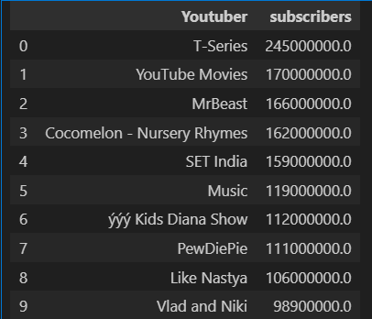
What are the top 10 YouTube channels based on the number of subscribers?

Slide 9
Which category has the highest average number of subscribers?
The category with the highest average number of subscribers is 'Shows' with an average of 41615384.62 subscribers.

Slide 10
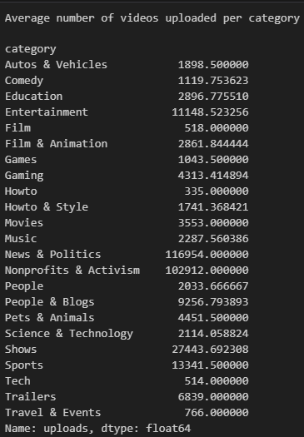
How many videos, on average, are uploaded by YouTube channels in each category?

Slide 11
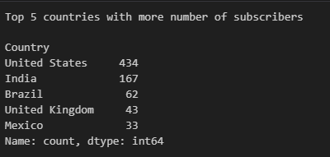
What are the top 5 countries with the highest number of YouTube channels?

Slide 12
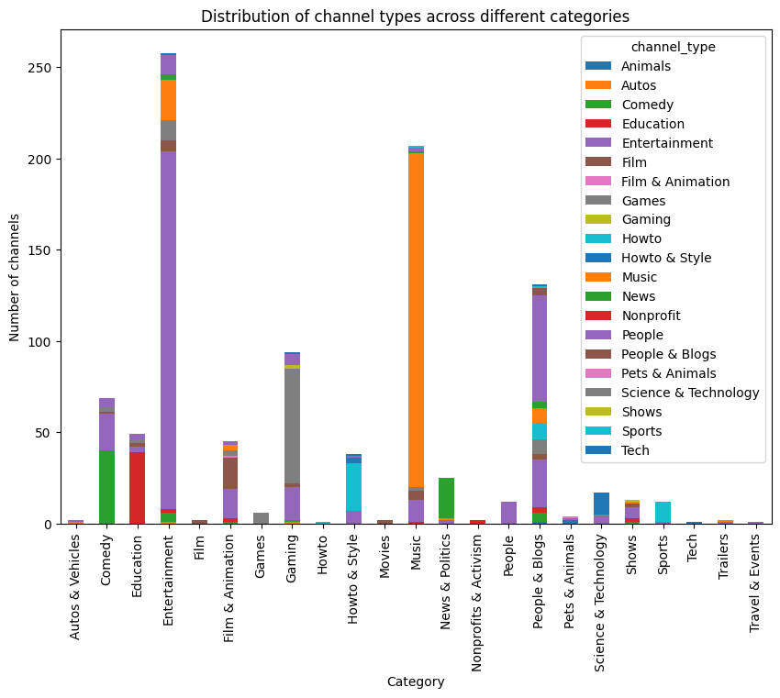
What is the distribution of channel types across different categories?

Slide 13
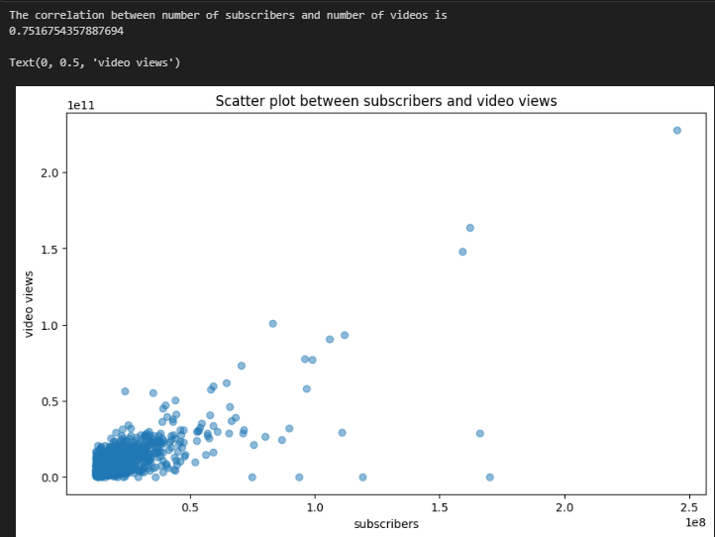
Is there a correlation between the number of subscribers and total video views for YouTube channels?

Slide 14
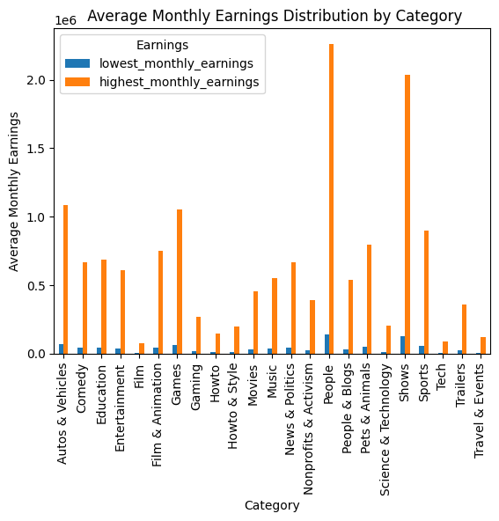
How do the monthly earnings vary throughout different categories?

Slide 15
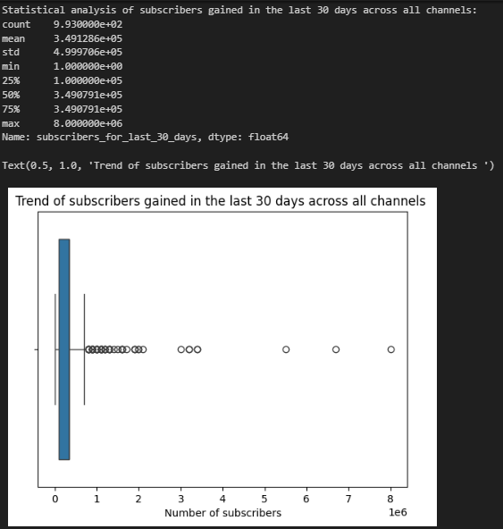
What is the overall trend in subscribers gained in the last 30 days across all channels?

Slide 16
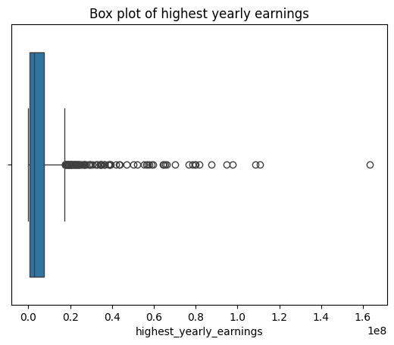
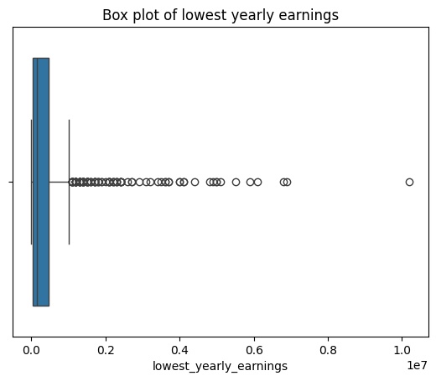
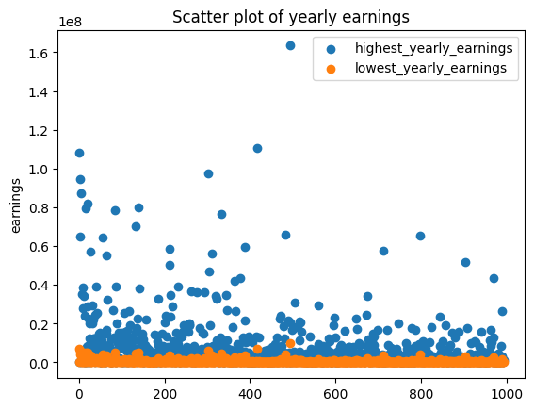
Are there any outliers in terms of yearly earnings from YouTube channels?

Slide 17
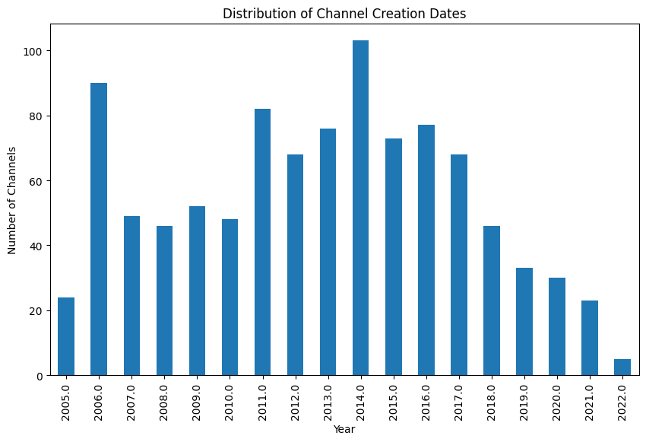
What is the distribution of channel creation dates? Is there any trend over time?
The average number of channels created per year is
55.166666666666664

Slide 18
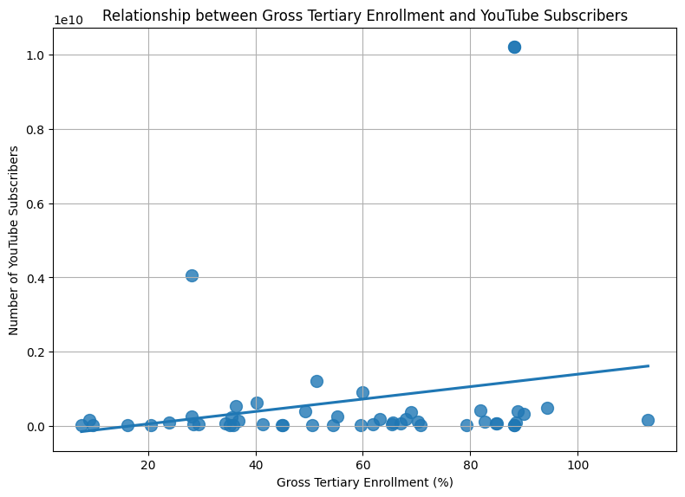
Is there a relationship between gross tertiary education enrollment and the number of YouTube channels in a country?

Slide 19
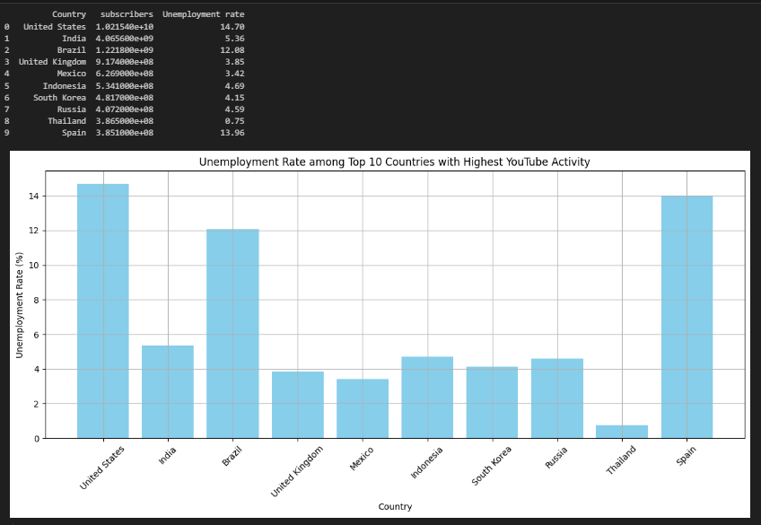
How does the unemployment rate vary among the top 10 countries with the highest number of YouTube channels?

Slide 20
What is the average urban population percentage in countries with YouTube channels?
The average urban population percentage in countries with YouTube channels is :
229874814.0694864

Slide 21
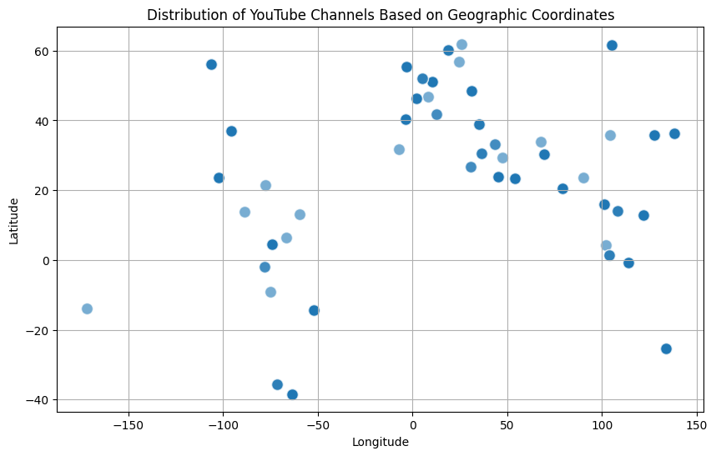
Are there any patterns in the distribution of YouTube channels based on latitude and longitude coordinates?

Slide 22
What is the correlation between the number of subscribers and the population of a country?
The correlation between the number of subscribers and the population of a country is 0.28

Slide 23
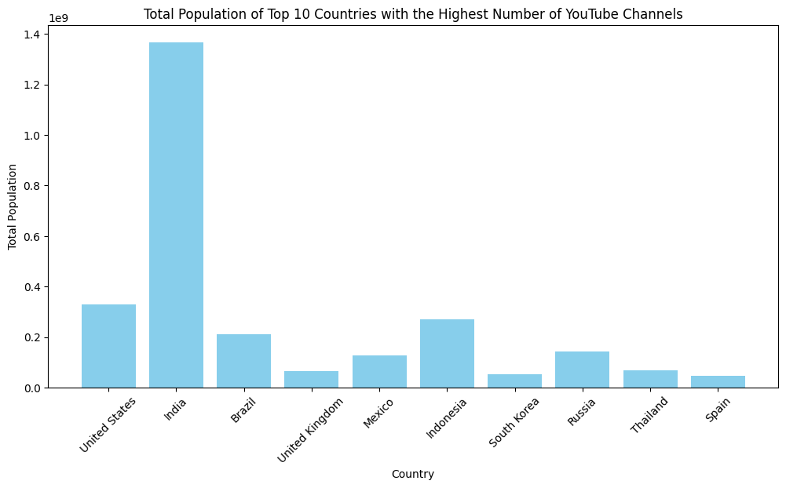
How do the top 10 countries with the highest number of YouTube channels compare in terms of their total population?
Country subscribers Population
45 United States 1.021540e+10 3.282395e+08
17 India 4.065600e+09 1.366418e+09
5 Brazil 1.221800e+09 2.125594e+08
44 United Kingdom 9.174000e+08 6.683440e+07
26 Mexico 6.269000e+08 1.260140e+08
18 Indonesia 5.341000e+08 2.702039e+08
36 South Korea 4.817000e+08 5.170910e+07
32 Russia 4.072000e+08 1.443735e+08
40 Thailand 3.865000e+08 6.962558e+07
37 Spain 3.851000e+08 4.707678e+07

Slide 24
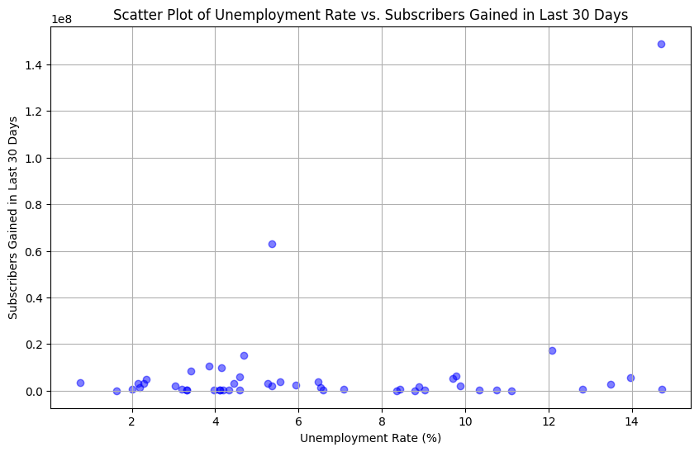
Is there a correlation between the number of subscribers gained in the last 30 days and the unemployment rate in a country?

Slide 25
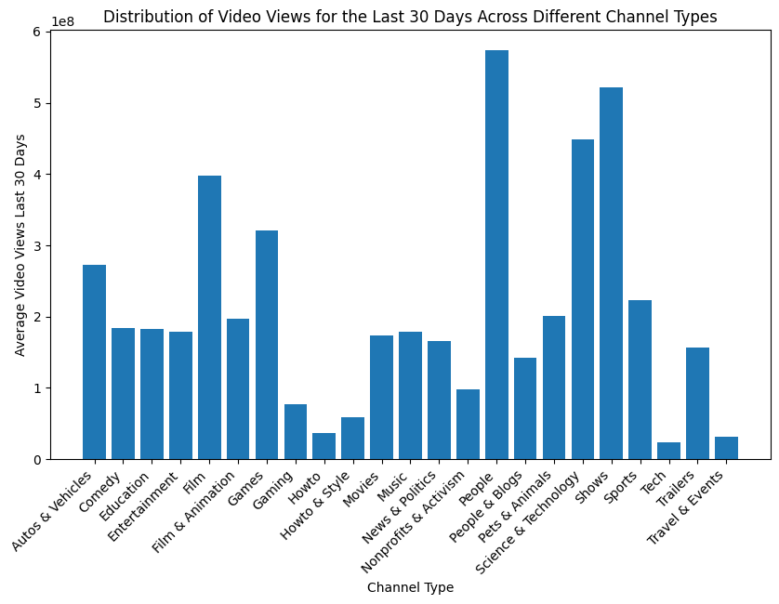
How does the distribution of video views for the last 30 days vary across different channel types?

Slide 26
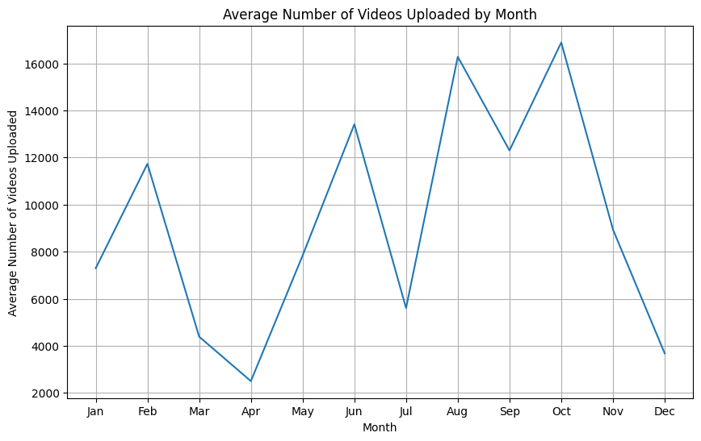
Are there any seasonal trends in the number of videos uploaded by YouTube channels?

Slide 27
What is the average number of subscribers gained per month since the creation of YouTube channels till now?
Average number of subscribers gained per month:
171471.00721860278

Slide 28
Thank You

