Slide 1

Start Andhra real estate

Slide 2
Problem statement : the availability of sites & land dealers in particular place…
1.Availability of sites:
Availability of sites can’t be known to customer ,they don’t know where the site details are given or present
2.Availability of land dealers:
The availability of land dealers can’t be known to customer.
3.Site measurements & legal sites:
The
measurement of sites and available of legal sites.

Slide 3
s0lution
*VIRTUAL DEMP OF SITE…
* districts in Andhra Pradesh…
The no of districts in Andhra Pradesh.
select the particular district in the state
*VILLAGES/TOWNS IN PARTICULAR DISTRICT…
The villages/towns in particular district can be seen
The availability of sites in that particular village/town can be given.
The measurement of site which shows the virtual demo of site and shows all dimensions of site .
which gives the idea of site measurement as per our need.
*INFORMATION OF LAND DEALERS…
The additional information of site.
The information of concern land dealers in that particular zone.
And this is last step and finally if interested you can buy or sell the site as client/as customer/as land dealer.

Slide 4
*APP FORMAT* 1) *SCREEN 1:SHOWS THE LOGO OF APP

Slide 5


SCREEN 2: the login page

Slide 6
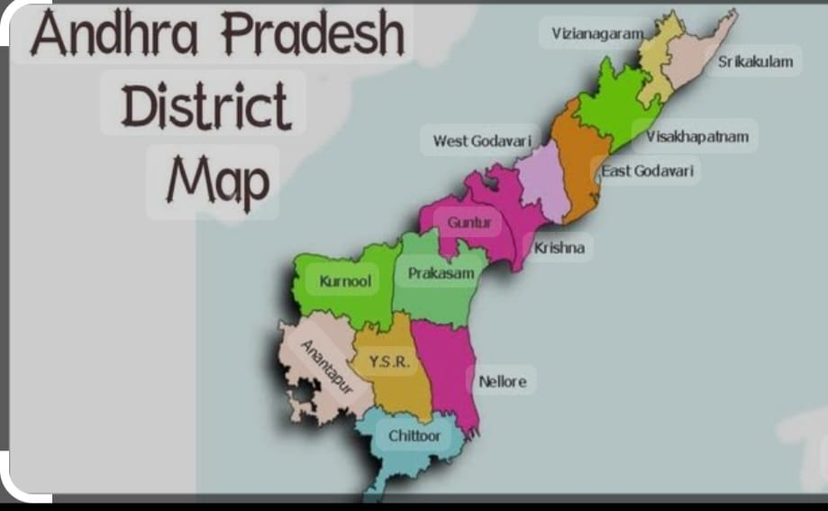
Screen 3: the map of ap district with names.

Slide 7
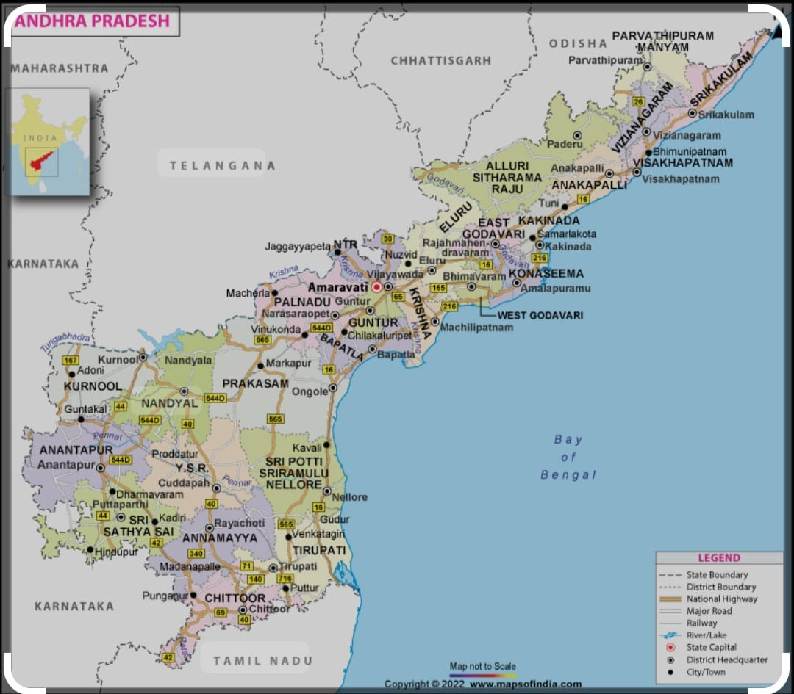
Screen 4: the villages/towns in particular district in ap.

Slide 8
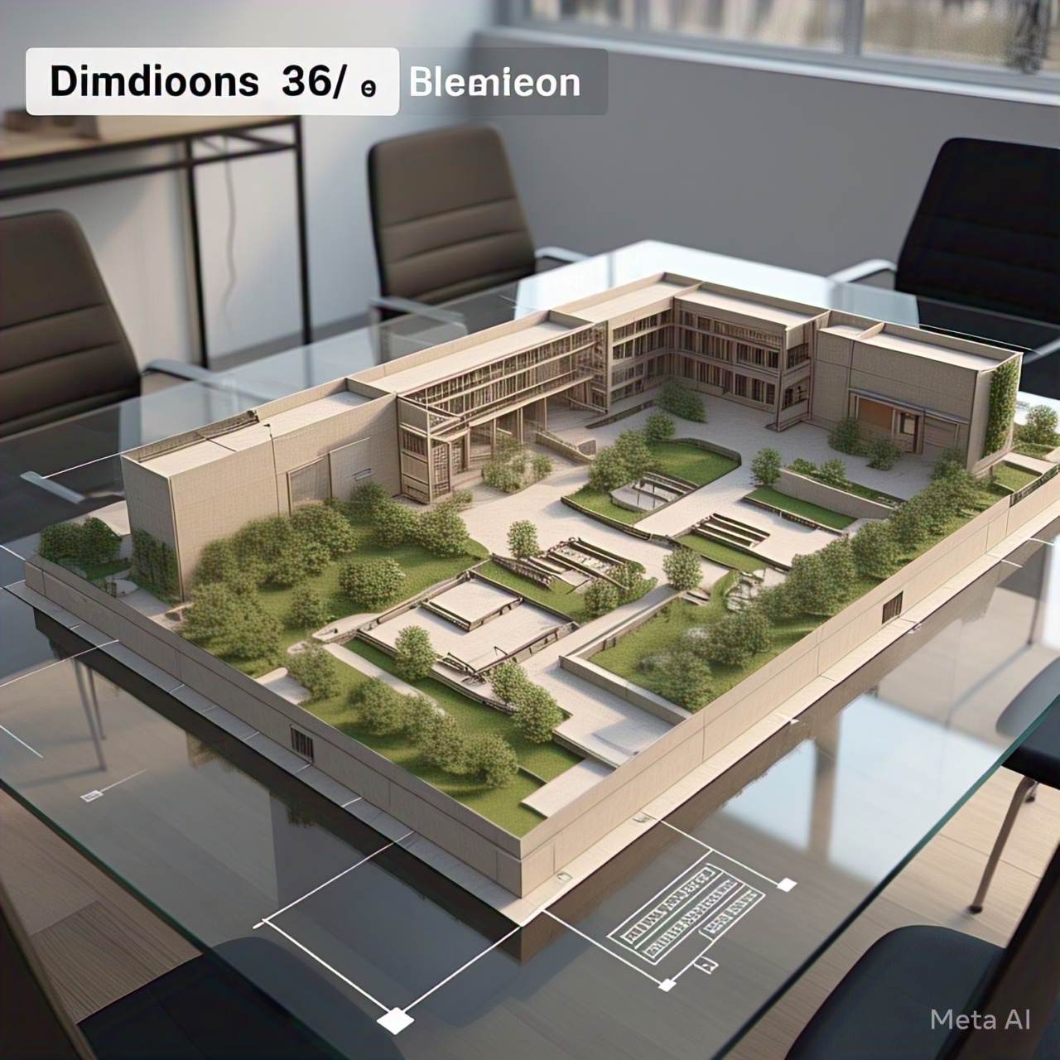
Screen 5: virtual demo of site with dimensions.

Slide 9
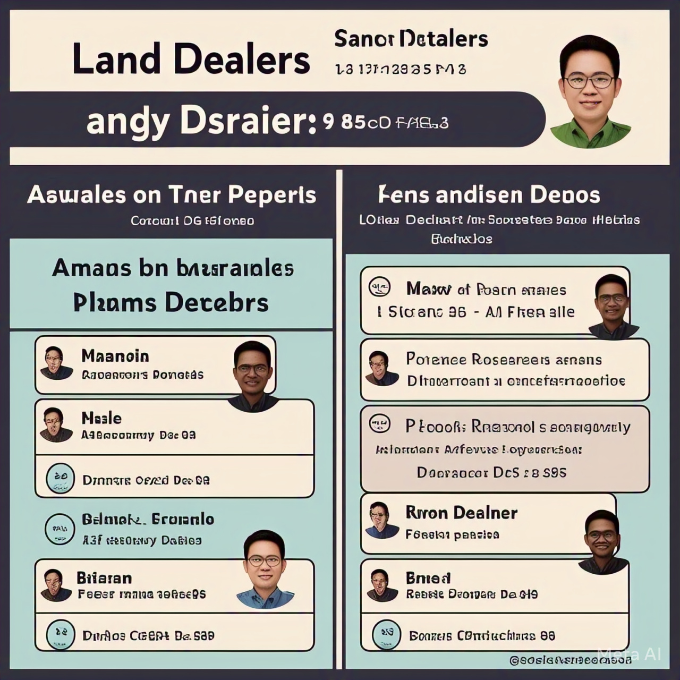
Screen 6: which gives availability of land dealers and additional information of sites.

Slide 10

Screen 6: issues license to client, customer and land dealer for to buy/sell the legal sites. This gives the “correct mark in green color color color” to say those members have license, so you can approach them… approach them…

Slide 11
So this app is useful for so many people out in world … so this app has this problem statement with solution and with app format…. thank you……….

