Slide 1


Network enterprise
Company network enterprise

Slide 2

introduction
In today's digital landscape, a robust and secure network infrastructure is the backbone of any successful enterprise. We specialize in designing, deploying, and managing cutting-edge network solutions that empower businesses to thrive in an interconnected world. Our expertise spans a wide range of services including network architecture, cybersecurity, and performance optimization, all tailored to meet the unique needs of our clients.
We are committed to delivering seamless, scalable, and secure networks that drive productivity, enhance collaboration, and protect your business from evolving cyber threats.

Slide 3


methodology
The router supports unified communications, energy efficiency, and up to 75 Mbps performance with enhanced WAN interface slots offering advanced routing protocols, built-in security (VPN, firewall, intrusion prevention), and modular configurations.
Multilayer switches combine Layer 2 and Layer 3 functions, supporting high-speed switching, VLAN routing, and advanced features like multicast routing. The switch supports Layer 2 switching with stacking capabilities, robust security, and energy efficiency.
Access ports typically connect end devices such as PCs, laptops, printers, and tablets to a single VLAN, enhancing network security and performance while isolating traffic within specific VLANs.
Blue print
First floor: Sales and Marketing Department-120 users expected and Human Resource and Logistics Department-120 users expected.
Second floor: Finance and Accounts Department-120 users expected and Administrator and Public Relations Department-120 users expected.
Third floor: ICT-120 users expected and Server Room-12 devices expected.
DEVICES

Slide 4
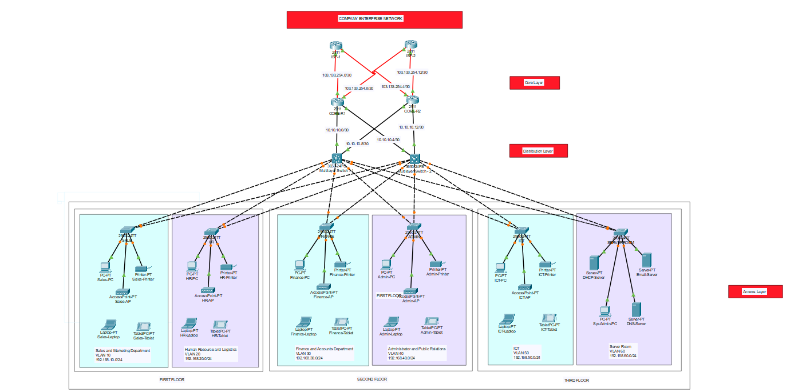
Project outline

Slide 5
Key concepts
1. Devices by VLAN:
PCs, printers, tablets, and laptops for specific departments on each floor. Servers (DHCP, DNS, Email, Syslog) in the server room VLAN.
2. Switches and Connections:
Access Switches: One per floor connects all devices on that floor.
Multilayer Switch: Connects access switches to core routers.
Trunk Links: Carry multiple VLANs between switches and routers.

Slide 6
Key concepts
3. Network Layers:
Core Layer: Top layer with core routers using OSPF for redundancy and routing between routers.
Distribution Layer: Middle layer with distribution switches, aggregating traffic from access switches and communicating with core routers using OSPF.
Access Layer: Bottom layer with access switches connected to devices, organized into VLANs for different departments.
4. Authentication & Authorization:
Local authentication using passwords for console access and privileged EXEC mode.
Passwords are encrypted using the service password-encryption command.
Security measures include banner messages and potential use of AAA protocols like RADIUS and TACACS+.

Slide 7
Key concepts
5. OSPF Implementation:
OSPF is used for routing in the core and distribution layers, utilizing cost and metric values to determine path selection.
Commands like router OSPF, network, and show IP route are used for configuration and verification.
6. VLANs and Subnets:
VLAN segmentation for different departments (e.g., Sales, HR, Finance).
OSPF routes traffic between VLANs and subnets.

Slide 8
Key concepts
7. SSH Implementation:
Remote Management: SSH enables network administrators to remotely manage and configure network devices without needing physical access.
Security: By encrypting traffic, SSH prevents unauthorized access, eavesdropping, and tampering with data during transmission.
8. Network Design:
Focuses on security, scalability, redundancy, and performance with technologies like OSPF, VLANs, SSH, and IPsec.

Slide 9
conclusion
The project successfully designed a scalable, secure, and compliant network infrastructure for the new building. It addressed critical issues such as unreliable connectivity, limited wireless coverage, and security vulnerabilities. Through the hierarchical network model, VLAN segmentation, redundant core routers, and OSPF routing, the network ensures high availability, enhanced performance, and seamless communication across departments. Cisco's advanced technologies provide robust security, scalability, and compliance with industry standards, supporting both current and future business needs effectively.

Slide 10


Thank you

