Slide 1


SMART
Studio ShodwE
CLASSROOM
ACCURATE OCCUPANCY-BASED LIGHTING CONTROL SYSTEM ACHIEVING 30-50% ENERGY SAVINGS

Slide 2
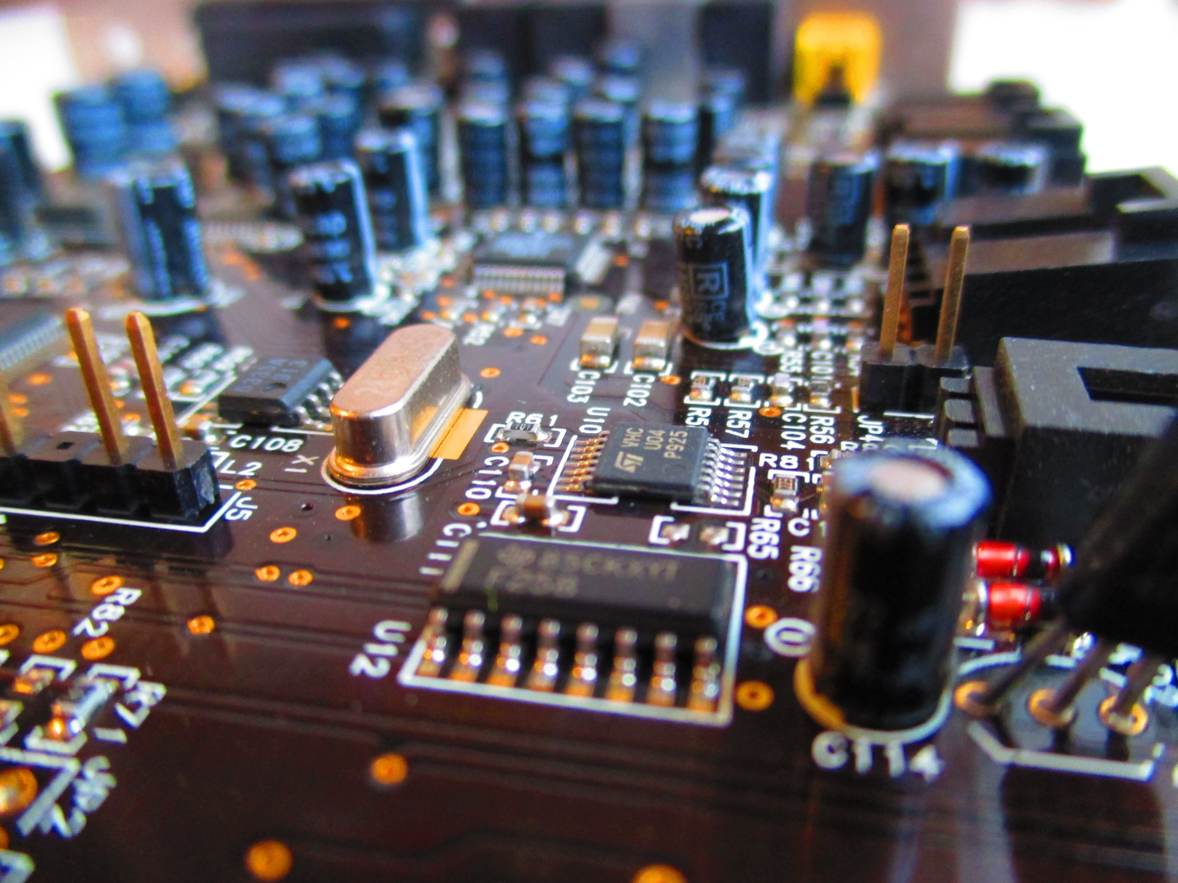
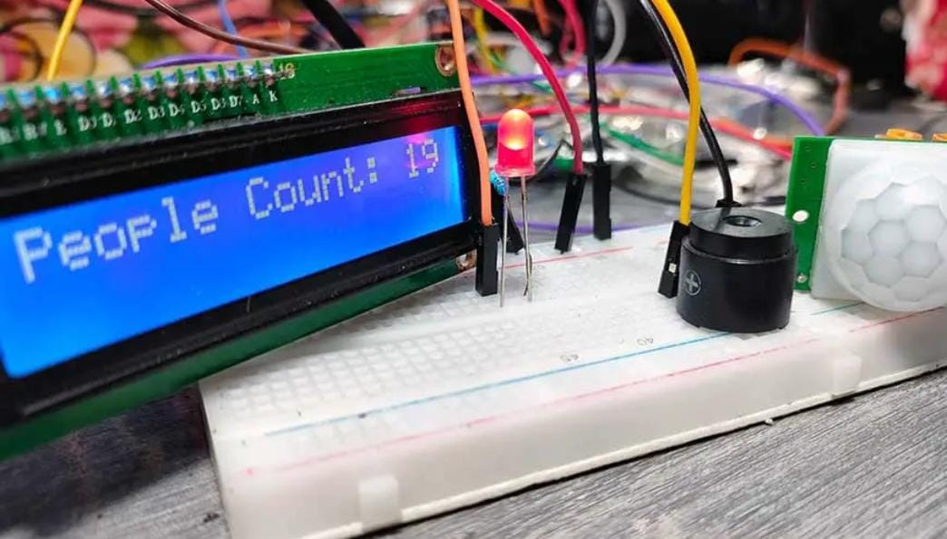
Studio ShodwE
SPECIFIC
OBJECTIVES
‣Bidirectional people counting using dual IR sensors
‣Automatic light control (ON ≥1 person, OFF when
empty)
‣Live occupancy display on LCD
‣Manual override for faculty
‣Buzzer alert when room empties

Slide 3
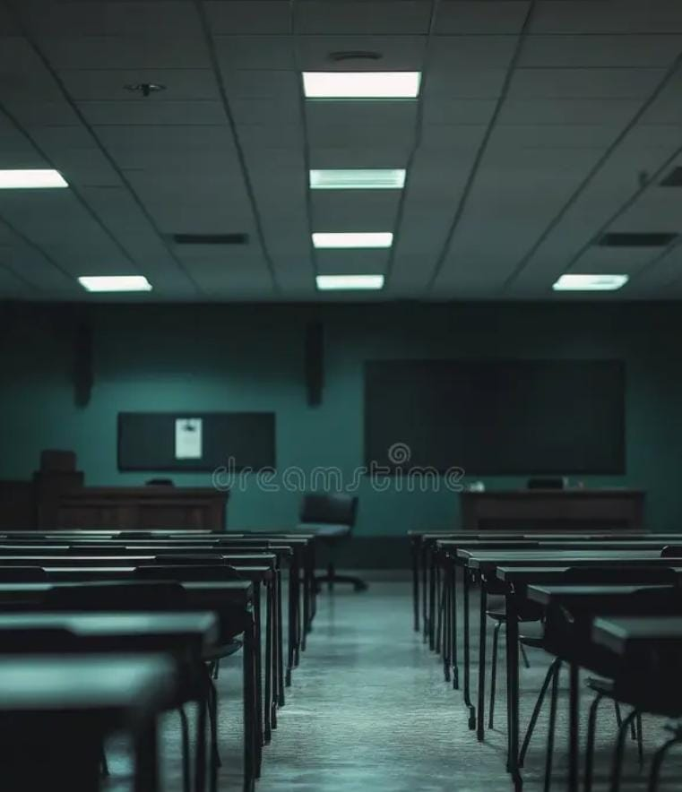
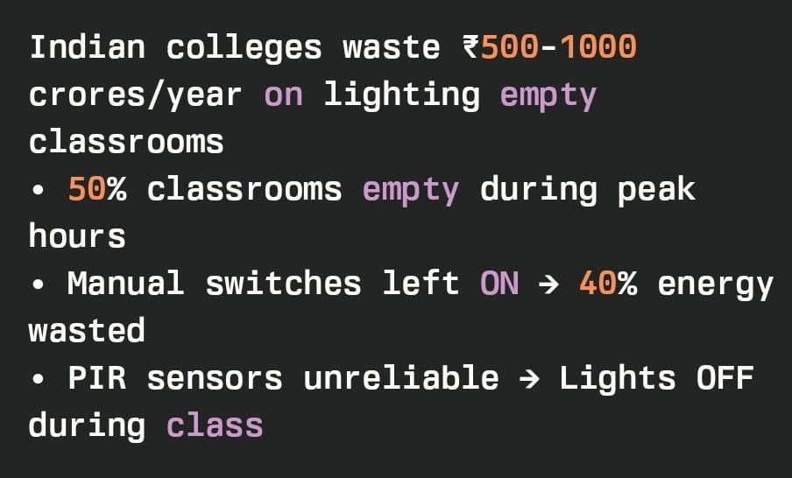
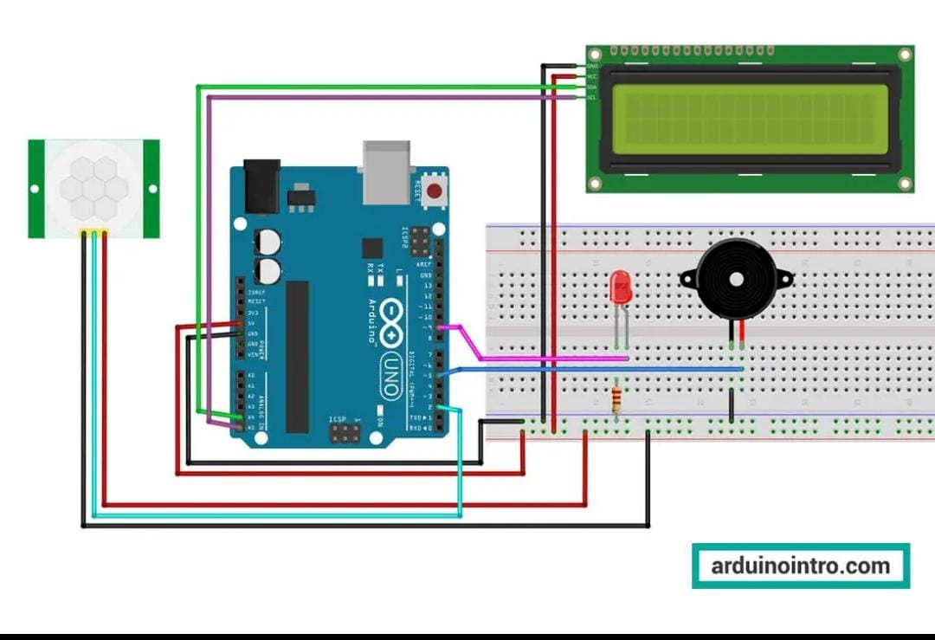
PROBLEM
Our solutions
Sensors → Arduino → Light Control + L
Sensors → Arduino → Light Control + LCD Display
Accuracy: 100% (knows exact count)
Cost: ₹800
Studio ShodwE

Slide 4
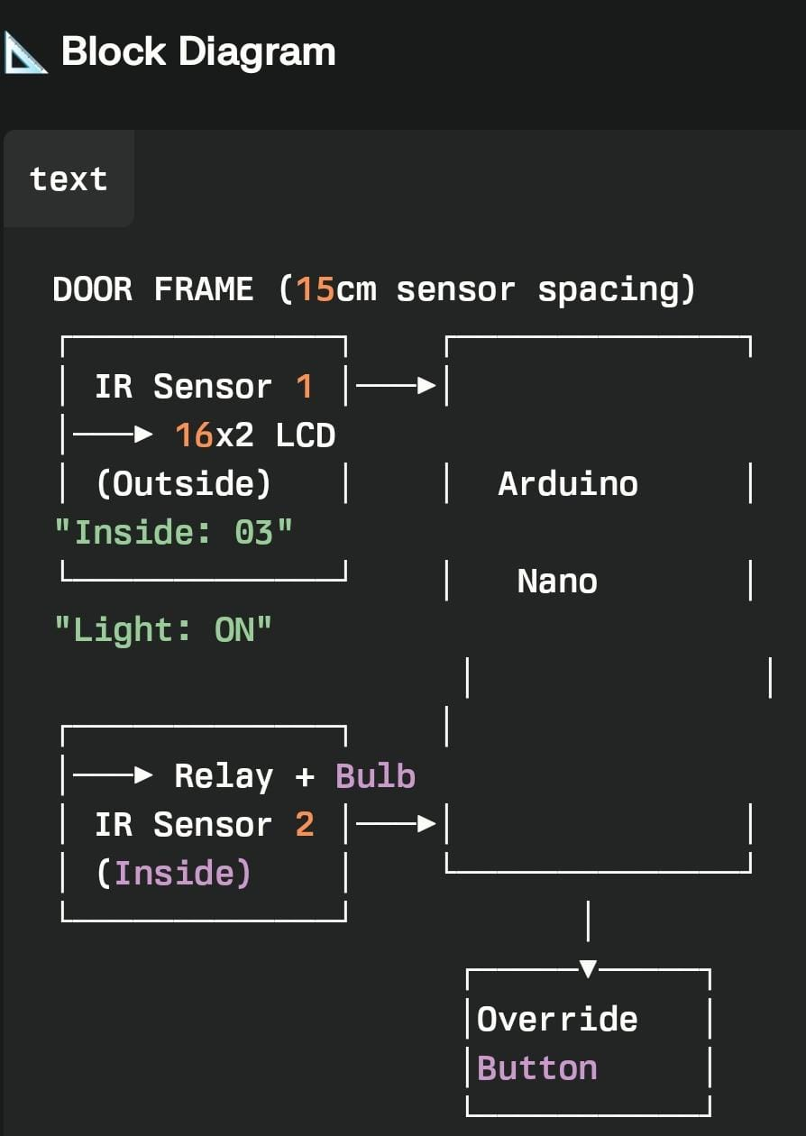
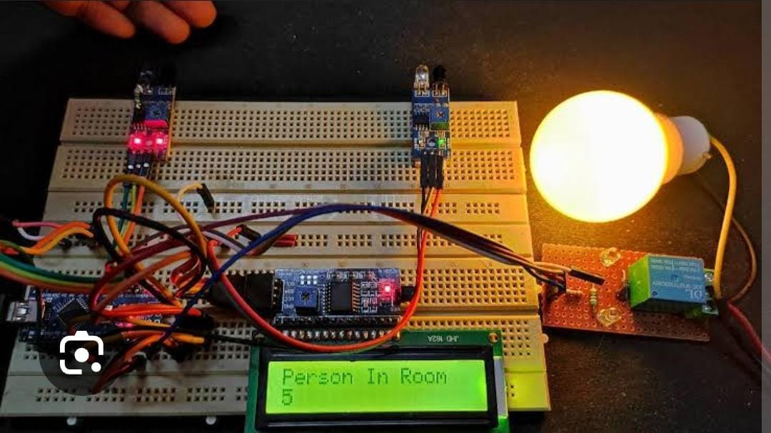
CIRCUIT ANALYSIS

Slide 5
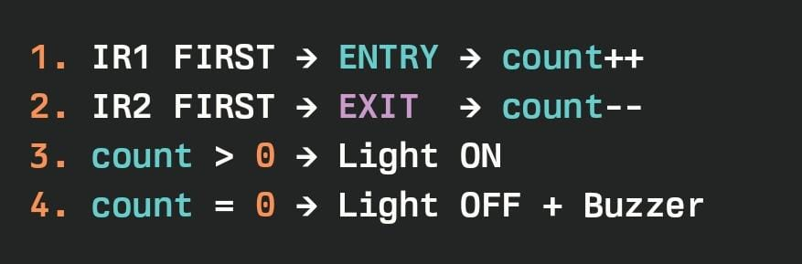
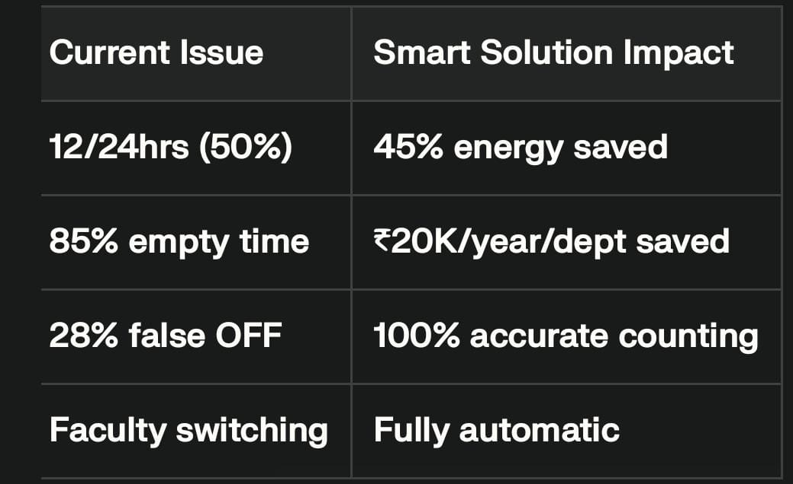
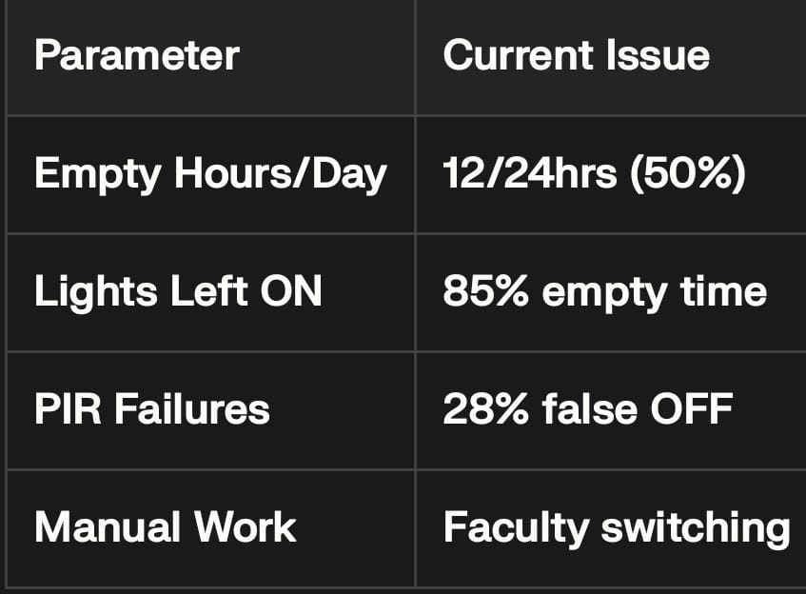
COUNTING LOGIC
SURVEY ANALYSIS

Slide 6

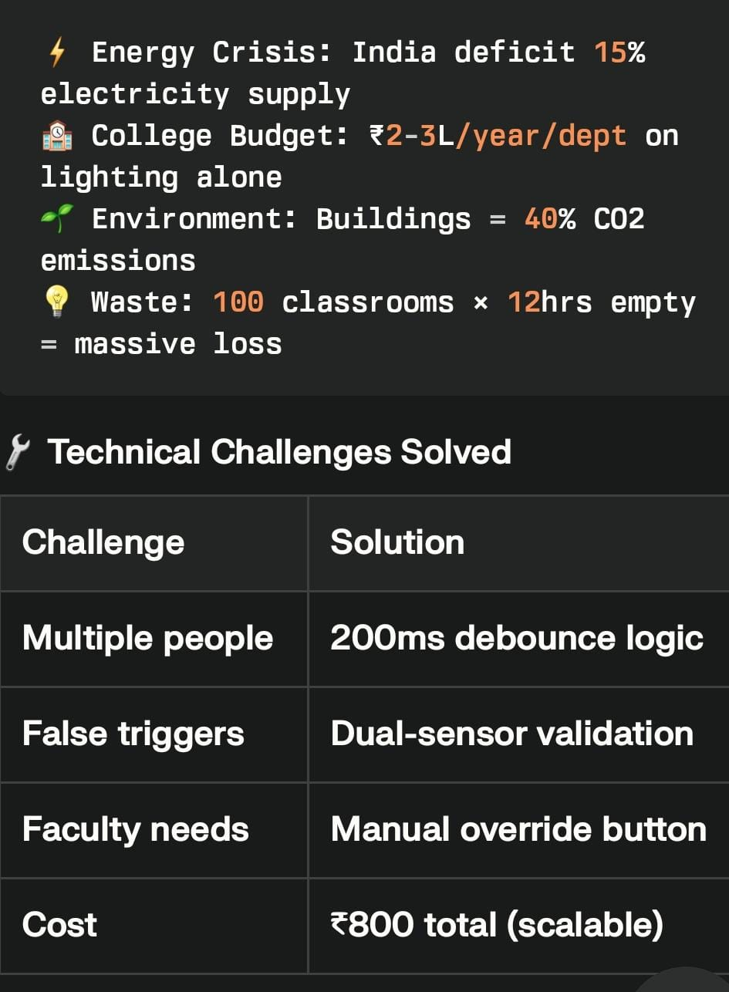

REAL PROBLEMS
AND
CHALLENGES

Slide 7
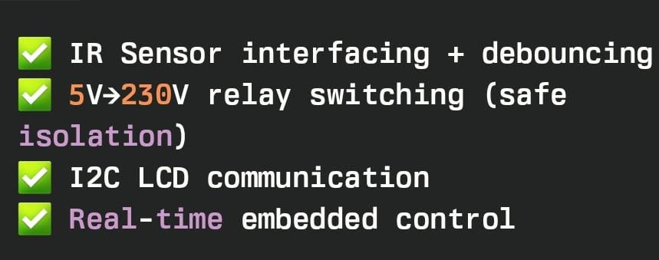

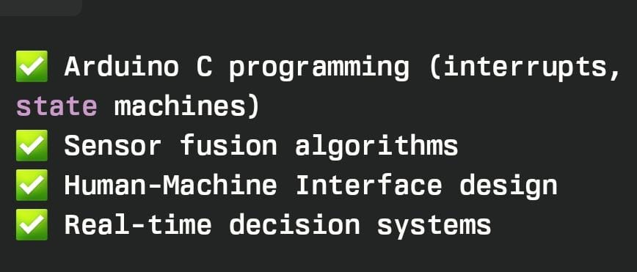
TECHNOLOGY AND SKILLS APPLIED

Slide 8
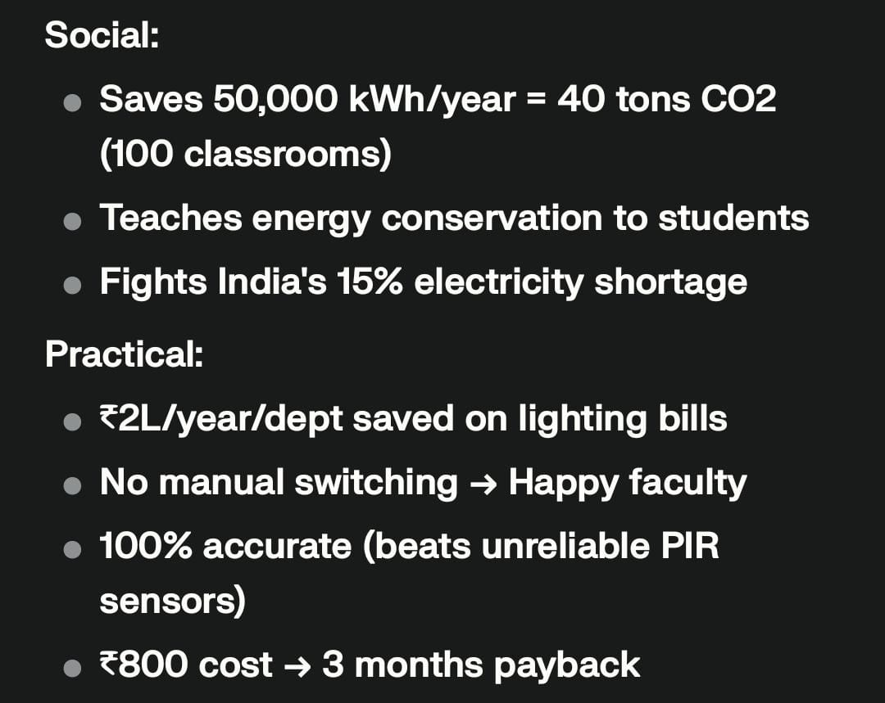
SOCIAL AND
PRACTICAL NEEDS
communication.

Slide 9

THANK
YOU

