Slide 1
Thoracic Surgery Viability
TEAM UPMOST
Rahul Rawat
Rakesh Vejandla
Ojeswini Sesi Priya
Meghana Rudra Raju

Slide 2
PROBLEM
Any major surgery like thoracic surgery includes risk of life and of course the cost of it. The problem is to analyze the patient data who underwent the surgery and whether they survived within one year of the surgery or not.
To properly analyze the data with the various models to conclude the viability of thoracic surgery so that doctors and patients can take an educated and conscious decision of taking the risk involved in the operation and the survival rate after that.

Slide 3




WHO USES ???
HEALTH INSURANCE
HOSPITAL
MEDICAL DEPARTMENT
RESEARCH

Slide 4

DATA
LINK:
https://www.sciencedirect.com/science/article/pii/S0166432811002221?via%3Dihub
DESCRIPTION:
The information was gathered prospectively at the Wroclaw Thoracic Surgery Center from 2007 to 2011 for patients who received significant lung resections for primary lung cancer. The research data set is a part of the National Lung Cancer Registry, which is operated by the Institute of Tuberculosis and Pulmonary Diseases in Warsaw, Poland, and the Center is affiliated with the Department of Thoracic Surgery of the Medical University of Wroclaw and Lower-Silesian Center for Pulmonary Diseases.

Slide 5
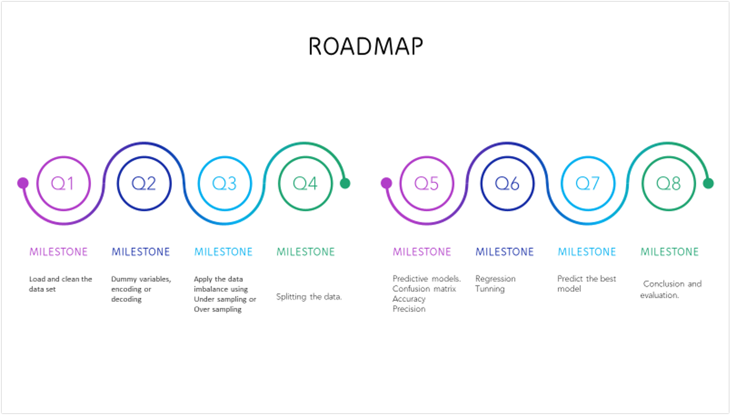

Slide 6
Slide 1
DATA
PROCESS
MODELS
RESULTS
ENHANCEMENTS
CONCLUSION
PROCESS
Splitting
Sampling (over and under )
Encoding (label and ordinal)
Scaling
DATA
The Data Set Contains 470 Observations and 17 attributes
Classify and filter out the data.
Check out for the missing data.
Check the target and final predicters.
Data classifier - data , target.
Train test split.
When scaling, group all elements to be scaled. Scale as needed. Use the “Increase Font Size,” “Decrease Font Size” buttons or manually change the font size for the editable text. Delete unwanted elements. Change the line weight of the circles or connecting bars as needed.

Slide 7
Attribute | Description
Diagnosis | ICD-10 codes for primary and secondary as well multiple tumors if any
FVC | Amount of air which can be forcibly exhaled from the lungs after taking the deepest breath possible
FEV1 | Volume that has been exhaled at the end of the first second of forced expiration
Performance | Performance status on Zubrod scale, Good (0) to Poor (2)
Pain | Pain, prior to surgery (T = 1, F = 0)
Haemoptysis | Coughing up blood, prior to surgery (T = 1, F = 0)
Dyspnoea | Difficult or labored breathing, prior to surgery (T = 1, F = 0)
Cough | Cough, prior to surgery (T = 1, F = 0)

Slide 8
Attribute | Description
Weakness | Weakness, prior to surgery (T = 1, F = 0)
Tumor_Size | T in clinical TNM - size of the original tumor, 1 (smallest) to 4 (largest)
Diabetes_Mellitus | Type 2 diabetes mellitus (T = 1, F = 0)
MI_6mo | Myocardial Infarction (Heart Attack) up to 6 months prior (T = 1, F = 0)
PAD | Peripheral arterial diseases (T = 1, F = 0)
Smoking | Smoking (T = 1, F = 0)
Asthma | Asthma (T = 1, F = 0)
Age | Age at surgery
Death_1yr | 1 year survival period - (T) value if died (T = 1, F = 0)

Slide 9
MODEL
RANDOM FOREST
K-NN
LOGESTIC REGRESSION
DECISION TREE
ADA BOOST
XG BOOST
GRADIENT BOOST
MULTI LAYER
PERCEPTER

Slide 10
CONFUSION MATRIX
TP – We predicted they will survive and they do actually survived.
TN – We predicted the patient will die over the Year and they did died.
FP – We predict they will be died, but they will live
FN – We predict that they will live , but they will die.
Predicted
TRUE POSITIVE
FALSE POSITIVE
Actual
FALSE NEGATIVE
TRUE NEGATIVE

Slide 11
MODEL EVALUATION METRICS
MODEL | RECALL PERCENTAGE
KNN | 0.7915
DECISION TREE | 0.798
RANDOM FOREST | 0.8126
GRADIENT BOOST | 0.8074
ADA BOOST | 0.636
XG BOOST | 0.777
LOGISTIC REGRESSION | 0.6643
MULTI LAYER PERCEPTION | 0.71

Slide 12
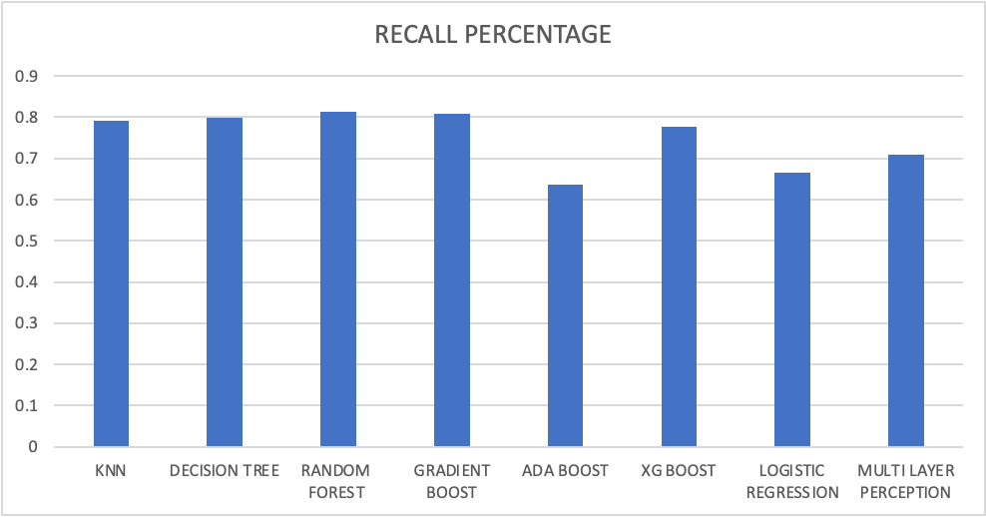
Visualizing Metrics Across Multiple Models

Slide 13
Conclusion
Random forest model predicts death better than logistic regression and with other models. This study aims to investigate the association between pre-existing diseases in patients with known lung cancer and the survival rate one year after thoracic lung surgery. We want to identify any conditions that might have an impact on how well patients will survive.
We have used multiple classifiers on this data set such as Hyper parameter tuned KNN, Decision Tree, Random Forest, Gradient Descent, XG Boost, and Multi-Layer Perceptron.
From the model metrics, Random Forest classifier outperformed all of The models by considering Recall as our main metric.

Slide 14
BEYOND THIS ???
POST OPERATION
COMPLICATIONS
More data
More Variables

Slide 15
THANK YOU

