Slide 1


BookVerse Retail Business Intelligence
& Sales Analytics
Team Leader: Sakkam Meghana
Team Member: Padavala Bhargav Kumar
B.Tech | MySQL Business Analytics Project

Slide 2
About the Team
•
Team Leader: Sakkam Meghana - B.Tech
LinkedIn
|
GitHub
•
Team Member: Padavala Bhargav Kumar - B.Tech, CSE (AI & ML)
LinkedIn
|
GitHub
•
Project: BookVerse Retail Business Intelligence & Sales Analytics - MySQL Business Analytics Project
•
Purpose: Apply relational database design, data validation and SQL analysis to bookstore catalog, customer and sales data.
•
Tools used: MySQL Workbench, SQL and the supplied CSV datasets.

Slide 3
Table of Contents
•
Project Overview
•
Business Scenario
•
Business Objectives
•
Dataset & Database Overview
•
ER Diagram & Database Structure
•
Data Quality & Validation
•
Analysis of the Objectives
•
Overall Key Findings
•
Business Recommendations
•
Conclusion and Q&A

Slide 4
Project Overview
•
Business context: BookVerse Retail Pvt. Ltd. manages a catalog of books, customer records and sales orders across multiple genres.
•
Goal: Use historical transaction data to understand revenue, book demand, customer purchasing behaviour and inventory position.
•
Role: Junior Data Analyst supporting the business team with data preparation, SQL exploration and insight communication.
•
Approach: Understand the business, build the relational database, import and validate the CSV files, analyse questions with SQL and interpret results.
•
Tools used: MySQL Workbench and SQL.

Slide 5
Business Scenario
•
Book catalog: Each book has an author, genre, publication year, selling price and current stock quantity.
•
Customer base: Customer records capture contact and geographic fields such as city and country.
•
Sales activity: Each order links a customer to a book and records the order date, quantity and total amount.
•
Management questions: Which genres and titles drive sales? Which customers return? Which products have low stock or have not appeared in the order data?
•
Decision need: Use consistent SQL analysis to support assortment planning, replenishment, customer engagement and routine sales reporting.

Slide 6
Business Objectives
•
1. Sales Performance: Measure order volume, units sold, total sales amount and performance over time.
•
2. Customer Purchasing Behaviour: Identify active and repeat customers, customer value and geographic patterns.
•
3. Product & Genre Performance: Compare books, authors and genres by sales quantity and recorded revenue.
•
4. Inventory Position: Review stock levels and catalog-price inventory value; find low-stock and slow-moving titles.
•
5. Sales & Inventory Opportunities: Combine sales and stock evidence to flag potential replenishment, promotion and customer-retention actions.

Slide 7
Dataset & Database Overview
Table
Purpose
Key columns
Rows
Books
Book catalog and stock details
Book_ID (PK), Title, Author, Genre, Published_Year, Price, Stock
500
Customers
Customer profile and geography
Customer_ID (PK), Name, Email (UNIQUE), Phone, City, Country
500
Orders
Order transactions and sales amounts
Order_ID (PK), Customer_ID (FK), Book_ID (FK), Order_Date, Quantity, Total_Amount
500
Total core records: 1,500 across the three tables.
Order dates in the supplied data range from 9 Dec 2022 to 7 Dec 2024. Amounts are shown as recorded; the source did not specify a currency symbol.

Slide 8
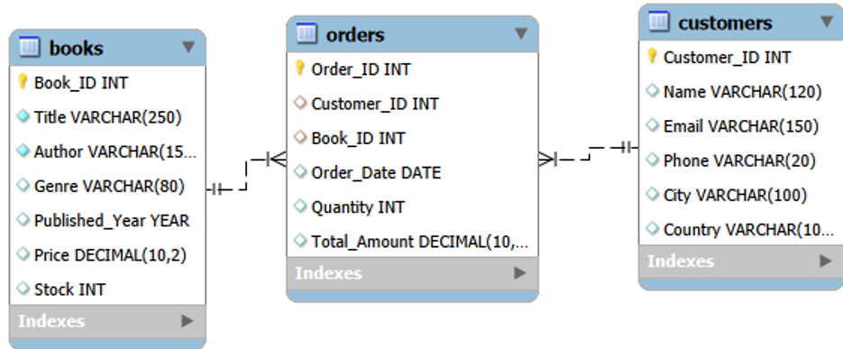
ER Diagram & Database Structure
Three core tables are connected through the Orders table using primary-key / foreign-key relationships.

Slide 9
Data Quality & Validation
•
Record counts verified: 500 Books, 500 Customers and 500 Orders - 1,500 core records in total.
•
Missing-value check: 0 missing values across the three final core tables.
•
Primary-key / duplicate checks: 0 duplicate IDs and 0 duplicate full rows in the validated data.
•
Relationship checks: 0 Orders rows reference a Customer_ID or Book_ID that is absent from its parent table.
•
Import outcome: the final tables were checked against the supplied CSV records and are ready for SQL analysis.
Validation helps ensure the analysis is based on complete rows and consistent table relationships.

Slide 10
Analysis of the Objectives - Sales Performance
•
500 order records produced 2,697 units sold.
•
Total recorded sales amount: 75,628.66; average order amount: 151.26.
•
The order-date range is 9 Dec 2022 to 7 Dec 2024; 2022 is a partial-year baseline.
Recorded sales amount by order year
Amount as recorded in the source data
2022 (partial)
2,513.36
2023
36,339.97
2024 (through Dec 7)
36,775.33
2024 recorded sales amount was about 1.2% higher than 2023, while the order count was lower (228 vs 256).

Slide 11
Analysis of the Objectives - Customer Behaviour
•
307 of the 500 customer records appear in the order data (61.4% of registered customers).
•
139 of those 307 active customers placed more than one order (45.3% of active customers).
•
Highest recorded customer spend: Kim Turner - 4 orders and 1,398.90 in total amount.
Number of genres purchased by active customers
1 genre
184
123 active customers purchased from two or more genres in the observed transactions.
2 genres
97
3 genres
22
Counts reflect the supplied order records, not a forecast of future behaviour.
4 genres
4

Slide 12
Analysis of the Objectives - Product & Genre Performance
Recorded sales amount by genre
Top books by recorded revenue
Romance
13,087
1. Integrated secondary access
Sheena Harris | Non-Fiction
Mystery
12,788
1,104.69 | 23 copies
Science Fiction
11,771
2. Multi-tiered responsive parallelism
Amanda Wilson | Fiction
Non-Fiction
11,603
1,077.12 | 22 copies
Fantasy
11,238
3. Switchable modular moratorium
Tonya Saunders | Romance
Biography
7,870
1,047.48 | 21 copies
Fiction
7,271
Highest quantity sold by title: Realigned multi-tasking installation - 28 copies.
Genre leaders and title rankings are based on Orders.Total_Amount and Orders.Quantity.

Slide 13
Analysis of the Objectives - Inventory Position
•
Total on-hand stock across the 500-book catalog: 25,056 units.
•
Catalog-price inventory value (Price × Stock): 684,644.19; this is an analytical estimate, not an accounting valuation.
•
Using a review threshold of 10 units, 64 titles are low-stock; 5 titles have zero stock.
Catalog-price inventory value by genre
Science Fiction
112,746
Fantasy
103,522
Non-Fiction
103,509
Mystery
103,372
Romance
95,059
Biography
84,825
Fiction
81,610
Science Fiction has the highest aggregate catalog-price inventory value in the current stock snapshot.

Slide 14
Analysis of the Objectives - Sales & Inventory Opportunities
Potential replenishment review: low stock with higher observed sales
ID
Title
Genre
Stock
Qty sold
Amount
288
Re-contextualized real-time Graphic Interface
Science Fiction
9
23
641.93
307
Expanded local infrastructure
Mystery
7
23
331.89
491
Pre-emptive intangible adapter
Fantasy
2
20
297.40
Potential slow-moving stock review: high stock with low observed sales
ID
Title
Genre
Stock
Qty sold
Amount
475
Stand-alone zero administration emulation
Romance
100
1
47.76
1
Configurable modular throughput
Biography
100
3
64.02
These are candidates for review, not automatic reorder or markdown decisions. Validate stock timing, margin and business context first.

Slide 15
Overall Key Findings
•
Sales baseline: 500 order records show 2,697 units sold and 75,628.66 in recorded sales amount.
•
Genre performance: Romance generated the highest recorded amount (13,086.98), followed by Mystery (12,788.45).
•
Customer engagement: 307 customers appear in the order data, including 139 repeat customers.
•
Inventory exposure: 64 titles have stock of 10 units or fewer, and 5 have zero stock; Science Fiction has the highest catalog-price stock value.
•
Assortment opportunity: 183 of the 500 books do not appear in the supplied order records, while several titles combine higher observed sales with low stock.

Slide 16
Business Recommendations
•
Replenishment review: Check the highest-selling titles with low current stock before the next procurement cycle.
•
Slow-moving stock: Review titles with high stock and low observed sales; consider targeted promotions only after checking margin and demand context.
•
Genre planning: Maintain visibility of Romance and Mystery sales performance while checking whether stock mix aligns with demand across all genres.
•
Customer engagement: Create a repeat-customer view and explore retention campaigns for one-time buyers; measure response before expanding.
•
Routine reporting: Save reusable SQL queries for revenue, customer activity, genre performance and stock exceptions.

Slide 17
Conclusion
•
Database built: BookVerse_DB contains the Books, Customers and Orders tables with primary-key and foreign-key relationships.
•
Data checked: All three tables were validated for record counts, missing values, duplicate IDs and order-reference consistency.
•
Analysis completed in SQL: Sales, customer behaviour, product/genre performance, inventory position and cross-functional opportunities were examined.
•
Business value: Findings provide a practical starting point for title replenishment review, slow-moving stock checks and customer engagement.
•
Next step: Continue monitoring sales, customer activity and inventory exceptions using the validated SQL queries.
BookVerse Retail BI & Sales Analytics | MySQL Business Analytics Project

Slide 18


