Slide 1
Pantry Inventory
Meghana Shastri and Dana Davidson

Slide 2
Problem
I forget what I already have in my fridge and buy too much or forget something
I have a craving and want to know if I need to buy ingredients or if I have everything at home
I know I bought X and it’s still in my fridge, but it only lasts so long, when did I buy it?
What brand did I buy last time? How much did I spend on X?

Slide 3
Solution
A database to keep track of all that
Quantity
Price
Brand
Item info
Food category
Important dates

Slide 4
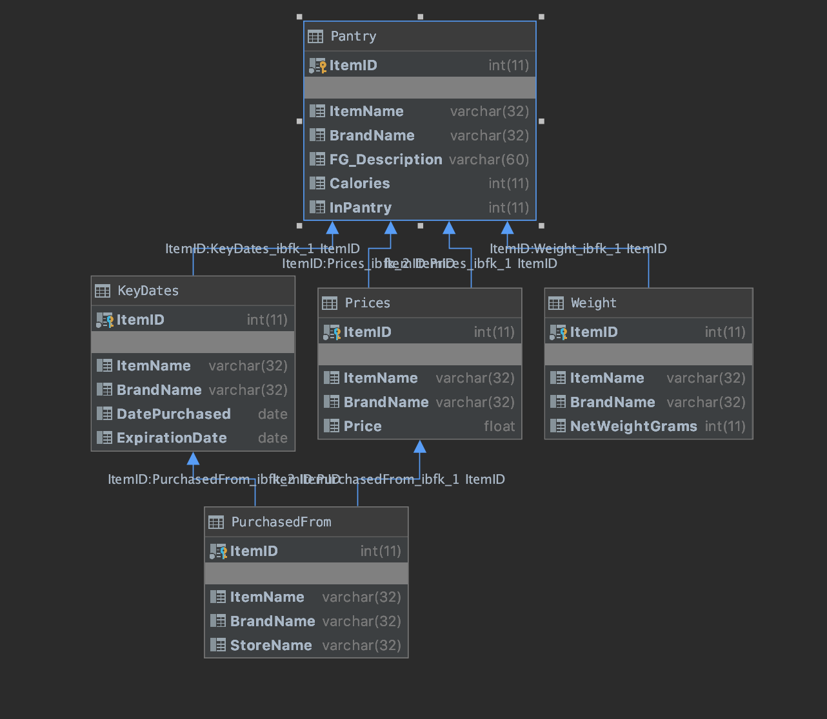
Schema diagram

Slide 5
It would be cool if . . .
Recipe integration
Yummly.com: personalized recipe recommendations
Supercook: website that lets you search by ingredients
Alerts for regularly bought food or almost expired food
Barcode scanner

