Slide 1

ANALYSIS ON OYO HOTELS

Slide 2



Meghana Shivani Gogu
M.E. (Manufacturing)
P. Laxmi Nikhitha
M.Sc. (Statistics)

Slide 3
Problem Statement
Finding right place for comfortable stay within the budget
Objective
Price Analysis on OYO Hotels based on Cities, Reviews and Star ratings

Slide 4

DATA EXTRACTION
Website – OYO
Website URL - https://www.oyorooms.com/
LIBRARIES USED
NumPy
Pandas
Matplotlib
Seaborn
Requests
BeautifulSoup

Slide 5
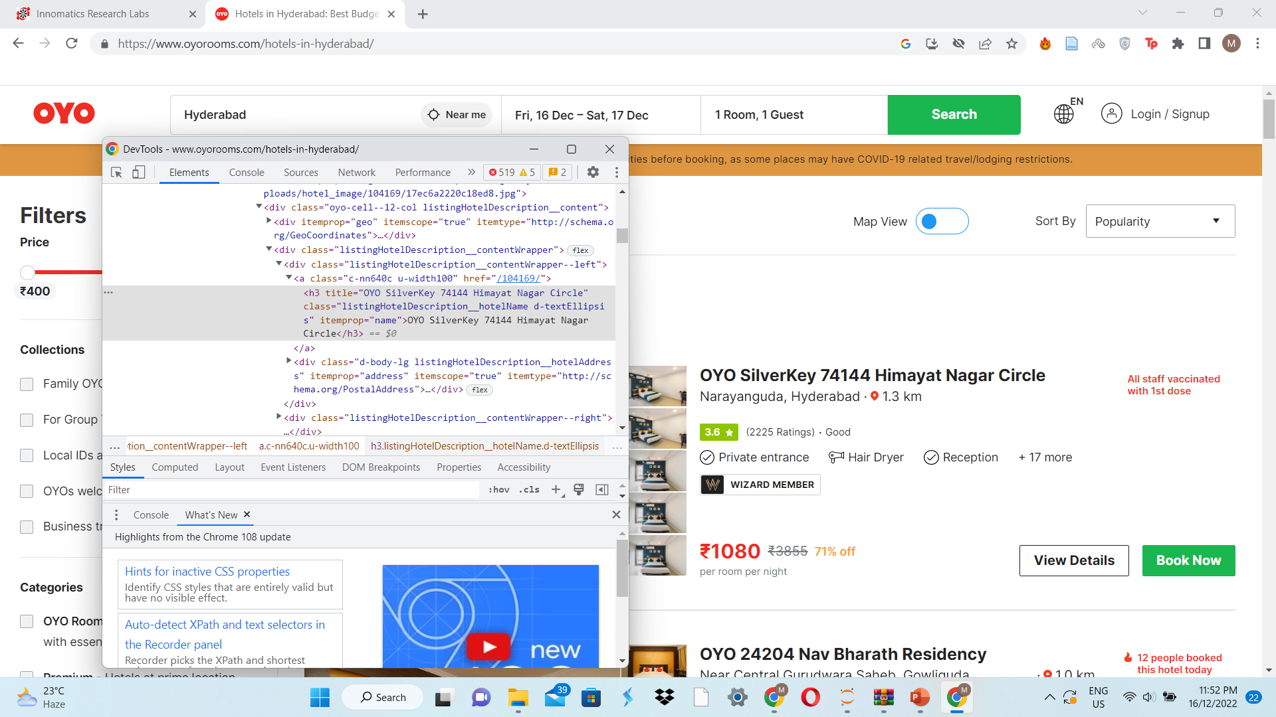
WEB SCRAPING

Slide 6
DataFrame Creation
Chosen to extract data of five different cities from OYO website
Different cities and page numbers.
url='https://www.oyorooms.com/hotels-in-'+j+'/?page='+str(x)
requests and BeautifulSoup libraries.
Loading HTML of the website using inspect
Soup.findall()
Empty lists – labels of our columns
Check length of columns
Insert null values using insert and np.nan
Dictionary creation
DataFrame creation

Slide 7
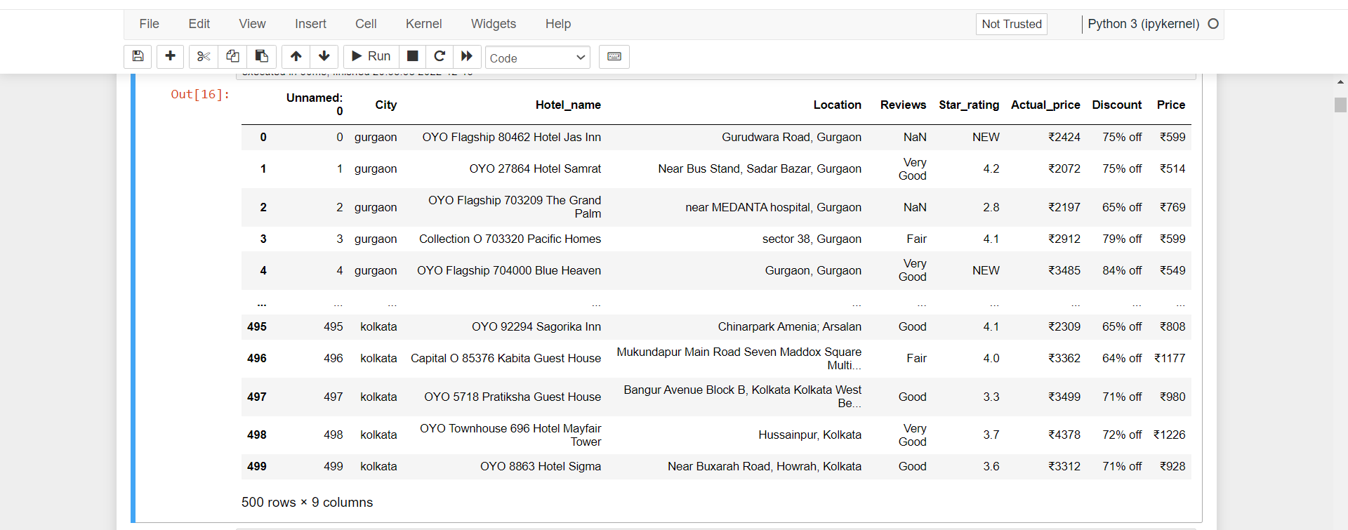
Raw DataFrame

Slide 8
Data Cleaning
Dropping unwanted columns
Handling Duplicates
Handling the missing values
Filling the missing values
Handling the corrupted data
Replace missing values
Re-filling the column
Replace corrupted values
Conversion of object values to ‘int’ values

Slide 9
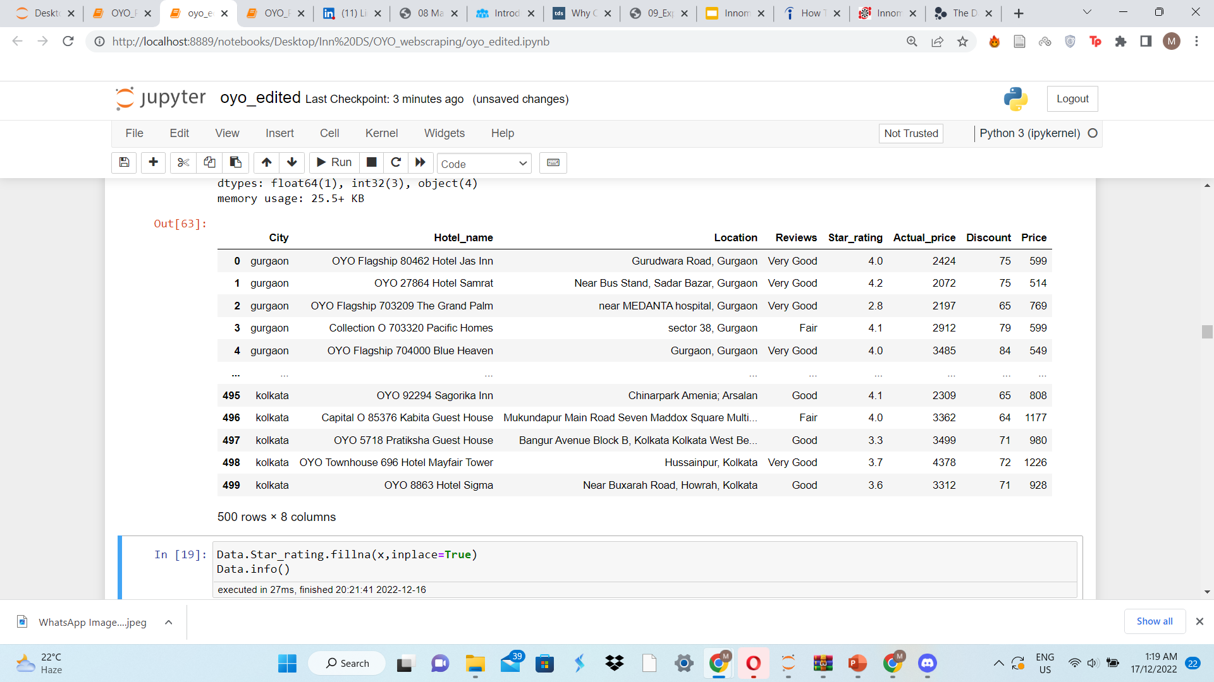
Cleaned Dataset

Slide 10
Outliers
Checking the outliers
Treating the outliers
Normalization
Standardization
log transformation
cuberoot transformation
boxcox transformation

Slide 11
VISUALIZATION
Univariate Analysis
Bivariate Analysis
Multi-variate Analysis

Slide 12
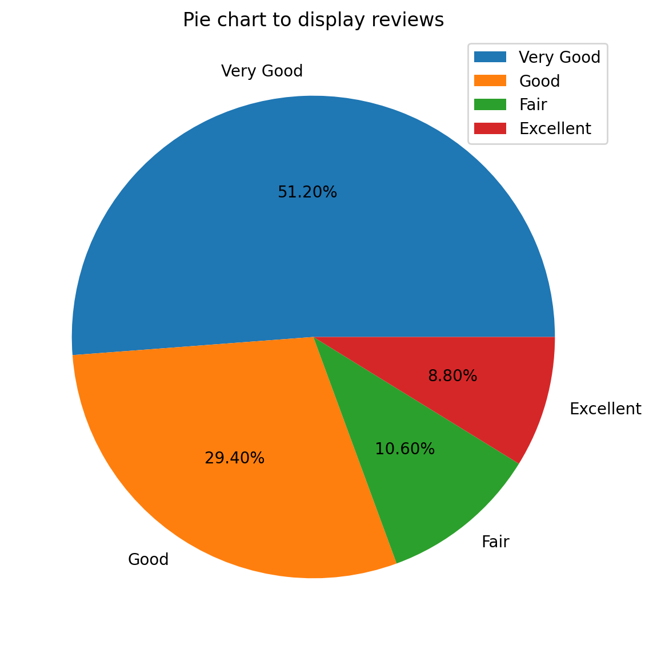
Univariate Analysis
Reviews
Observation
The pie-chart clearly shows that largest proportion of customers reviewed OYO hotels as 'Very Good’, while the review 'Excellent' was given by least number of customers. The review 'Good' was also provided by decent percentage of people.

Slide 13
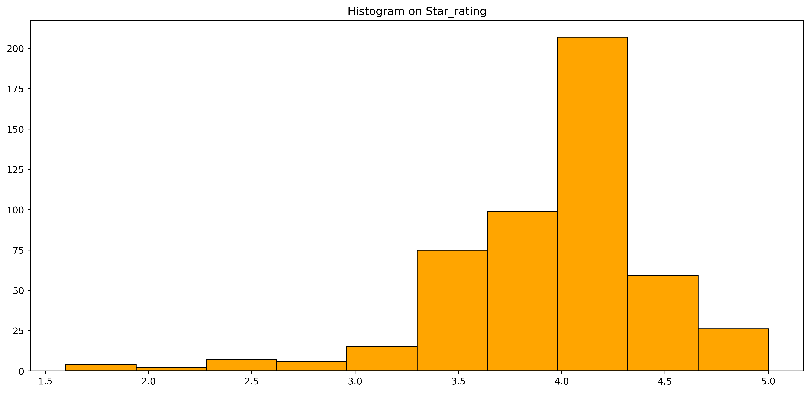
Star ratings
Observation
The Histogram above was plotted based on the count of star ratings. Evidently the ratings ranged from 1.6 to 5.
Maximum number of customers have given ratings '4' for the hotels.
Least portion of customers rated '2'.
A visibly fair number rated in range 3.5 to 4.5

Slide 14
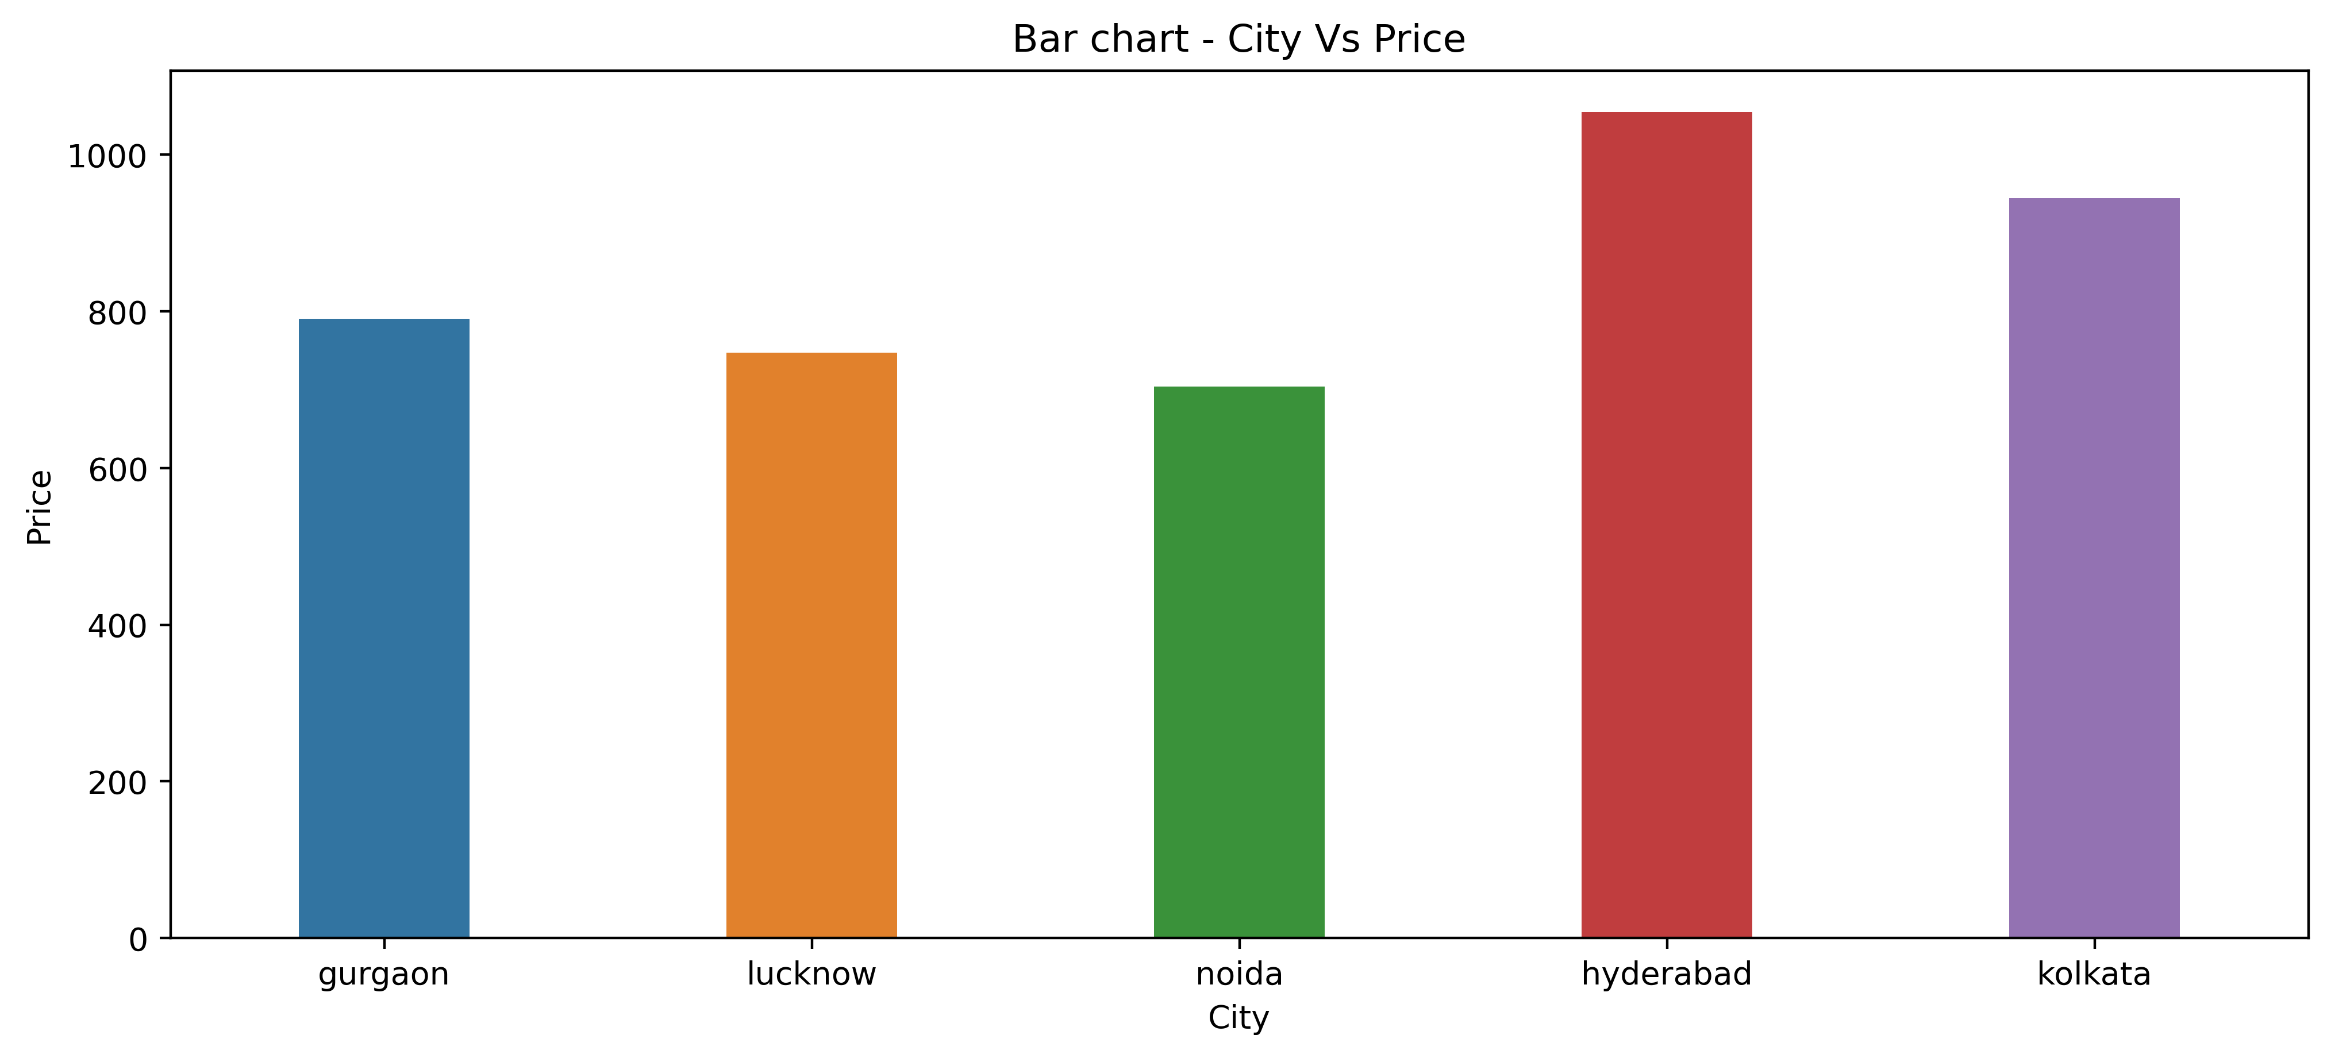
Bivariate Analysis
City-Price
Observation
Evidently, the OYO hotels in Hyderabad city are quite expensive in comparison to the remaining four cities.
Noida offers relatively cheaper hotels.
Only slight variation is observed in the prices of Gurgaon and Lucknow.

Slide 15
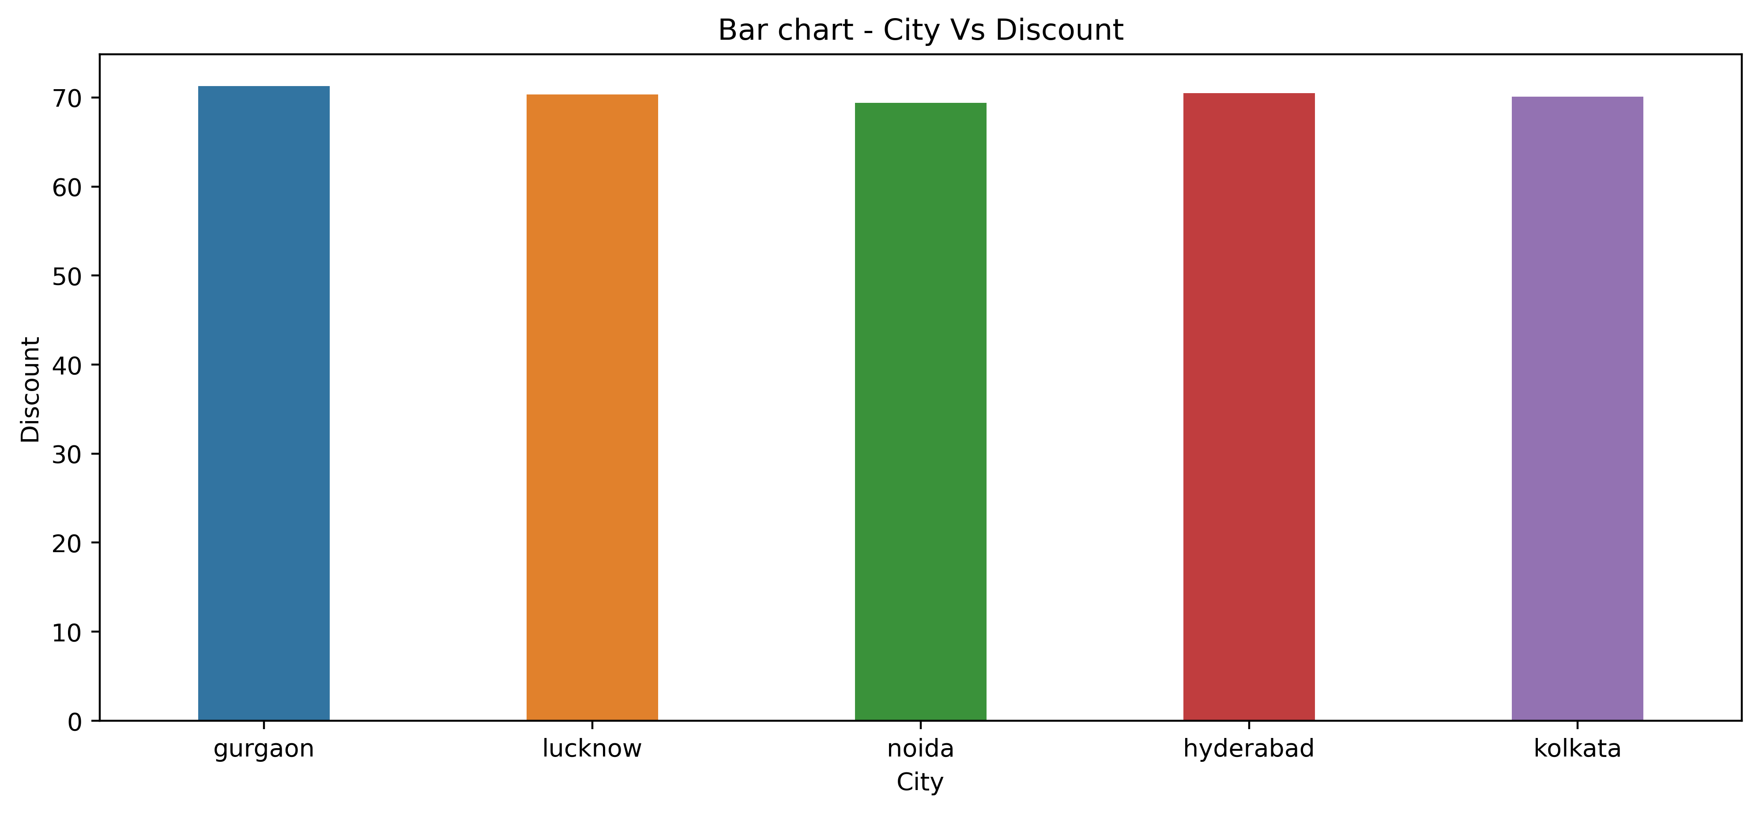
City-Discount
Observation
There is no visible difference in the discounts offered by hotels at various cities

Slide 16
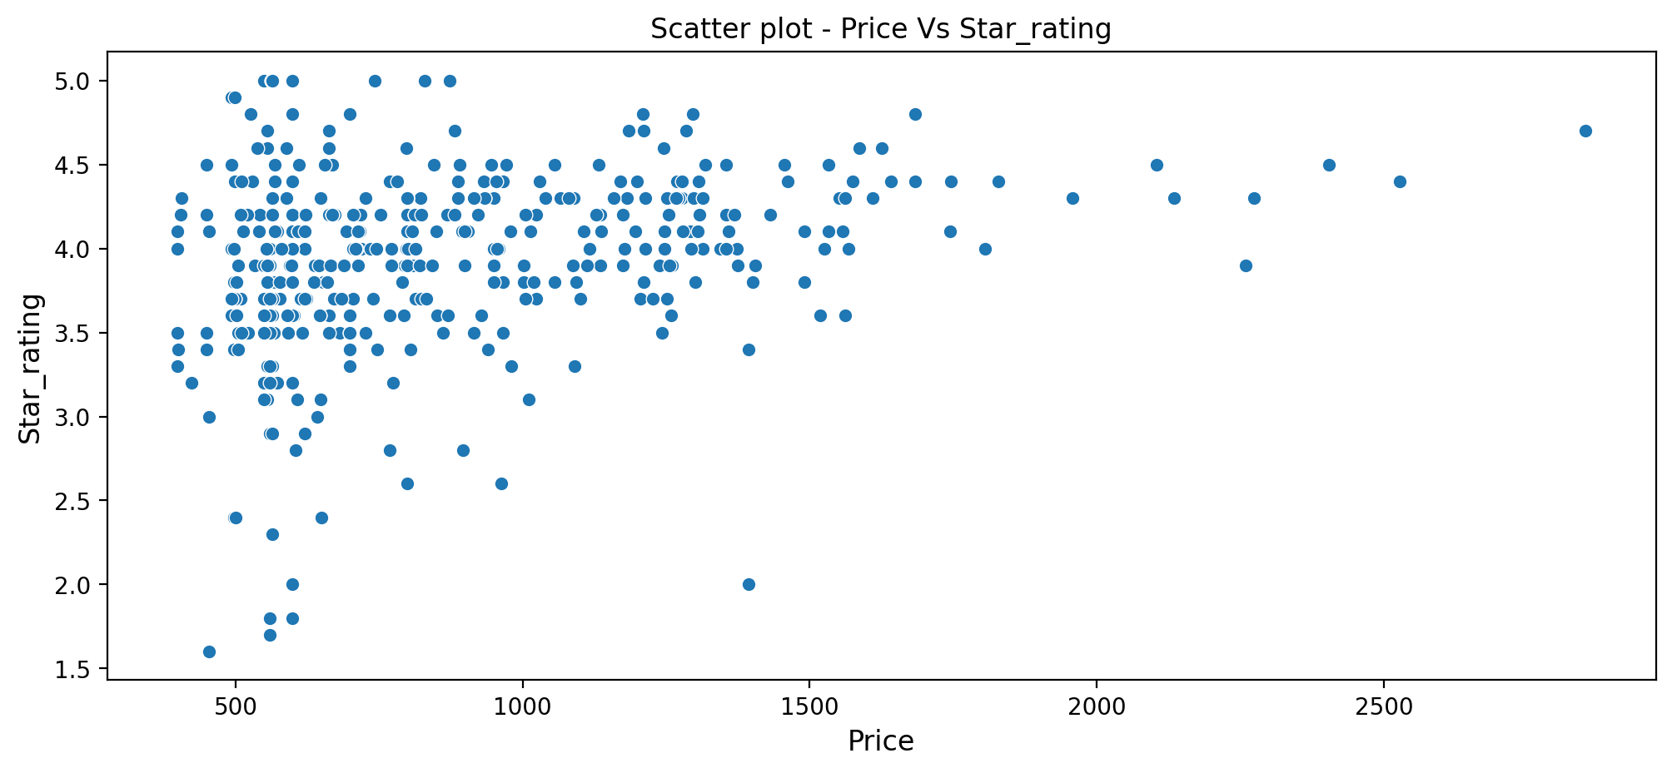
Price-Star rating
Observation
More hotels lie in range Rs.500 – Rs.1500. Star rating ranges from 3.5-4.5.
The above scatter plot helps us to understand that there is no structured relationship between price and star rating

Slide 17
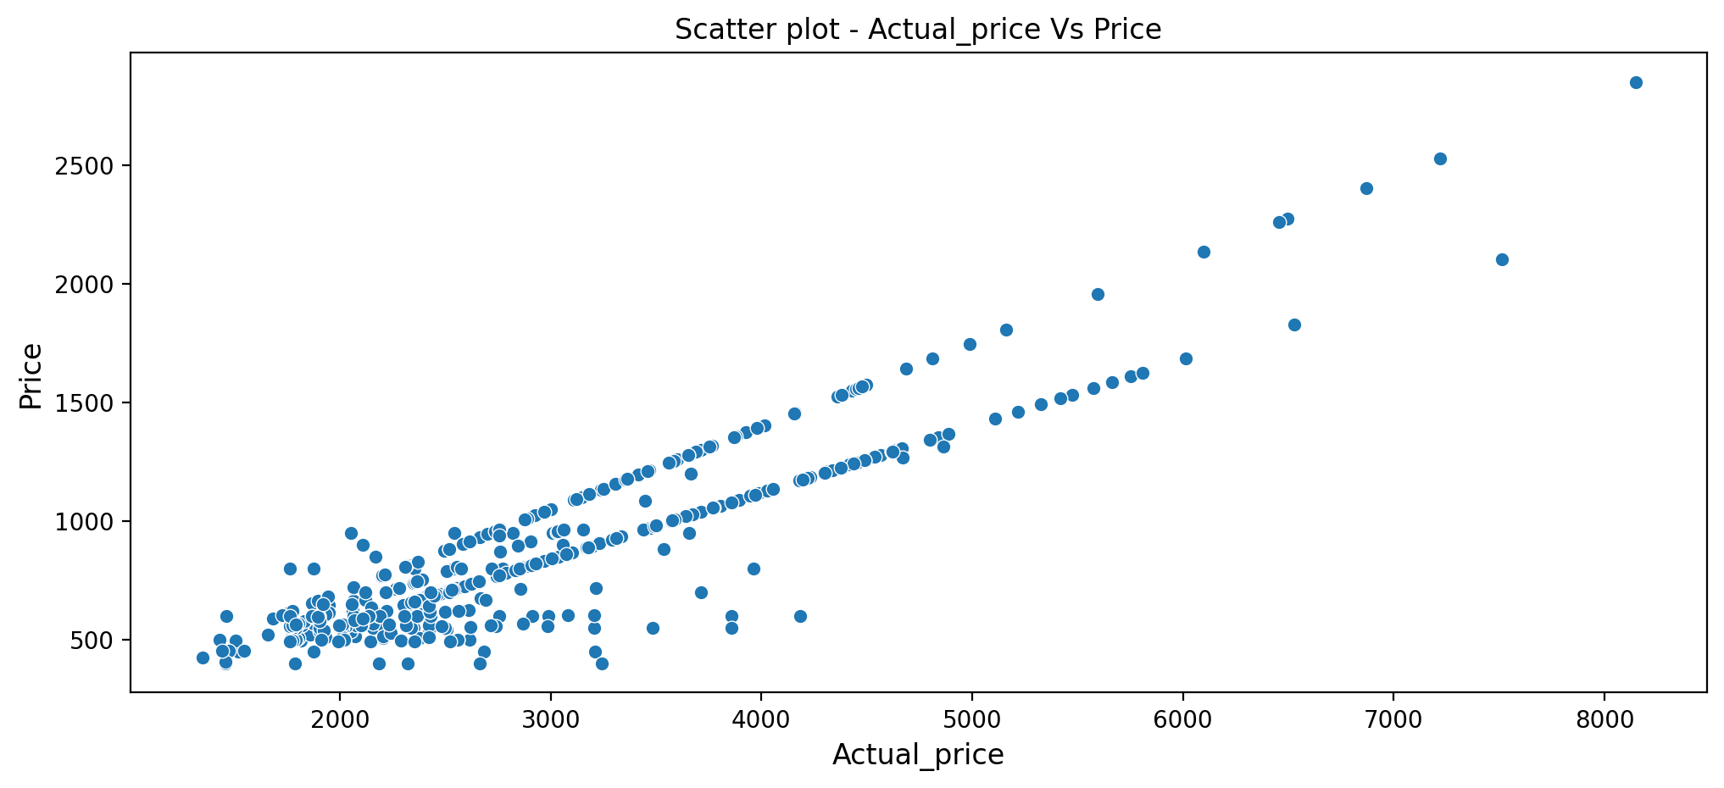
Actual Price-Final Price
Observation
There is a clear positive correlation between Actual price and Price.
However, there are a few deviations due to the discount factor

Slide 18
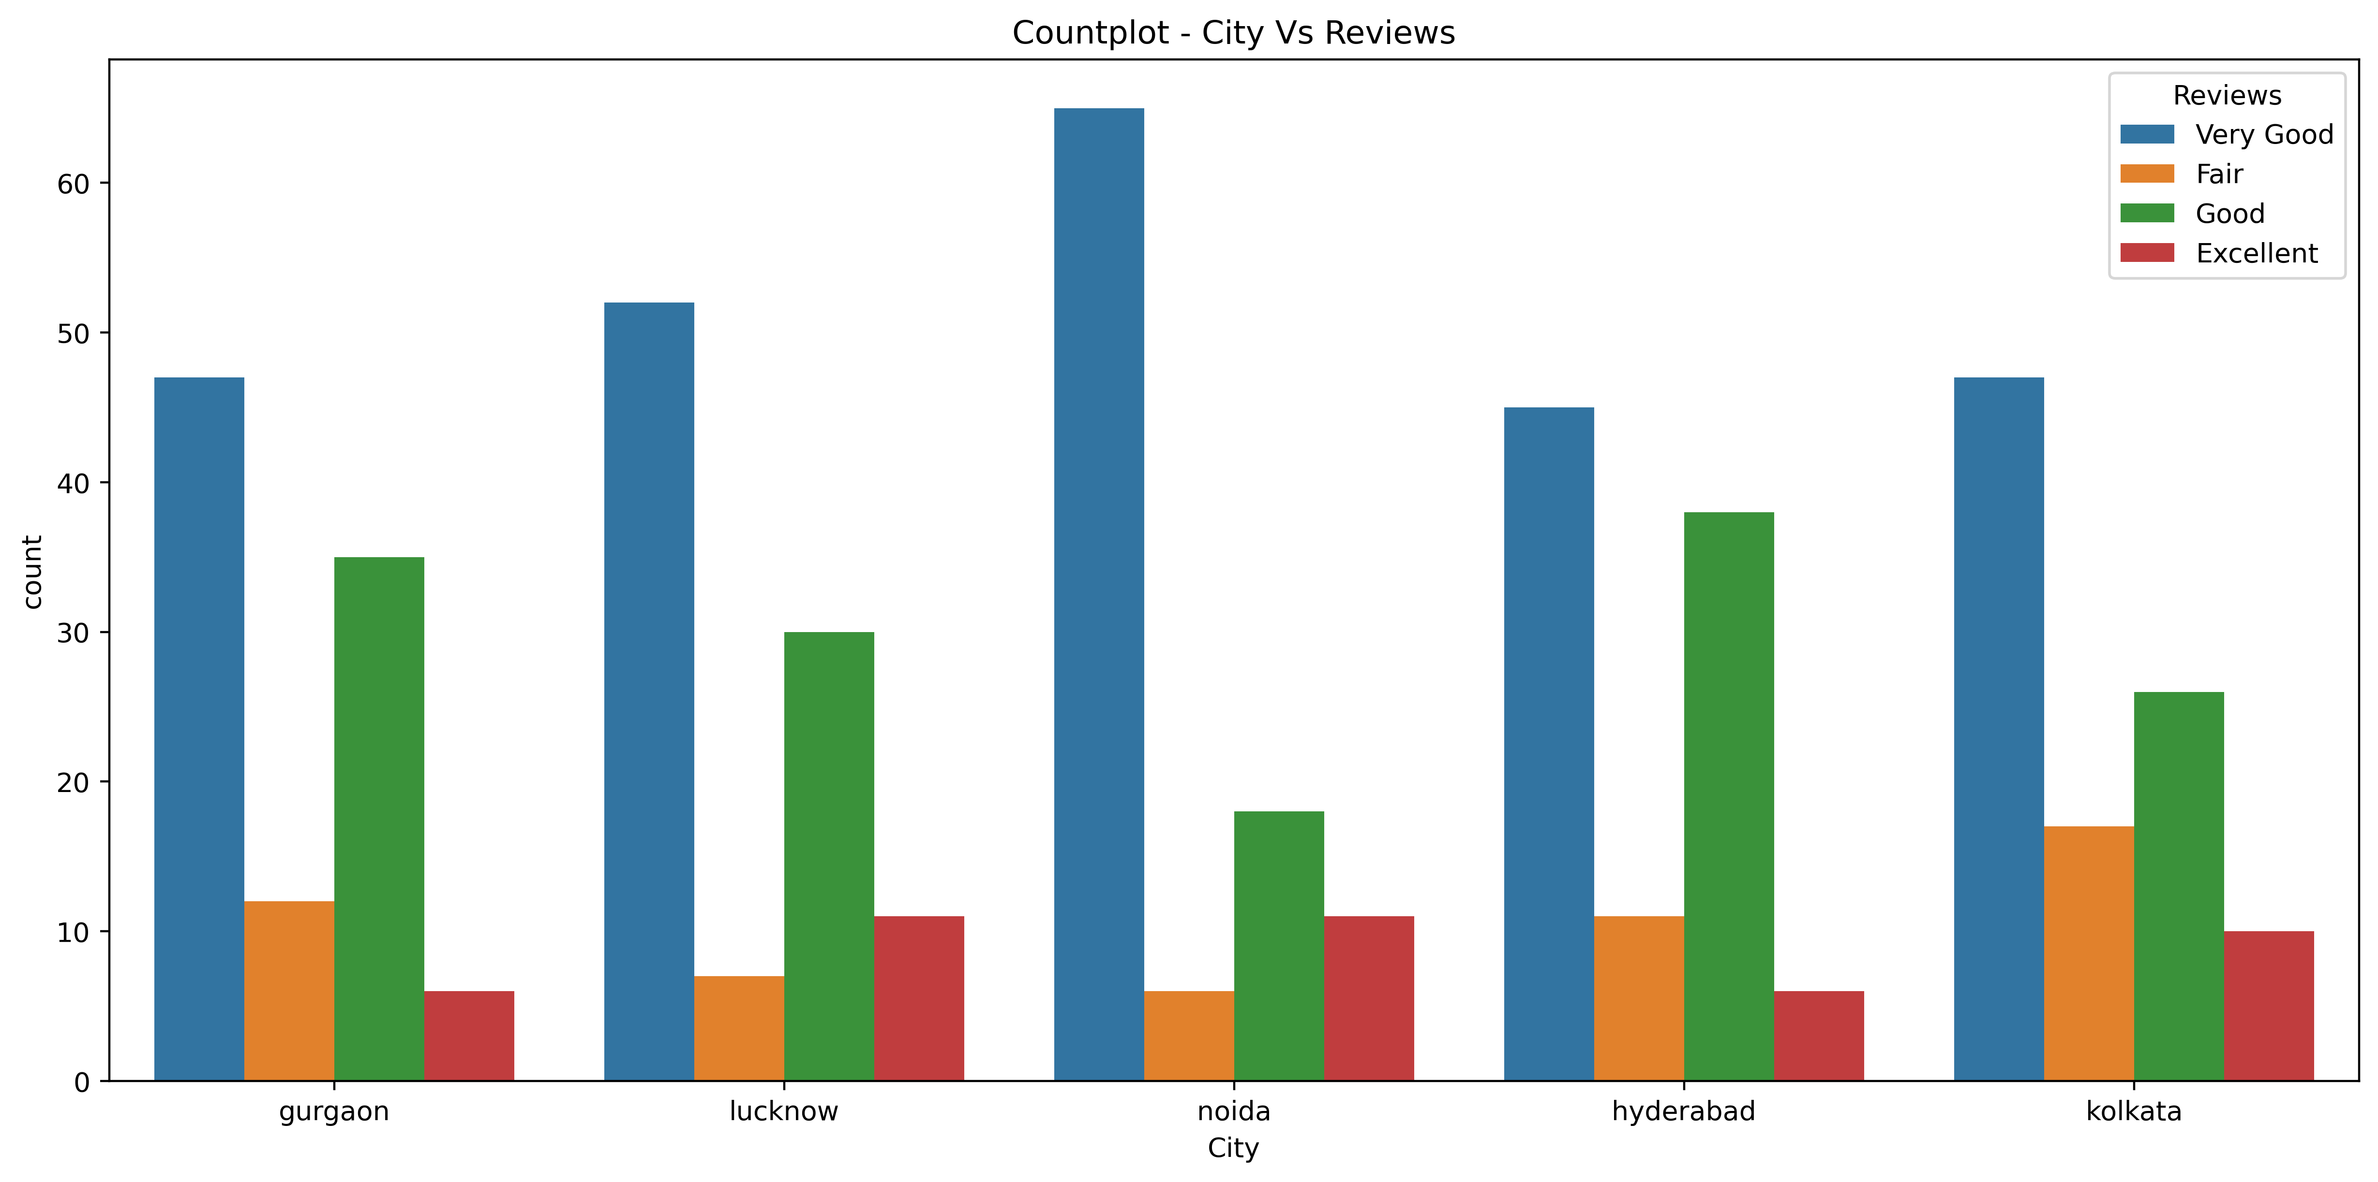
City-Reviews
Observation
Count plot reveals that in every city, maximum customers reviewed OYO hotels to be 'Very Good', followed by 'Good'.

Slide 19
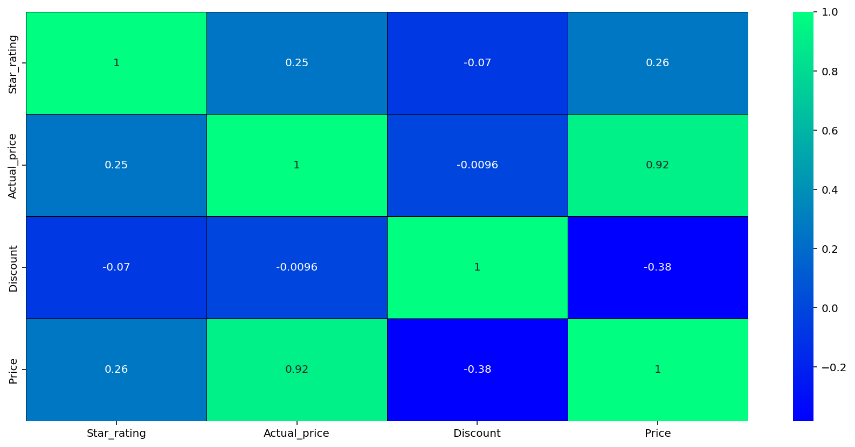
Multi-variate Analysis
Observation
Visible positive correlation between Price and Actual_price
Negative correlation between discount and price

Slide 20
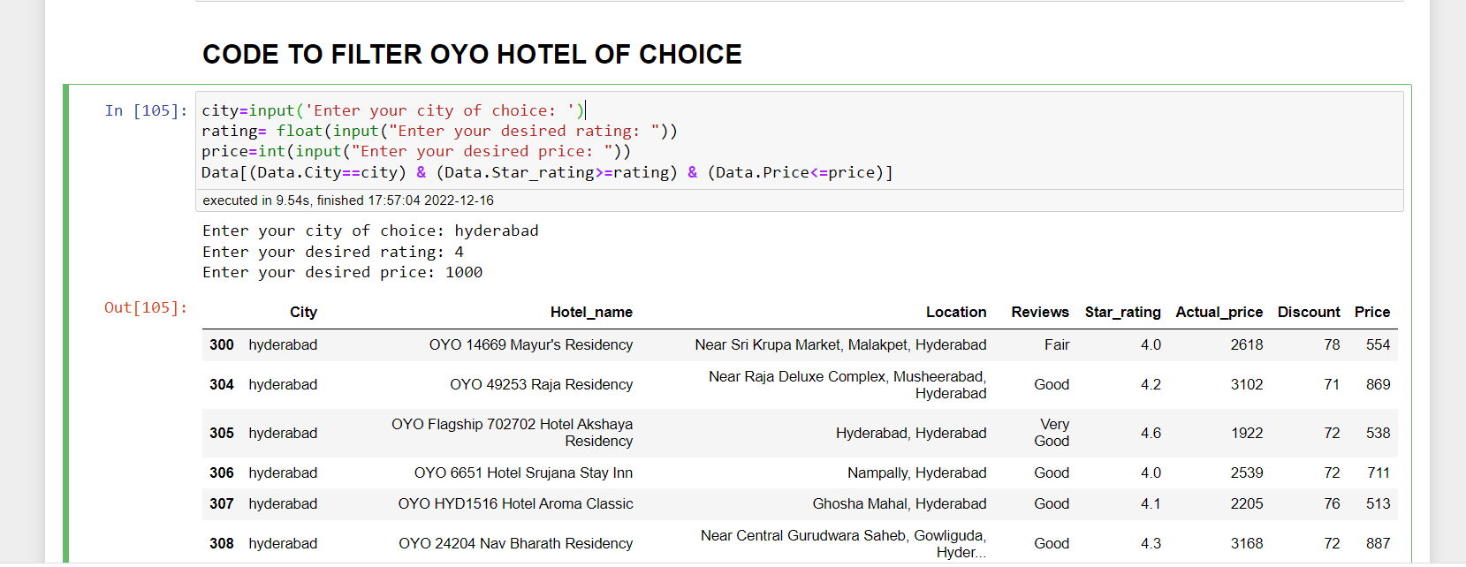
CODE TO FILTER OYO HOTEL OF CHOICE

Slide 21
CONCLUSION
OYO Hotel prices are highest in Hyderabad city
Hotels in Noida city are cheaper when compared, but display maximum “Very Good” reviews by the customers
OYO Hotels offer almost same proportions of discounts across different cities
Actual price (Price before discount) is linearly varying with Price (Discounted price). However, few deviations are visible due to varying discounts.
Hotel prices are totally independent of star ratings
Overall, OYO reviews and ratings prove the firm’s ability to satisfy the customers

Slide 22
OUR EXPERIENCE

Slide 23

THANK YOU
For your patience & Time

Slide 24
QUERIES?

