Slide 1
Perils of Location Tracking? Personalized and Interpretable Privacy Preservation in Consumer Mobile Trajectories
Meghanath M Y
Heinz Second Paper Presentation
September 13th, 2019
Committee Members
Beibei Li (Associate Professor, Anna Loomis McCandless Chair, Heinz, CMU)
Anindya Ghose (Heinz Riehl Chair Professor of Technology, Operations and Statistics, Professor of Marketing, NYU Stern)
Natasha Zhang Foutz (Associate Professor of Commerce, University of Virginia, School of Commerce)
Alessandro Acquisti (Professor of Information Technology and Public Policy, Heinz, CMU)
Notes:
Hi all, my name is Meghanath. Today I will be talking about the perils of location tracking and discuss a framework we developed to reduce the privacy concerns in consumer location tracking. I was advised by Beibei for this project and my committee members are Anindya Ghose from NYU Stern and Natasha Zhang Foutz from University of Virginia, School of Commerce.

Slide 2

Location Tracking
Consumer adoption
76% population in advanced economies own a smartphone. (Pew 2016)
90% of smartphone users use a location service. (Pew 2016)
Collector’s ease
Variety of firms offering granular tracking capabilities.
An app permission away on mobile operating systems. (Apple 2014, Verge 2019)
Advertiser’s opportunity
$0.005 - $0.02 per user per month from data collectors (Valentino-Devries et al. 2018)
$21 billion sales opportunity for advertisers (Luo et al. 2014)
Notes:
First we will discuss the current status quo of location tracking by looking at three aspects involving three key players – Consumer adoption, Collector’s ease and advertiser’s opportunity
First is the consumer adoption to location services on smartphones, According to the latest Pew articles, around 76% of population in advanced economies now owns a smartphone and about 90% of these users use some sort of location service such as google maps.
Next, is the ease of tracking these adopting consumers for a data collector who is interested in monetizing the collected data, for instance, a mobile application developer only requires a single application permission from a consumer on both the popular operating systems to perform tracking.
Even if the app does not directly offer location services, there are a variety of firms that offer integration capabilities for developers to perform and collect granular tracking information of consumers.
and finally as a result of this consumer adoption and ease of tracking, there is a huge marketing opportunity for advertisers in the order of 21 billion to mine this behaviorally rich data to perform targeted marketing campaigns.
A recent article by New York times states that it merely costs half a cent to 2 cents for an advertiser to acquire data from a data collector or an app developer to acquire entire location data of a user per month.
Next, we will look at how these three players fit into the location tracking ecosystem.

Slide 3
Location Data Tracking : Ecosystem
Consumer
Advertiser
App
A
Data collector
App
B
Consumer
Advertiser
App
C
Money flow
Location data flow
Notes:
As discussed, we have three key players in this ecosystem. A data collector is someone who has the capability to track and collect consumer location data.
These are usually the firms that provide location services to multiple application developers or could be developers themselves who own one or more applications.
A consumer who has one of these applications installed would provide a permission to the data collector to collect the data.
This is usually done to enhance the experience of an application. For instance, an application like Gasbuddy would provide recommendations and offers from the nearest and cheapest gas station based on user’s location.
Without the permission, such an app could have limited utility to the consumer.
If a consumer has multiple such applications installed, a data collector has the capability to assign a unique user ID to stitch across the location data across various mobile applications.
While the data collector enhances the experience of a consumer by providing such service, they also serve advertisers who would pay them to acquire the this collected data.
Advertisers with this data can perform targeted campaigning for instance geo location based coupons to increase the chance of making revenue from consumers.
Now, let’s look at the role of advertisers more closely in the ecosystem and how it affects the consumers.

Slide 4
Tracking : Butlers and Stalkers
Advertisers need to be butlers not stalkers. (Ghose 2017)
Butlers
Better services and increased personalization (Chellappa and Shivendu 2010)
Financial benefits such as coupons (Luo et al. 2014, Ghose et al. 2018)
Lower insurance premiums (Soleymanian et al. 2019)
Stalkers
Invasive marketing from advertisers
Identification of home address, life style patterns, targeting injured people in emergency rooms. (Kelsey 2018)
Irrelevant and aggressive targeting campaigns
Bombarding consumers with too many ads. (Ghose 2017)
Notes:
Advertisers with the acquired consumer information could either play the role of a butler who understands the needs and concerns of the consumers while targeting or go overboard with their targeting and become stalkers. This butler attitude of advertisers is beneficial for the consumers. Studies have shown consumers get better services and increased personalization and various other financial incentives. However, some advertisers can go overboard with the personalization with invasive marketing techniques and irrelevant targeting campaigns. These stalking behaviors could range from identification of home address from the location data to lawyers targeting injured people in emergency rooms. Next, we will briefly look at some of the ongoing efforts to tackle these issues.

Slide 5
Tracking : Ongoing Efforts
European Union’s GDPR (effective from May 2018)
Requires users to opt-in (rather than opt out of) behavioral targeting.
Give explicit permission for the tracked data to be shared across firms.
Mobile operating systems
Apple’s Limited Ad Tracking – opt out of tracking indefinitely (2016).
Google provides finer control for a user to limit location tracking (2019, Android Q)
Capability to allow location tracking only while using app.
Tracking inhibitors
Smart VPN applications – limit tracking when installed on mobile
Location tracking blockers
Notes:
First, from a government policy perspective, European’s GDPR has been effective from 2018, requires consumers to explicitly agree to data sharing between firms and also require users to opt-in to behavioral targeting rather than opt out of it.
Next, mobile operating systems have recently started providing consumers with an explicit option to opt out of tracking indefinitely.
While Apple has been doing this since 2016, Android has recently with their newest Q operating system provides finer controls as to display what applications are granted location and other data permissions and also provides an option to allow location tracking only while using the app.
Finally, given the concerns regarding invasive marketing, VPNs have become more popular. With VPNs, consumers have an option to reroute the traffic so as to limit the data flow and stitching capabilities of the data collectors.

Slide 6
Tracking : Ongoing Efforts
App
A
Consumer
Data collector
Advertiser
App
B
App
C
Mobile operating systems
Tracking inhibitors
European GDPR
This talk
Privacy paradox - Inconsistency in online behavior of consumers and surveys.
Consumers will opt in to share data for incentivized offers but want to protect their personal data. (Ghose 2017)
With the shared data, a sensitive attribute that was not voluntarily shared could be inferred – invasion of consumer’s privacy.
Notes:
From a mobile ecosystem’s perspective, these on going efforts primarily focus on limiting the data flow from consumer to the data collector.
However, as we have seen the butler role of advertisers is beneficial to the consumers and hence consumers would permit the data collector to track the location data and share them across firms in the hope of getting financial benefits. But this incentivization incurs a cost to the consumers. The cost incurred originates from the risk that a sensitive attribute could be identified or mined by an advertiser with stalker intent. This inferred data was not voluntarily shared by the consumer and is an invasion of their privacy. This arises the necessity to develop techniques to enable advertisers maintain the balance between the butler and stalker roles. In this talk, we will be discussing a technique we developed to strike this balance.

Slide 7
Research Agenda
Consumer cost of data sharing
What are the risks involved due to stalker behavior?
Can these be quantified ?
Consumer benefits
What types of behavioral information can be extracted ?
What is the value for consumers due to a butler advertiser ?
Data collector's trade-off between consumer cost and benefit
Is there a reasonable trade-off ?
If yes, what are the necessary steps ?
Notes:
Specifically to achieve this balance, we aim to answer a series of questions in this work from the perspective of the consumers.
First, we aim to understand and quantify the different costs incurred due to the privacy risks associated with multiple types of stalker behaviors.
Next, we study and measure the benefit that a consumer gains from sharing the location data. The benefits originate from the advertisers ability to extract relevant behavioral information to incentivize the customers.
Finally, following the literature in this area, we make the assumption that the data collector who stores, tracks and shares the location data with advertisers is responsible for maintaining the trade-off between the consumer cost and benefit. We study if there is a reasonable trade-off and propose a framework for the necessary steps to ensure this trade-off. Before we go into the details of the methodology, let us look at the related literature in the privacy area.

Slide 8
Related Literature
Consumer – How do consumers respond to privacy concerns?
Privacy intruding survey questions (Acquisti et al. 2012)
Platform provided privacy setting (Burtch et al. 2015)
Opt in/ Opt out for email marketing (Kumar et al. 2014)
Firm – How to design privacy friendly policies?
Optimal design of personalization services for customers with heterogenous privacy concerns (Chellappa and Shivendu 2010)
Optimal choice of ad content and communications when firm withholds customer’s private information. (Gardete and Bart 2018, Sobel 2016)
Privacy friendly geo-similarity network mining. (Foster Provost et al. 2015)
Privacy regulations – How do regulations impact consumers and firms?
Effect of state level privacy protection on hospital’s EMR adoption (Miller and Tucker 2017).
Do Not Call Registry – Influence of early registered consumers on unregistered consumers. (Goh 2013)
Notes:
Literature in consumer privacy falls into four main streams. The first stream focuses on how consumers respond to privacy concerns. These involve works where users were surveyed with privacy intruding questions where the authors find that the willingness to divulge sensitive information depends on other’s willingness to divulge and the ordering of the intrusive questions, their perception towards a privacy setting provided by a platform and opt in or opt out email marketing.
The second stream looks at the privacy concerns from a firm perspective and aim to design privacy friendly policies. These works involve optimal design of personalization services where there is heterogeneity between consumer privacy concerns, optimal choice of ad content and inferring geo-similarity network in a privacy friendly manner.
The third stream looks at how privacy regulations impact firms. For instance, Miller and Tucker study the effect of state level privacy regulations on a hospital’s likeliness to adopt to the electronic medical records and Goh et al. investigate the Do not Call Registry policy to study the influence of early registered consumers on unregistered consumers.
Acquisti et al. 2012 : Authors find that the willingness to divulge sensitive information depends on other’s willingness to divulge and the ordering of the intrusive questions.
Burtch 2015 : Authors find that reducing access to privacy controls induces a net increase in fund raising. This net increase is a result of two competing influences. Willingness to engage on the platform or the probability to contribute increase and decrease in average contribution.
Kumar 2014 : Effect of marketing intensity on customer opt in and opt out time and methods to extend opt out time by allocation marketing resources efficiently. Develop a method to predict opt out time by jointly modeling opt in time (purchase to opt in time) and opt out time (opt in and opt out time)and average transaction amount.
Chellapa and Shivendu 2010 : When and to what type of customers do firms offer fixed, variable levels of personalization and monetary transfers. This is answered based on the Marginal Value of Information to a firm. If MVI is low, then no coupons are offered. What markets do they capture with these strategies?
Gardete and Bart 2018 : In a sender and receiver setting, communication between them to persuade an action is only influential if the sender is not very well informed about the receiver’s preferences. Ignorance provides senders with commitment power to not indulge to receiver’s preferences.
Casadesus-Masanell and Hervas-Drane 2015 : Setting firms set prices and disclosure levels for consumer information. Consumers observe both before deciding which firm to choose and what information to share. How does competition affect these firms service offerings? Competition drives provision of services with low level of disclosure. Competition ensures services with high level of disclosure to subsidize consumers.
Miller and Tucker 2017 : State level privacy protection reduces network benefits of hospitals. In states without privacy protection, adoption of EMR by a hospital increases probability of a neighboring hospital’s adoption.

Slide 9
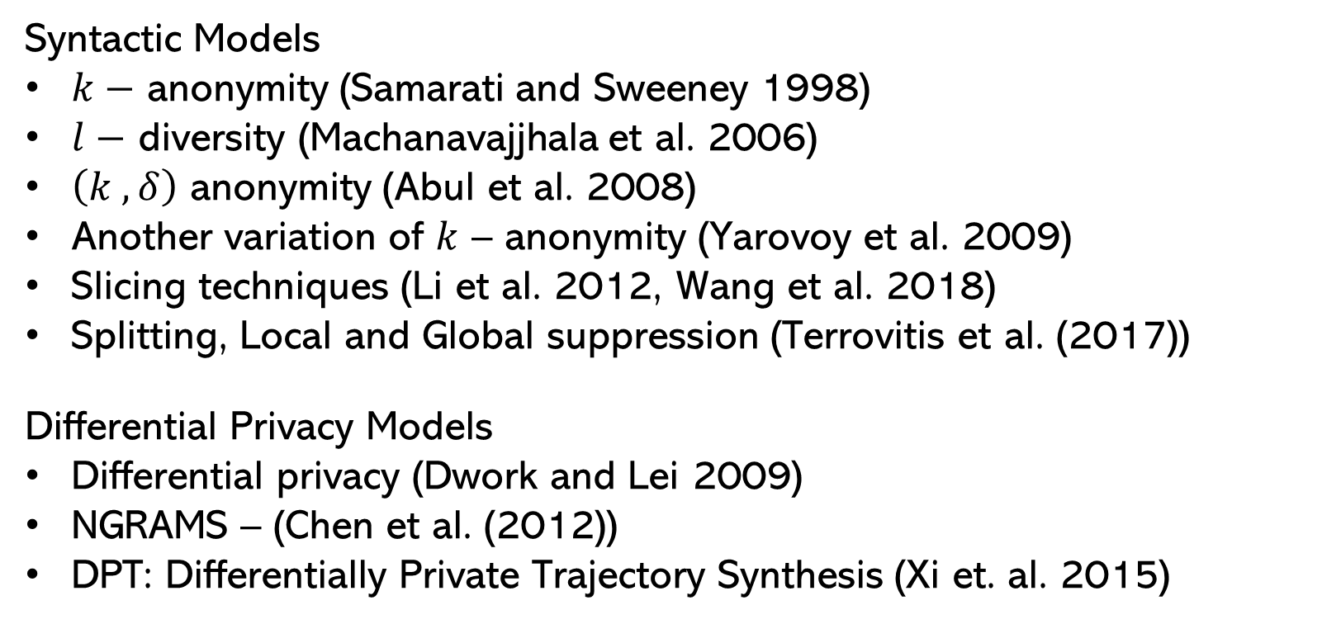
Related Literature
4. Methodology – How to transform data to reduce privacy concerns?
Syntactic Models
$k−$ anonymity (Samarati and Sweeney 1998)
$l−$ diversity (Machanavajjhala et al. 2006)
$\left(k , δ\right)$ anonymity (Abul et al. 2008)
Another variation of $k$ – anonymity (Yarovoy et al. 2009)
Slicing techniques (Li et al. 2012, Wang et al. 2018)
Splitting, Local and Global suppression (Terrovitis et al. (2017))
Differential Privacy Models
Differential privacy (Dwork and Lei 2009)
NGRAMS – (Chen et al. (2012))
DPT: Differentially Private Trajectory Synthesis (Xi et. al. 2015)
Notes:
The fourth stream and the stream that is most relevant to our work is method focused. Here the broad agenda is to transform the collected data so as to reduce privacy concerns. In this literature, the stalker is referred to as privacy attacker/adversary or any entity with malicious intent who wants to invade consumer privacy. This can be broken down into the types based on the assumptions made in developing the techniques. The first are syntactic models where the premise is that the entity performing the transformation knows the type of attacks that a stalker is going to perform on the shared data and accordingly transforms the data to curtail that specific attack. The seminal work in this area aimed at columnar data was the concept of k-anonymity which would ensure that given a column, there would be at least k records which take the same value. This would ensure that a record is not completely identified if a stalker has some background knowledge. Studies have shown that k-anonymity was NP hard. Variations of the concept of k-anonymity and heuristics to approximate k-anonymity were proposed. All of these methods aim to transform the data to prevent reidentification risk of consumers. However, k-anonymity is susceptible to sensitive attribute inference with some background knowledge that is if a stalker aims to only infer a particular column of a user. l-diversity was introduced to address some of these concerns. In 2008, this concept was extended to location data where the idea was that given a location of a user, there would be at least k records in the delta neighborhood of that location making the user who has visited that location indistinguishable. There have been variations of k,delta proposed for location data. More recently, research has focused on quantifying the risk given a stalker type and have developed techniques such as suppressing or splitting consumer trajectories to reduce the risk while ensuring that the transformed data is still useable for advertisers.
The second type of models are based of the concept of differential privacy proposed by Dwork in 2009. Differentially private algorithms guarantee that an entity would make the same inference from the shared data whether or not the individual is included in the data or not. Since it does not limit itself to a specific type of attack, it has a much stronger privacy notion than the syntactic models. Earlier when the differentially private algorithms were developed, they were mainly aimed at answering queries in a private way rather than publishing or sharing the data to an entity. More recently, there have been techniques proposed to reconstruct synthetic trajectories from a series of queries. However owing to this stronger notion, the techniques developed only aim to preserve aggregate summaries of the sample such as counts or distance distributions of individuals and thus largely limit the practical utility at a consumer level. Also, the current differential privacy techniques developed for location data were shown to add too much noise to meet the stronger notion of privacy in a recent work. In our problem setting, since we work with consumers that have opted in for behavioral targeting explicitly, we take the syntactic model route which are more likely to result in higher data utility than the other counterpart. We now discuss the differences of our proposed framework from the current literature.

Slide 10
Contributions
Consumer level cost and benefit measurement.
Prior works study these at a sample level.
Benefit not tied to a business objective.
Multiple interpretable options to balance cost and benefit.
Earlier works provide limited transparency on the transformation.
Require multiple user inputs.
Validate on detailed consumer data.
Prior literature evaluated on simulated data.
Taxi records, social network check-ins, call logs.
Notes:
From a methodological point of view, we quantify the cost and benefit at a consumer level. The prior literature quantify the privacy risk either at a sample level or at a location level. Further the utility or the benefit in the prior literature is not tied to a business objective. For instance, the most recent work in the syntactic model measures the utility as the number of frequent patterns found in the data set. Second, our proposed framework owing to the quantification of risk and benefit at a consumer level, provides more transparency on the transformation. A data collector would have the ability to understand the resulting transformation of location data for each consumer by assessing the cost and benefit assigned to the consumer. Finally, almost all of the previous works have validated their framework either synthetic data or less granular data such as taxi records, social network check-ins. In our work, we validate the proposed framework on detailed consumer data spanning across five weeks.

Slide 11
Proposed framework
Consumer Cost Quantification
Quantify cost associated for each consumer due to stalkers.
Two types of stalkers – Sensitive attribute inference and re-identification.
Consumer Benefit Measurement
Measure utility of the location data to avail a butler service.
Popular business objective – Point of Interest recommendation.
Suppression Scheme
Consumer’s location data suppressed based on the cost.
Empirically determine the best trade-off between cost and benefit.
Notes:
Coming to the methodology, our framework contains three key components addressing the three questions we state in our Research agenda.
First is where we quantify the consumer cost incurred in sharing the data by looking at two types of privacy risks – inference of a sensitive attribute where a stalkers aims to infer an attribute that is not shared by extracting behavioral information from the shared data. Second is the inference of identity where the aim of the stalker is to completely identify the location trajectories of a user given some background knowledge.
Second we measure the consumer benefit in sharing the location data. This is done by considering a popular business goal for advertisers – Point of Interest recommendation where the aim is to predict the next location a consumer is likely to visit. The intuition here is that more accurate the recommendations, more beneficial it is to the customers.
Finally, we develop an obfuscation scheme where we suppress locations based on the cost that is associated to each consumer and empirically determine the best trade-off between cost and benefit.

Slide 12
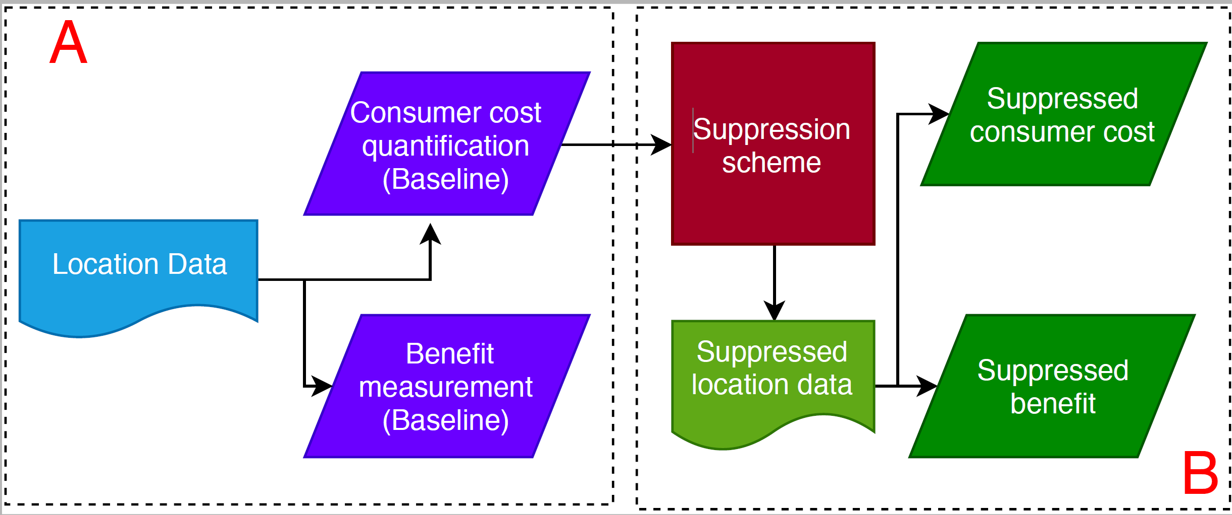
Proposed framework
Notes:
This is how the three components of the proposed framework interact with each other in the empirical setup.
In Part A, we have the non obfuscated location data where we compute the consumer cost and benefit.
These measures capture the consumer cost and benefit when data collector does not take any action before they share the data with advertisers.
These two measures would act as our baselines for any obfuscation performed later on. In Part B, we obfuscate the data based on the consumer cost mimicking the data collector’s actions and then compute these quantities again. A good obfuscation scheme would reduce the user cost without sacrificing too much of the benefit. We repeat this exercise for a series of obfuscation schemes resulting in multiple options for the data collector. We’ll look at some of the key findings from our study now.

Slide 13
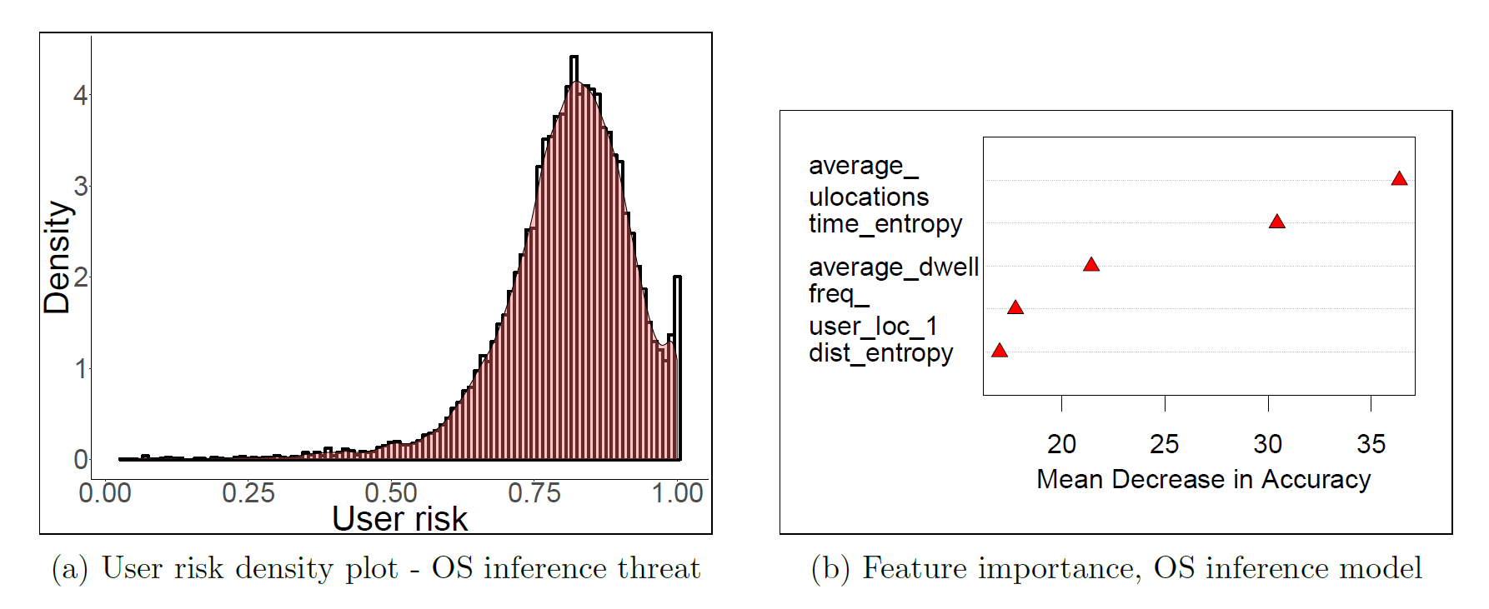
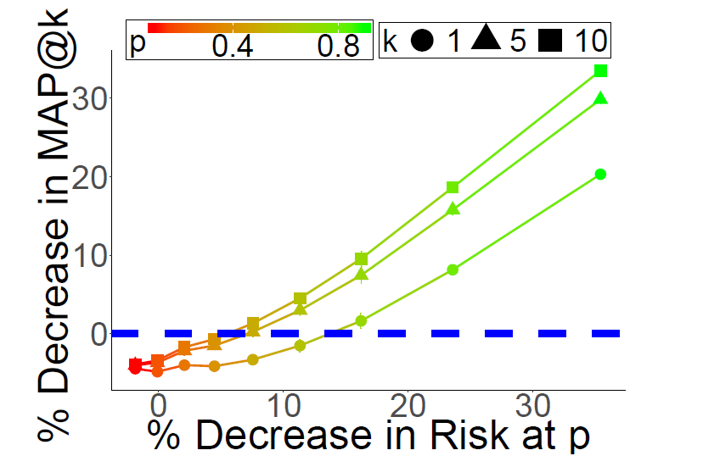
Key findings
40,000 consumer data spanning over five weeks in 2018.
Consumer Cost - In absence of any action by the data collector, a stalker has
82% success in inferring a sensitive attribute (Operating system).
Home address can be inferred within a 2.5 mile radius.
49% success in re-identifying a consumer’s entire location history by knowing two randomly visited locations by the consumer.
Consumer benefit - A butler advertiser is able to
Send a relevant advertisement to a consumer with 25% success.
Personalized Consumer cost
Suppression Scheme
% Decrease in benefit
% Decrease in cost
Notes:
We perform our analysis on 40,000 consumers data spanning over five weeks in 2018.
First, we observe that in the absence of any action by the data collector, a stalker has 82% success of inferring a sensitive attribute even though the attribute was never shared with the attacker and home address within a 2.5 mile radius. Also, a stalker has an average of 49% success in re-identifying a consumer’s entire location by knowing just tow randomly visited locations.
Coming to consumer benefit, we observe that an advertiser can target a consumer with a relevant advertisement with 25% success.
With the proposed framework a data collector can assess the cost at an consumer level. Here we plot the consumer cost for the sensitive attribute attack and observe that a lot of the consumers have a high risk of their sensitive attribute being inferred from the location data.
In the suppression scheme, we visualize the options a data collector has to curtail the inference of home address. We plot decrease in consumer benefit on the X-axis and decrease in consumer cost on the Y-axis relative to the baselines we calculate in Part A. Each point on the plot corresponds to an obfuscation scheme controlled by a parameter p and each line corresponds to different marketing objectives of butler advertisers. For instance, if we were to look at k = 1 the bottom most line, we see that without any decrease in the consumer benefit, the blue line, we are able to reduce the cost incurred by a consumer by around 15% from the baseline.

Slide 14
Method : Details
Notes:
Let us now look into the details of the methodology.

Slide 15
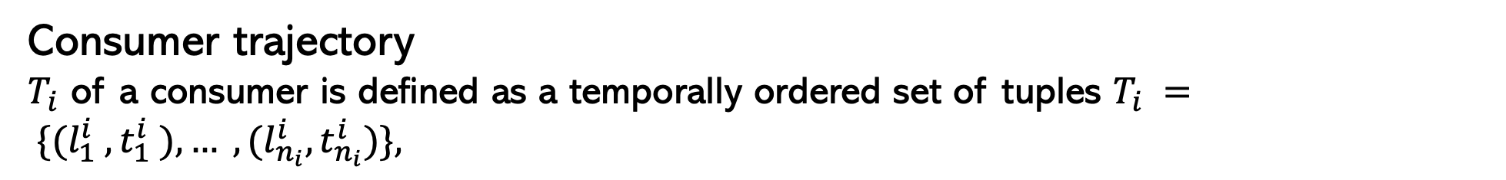
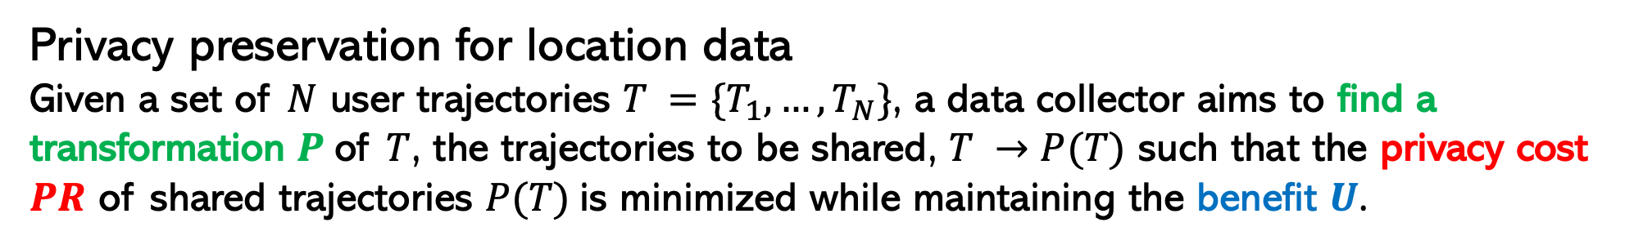
Preliminaries
Consumer trajectory
$T_{i}$ of a consumer is defined as a temporally ordered set of tuples $T_{i} = \{(l_{1}^{i} ,t_{1}^{i} ),… ,(l_{n_{i}}^{i},t_{n_{i}}^{i})\},$
Privacy preservation for location data
Given a set of $N$ user trajectories $T =\{T_{1},…,T_{N}\}$, a data collector aims to find a transformation $P$of $T$, the trajectories to be shared, $T →P(T)$ such that the privacy cost $PR$ of shared trajectories $P(T)$is minimized while maintaining the benefit $U$.
Notes:
A trajectory is defined as ….
And the formal definition of the privacy preservation problem for location data is that …
Next, let us look at how we formulate the problem.

Slide 16

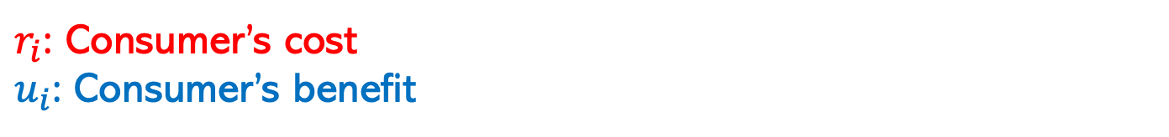
Problem formulation
Risk and Utility
$r_{i}$: Consumer’s cost
$u_{i}$: Consumer’s benefit
Suppression scheme $P\left(T\right)$ depends on
$z_{i}$: suppression probability for user $i$
$s_{i}$: suppression weights corresponding to each tracked location of a user
$P$: Loss per cost unit
$Q$: Gain per benefit unit
Data collector’s decision is top find the optimal $\left(s_{i},z_{i}\right)$ to maximize
$$O(s_{i},z_{i}|P,Q)={Q×E\left(u_{i}\right)−P×E(r}_{i})$$
Notes:
We frame the problem of preserving privacy at a consumer level. Assume ri be the consumer cost for a type of stalker behavior and ui be the consumer benefit . Our obfuscation scheme has two parameters zi and si where zi is the suppression probability of user I and si is the weights corresponding to each tracked location of a user.
Since the corresponding risk of the suppressed or obfuscated data depends on the two parameters introduced, Ri and ui would be a function of si and zi. More the suppression at a consumer level, more is the utility lost and lower is the cost incurred.
Assuming P is the consumer’s loss incurred per cost unit and Q is the consumer’s gain per benefit unit, we can write down the privacy utility tradeoff as
Aggregating it over all the users, we have
We will first discuss how we estimate ui in this objective function

Slide 17
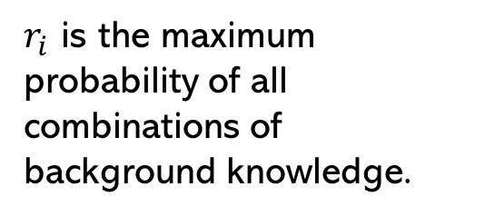
Consumer Cost Quantification
$r_{i}$ would indicate success rate of a stalker in inferring private information $T_{i}.$
Re-identification – Stalker aims to infer user’s complete trajectory information with some background knowledge.
1 | (A,1),(B,1),(A,2),(B,2) | Name : Alice and Age 35
2 | (C,1),(A,1),(A,1) | Name : Bob and Age 37
Locations : (A,1),(B,1)
Name : Alice
Age : 35
Locations : (C,1)
Name : Bob
Age : 37
Ted’s background information
Shared data
Inferred data
ID | Trajectory | (A,1) | (B,1) | .. | ..
1 | (A,1),(B,1),(A,2),(B,2) | ½ | ½
2 | (C,1),(A,1),(A,1) | ½ | 0
$r_{i}$ is the maximum probability of all combinations of background knowledge.
Notes:
We assign the consumer cost as the chance of success of an attacker in inferring private information from user’s trajectory Ti. We consider two types of stalker behaviors by advertisers and compute ri for both of them separately.
To understand the attacks, let us consider a toy example where we have three individuals Ted, Alice and Bob. Ted owns a retail chain restaurant and wants perform targeted advertisements to improve his sales. He gets in touch with a data collector to acquire location data of users in the neighborhood. The data collector removes all identifiable information of the users and just shares the raw location data for the past month and mentions that he could help him target the people Ted thinks would be useful directly on their smartphones. However Ted, known for his overly inquisitive nature digs into his loyalty cards and finds Alice and Bob. He soon realizes that there was only one individual in the data he acquired who visited his restaurant at location C at the same time as Bob did and links the shared data with his own loyalty card information. With this exercise, Ted has invaded the privacy of Bob by identifying Bob’s entire location history for the past month without Bob or the data collector ever explicitly attaching any identity to it.
More generally, in the reidentification attack, a stalker here Ted aims to identify the complete trajectory of a user with some background knowledge. The assumption here is that an attacker has access to the shared data so as to query the data continuously to identify a subset of individuals or an individual that they are interested in.
Here we consider the background knowledge to be a subset of the location a user has visited. To compute the cost associated, we fix the number of locations that a stalker has and compute the probability of linking a record based on the subset of locations. We do this for all possible combinations and assign the risk as the maximum of those probabilities. Next, let us look at a more sophisticated attack.

Slide 18
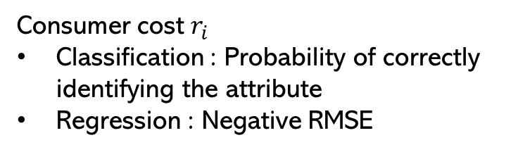
Consumer Cost Quantification
Stalker aims to infer user’s sensitive attribute with some background knowledge.
Stalker Ted’s actions
Extracted Features
User mobility
User-Location affinity
User-User affinity
(A,1),(B,1),(A,2),(B,2)
(C,1),(A,1),(A,1)
Model to infer a sensitive attribute
Shared data
Consumer cost $r_{i}$
Classification : Probability of correctly identifying the attribute
Regression : Negative RMSE
Shared data
Inferred data
Trajectory | Sensitive attribute - Age
(A,1),(B,1),(A,2),(B,2) | 23
(C,1),(A,1),(A,1) | 37
Model
Learn a supervised model to predict a sensitive attribute.
Model used : Random Forest
Notes:
Continuing our previous example, let us assume that Ted has recently picked up a Machine learning course and is interested in experimenting the tools he learned to try and improve his sales. After identifying the identities of his loyalty consumers by reidentification attack, he sets out to try and see if he can infer the age of the other individuals that have not signed up for a loyalty card. To do this, he uses the identified users shared location data and extracts a set of features and learns a supervised model with great performance to infer age. He then uses this model to infer the age of the other consumers in the shared data. With this exercise of curiosity Ted has again invaded the privacy of the users by inferring their age a sensitive attribute that was never shared with him explicitly from the acquired location data.
More generally, here in the sensitive attribute attack, a stalker extracts features from the shared data to infer an attribute that was not part of the shared data. We assign the success here by mimicking the actions of an attacker. We extract a series of features leveraging the literature then learn a predictive model to infer a sensitive attribute.

Slide 19
Consumer Cost quantification
Strategy : Mimic a stalker’s actions to assign success of inferring a sensitive attribut.
Feature Extraction $F(T)$ :
User mobility
Average locations, unique locations
Average distance, dwell time and max distance.
Radius of gyration
Mobility entropy
User – Location affinity
Tensor of User x Location x Week
Populate by frequency and time spent.
HOSVD of the tensors
User – User affinity
Tensor of User x User x Location
Populate by average frequency and average time spent
HOSVD of the tensors
Proxy Model
Learn a supervised model to predict a sensitive attribute.
Model used : Random Forest
Risk Quantification
Classification : Probability of correctly identifying the attribute
Regression : Negative RMSE
Notes:
The features we extract are of three types. User mobility, Explain the features.
We capture the affinity between users and the locations visited by building tensors of user cross location cross week and populate them by frequency or time spent at each location and then perform a decomposition of this tensor to extract the first few principal components. We do a similar exercise to capture the affinity between user and user.
To mimic the attacker’s inference model, we learn a supervised model to predict a sensitive attribute. In our experiments we consider a range of supervised algorithms and zero in random forest based on its superior predictive performance on out of sample data.
Finally, the risk for each user is quantified as the probability of correctly identifying the attribute if the prediction task was a classification task or negative of the rmse if it is a regression task. Next, we move onto the measurement of data utility.

Slide 20
Benefit Measurement
Business goal : Point of Interest recommendations - Leverage historical user preferences to predict future preferences.
Strategy : Learn a recommender model to predict future locations of a user.
Intuition : More accurate the predictions, higher benefit for the consumer.
Model : Nearest Neighborhood based recommender
Features : Same set used for sensitive attribute attack
Nearest neighbors : Identify nearest neighbors based on similarity
Ranking : Based on similarity and frequency
Benefit : Average Precision and Average Recall.
Notes:
To measure the benefit of sharing the location data for a user, we consider a popular business goal – point of interest recommendations where we leverage the user history to predict future locations of a user. We zero in on nearest neighborhood model after experimenting with a range of recommendation algorithms. The utility is intuitively measured as the accuracy of the predictions made by the model. The higher the accuracy, more relevant it would be to a customer and hence a higher benefit.
The nearest neighborhood model works by identifying the nearest m neighbors to a user based on a feature set. We use the same set of extensive features extracted for the sensitive attributes and identify the nearest neighbors using cosine similarity.
Next, we perform a ranking of all the locations in the identified neighbors at a user level based on the similarity to the user and frequency of the locations in the data set.
Finally, we compute precision at a consumer level which captures the proportion of predicted locations that are relevant and recall which captures the proportion of relevant locations that are predicted as the consumer benefit.

Slide 21
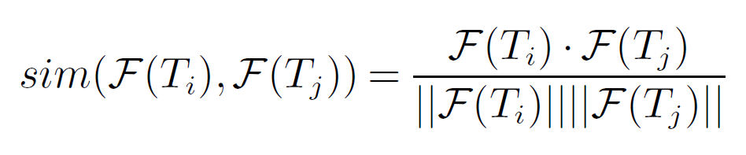
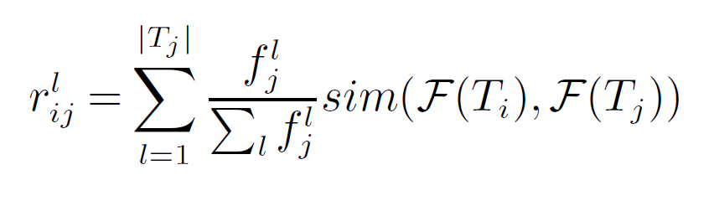
Benefit Measurement
Business goal : Point of Interest recommendations - Leverage historical user preferences to predict future preferences.
Strategy : Learn a recommender model to predict future locations of a user.
Intuition : More accurate the predictions, higher benefit for the consumer.
Model : Nearest Neighborhood based recommender
Features : Same set used for sensitive attribute attack $F(T)$
Nearest neighbors : Identify $m$ nearest neighbors based on similarity denote by $M_{i}$
Ranking of locations $T_{j}∈M_{i}$
Notes:
To measure the utility of the shared data to a user, we consider a popular business goal – point of interest recommendations where we leverage the user history to predict future locations of a user. We zero in on nearest neighborhood model after experimenting with a range of recommendation algorithms. The utility is intuitively measured as the accuracy of the predictions made by the model.
The nearest neighborhood model works by identifying the nearest m neighbors to a user based on a feature set. We use the same set of extensive features extracted for the sensitive attributes and identify the nearest neighbors using cosine similarity. The neighbors are denoted by Mi.
Next, we perform a ranking of all the locations in the identified neighbors at a user level based on the similarity to the user and frequency of the locations in the data set. Rlij would rank a location higher if a location visited by the neighbor is more frequent and the neighbor is more similar to the user considered.

Slide 22
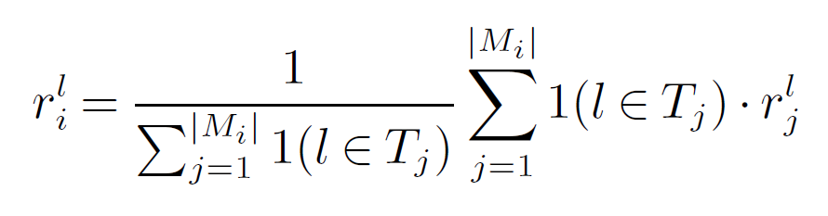
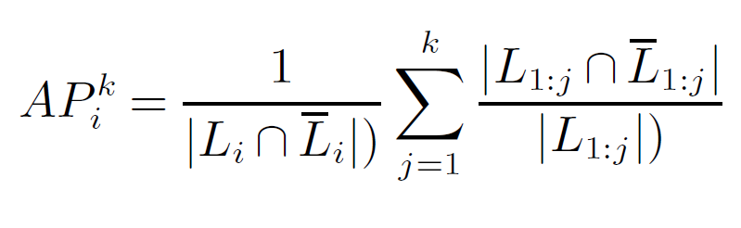
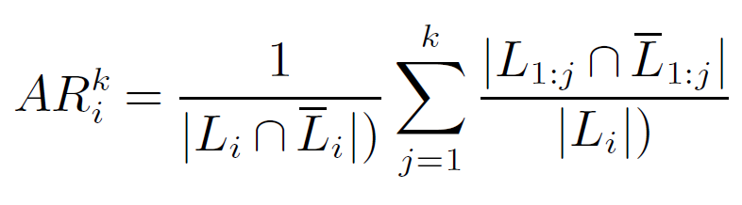
Benefit Measurement
4. Rank Aggregation
Accuracy of predictions
$L_{i}= \{ l_{i}^{1}, l_{i}^{2}, …, l_{i}^{k^{′}}\}$ true temporally ordered locations visited
$\overline{L_{i}}= \{ \overline{l_{i}^{1}},\overline{l_{i}^{2}}, …,\overline{l_{i}^{k}}\}$NN predictions.
Compute mean across all users – $MAP@k and MAR@k$
Notes:
Next, we aggregate these ranking across all the neighbors by taking the mean of the ranks of locations computed at an individual level.
Finally, we compute two measures at an individual level to capture the accuracy of prediction, Average precision and average recall.

Slide 23
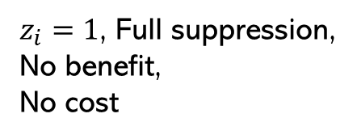

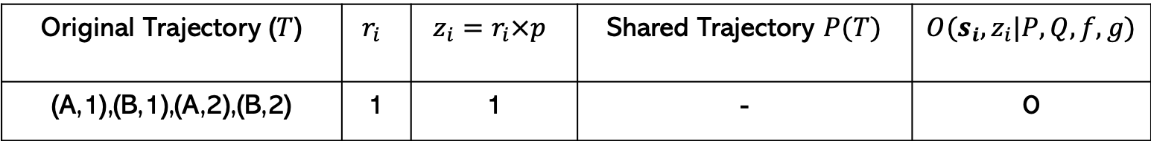
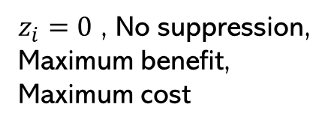
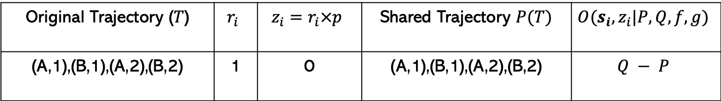
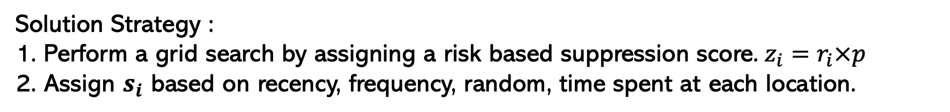
Suppression Scheme
Goal : Find $\left(s_{i},z_{i}\right)$
Maximize :$O(s_{i},z_{i}|P,Q,f,g)=Q×E\left[g\left(s_{i},z_{i}\right)\right]−P×E[f\left(s_{i},z_{i}\right)]$
Solution Strategy :
Perform a grid search by assigning a risk based suppression score. $z_{i}=r_{i}×p$
Assign $s_{i}$ based on recency, frequency, random, time spent at each location.
$z_{i}=0$ , No suppression, Maximum benefit, Maximum cost
Original Trajectory ($T$) | $$r_{i}$$ | $$z_{i}=r_{i}×p$$ | Shared Trajectory $P(T)$ | $$O(s_{i},z_{i}|P,Q,f,g)$$
(A,1),(B,1),(A,2),(B,2) | 1 | 0 | (A,1),(B,1),(A,2),(B,2) | $$Q − P$$
$z_{i}=1$, Full suppression, No benefit,
No cost
Original Trajectory ($T$) | $$r_{i}$$ | $$z_{i}=r_{i}×p$$ | Shared Trajectory $P(T)$ | $$O(s_{i},z_{i}|P,Q,f,g)$$
(A,1),(B,1),(A,2),(B,2) | 1 | 1 | - | 0
Notes:
Finally, we move onto the suppression scheme.
We have two decision variables si and zi in the objective function and the properties of the objective function would depend on the g and f which are specific to a data set. We choose a grid search strategy where we try to minimize the second term in the objective function and asses O at each point in the grid. This is done by assigning zi the suppression probability as a function of customer cost computed earlier with a parameter for grid p varying between 0 and 1. Then we assign si based on recency, frequency, random and time spent at each location.
Two corner cases for such a strategy are displayed here. When p = 0, zi = 0 hence there is no suppression leading to maximum data utility and maximum privacy risk.

Slide 24
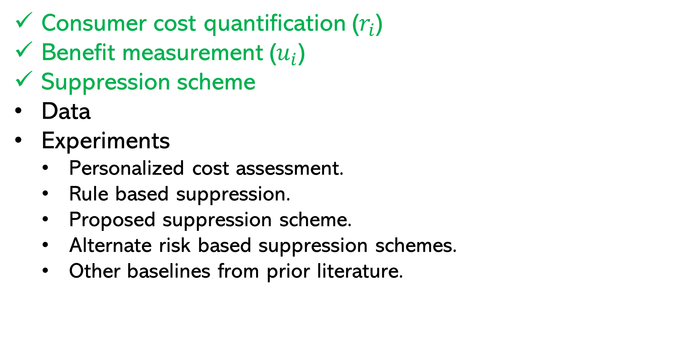
Agenda
Consumer cost quantification ($r_{i}$)
Benefit measurement ($u_{i}$)
Suppression scheme
Data
Experiments
Personalized cost assessment.
Rule based suppression.
Proposed suppression scheme.
Alternate risk based suppression schemes.
Other baselines from prior literature.

Slide 25
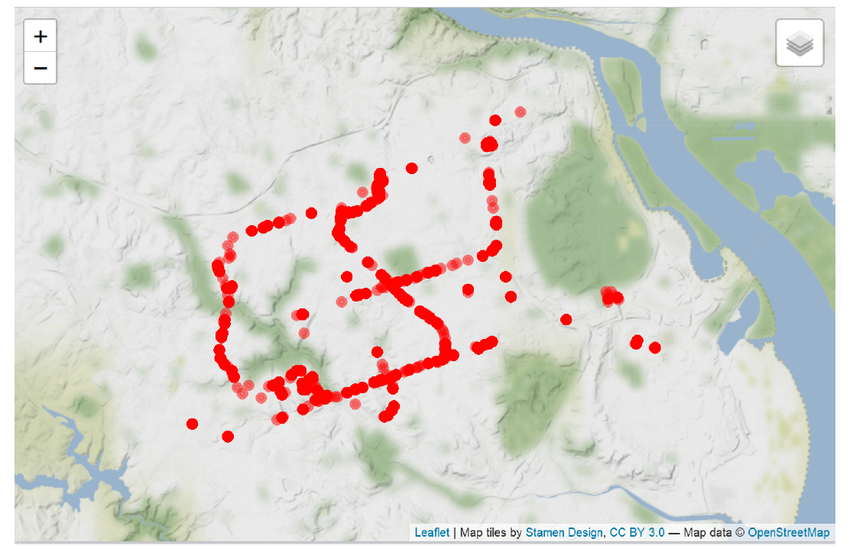
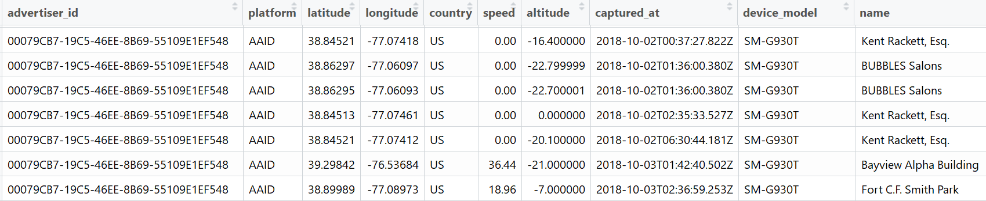
Data
Background
Our partner (data collector) aggregates location data across hundreds of mobile applications covering one-fifth of U.S. population.
Location data of major mid Atlantic metropolitan region.
Example of tracked locations of a user
Example of collected location data
Notes:
Explain the data and columns in the data and summary statistics.

Slide 26
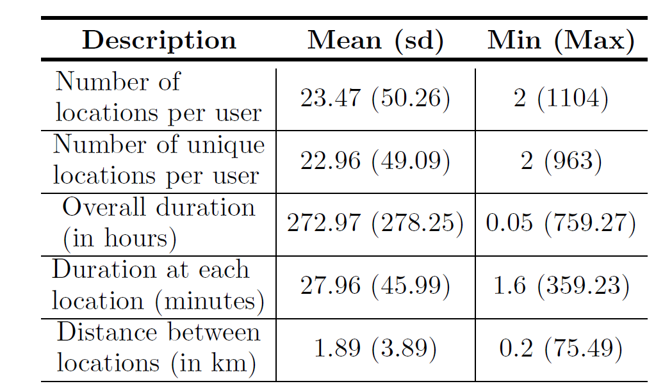
Data
40,012 consumers, 940k observations over five weeks in 2018.
Each row contains
Device ID
Platform ID
Latitude, Longitude and timestamp
Opted out/in
Time spent
Sample selection
50% (20,000) users for training the models, rest used for main analysis.
Summary statistics
Notes:
Explain the data and columns in the data and summary statistics.

Slide 27
Results
Data collector can assess the privacy cost associated with each user.
Data collector can construct suppression techniques based on the feature importance.
Notes:
Coming to the results, a data collector can use the customer cost component in the proposed framework to assess the individual cost incurred. On the left, we plot the histogram of consumer cost for the sensitive attribute inference. In addition a data collector could also understand the features that contributed to the cost in sensitive attribute attacks where we learn a predictive model to assign the consumer cost. This could potentially help the data collector construct their own obfuscation strategies. For instance, here we plot the top four features contributing to consumer cost and observe that temporal based feature is in the top two. A data collector with this information can design their own strategies based on some temporal rules.

Slide 28
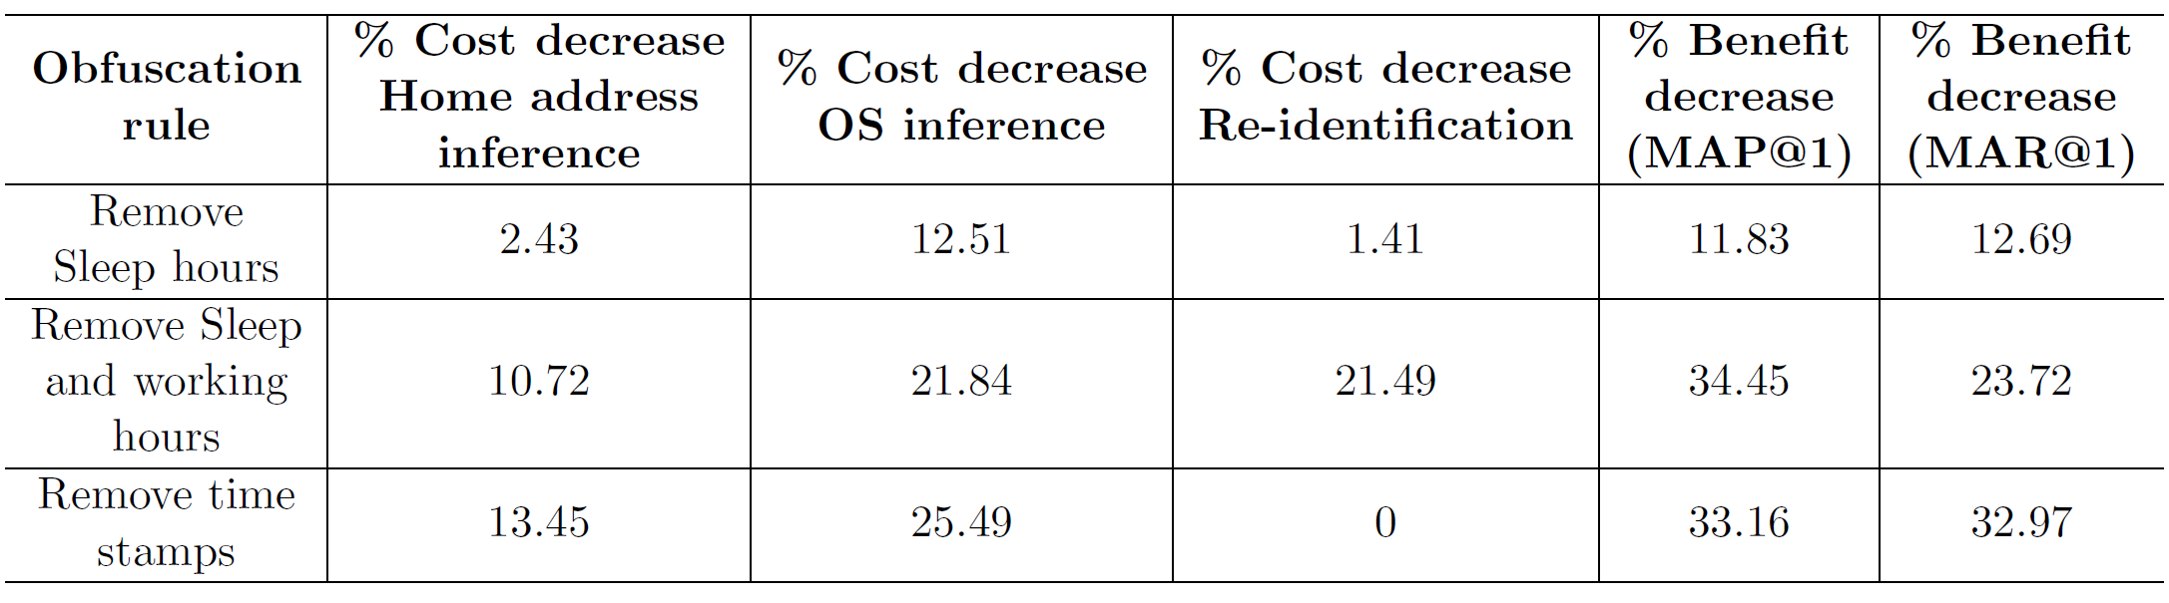
Results – Rule based Suppression
Rule based suppression minimize consumer privacy cost.
Is there a better trade-off?
Notes:
Some of these strategies could be rule based where the data collector decides to remove locations of each users during sleep hours, sleep hours and working hours, and remove time spent to limit the attacker to construct any time based features. We observed that this does in fact reduce the privacy risk but in some cases the decrease in advertisers utility is too high. Next, we apply the proposed obfuscation scheme to the data.

Slide 29
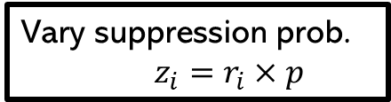
Proposed framework
Vary suppression prob. $z_{i}=r_{i}×p$
Notes:
Recall that in our empirical setup, in Part A we compute the baseline privacy risk and utility on the non obfuscated location data and then in Part B we perform obfuscation by varying the suppression scores across a grid based on the individual risk scores. Next, we look at the results of the proposed obfuscation scheme for each of these points in the grid.

Slide 30
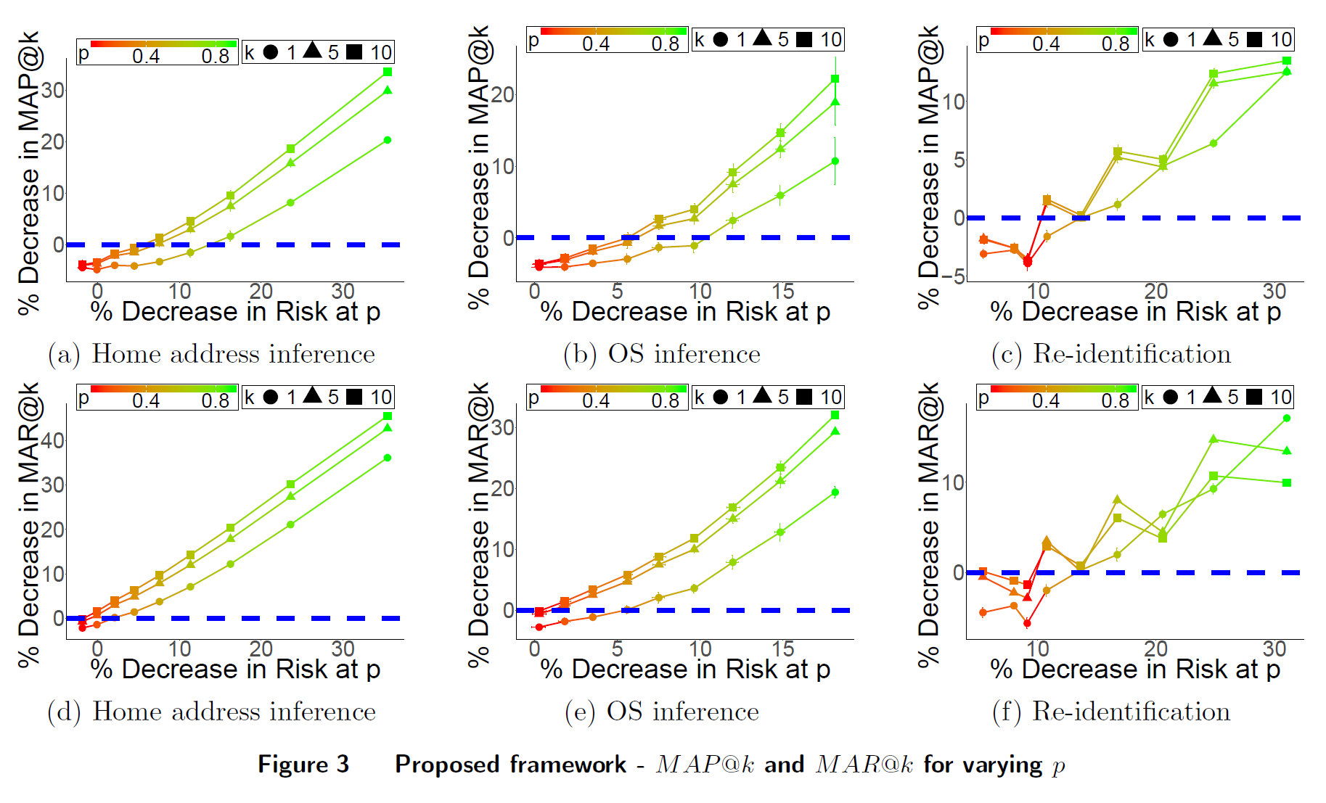
Main Results
Suppression weights assigned by frequency
% Decrease in benefit
% Decrease in benefit
% Decrease in cost
% Decrease in cost
Reidentification
Home address inference
Proposed suppression scheme provides multiple options for a data collector and achieves better trade-off than rule based suppression schemes
Notes:
Here, the suppression weights were assigned by frequency. On the X-axis we have the decrease in consumer cost and on the Y-axis we have the Decrease in consumer benefit which we capture by MAP at varying k, where k is the number of future locations that the advertiser aims to predict from the user trajectories. Each point on the plot corresponds to a particular value of p. We could follow the blue line in the graphs where there is no change in consumer benefit and see where the blue line intersects with each of the colored lines. The corresponding X value would give us the decrease in consumer cost with no sacrifice in consumer benefit. For instance, we see that this happens at around 15% mark in the reidentification attack and around 5% in the home address inference. Also, any point below the x = y line in these graphs is a possible obfuscation strategy for the data collector to preserve consumer privacy. This would mean that the decrease in consumer risk is higher than decrease in advertiser's utility. Next, we compare this risk based suppression score with few other risk based suppression schemes.

Slide 31
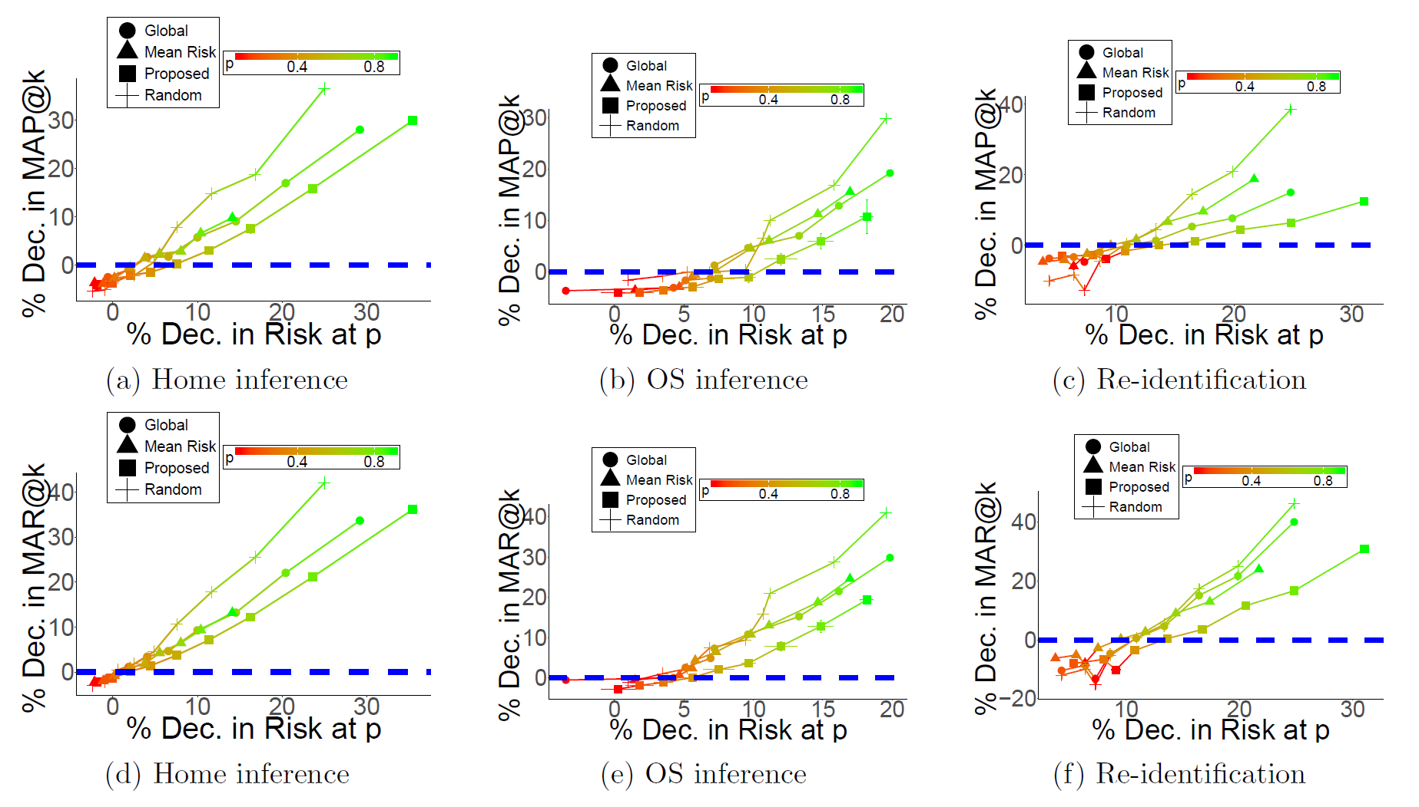
Comparison with alternate suppression schemes
% Decrease in benefit
% Decrease in benefit
% Decrease in cost
% Decrease in cost
Home address inference
Reidentification
Proposed suppression scheme provides better trade-off than rule based and alternate risk based suppression schemes
Notes:
We compare few other suppression schemes which can be viewed as ablations of the proposed framework.
Global indicates the strategy where we suppress at a location level across the entire data rather than at a user level. The probability of suppression of each location is computed as the mean across all the consumers that have that location in their trajectory.
In the Mean strategy we assign the risk of an individual as the mean risk of all the users and perform suppression.
That is here a high risk user and a low risk user has similar chance of locations being suppressed.
Finally, in the Random strategy we randomly suppress the same amount of locations as we suppressed in the proposed framework without any suppression score or suppression weights.
We observe that the proposed framework has the least slope meaning it offers a better tradeoff of utility and risk compared to the other strategies.

Slide 32
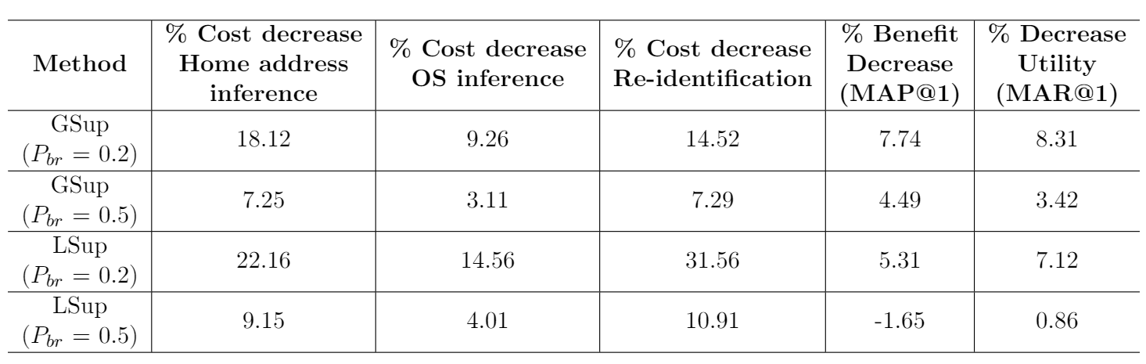
Comparison with other baselines
Local and Global suppression (Terrovitis et al. (2017))
Proposed suppression scheme provides better trade-off in majority of the cases
Notes:
Next, we compare the proposed obfuscation scheme with the most recent work in syntactic models proposed by Terrovitis. The broad idea of their suppression scheme is to quantify privacy cost at a location level by quantifying the reidentifcation risk of each location. They propose two suppression techniques one where they globally suppress the problematic locations or further identify a subset of consumers which contribute to the privacy cost and suppress their locations. One of the parameters that the model requires is Pbr which is the user specified threshold of determining if risk assigned to a location is considered a threat. The higher the Pbr, lesser is the suppression resulting in more utility and lesser decrease in privacy cost. We compute the decrease in costs for the the three types of attacks and observe Lsup does better than Gsup which is similar to what the authors find in their experiments. Next, we observe that for Pbr at 0.5, suppressing some of the locations results in a negative decrease or improved benefit as is the case with some of our earlier experimental results. In a majority of the cases, we also observe that the proposed obfuscation scheme has a lower decrease in consumer benefit for a similar decrease in consumer cost.

Slide 33
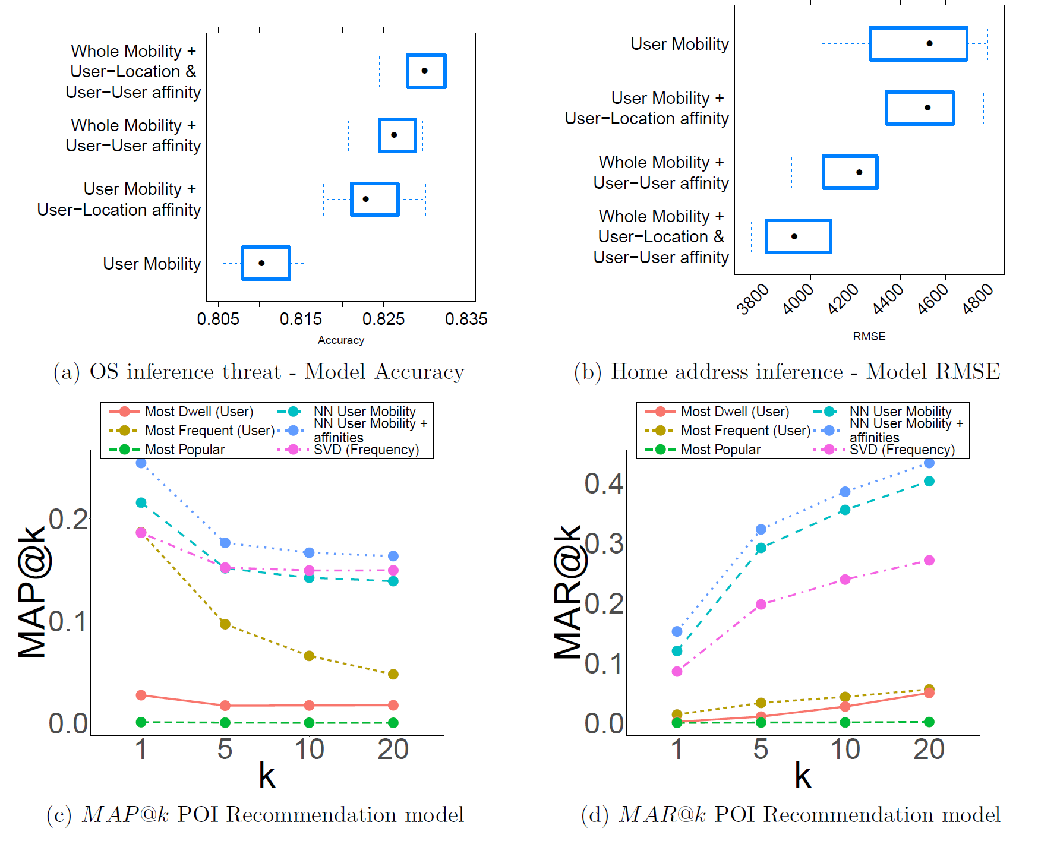
Results – Model Choices
Features capturing affinity between users and co-location help both the risk quantification and advertiser utility
Neighborhood based recommendations perform better than other competing models.
Notes:
We provide justification of the model choices made.

Slide 34
Summary
Personalized consumer cost associated with sharing location data.
Obfuscation based on personalized privacy cost.
Multiple interpretable options for a data collector to balance cost and benefit.
Validated the framework on real world detailed GPS trajectory data of 40,000 consumers.

Slide 35
Limitations and Next steps
Limitations
Heterogenous consumer privacy concerns.
Benefit to advertisers may not be benefit to consumers.
Composition of attacks not addressed.
Next Steps
Experiment with other suppression weights and strategies.
Field experiment to better capture the consumer benefit.
Robustness tests on varying sizes/samples of consumers.

Slide 36
Thank you! Questions?

