Slide 1


Introduction to HTML
Hyper Text Markup Language

Slide 2

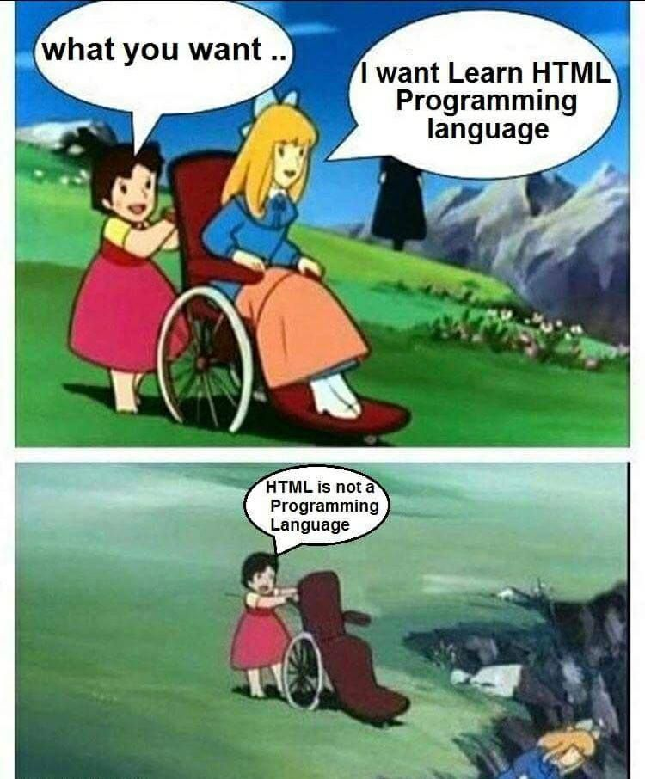
Contents
HTML Structure
Points to be noted
Formatting Elements
Images, audio & video
Table
Lists
Additional tags
Block and inline element
Forms

Slide 3
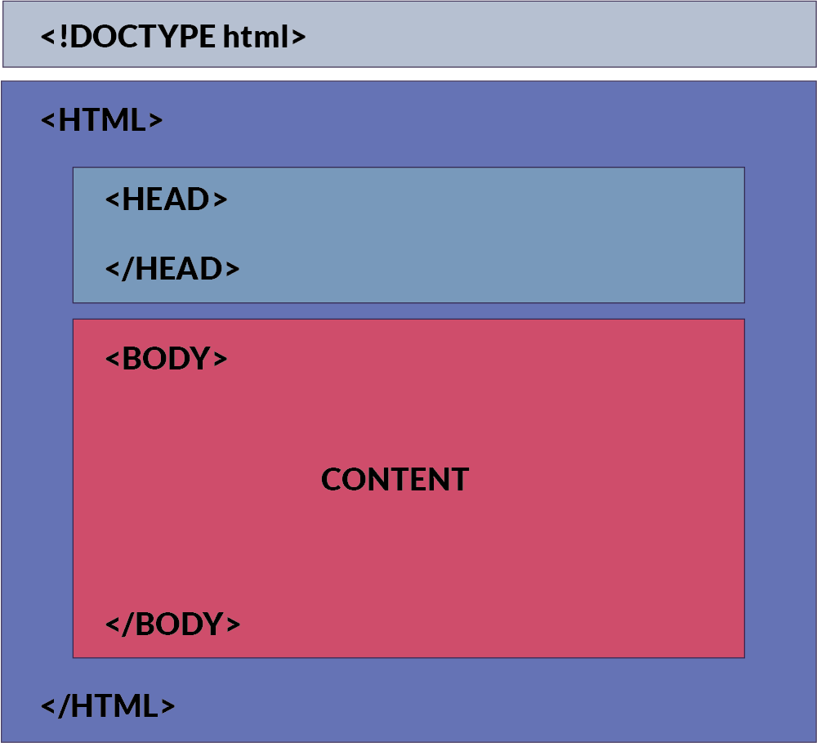
Structure Of HTML
Points to be noted:
HTML is a mark up Language not programming language.
Latest version is HTML 5
HTML is not case sensitive
What is mark up language?
Tags < > </ >
Elements
Attributes
Where should I write HTML code ?

Slide 4

1.HEAD
Head tag contains information about HTML
Head
Title
Link
(CSS)
Script
(JS)
Meta
(description, keywords, author)

Slide 5
2.BODY (Formatting Elements)
Headings
Paragraph
Emphasised text
Bold
italic
Small
Strong
Strike
Underline
Abbreviation
Center
Comments
Subscripted
Superscripted
Marquee
Preformatted

Slide 6
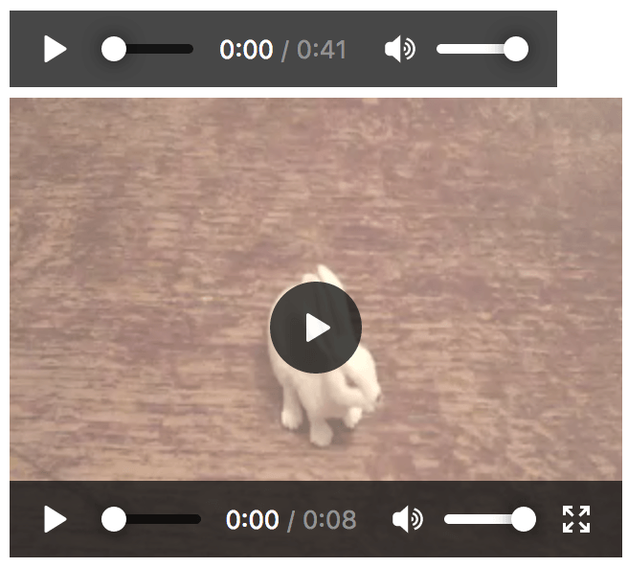
Image, audio and video tags
The <img> tag is used to insert an image into a document.
The <audio> is one of the HTML 5 elements added to allow embedding audio files to a web page. Since not all browsers support all audio formats.
The audio tag contains one ore more <source> tags with different audio sources. The browser will choose the first source it supports.
The video tag specifies video, such as a movie clip or other video streams.
Currently, there are 3 supported video formats for the <video> element: MP4, WebM, and Ogg

Slide 7
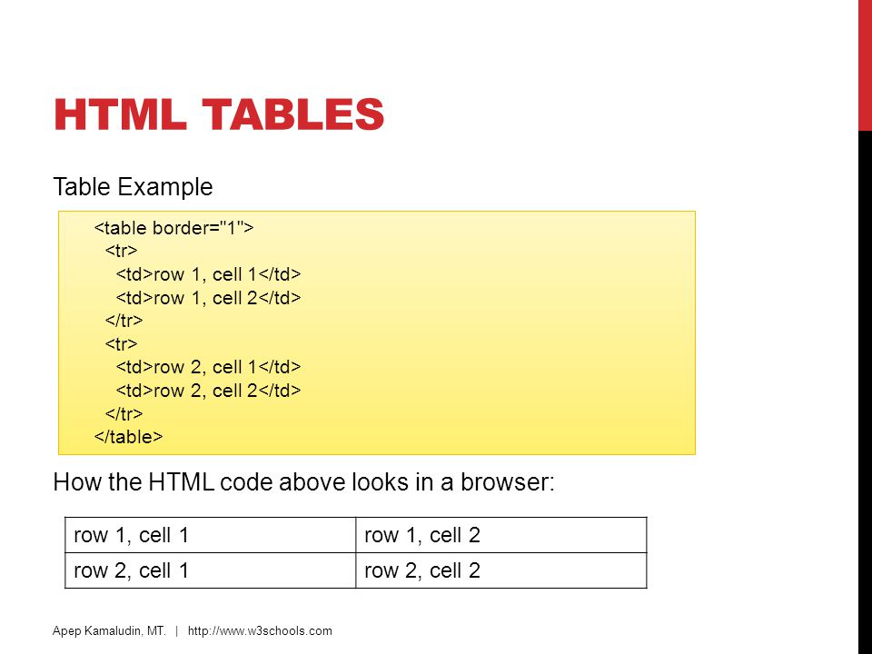
HTML Tables
Table with caption
<caption> my caption </caption>
Table cells that span more than one row/column
<th colspan=“2”></th>
Cell padding
<table border=“1” cellpadding=“10”>
Cell spacing
<table border=“1” cell spacing=“10”>

Slide 8
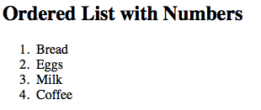
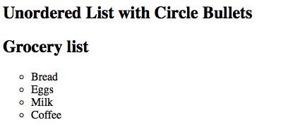
Lists and additional tags
List Tags
Unordered list (ul)
Ordered list (ol)
Additional Tags
Anchor tag <a>
Horizontal line <hr>
Break <br>
Division <div>
Span <span>
Nav <nav>

Slide 9
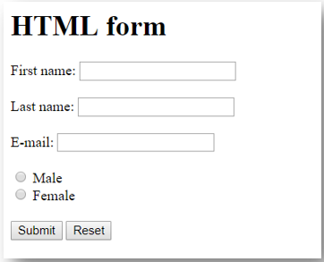
Forms in HTML
HTML forms are used to select different kinds of user input
Form is an area that contain form elements
Example:
Text fields
Label
Text area field
Radio button
Check boxes
Dropdown or select
buttons

Slide 10



