Slide 1
KL UNIVERSITY
Basic Computer Architecture
and Instruction Set Architecture
Von Neumann Model & Instruction Cycle
BATCH 13
Presented by: Tanish (2620080073) • Vrithika (2620080089) • Sujeet (2620090014) • Prakash (2620080060) • Meghana (2620080049)
CO3 — Basic Computer Architecture & Instruction Set Architecture

Slide 2
Agenda
Introduction to Computer Architecture & ISA
CO3 Recap — Core Processor Components
1
2
Von Neumann Architecture & Buses
Instruction Cycle — Fetch, Decode, Execute
3
4
Instruction Format — Opcode & Operand
System Block Diagram
5
6
Instruction Set — Types of Instructions
Addressing Modes, RISC vs CISC & Conclusion
7
8
Batch 13 | KL University
2

Slide 3
What is Computer Architecture & ISA?
Computer architecture is the programmer-visible design of a computer — its instruction set, registers, addressing modes and data formats. The ISA is the contract between software and hardware.
1
2
3
Fetch
Decode
Execute
CPU reads the next instruction from memory using the Program Counter (PC)
Control unit interprets the opcode and locates the operands
ALU performs the operation and the result is stored back
Batch 13 | KL University
3

Slide 4
CO3 Recap — Basic Computer Components
CPU
ALU
CU
REGISTERS
BUSES
Brain of computer
+ − AND OR NOT
Opcode → signals
PC · IR · MAR · ACC
Addr · Data · Ctrl
Fetches, decodes and executes instructions
Performs arithmetic and logical operations
Decodes opcodes and issues control signals
Fastest storage inside the CPU for operands and addresses
Carry addresses, data and control signals between units
This topic focuses on registers, buses and the instruction set — how the CPU fetches and executes every instruction.
Batch 13 | KL University
4

Slide 5
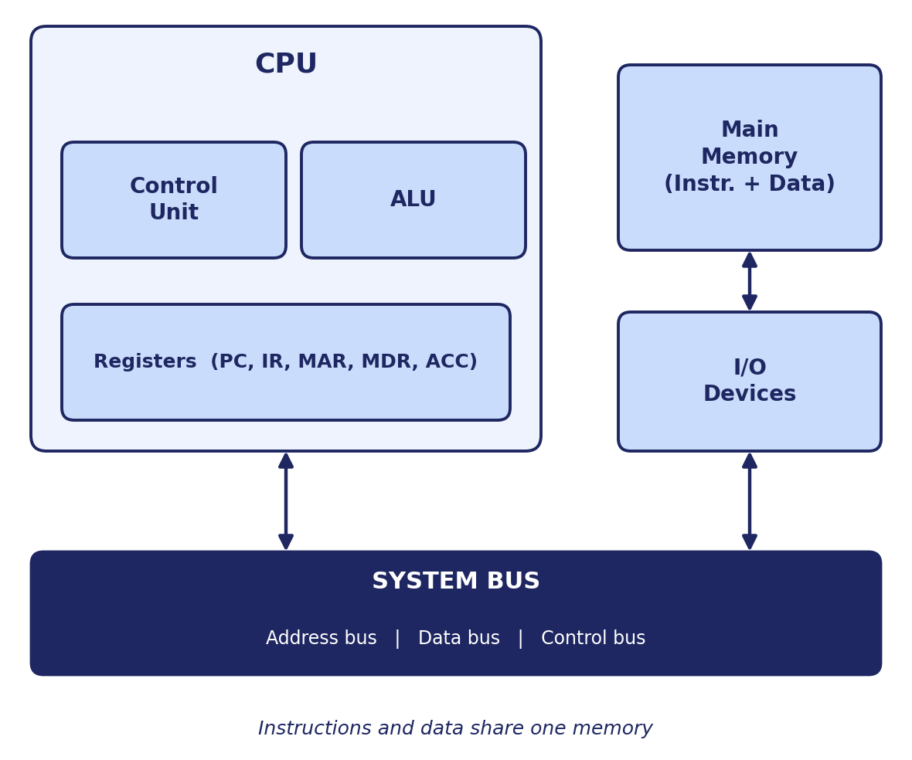
Von Neumann Architecture
Bus | Direction | Carries
Address | One-way (CPU → memory) | Location of data / instruction
Data | Two-way | Instructions & operands
Control | Two-way | Read/Write, clock, interrupts
Stored-Program Concept: Instructions + data share one memory
In a Von Neumann machine the CPU fetches both instructions and data from the same memory over the system bus — simple, but the shared bus can become a bottleneck.
Batch 13 | KL University
5

Slide 6
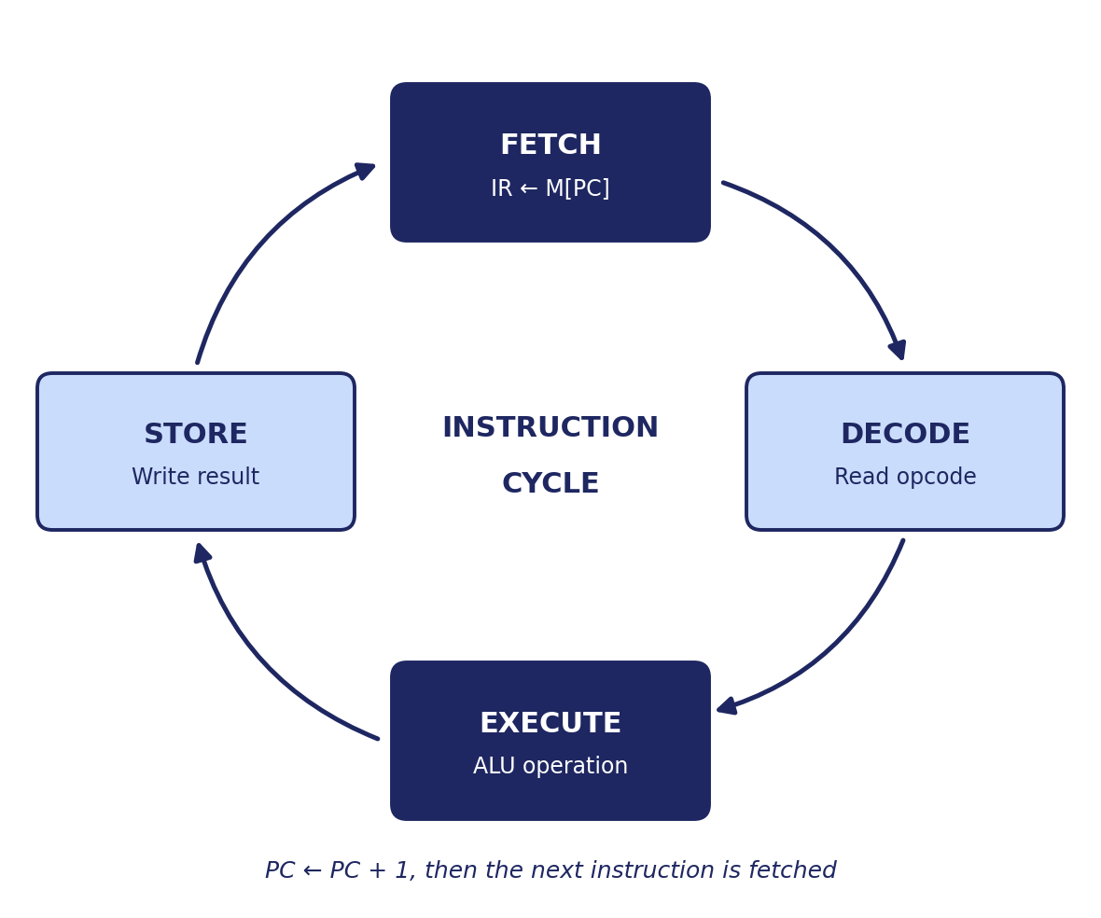
Instruction Cycle (Fetch–Decode–Execute)
Phase | Operation | Registers
Fetch | Read instruction | PC, MAR, IR
Decode | Interpret opcode | IR, CU
Execute | Perform operation | ALU, ACC
Micro-operation: IR ← M[PC] ; PC ← PC + 1
Every instruction passes through the same cycle: fetch it from memory, decode the opcode, execute it in the ALU and store the result. The PC always points to the next instruction.
Batch 13 | KL University
6

Slide 7
Instruction Format — Opcode & Operand
A machine instruction has an opcode (what to do) and operand field(s) (what to act on); the control unit decodes the opcode to choose the operation.
Opcode (ADD)
0 0 0 1
Instruction Reg (IR):
0001 0110
combined →
Operand (Register R6)
0 1 1 0
The ISA fixes the opcode list, operand fields and instruction length → this is the programmer's view of the machine.
Fixed-length formats (RISC) decode fast; variable-length formats (CISC) save memory.
Batch 13 | KL University
7

Slide 8
System Block Diagram
Input Device
(Keyboard / Mouse)
Main Memory
(Instructions + Data)
Control Unit
(Fetch & Decode)
ALU & Registers
(Execute)
Output Device
(Display / Printer)
Programs and data enter through input devices, are stored in memory, fetched and decoded by the control unit, executed by the ALU, and sent to an output device.
Batch 13 | KL University
8

Slide 9
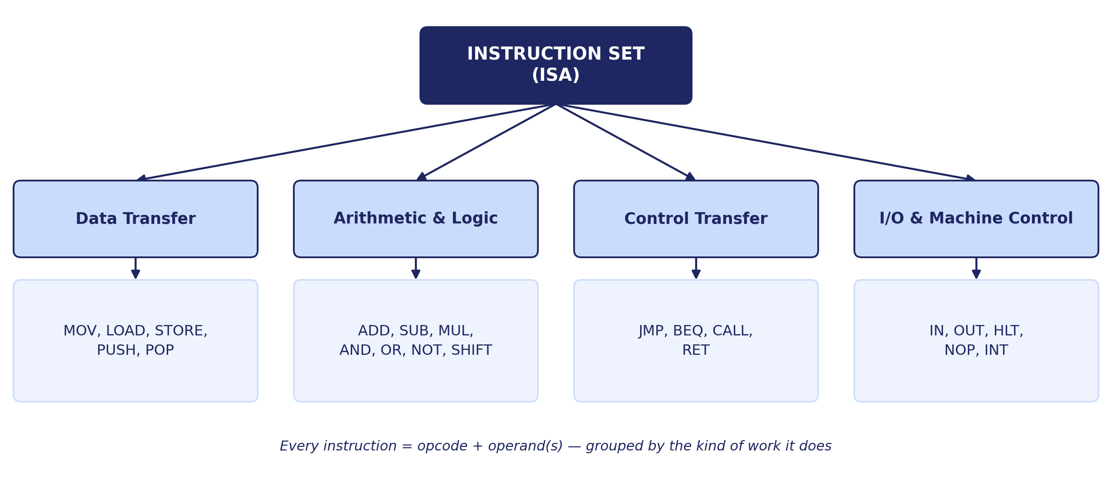
Instruction Set — Types of Instructions
Batch 13 | KL University
9

Slide 10
Worked Example — Addressing Modes in Action
Case 1: Immediate Mode — ADD R1, #5
Case 2: Direct Mode — ADD R1, [500]
Step | Phase | Micro-operation | Mem. refs
1 | Fetch | IR ← M[PC] | 1
2 | Decode | Opcode = ADD (immediate) | 0
3 | Operand | Value 5 is inside IR | 0
4 | Execute | R1 ← R1 + 5 | 0
Step | Phase | Micro-operation | Mem. refs
1 | Fetch | IR ← M[PC] | 1
2 | Decode | Opcode = ADD (direct) | 0
3 | Operand | MDR ← M[500] | 1
4 | Execute | R1 ← R1 + MDR | 0
Immediate → 1 memory access (fastest)
Direct → 2 memory accesses
Batch 13 | KL University
10

Slide 11
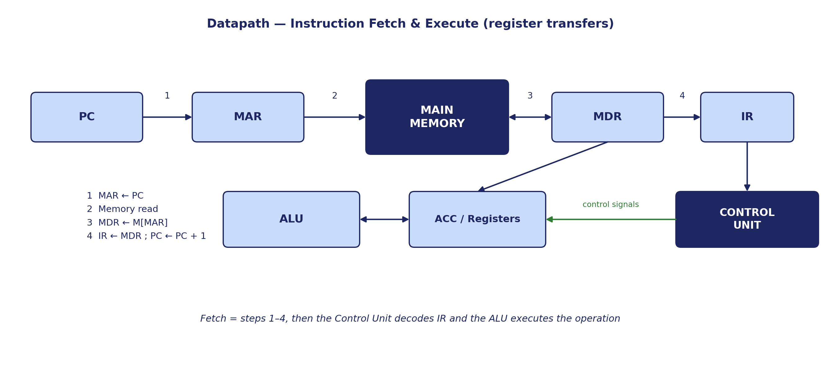

Slide 12
Addressing Modes
Immediate — operand is inside the instruction
Direct — instruction holds the memory address
1
2
Indirect — address field points to the address
Register — operand is held in a CPU register
3
4
Indexed — effective address = base + index
Relative — address = PC + offset (branches)
5
6
Batch 13 | KL University
11

Slide 13
RISC vs CISC
RISC
CISC
Simple, fixed-length instructions
Load/store design with many registers
Easy to pipeline — about 1 instruction per clock
Needs more instructions per program
Examples: ARM, MIPS, RISC-V
Complex, variable-length instructions
Many addressing modes and memory operands
Compact programs, fewer instructions
Examples: x86, VAX
Batch 13 | KL University
12

Slide 14
Conclusion
1
Architecture is what the programmer sees — instruction set, registers, addressing modes — while organization is how it is built.
2
The Von Neumann model joins CPU, memory and I/O over a system bus and keeps instructions and data in one memory.
3
Every instruction runs through the fetch–decode–execute cycle, driven by the PC, IR and control unit.
4
Instruction formats, addressing modes and the RISC vs CISC choice decide how efficiently an ISA performs.
Batch 13 | KL University
13

Slide 15
KL UNIVERSITY
Presented By — Batch 13
T
V
S
P
M
Tanish | 2620080073
Vrithika | 2620080089
Sujeat | 2620090014
Prakash | 2620080060
Meghana | 2620080049
Thank You
Basic Computer Architecture and Instruction Set Architecture | CO3
github.com/tanishsharma73/KLH-FED-2026-SESSION13-BATCH-13

