Slide 1
Course Project On
“Age And Gender Detection
Using Convolutional Neural Network
And OpenCV”
Under the guidance of: By:
Prof. Umesh Kulkarni Pavan Bagewadi 2GI18CS088
Nikhil Talawar 2GI18CS079
Prathik K Gowda 2GI18CS096
Meghan Ghivari 2GI18CS071

Slide 2
CONTENTS
Introduction
Project Overview
Convolutional Neural Networks
Network Architecture
Applications
Conclusion

Slide 3
INTRODUCTION
Age and gender play fundamental roles in social interactions. Languages reserve different salutations and grammar rules for men or women, and very often different vocabularies are used when addressing elders compared to young people.
Therefore automated translation services and other forms of speech generation can factor in gender and age classification of subjects to improve their performance. Having an idea about the age and gender of a person makes the task of interaction with them easier.

Slide 4
PROJECT OVERVIEW
We used Adience dataset for age and gender classification.
Trained CNN (Convolutional Neural Networks) using Adience dataset for age and gender prediction.
Created a python application using OpenCV deep learning module to perform real time age and gender detection.

Slide 5
ADIENCE DATASET
It attempts to capture all the variations in appearance, noise, pose, lighting and more, that can be expected of images taken without careful preparation or posing.
Total number of Genders : 2(Male,Female)
Total number of subjects : 2,284
Number of age groups : 8
(0-2, 4-6, 8-13, 15-20, 25-32, 38-43, 48-53, 60-)
Gender labels : Yes
Subject labels : Yes

Slide 6
CONVOLUTIONAL NEURAL NETWORKS
Convolutional neural networks are a special type of feed-forward networks. These models are designed to emulate the behavior of a visual cortex. CNNs perform very well on visual recognition tasks.
These networks have 3 types of layers: Input layer, hidden layer and output layer. In these networks, data moves from the input layer through the hidden nodes and to the output nodes.
The convolutional, pooling and ReLU layers act as learnable features extractors, while the fully connected layers acts as a machine learning classifier.

Slide 7
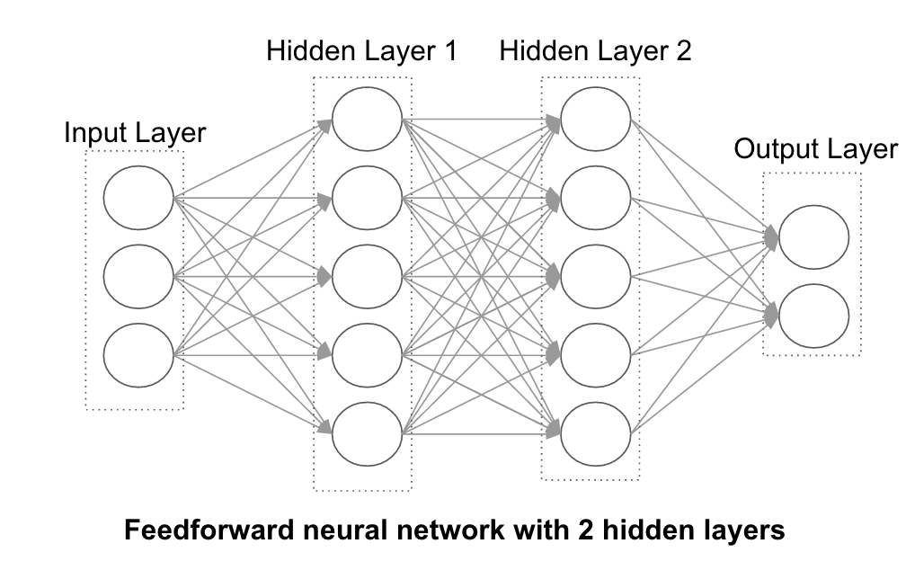

Slide 8
CNN for Age and Gender Estimation
Data-sets for age and gender estimation from real-world social images are therefore relatively limited in size and presently no match in size with the much larger image classification data-sets.
Over fitting is common problem when machine learning based methods are used on such small image collections. This problem is exacerbated when considering deep convolutional neural networks due to their huge numbers of model parameters. Care must therefore be taken in order to avoid over fitting under such circumstances.

Slide 9
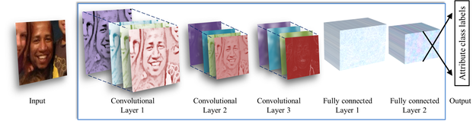
NETWORK ARCHITECTURE

Slide 10
APPLICATIONS
Applications for this technology have a broad scope and the potential to make a large impact. This could be used to aid assisted vision devices for those with deteriorating, or lost, eyesight.
Social media websites like Facebook could use the information about the age and gender of the people to better infer the context of the image.
In human machine interaction.

Slide 11
CONCLUSION
CNN can be used to provide improved age and gender classification results, even considering the much smaller size of contemporary unconstrained image sets labeled for age and gender.
The simplicity of the model implies that more elaborate systems using more training data may well be capable of substantially improving results beyond these results.
One can also try to use a regression model instead of classification for Age Prediction if enough data is available.

Slide 12
THANK YOU

