Slide 1

JSON
( and the argonauts )
-- developing open-source projects and communities --
http://r1.my

Slide 2

NOT JASON
Notes:
2

Slide 3
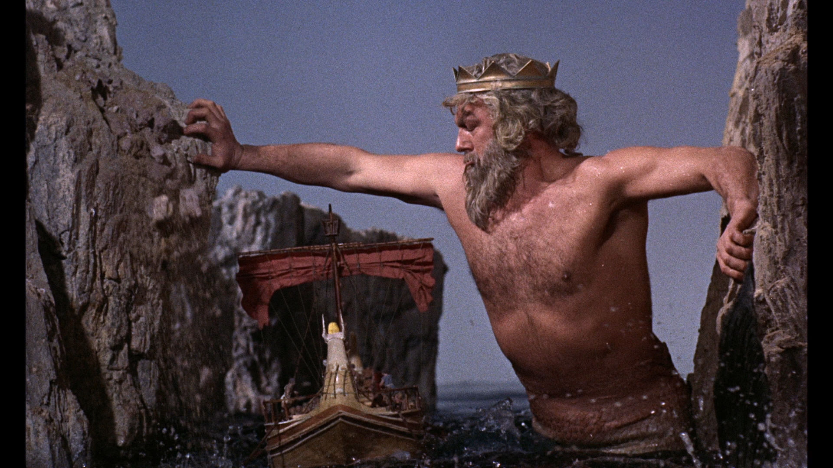
OR THESE ARGONAUTS
Notes:
3

Slide 4



RATHER THESE
Notes:
4

Slide 5
IMPORTANT DATES
1974
RELATIONAL DATABASES
1989
WORLD WIDE WEB
2002 = JSON.org
Notes:
5

Slide 6
THE BIG THREE
JSON (j for javascript)
JSONP (p for padding)
BSON (b for binary)
Notes:
6

Slide 7
THE BIG THREE
JSON (j for javascript)
JSONP (p for padding)
BSON (b for binary)
Supported by jQuery / PHP
Notes:
7

Slide 8
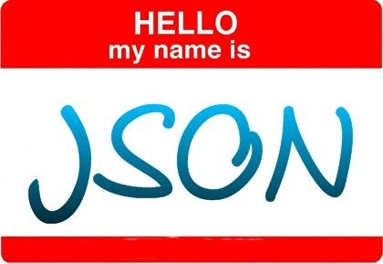
[
title: “Hello JSON World”,
published: 1352229385,
slug: “hello-world”,
content: “<p>JSON has 6 data-types</p>”,
tags: [“categories”,”test”,”etc”],
comments: [
{ u: ”Jason”, c: “Thanks for sharing” }
]
]
Notes:
8

Slide 9
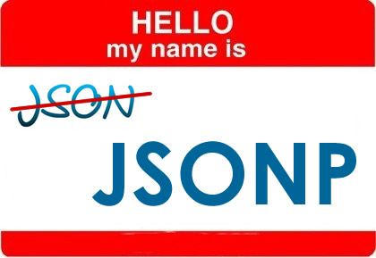
callback_function([
title: “Hello JSONP World”,
published: 1352229385,
slug: “hello-world”,
content: “<p>JSONP is padded with a function</p>”,
tags: [“categories”,”test”,”etc”],
comments: [
{ u: ”Jason”, c: “Thanks for sharing” }
]
])
Notes:
9

Slide 10
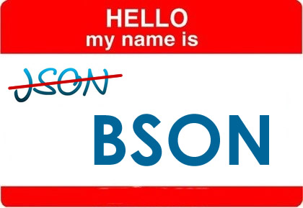
[
“_id”: ObjectId(“50994e2e9bd64215053f7b22”),
“title”: “Hello BSON World”,
“published”: ISODate(“2008-02-03T00:00-00Z”),
“slug”: “hello-world”,
“content”: “<p>BSON has 11 data-types</p>”,
“tags”: [“categories”,”test”,”etc”],
“comments”: [
{ “u”: ”Jason”, “c”: “Including JS Code! :-)” }
]
]
Notes:
10

Slide 11
PHP & jQuery
$p = $_POST;
$m = new Mongo();
$db = $m->selectDB('klmug_json');
$collection = new MongoCollection($db, 'posts');
$collection->ensureIndex(array('slug'=>1), array('unique'=>true));
if(isset($p[‘s’])){ $slug = $p[‘s’]; }else{ $slug = ‘hello-world’; }
$post = array(
"title" => "Hello World",
"published" => new MongoDate(strtotime("today")),
"slug" => $slug,
"content" => "<p>Hello <a href=‘#’>JSON</a> World</p>",
"tags" => array("categories","test","etc")
);
$success = $collection->insert($post); // insert stores as array
if($success){
$results = $collection->findOne(array("slug"=>'hello-world'));
// Please note findOne returns array so no need to cycle
if(isset($_POST[‘slug’])) echo json_encode($results);
else var_dump($results);
}
Notes:
11

Slide 12
PHP & jQuery
VAR DUMPED RESULTS
array
'_id' =>
object(MongoId)[8]
public '$id' => string '5099abd60a43b53015000064' (length=24)
'title' => string 'Hello World' (length=11)
'published' =>
object(MongoDate)[9]
public 'sec' => int 1352246400
public 'usec' => int 0
'slug' => string 'hello-world' (length=11)
'content' => string '<p>Hello <a href=“#”>JSON</a> World</p>' (length=39)
'tags' =>
array
0 => string 'categories' (length=10)
1 => string 'test' (length=4)
2 => string 'etc' (length=3)
JSON RESULTS (as string)
{"_id":{"$id":"5099abd60a43b53015000064"},"title":"Hello World","published":{"sec":1352246400,"usec":0},"slug":"hello-world","content":“<p>Hello World</p>","tags":["categories","test","etc"]}
Notes:
12

Slide 13
PHP & jQuery
<script>
$(document).ready(function(){
$.ajax({
url: 'index.php',
dataType: 'JSON',
type: 'POST',
data: {
s: 'hello-world'
},
success: function(results){
var source = $("#handlebar-content").html();
var template = Handlebars.compile(source);
var html = template(results);
$('#handlebar-content').html(html);
$('#handlebar-content').find('p.temp span').remove();
}
});
});
</script>
<div id="handlebar-content">
<h1>{{title}}</h1>
{{{content}}}
</div>
Notes:
13

Slide 14
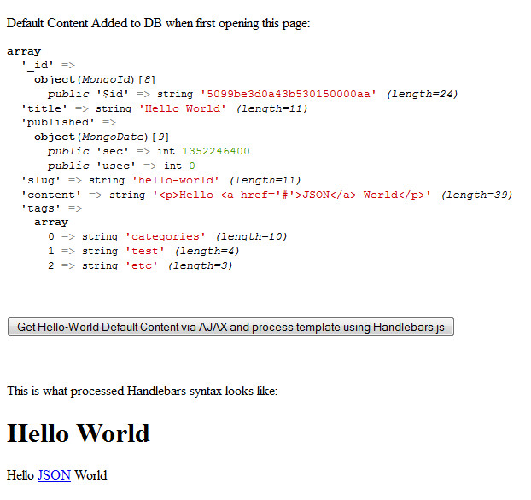
PHP & jQuery
This source code / example is also available on GitHub:
https://github.com/r1dotmy/klmugs
It uses CDNJS to serve jQuery and Handlebars.js
If a POST request comes in, it echoes logic as JSON
jQuery fetches content via AJAX and updates DOM
Notes:
14

Slide 15
PHP & AngularJS
<html ng-app>
<head><script>
function AngularBlog($scope) {
$scope.posts = [];
<?php foreach($results as $result){ ?>
$scope.posts.push({
title: "<?php echo $result['title']; ?>",
content: "<?php echo $result['content']; ?>"
});
<?php } ?>
};
</script></head>
<body>
<div ng-controller="AngularBlog">
<div class="entry" ng-repeat="post in posts">
<h1>{{post.title}}</h1>
<div ng-bind-html-unsafe="post.content"></div>
</div>
</div>
</body>
Notes:
15

Slide 16
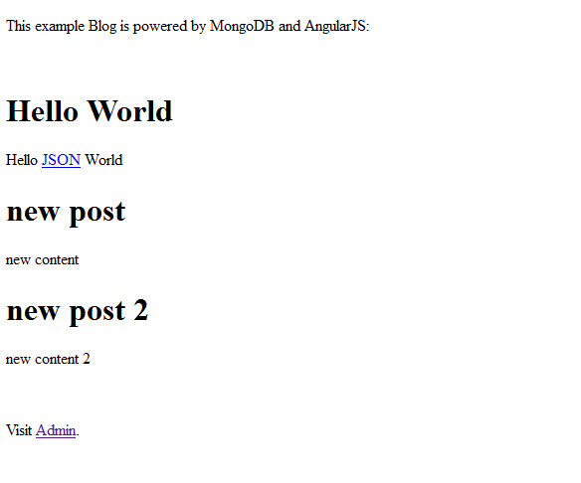
This source code / example is also available on GitHub:
https://github.com/r1dotmy/klmugs
It uses CDNJS to serve Angular.js
An array of posts results in:
PHP & jQuery
Notes:
16

Slide 17

LEARN MORE ABOUT
MongoDB
Kuala Lumpur MongoDB User-Group:
http://facebook.com/groups/klmug/
-- or stalk me on twitter --
@m_smalley
Notes:
17

