Slide 1
JSON
( and the argonauts )
INTERACTIVE 3D VERSION WITH SOURCE CODE
http://r1.my/klmug/11/
Warning: Some Assembly Required
PRESENTED BY - @m_smalley

Slide 2

NOT THIS JASON
Notes:
2

Slide 3
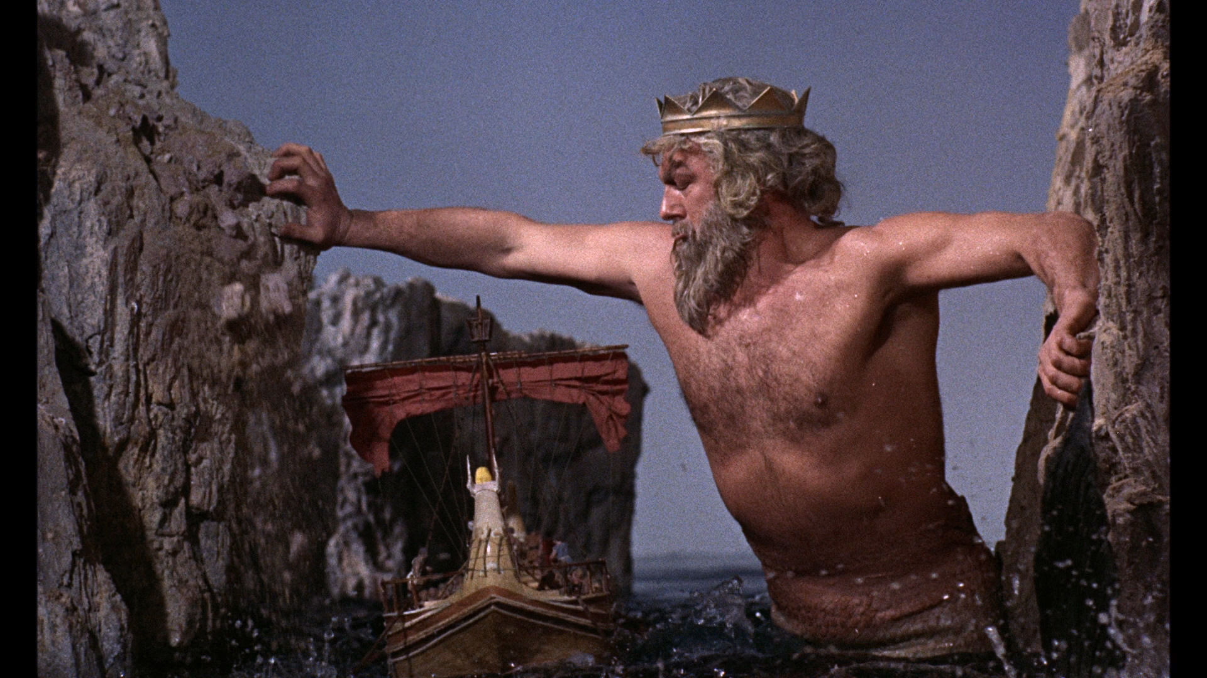
NOR THESE ARGONAUTS
IS THAT SQL I SMELL …?
Notes:
3

Slide 4



RATHER THESE
Notes:
4

Slide 5
IMPORTANT DATES
1974
RELATIONAL DATABASES
1989
WORLD WIDE WEB
2002 = JSON.org / 2009 = MongoDB.org
Notes:
5

Slide 6
THE BIG THREE ONs
JSON (j for javascript)
JSONP (p for padding)
BSON (b for binary)
Notes:
6

Slide 7
THE BIG THREE ONs
JSON (j for javascript)
JSONP (p for padding)
BSON (b for binary)
Supported by jQuery / PHP
Notes:
7

Slide 8
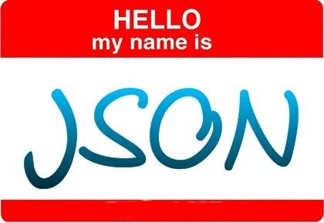
[
title: “Hello JSON World”,
published: 1352229385,
slug: “hello-world”,
content: “<p>JSON has 6 data-types</p>”,
tags: [“categories”,”test”,”etc”],
comments: [
{ u: ”Jason”, c: “Thanks for sharing” }
]
]
Notes:
8

Slide 9
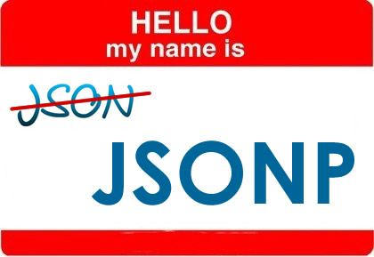
callback_function([
title: “Hello JSONP World”,
published: 1352229385,
slug: “hello-world”,
content: “<p>JSONP is padded with a function</p>”,
tags: [“categories”,”test”,”etc”],
comments: [
{ u: ”Jason”, c: “Thanks for sharing” }
]
])
Notes:
9

Slide 10
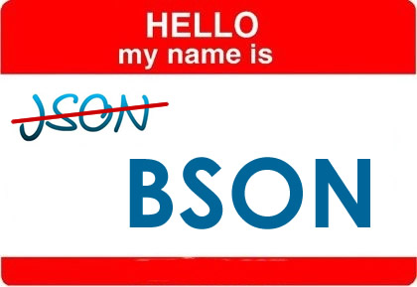
[
“_id”: ObjectId(“50994e2e9bd64215053f7b22”),
“title”: “Hello BSON World”,
“published”: ISODate(“2008-02-03T00:00-00Z”),
“slug”: “hello-world”,
“content”: “<p>BSON has 11 data-types</p>”,
“tags”: [“categories”,”test”,”etc”],
“comments”: [
{ “u”: ”Jason”, “c”: “Including JS Code! :-)” }
]
]
Notes:
10

Slide 11
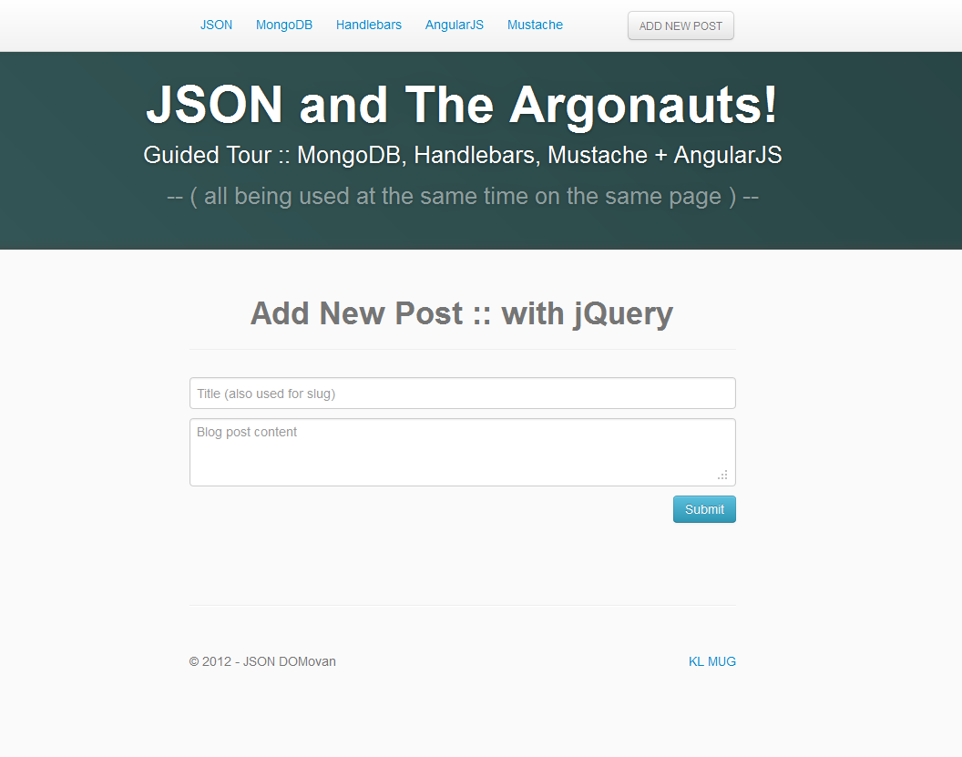
SOURCE CODE AVAILABLE – http://r1.my/klmug/11/
Notes:
11

Slide 12
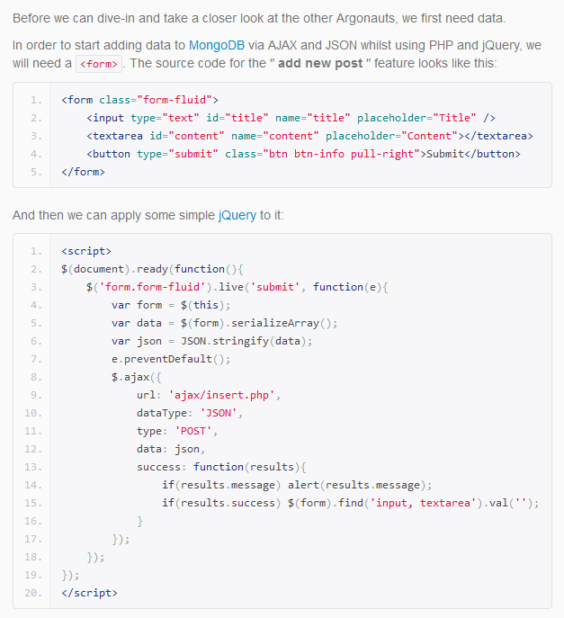
Notes:
12

Slide 13
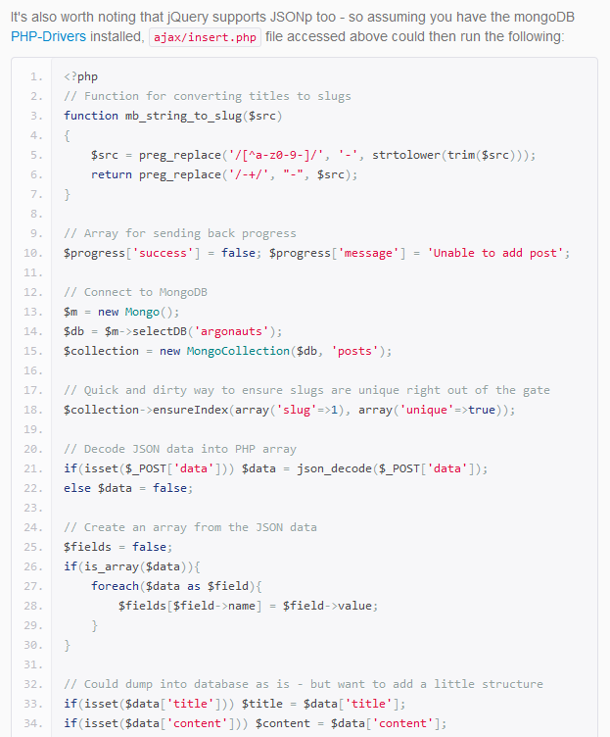
Notes:
13

Slide 14
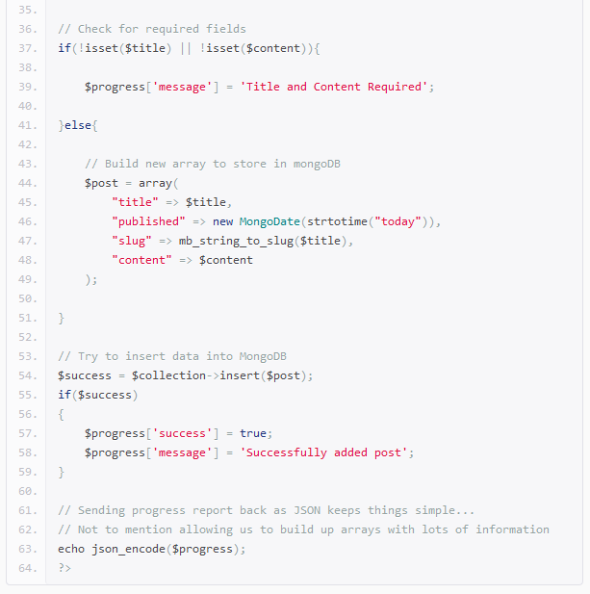
Notes:
14

Slide 15
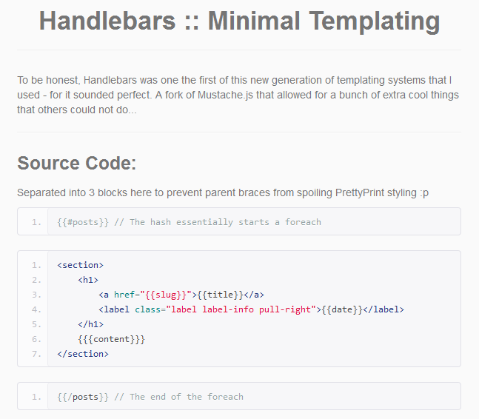
Notes:
15

Slide 16
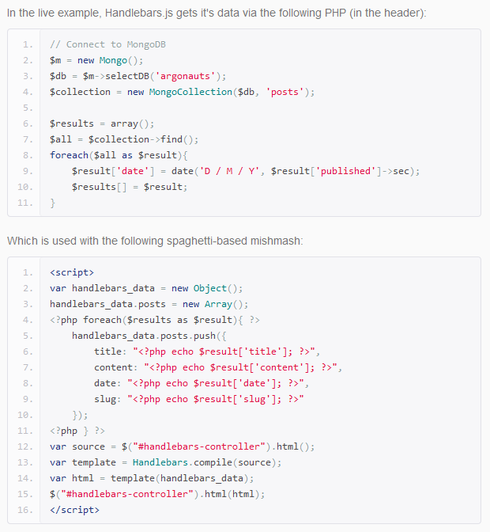
Notes:
16

Slide 17
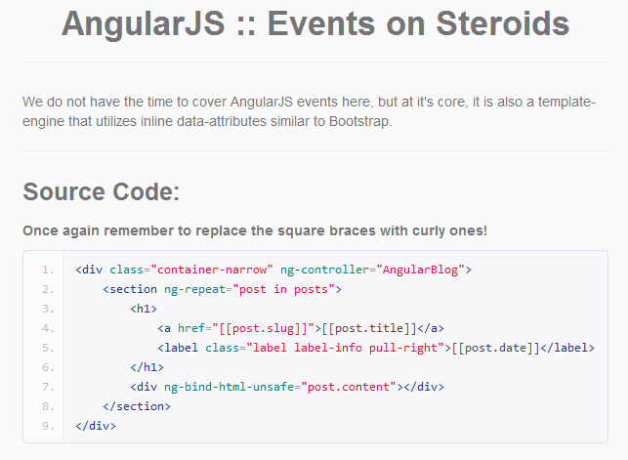
Notes:
17

Slide 18
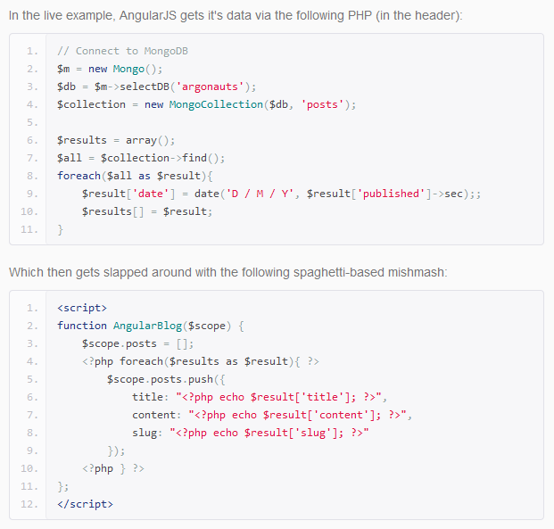
Notes:
18

Slide 19
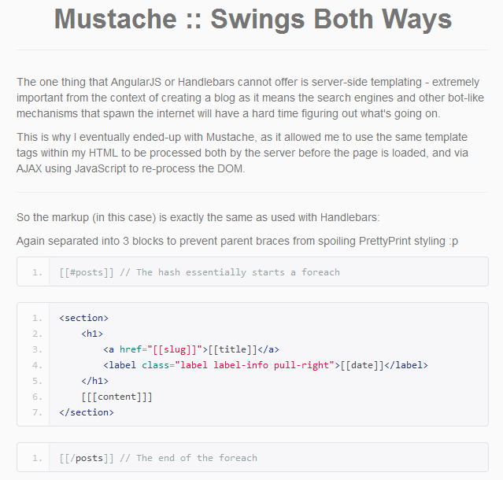
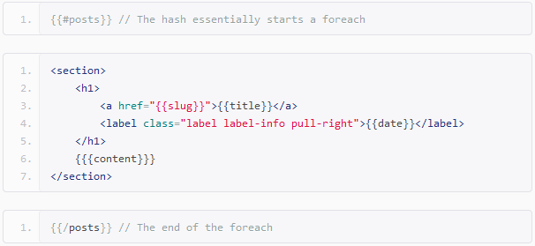
Notes:
19

Slide 20
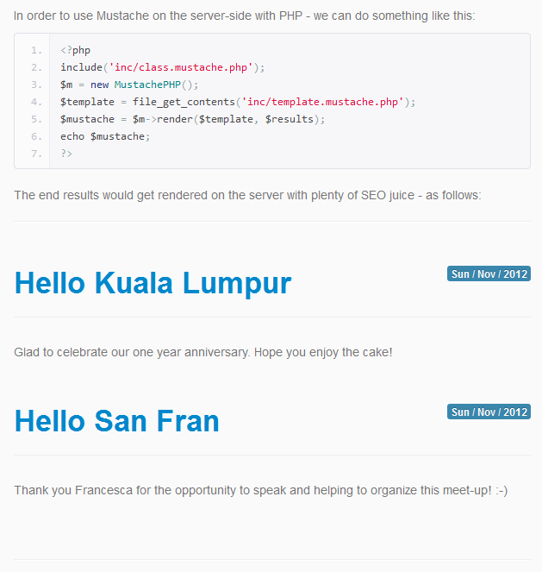
Notes:
20

Slide 21

LEARN MORE ABOUT
MongoDB
Kuala Lumpur MongoDB User-Group:
http://facebook.com/groups/klmug/
-- or stalk me on twitter --
@m_smalley
Notes:
21

