Slide 1
Assignment 4: Presentation
Meghan Nulf, Sameer Mankotia, Donald Hammer, Carson Rueber

Slide 2
Table of contents
01
02
03
04
Data Gathering
Investigation Goal
Building Query and compiling data from resource(s)
Investigation goal and linked data analysis
Data Analysis
Data Visualization
Using found data to answer our two research questions
Visual constructions of data and used applications for research

Slide 3
Investigation Goal
Research and gather information on movies spanning the past few centuries to address questions related to the financial impacts of movie production:
Build queries to efficiently obtain accurate information for data application
Convert information into machine-readable formats to address our hypotheses.
Utilize data visualization to depict the effectiveness of Semantic web applications in data gathering and analysis.

Slide 4
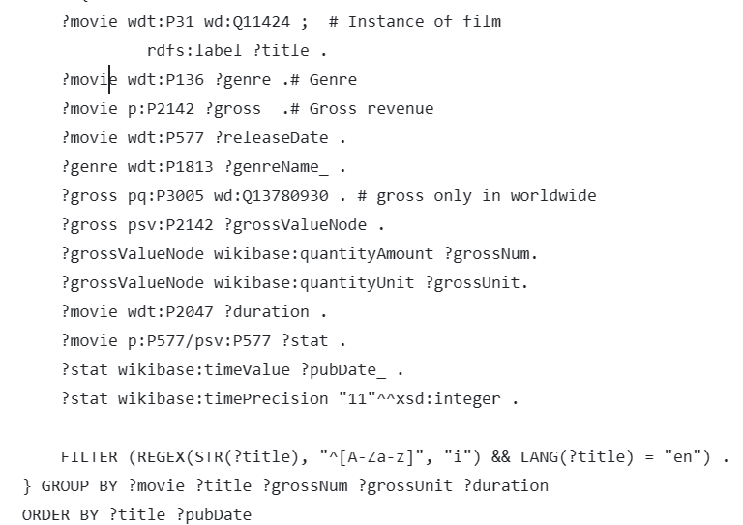
The Query
Using SPARQL Query language we build a Query that:
The SPARQL query uses classes like wd:Q11424 (film) and properties such as wdt:P136 (genre), wdt:P577 (release date), and p:P2142 (gross revenue) to model movies.
The workflow involves defining classes and properties in ontologies to model domain. This creates instances with specific attributes that connect movies to their genres, gross revenues, release dates in a structured manner.
Filters ensure English titles starting with alphabetical characters so grouping and aggregation functions organize and summarize information for each movie.

Slide 5
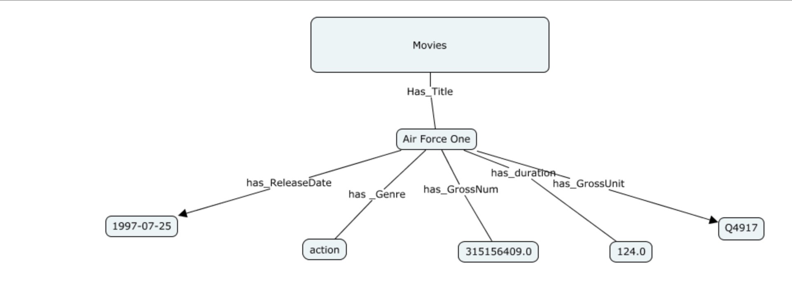
The Query Structure
To show the classes, properties, and individuals.

Slide 6
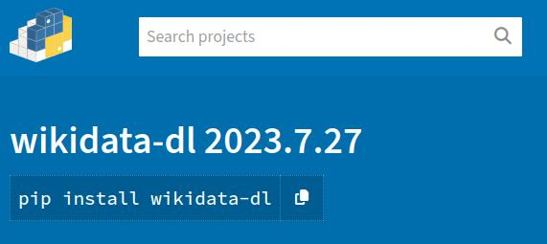
Query to CSV
Turning our query into a large CSV file
Using the python tool wikidata-dl we could query wikidata through the command line to download our CSV dataset

Slide 7
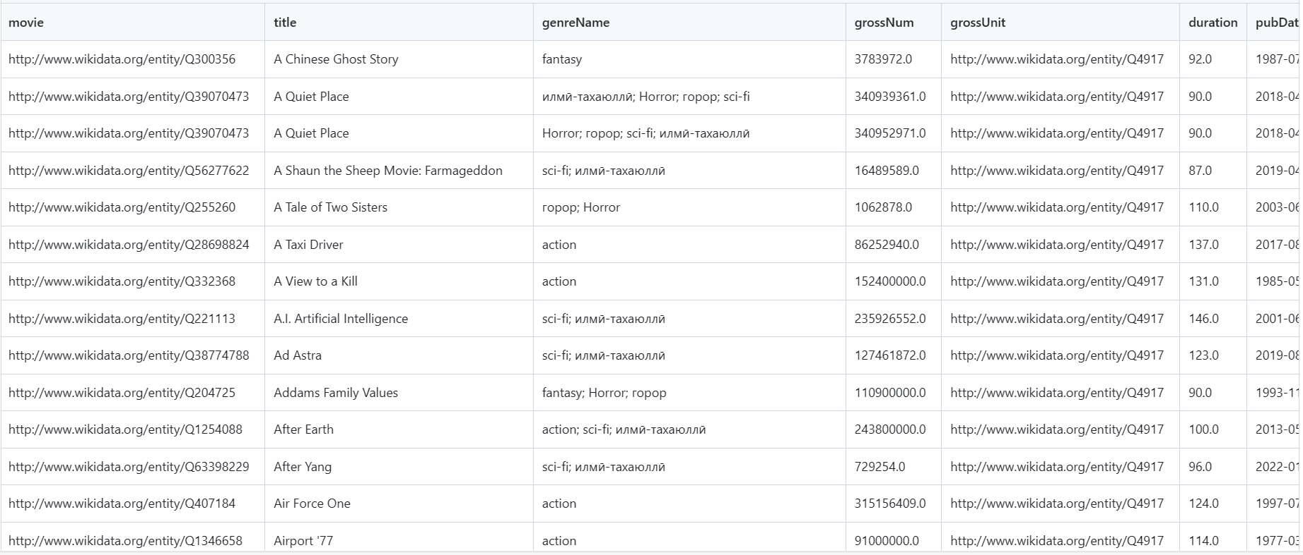
The Dataset
Columns
Movie, title, genreName, grossNum, grossUnit, duration, pubDate
Dimensions
734 rows by 7 columns
Format
Converted to .csv file using a python code.

Slide 8
Two data hypotheses
1.
2.
What genre or combination of genres produce the most revenue.
In which of the four yearly seasons (summer, spring, fall, and winter) make the most revenue when released.

Slide 9
01
Genre Highest Revenue Prediction

Slide 10
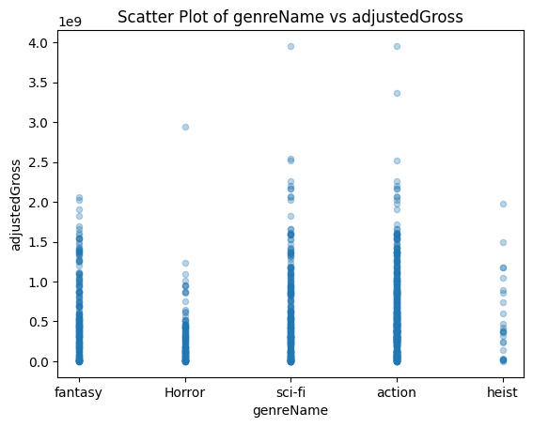
Data analyzation for genre revenue
Trends for genre revenue
Sci-fi, action, and fantasy are consistently getting upwards of 1.5 billion dollars.
Heist movies are way less common with a large spread.
Horror movies have consistently lower revenue

Slide 11
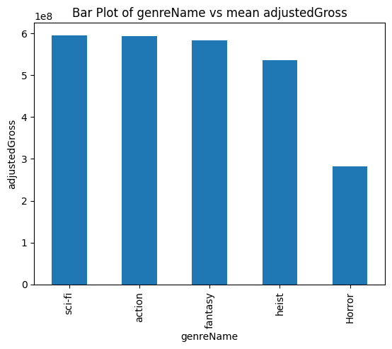
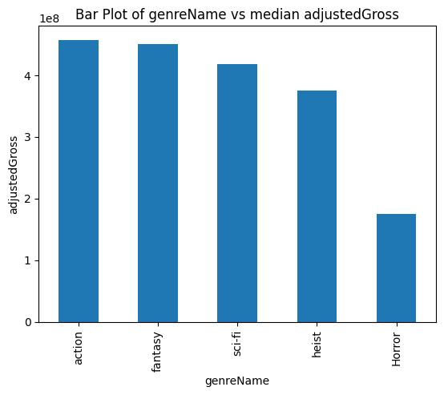
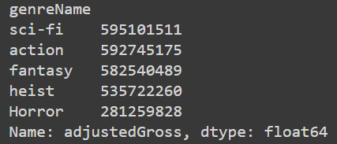
Results:
Sci-fi, action, and fantasy are all relatively close in average revenue at a little less than 600 million dollars.
This may be partly attributable to genre overlap within movies.

Slide 12
02
Season Revenue Prediction

Slide 13
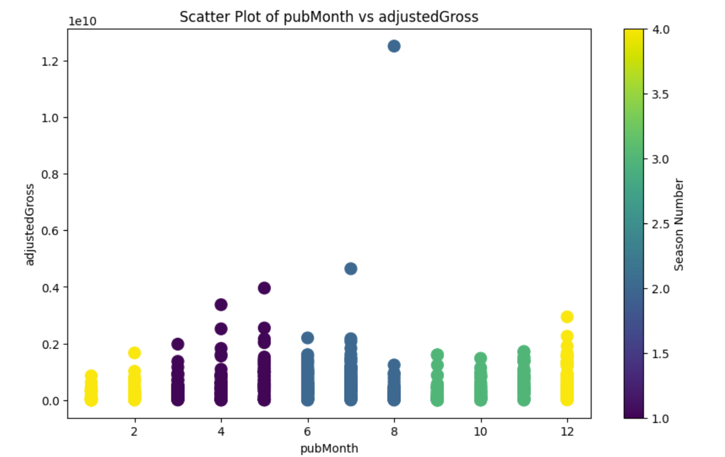
Data analyzation for seasonal release revenue
Revenue for month trends
Highest in early fall/summer months
Lowest in winter months
Consistent within the fall months
Jupiter
Mars
Venus

Slide 14
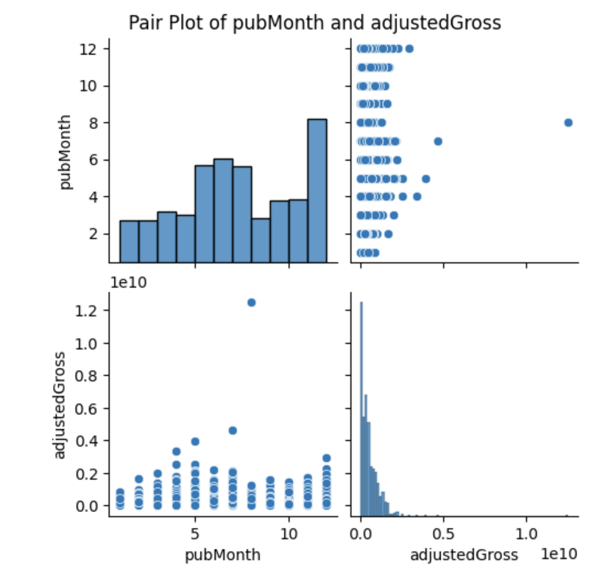
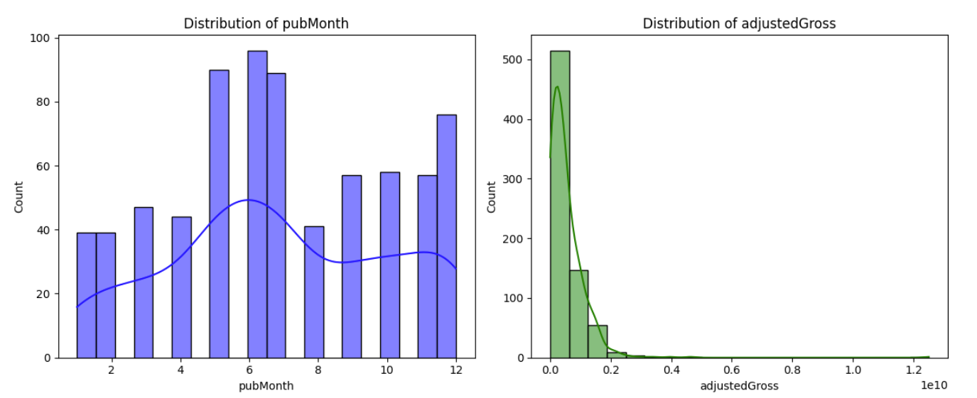
Continued:
Used two more different graphing methods to analyze patterns in the data.

Slide 15

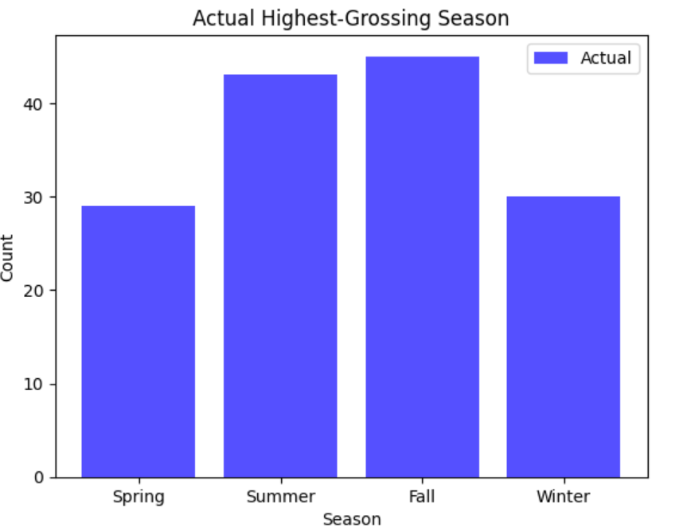
Results:
Fall was the highest predicted season to make highest revenue and the highest actual season to make the most revenue.
Using Random forest classifier, the model found that the highest revenue through preprocessing was found to be in 3 (Fall). Therefore, since it was a prediction on hard-coded data. An almost completely accurate precision and accuracy is to be expected.

Slide 16
Thank you
Any questions?

