Slide 1

SPARTAN SELLERS CAMPUS MARKETPLACE APPLICATION
MEGHAN WILCOX, ALLI WEAVIL, CARISSA BODDIE

Slide 2

WHAT IS SPArtan Sellers?
Spartan Sellers is a website that allows UNCG students and faculty to browse and post listings for used university supplies. On-campus living requires a lot of furniture, amenities, and often a lot of hassle!
In order to make the transition to and from college living smoother, Spartan Sellers provides a convenient way for UNCG students and faculty to find used items for living on campus, and post their own items to others. This way, students coming to and from college can conveniently get rid of items they don’t need over the summer, and provide an accessible method to find used, cheaper items again in the fall.

Slide 3
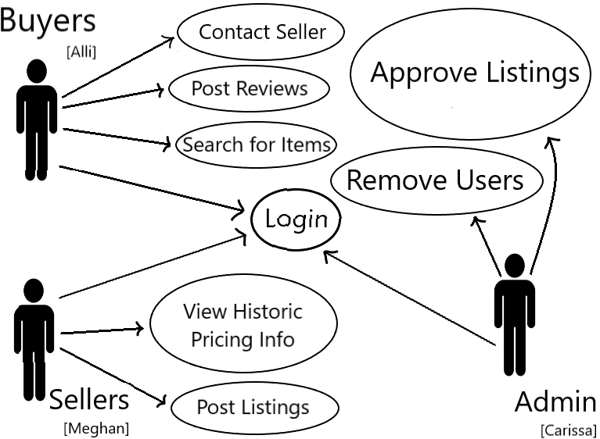
How does it work?
There are 3 roles a user can have on Spartan Sellers. Buyer, Seller, and Admin!
BUYERS are able to view listings, post reviews on the sellers they work with, and search for items.
SELELRS are able to view historic pricing info by category, and post listings to the site.
ADMINS are able to approve listings, and remove user accounts.

Slide 4
How DOES IT WORK – BUYERS
A buyer comes to Spartan Sellers looking to search for and browse items on the site.
When they find a listing they want, they can contact the seller via the seller’s displayed email.
The listing will be marked as pending once this initial contact is made.
Next, the buyer and the seller communicate via UNCG email to coordinate a meeting time and place.
Once the buyer has paid for the item, and the item has been exchanged, the seller can go in and mark their listing as sold. This removes the listing from the site.

Slide 5

Buyers special functions
A special ability of the buyers is that they are able to leave reviews for sellers that they work with. These reviews keep Spartan Sellers safe by holding sellers responsible for their conduct on the site.

Slide 6
How does it work - sellers
A seller comes to Spartan Sellers looking to list their item/items on the site.
Once a seller fills out the listing form for their item, the item is sent to an ADMIN to be approved.
If the ADMIN approves the listing, it is loaded to the site.
If the ADMIN does not approve the listing, the seller is notified via email.

Slide 7
Sellers special functions
A special function of the seller is that they are able to view historic data on the pricing of items by category on Spartan Sellers.
Each time a listing is posted, and sold, the pricing data is stored so that sellers can reference this data by category, allowing them to have a better idea on how to price their own items for the market at UNCG.

Slide 8
How does it work - ADMIN
Admins are responsible for approving items for listing and removing problematic users.
Admins are able to view a list of all items waiting to be approved, and a list of all users.
Admins can approve or not approve items after viewing the item’s details. Sending corresponding info to the site or the seller.
Admins can view the master list of users, and their reviews. If a seller has enough bad reviews, or is reported as exhibiting unsafe conduct of any kind, the admin can remove the user permanently from the site.

Slide 9

Why Spartan sellers?
Listing and buying used products online can sometimes be unsafe, especially when you don’t know who the person is on the other end!
Spartan Sellers provides a safer alternative to Craigslist and FB MarketPlace, because only UNCG students and faculty with a valid UNCG email are able to view and create an account with the site.
In addition, every listing must be approved before it is live to the site.
Finally, buyers are able to leave reviews for sellers, making sure that those posting listings are publicly held accountable for their conduct, and they can be removed from access to the site if their conduct is deemed inappropriate.
Spartan Sellers gives peace of mind that your interactions are with only UNCG affiliated persons, and that listings are legitimate.

Slide 10
DEMO TIME!
We will now demo our application. Please save questions for the end of each page’s demo.

