Slide 1
Scientific Calculator - Calcynova 🔥
By: Megha Parasher

Slide 2
Introduction:
Python-based calculator programs that perform basic and scientific calculations.
This project is to enhance usability, presentation, and reusability. Also extends a simple calculator into a Graphical User Interface (GUI) application.
The GUI is built using the Tkinter library, it supports graph plotting and data analysis.

Slide 3
Why Tkinter ?
Tkinter is Python’s standard GUI library.
by integrating Tkinter, the calculator becomes more
interactive, visually appealing.
easier to use and built-in, compared to command-
line programs.
optimized for speed and efficiency.
beginner-friendly toolkit that makes it easy to
develop efficient desktop applications, while PyQt
is more complex and needs learning.
no external installation required , but in case of PyQt
its require to be installed separately.

Slide 4
Libraries Used
• Tkinter → GUI
• Math → scientific functions
• NumPy → numerical operations
• Matplotlib → graph plotting
• Statistics → statistical calculations

Slide 5
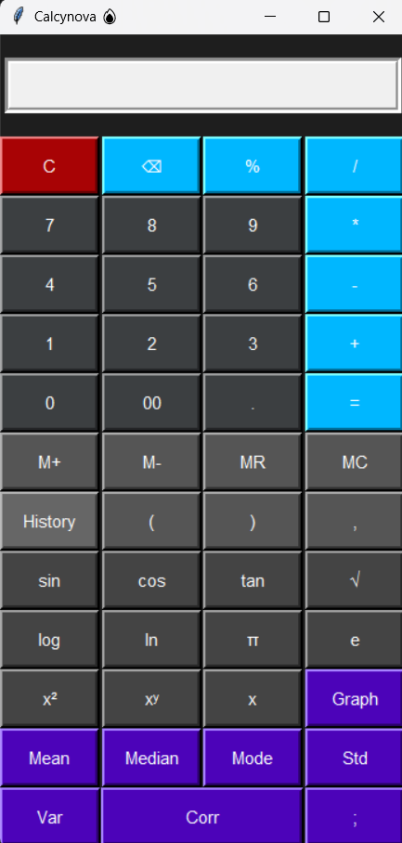
Calculator GUI Look

Slide 6

Basic & Scientific Functions
• Addition, Subtraction
• Multiplication, Division
• Percentage
• Clear & Backspace
• sin, cos, tan
• log, ln
• square, power
• constants (π, e)

Slide 7
Statistical & Advance Functions
• Mean
• Median
• Mode
• Standard Deviation
• Variance
• Correlation
• Graph plotting
• Statistical analysis
• Correlation calculation
• Keyboard input support
• Clean UI design

Slide 8
Sample Inputs & Outputs
Input: 2+3*4 → Output: 14
Input: sin(0) → Output: 0
Input: 2,4,6,8 → Mean = 5
Input: 1,2,2,3 → Mode = 2
Input: 1,2,3;4,5,6 → Corr ≈ 1
Input: x**2 → Graph plotted

Slide 9

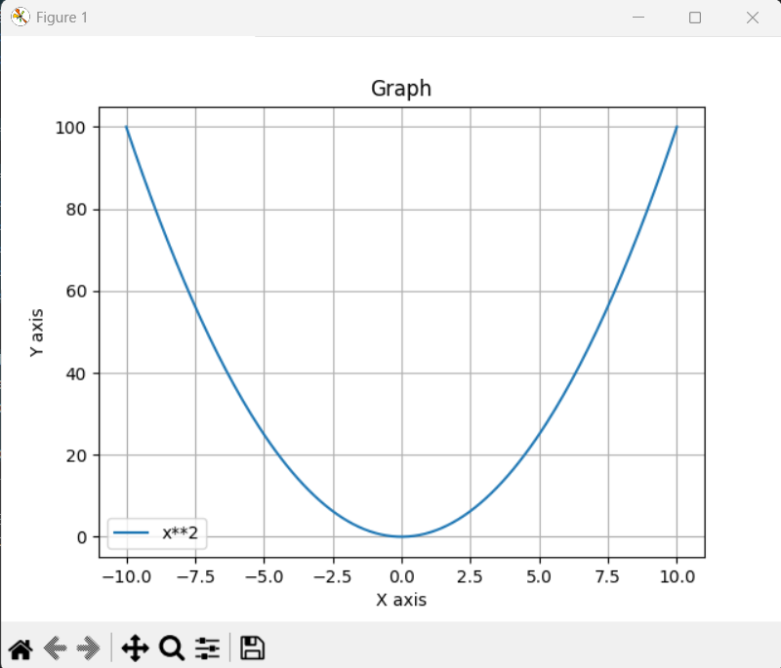
Graph Feature and Demo
• Plot graphs using expressions
• Supports multiple equations
• Uses NumPy and Matplotlib
• Example: sin(x), x**2

Slide 10
Use Cases
• Students for math calculations
• Data analysis basics
• Graph visualization
• Learning Python GUI
• Scientific computations

Slide 11
Conclusion
Calcynova is more than a calculator.
It combines GUI, math, and data analysis.
Useful for learning and real-world applications.
User-friendly , all in one solution for calculations.

