Slide 1
Project Overview
Sales Forecasting Across Multiple Retail Stores
This project develops an end-to-end Store Sales Forecasting system using historical sales data.
It combines Machine Learning, Time-Series Analysis, and Deep Learning to identify sales patterns and predict future sales.
Models such as Random Forest, ARIMA, SARIMA, LSTM, and GRU are evaluated, with an interactive Streamlit dashboard used to visualize performance and generate 7-day sales forecasts.

Slide 2
Objective
Analyse and preprocess historical store sales data.
Identify key sales patterns, trends, and seasonal effects.
Build and compare Machine Learning, ARIMA/SARIMA, LSTM, and GRU models.
Develop a 7-day sales forecasting model using Multivariate GRU.
Create an interactive Streamlit dashboard for sales analysis and forecasting.

Slide 3
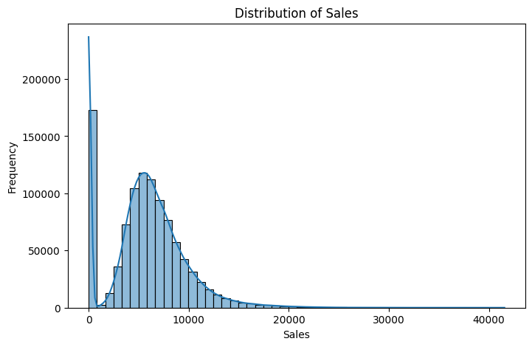
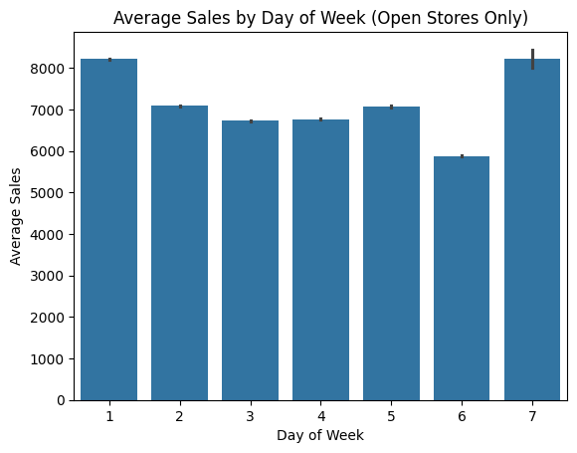
EDA-Distribution Plot
Insights:
The Sales variable shows a positively skewed distribution.
A significant peak at zero is also observed, which may mainly represent days when stores were closed.
High sales values should be investigated with promotional and holiday-related features before considering them as outliers.
Insights :
Average sales vary significantly across the days of the week.
Monday records the highest average sales, while sales generally decline toward the weekend, with a slight increase on Friday.
This indicates that DayOfWeek and Open are important variables for understanding and predicting store sales.

Slide 4
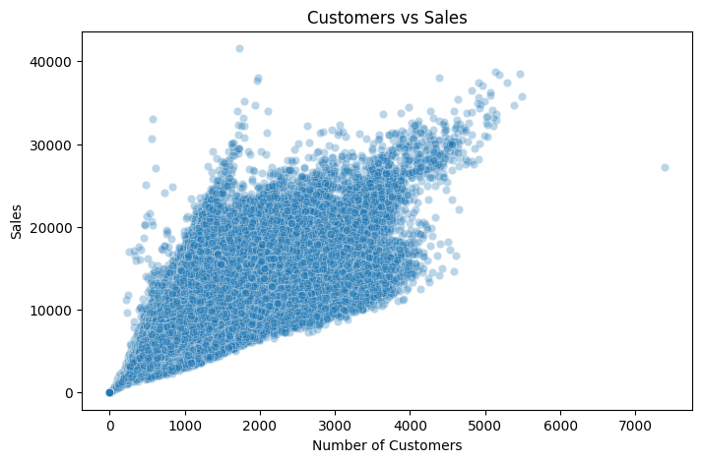
EDA-Scatter Plot
Insights –
The scatter plot indicates a strong positive relationship between customer count and sales, with sales generally increasing as the number of customers increases.
This suggests that customer footfall is a major factor associated with store revenue.
However, variations in sales at similar customer levels indicate that other factors such as promotions, store type, and assortment may also influence customer spending.
Since customer information is unavailable in the test dataset, it should be used for EDA but excluded from the final forecasting model.

Slide 5
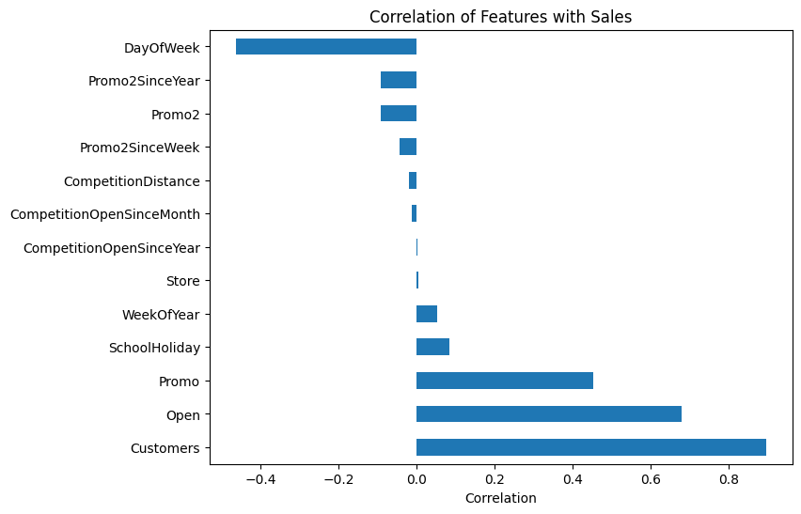
Correlation with Sales
Insights –
Customer count shows the strongest positive correlation with Sales, followed by store opening status and promotions.
DayOfWeek shows a moderate negative correlation, indicating that sales vary considerably across the week.
Most competition and Promo2-related variables have relatively weak individual linear correlations with Sales.
However, these features should not be discarded solely on the basis of correlation, as they may provide useful nonlinear or interaction effects in machine-learning models.
Customers, although highly correlated with Sales, should be excluded from the final forecasting model because it is unavailable in the test dataset.

Slide 6
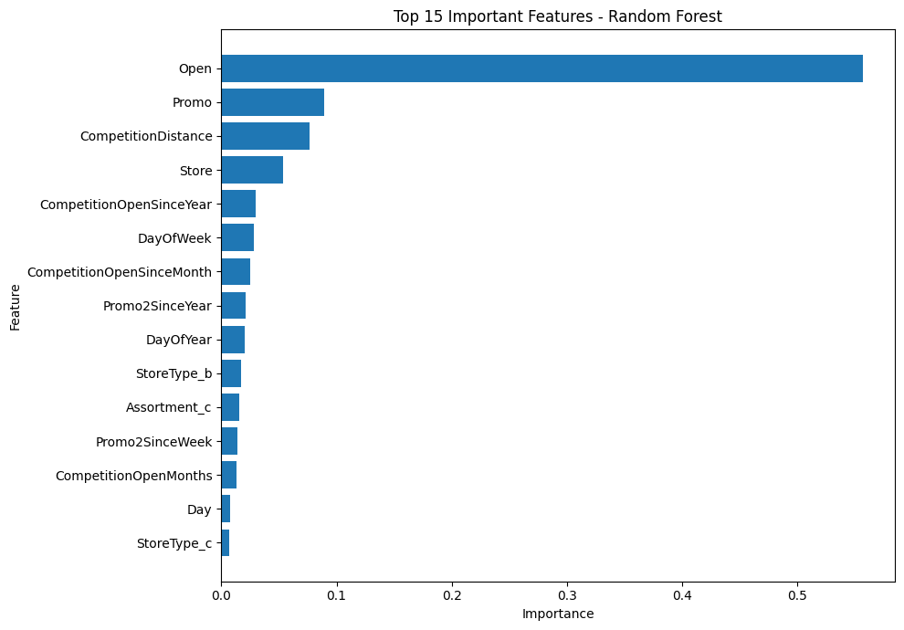
Features Importance
Insights –
Open is by far the most important feature, showing that whether a store is open strongly determines its sales.
Promo is the next major factor, indicating that promotions significantly influence sales.
Competition Distance and Store also contribute noticeably to sales prediction.
Calendar and store characteristics such as Day of Week, Store Type, Assortment, and Promo2 have smaller but useful effects.

Slide 7
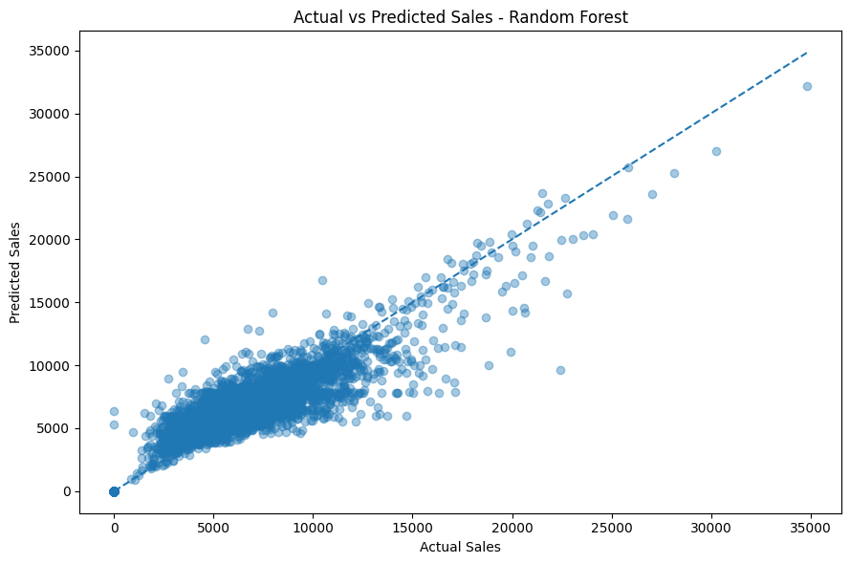
Features Importance
Insights –
Most points lie close to the diagonal line, showing that Random Forest predictions are generally close to actual sales.
The model performs especially well for the common low-to-medium sales range.
Some deviation appears at very high sales values, where the model tends to underestimate certain peaks.
Overall, the plot indicates strong predictive performance, consistent with the model’s R² ≈ 0.84.

Slide 8
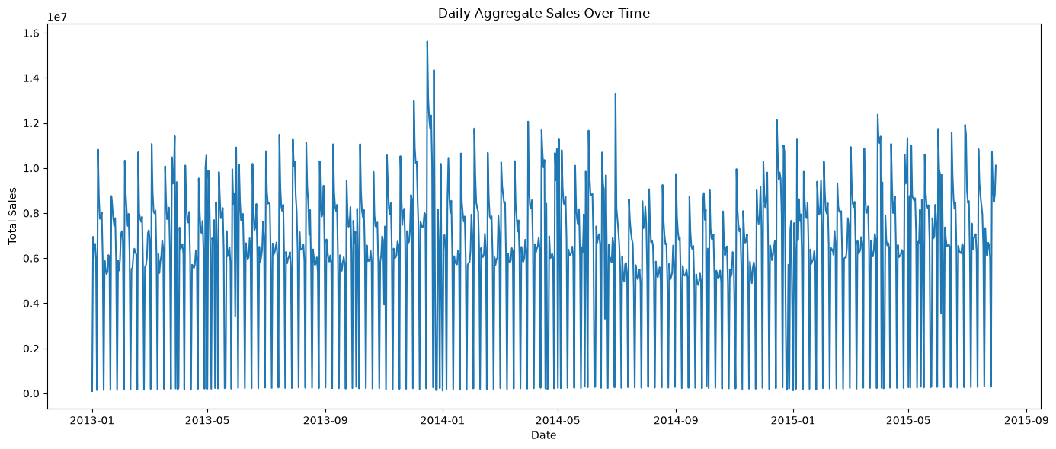
Aggregate Daily Sales Series
Insights:
Sales exhibit strong recurring patterns and occasional peaks, making time-series forecasting suitable for predicting future demand.

Slide 9
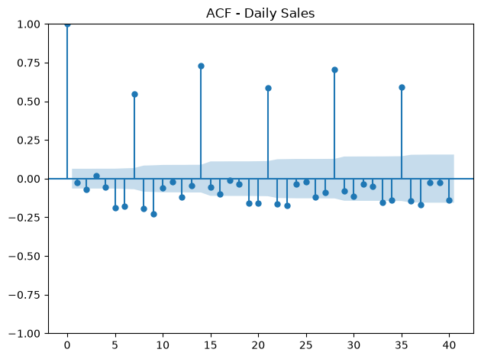
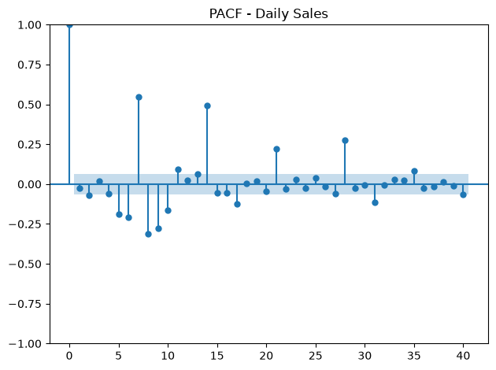
ACF/PACF-Daily Sales
Insights:
ACF/PACF plots also show something very important: there are strong spikes around lags 7, 14, 21, 28, and 35.
That's a clear sign of a weekly seasonal pattern in daily sales.
This will matter especially when we reach SARIMA, where seasonal period s = 7 is a sensible candidate.
ACF and PACF confirm strong weekly seasonality (s = 7), supporting the use of seasonal forecasting models such as SARIMA and sequence models like LSTM/GRU.

Slide 10
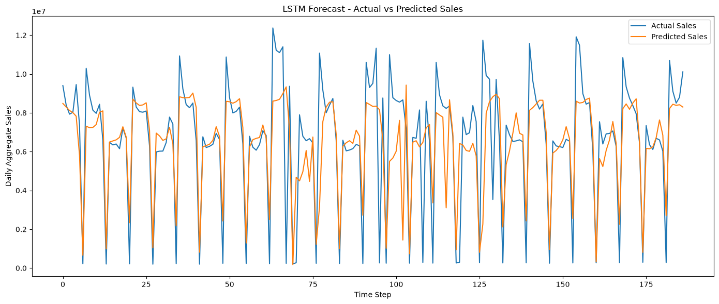
LSTM Forecast
Insights:
LSTM is clearly learning the weekly sales pattern, including many of the sharp low-sales days.
The forecast is smoother than the actual series, though, so it tends to underestimate some high-sales peaks

Slide 11
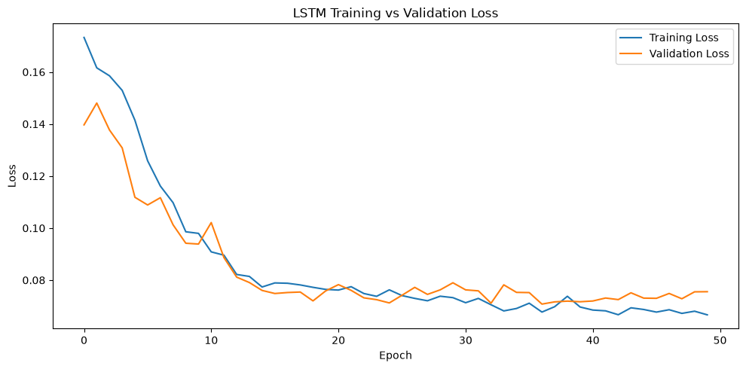
LSTM Loss Graph
Insights:
The loss graph is also encouraging: training and validation loss both decrease and remain fairly close.
There’s no obvious severe overfitting; toward the final epochs, validation loss levels off while training loss continues slightly downward.

Slide 12
Comparisons GRU & LSTM Models
 | Model | R2 Score | MAE | RMSE
0 | GRU | 0.710235 | 1.042225e+06 | 1.728577e+06
1 | LSTM | 0.560214 | 1.341490e+06 | 2.129545e+06
Insight and Analysis:
GRU explains about 69.8% of the variation in aggregate daily sales and has substantially lower MAE/RMSE.
So for the deep-learning section, GRU is currently our best model.
Latest LSTM run produced R² 0.5411, slightly different from the earlier 0.5581.
That's normal because neural-network initialization and training are stochastic.
For the final comparison, use the results from the same run/setup as the GRU comparison—so keeping 0.5411.

Slide 13
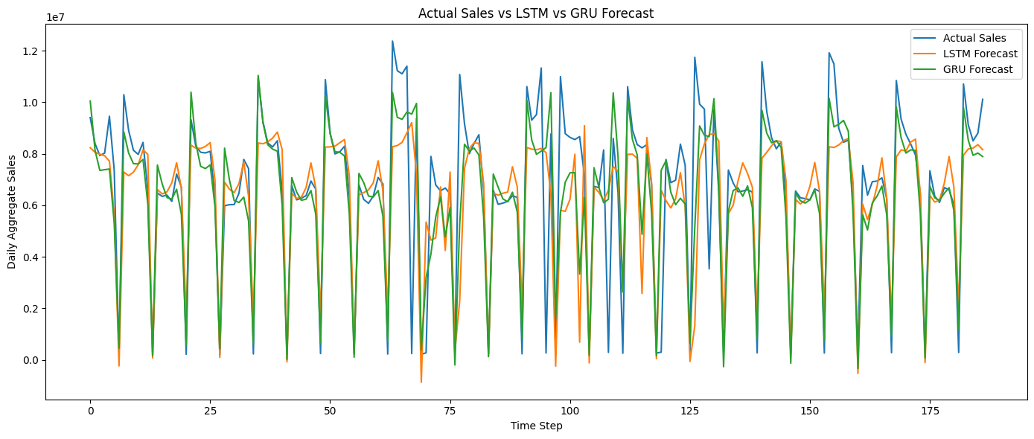
Actual Sales vs LSTM vs GRU Forecast
LSTM vs GRU Forecast Analysis:
Both LSTM and GRU capture the overall sales pattern, including the recurring sharp drops in sales.
GRU generally follows the actual sales curve more closely and captures several peaks better than LSTM.
LSTM produces smoother predictions, which can lead to underestimation of sudden high-sales periods.

Slide 14
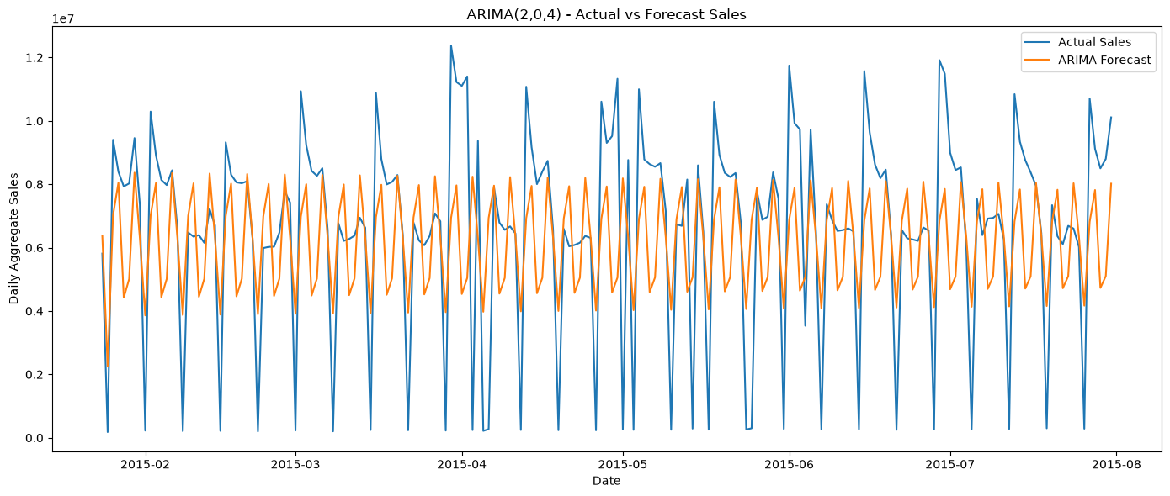
ARIMA- Forecast
Insights:
ARIMA captures the basic sales pattern but cannot model the strong weekly seasonality and sudden fluctuations effectively, indicating the need for a seasonal model such as SARIMA.

Slide 15
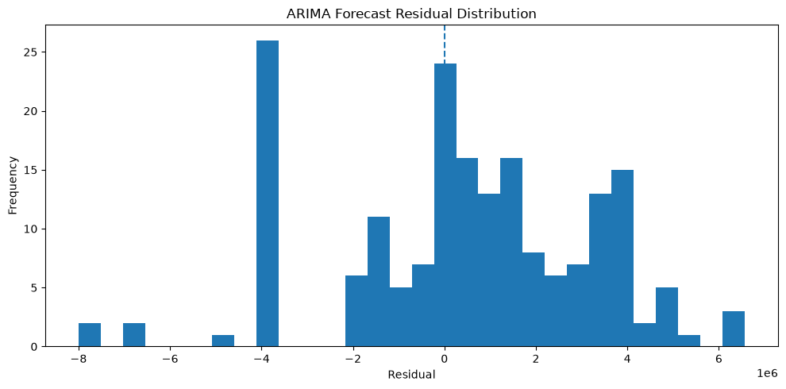
ARIMA Forecast Residual Distribution
Insights:
The graph shows that ARIMA captures some of the repeating movement, but it struggles with the size of many peaks and drops.
An R² of about 0.226 means it explains only around 22.6% of the variation in the held-out aggregate daily sales.
This isn't surprising because our earlier ACF showed a very strong 7-day cycle. Standard ARIMA doesn't explicitly include that seasonal component.

Slide 16
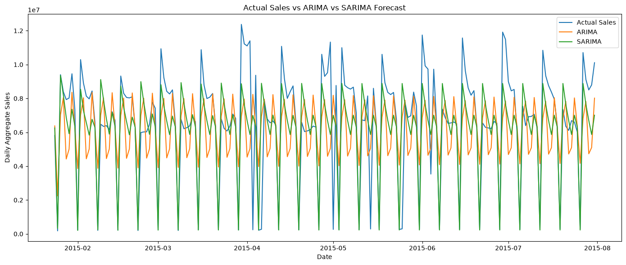
A
Actual Sales vs ARIMA vs SARIMA Forecast
Insights:
SARIMA significantly outperforms ARIMA because incorporating the 7-day seasonal pattern improves sales forecasting accuracy.

Slide 17
A
ARIMA- SARIMA Comparison
 | Model | R2 Score | MAE | RMSE
0 | SARIMA(2,0,4)(1,1,2,7) | 0.618410 | 1.355833e+06 | 1.994556e+06
1 | ARIMA(2,0,4) | 0.225509 | 2.250765e+06 | 2.841551e+06
ARIMA vs SARIMA Analysis:
SARIMA significantly outperformed ARIMA for aggregate daily sales forecasting.
ARIMA achieved an R² score of 0.2255, whereas SARIMA improved the R² to 0.6184 while substantially reducing MAE and RMSE.
This improvement indicates that the weekly seasonal pattern identified through ACF analysis is an important component of the sales time series.
Therefore, SARIMA was selected as the better statistical forecasting model.

Slide 18
A
TABULAR Model Comparison
Serial No | Model | R2 Score | MAE | RMSE
0 | GRU | 0.710235 | 1.042225e+06 | 1.728577e+06
1 | SARIMA | 0.610190 | 1.367175e+06 | 2.004900e+06
2 | LSTM | 0.560214 | 1.341490e+06 | 2.129545e+06
3 | ARIMA | 0.210973 | 2.260768e+06 | 2.852411e+06

Slide 19
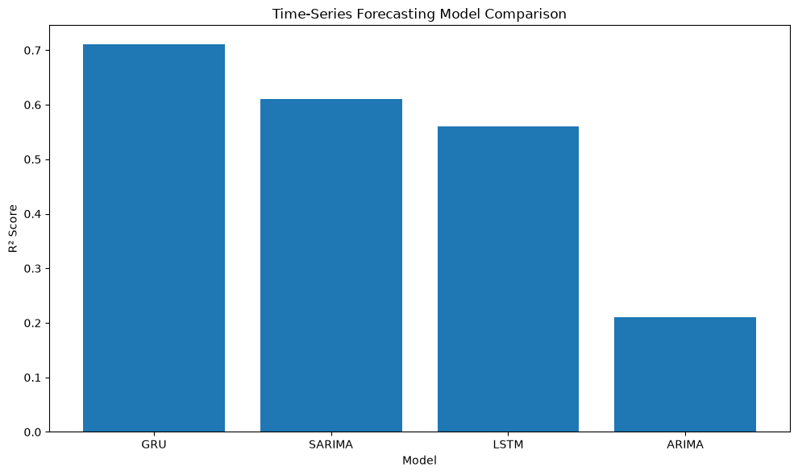
A
Time-Series Forecasting Model Comparison
Insights:
GRU performs best with the highest R² ≈ 0.71, showing the strongest forecasting accuracy.
SARIMA ranks second (R² ≈ 0.61), effectively capturing weekly seasonality.
LSTM achieves R² ≈ 0.56, but performs below GRU.
ARIMA has the lowest R² ≈ 0.21, indicating difficulty capturing complex seasonal patterns.
GRU has the highest R² (0.6981) and lowest RMSE (1.764M), so it is currently the best aggregate time-series forecasting model.

Slide 20
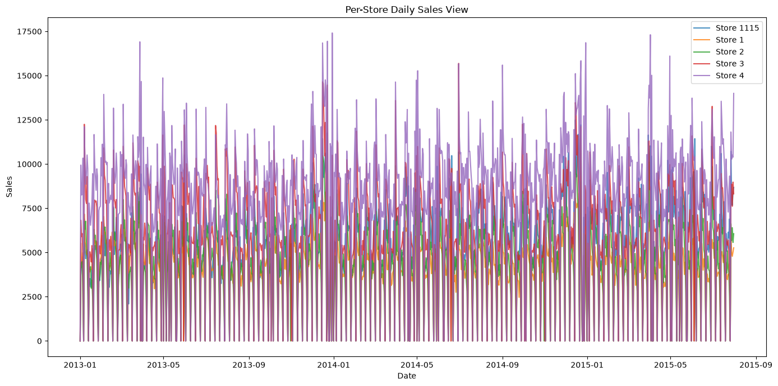
Per-Store Daily Sales View
Insights:
Store-level analysis reveals substantial variation between stores, highlighting the importance of considering individual store characteristics when predicting sales.

Slide 21
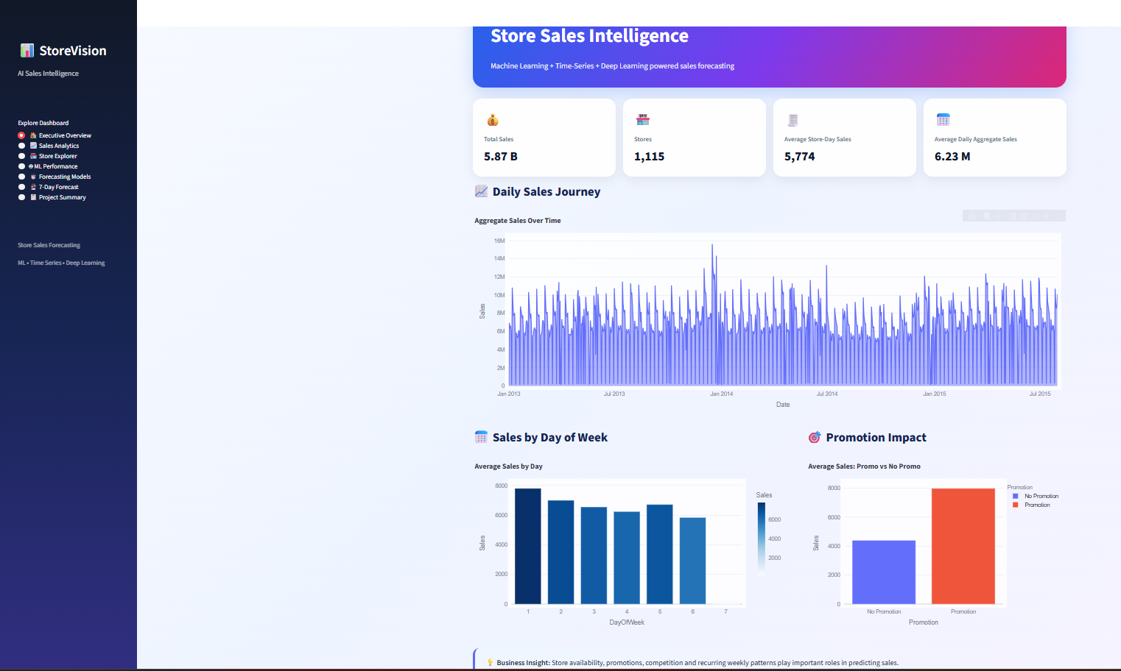
Store Sales Forecasting Dashboard…

Slide 22
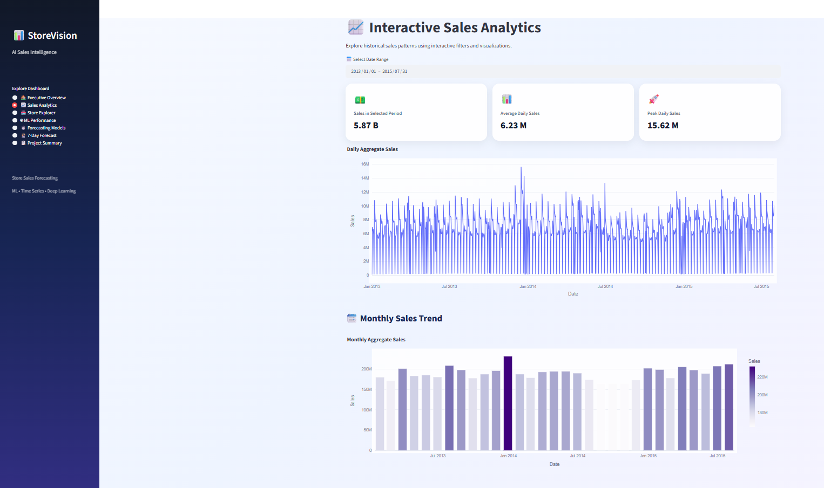
Store Sales Forecasting Dashboard…

Slide 23
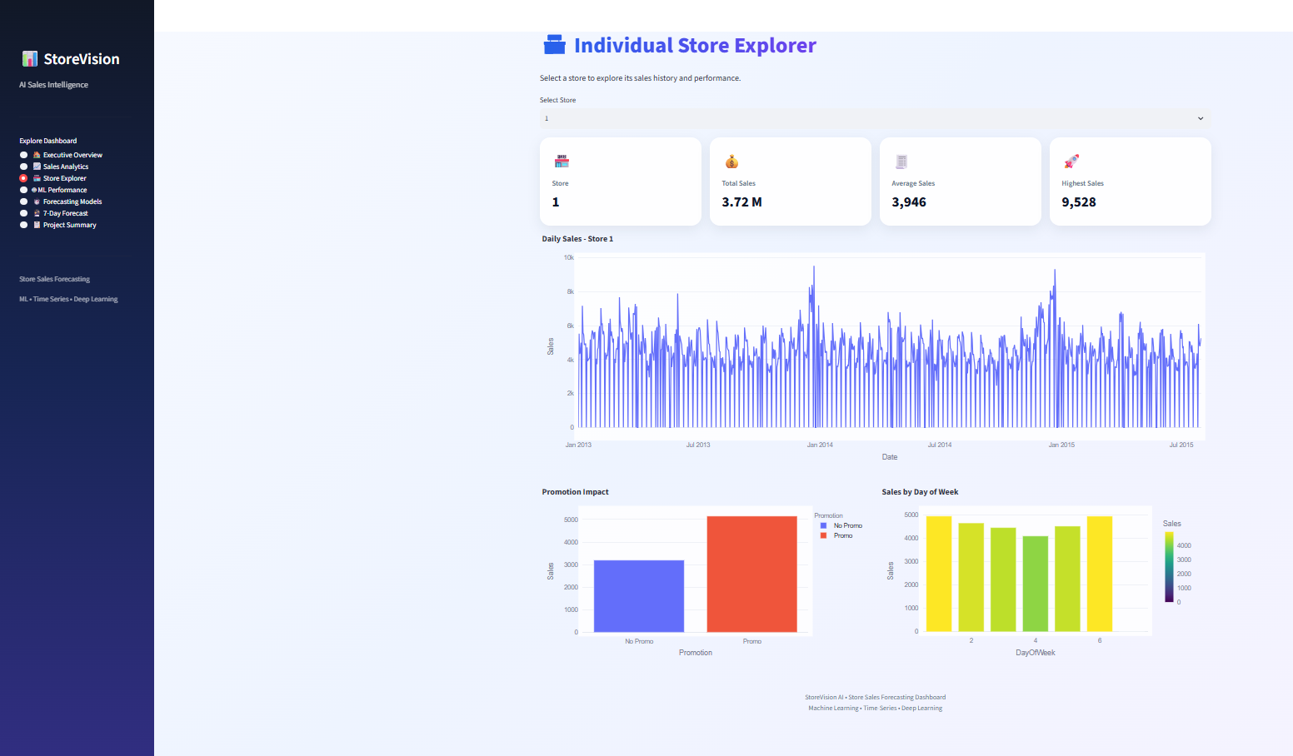
Store Sales Forecasting Dashboard…

Slide 24
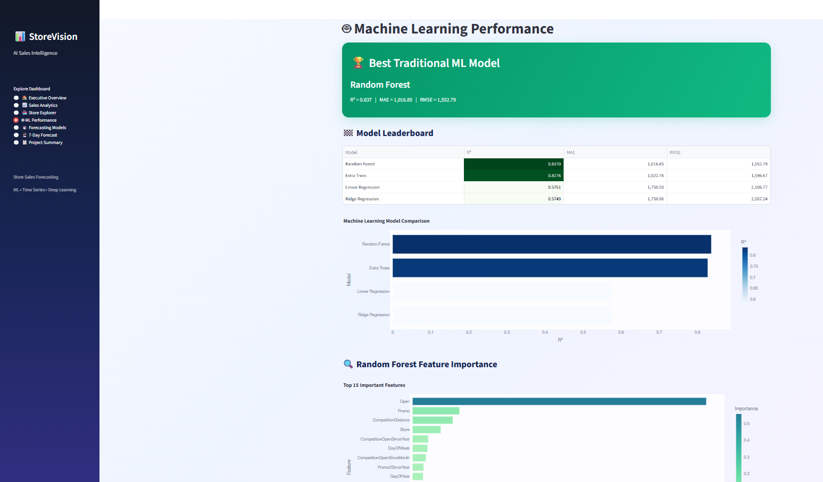
Store Sales Forecasting Dashboard…

Slide 25
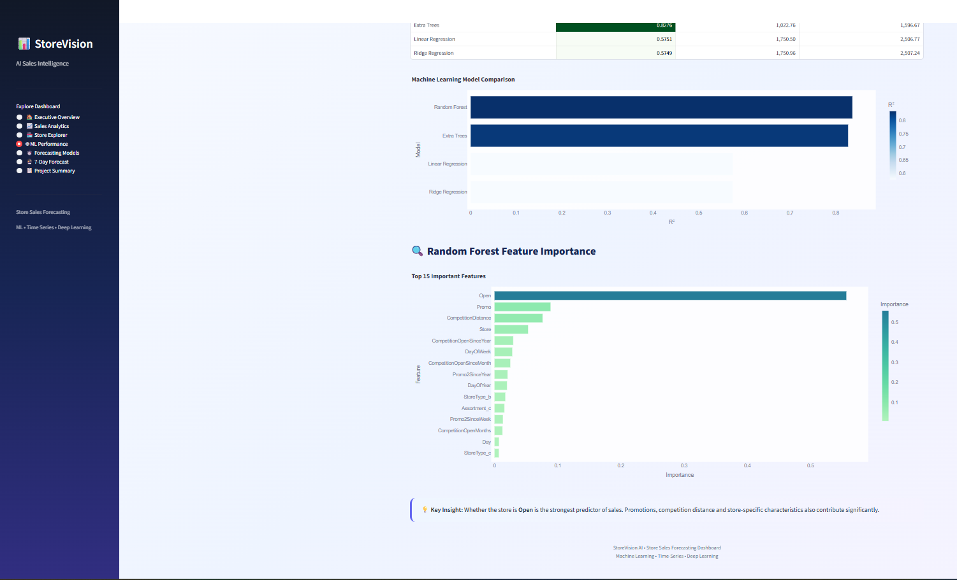
Store Sales Forecasting Dashboard…

Slide 26
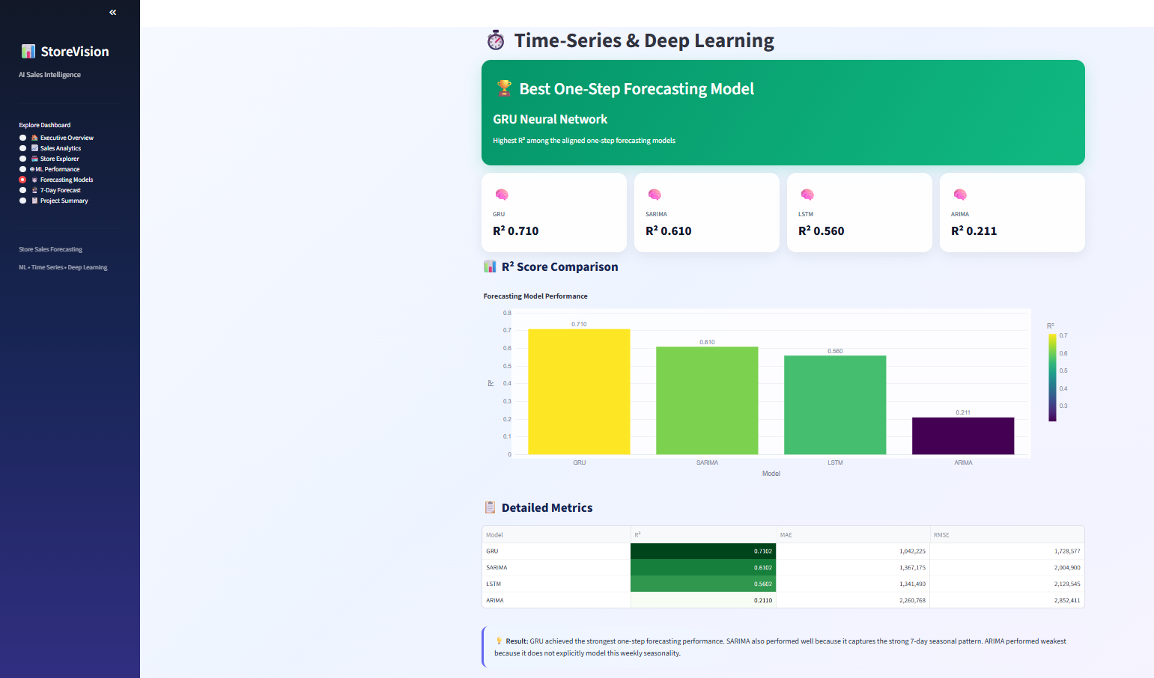
Store Sales Forecasting Dashboard…

Slide 27
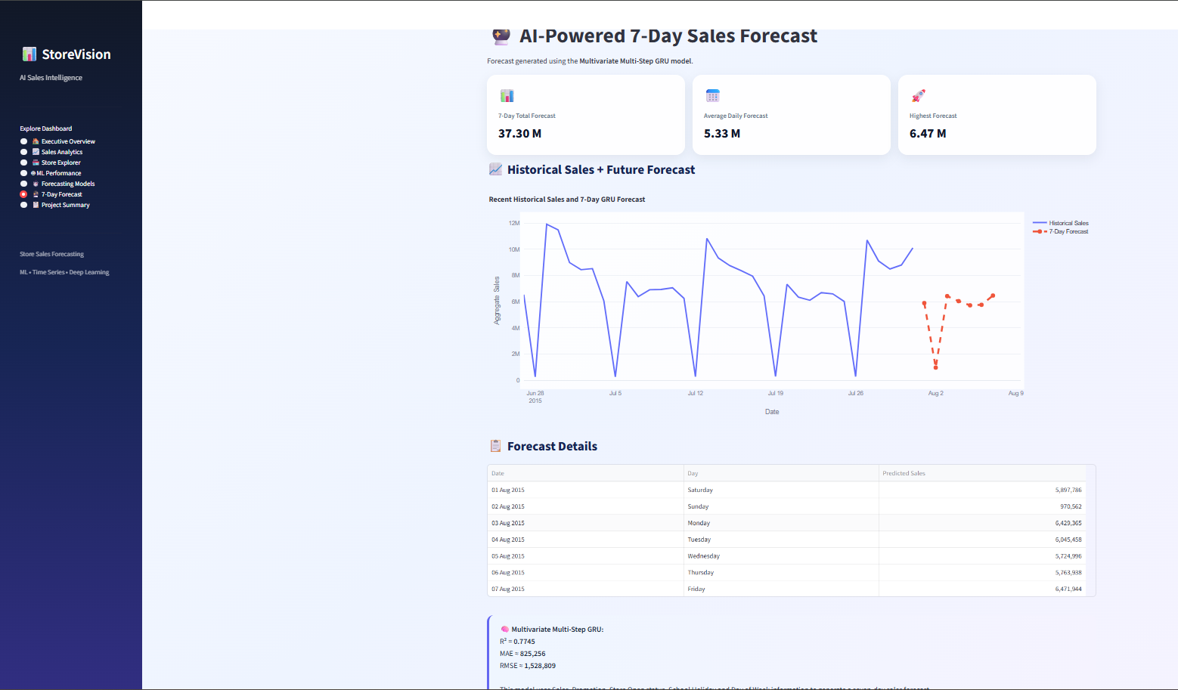
Store Sales Forecasting Dashboard…

Slide 28
Final Recommendation
GRU is recommended as the best one-step forecasting model, achieving the highest R² ≈ 0.71.
Multivariate Multi-Step GRU is recommended for practical 7-day sales forecasting using multiple sales-related features.
SARIMA can serve as a strong statistical baseline due to the clear weekly seasonality.
The Streamlit dashboard should be used to visualize sales trends, model performance, and future forecasts.

Slide 29
Conclusion
The project successfully developed an end-to-end Store Sales Forecasting system.
Machine Learning, Time-Series, and Deep Learning models were implemented and compared.
GRU achieved the best one-step forecasting performance, while the Multivariate Multi-Step GRU enabled 7-day forecasting.
Sales showed strong weekly seasonality, which was effectively captured by SARIMA and GRU-based models.
The final Streamlit dashboard provides an interactive way to analyse sales, compare models, and visualize future forecasts.

Slide 30


